Slide 1
MULTI-CLASS CLASSIFICATION PROJECT
Iris Flower Classification
A Multi-Class Supervised Learning Approach with Scikit-Learn

Slide 2
Project Overview
● Domain: multi-class supervised classification using classical, interpretable ML algorithms.
● Objective: classify Iris flowers as Setosa, Versicolor, or Virginica from sepal and petal measurements.
● Dataset: scikit-learn's built-in Iris dataset — a clean, balanced benchmark for classification.
150
Samples
Balanced across all 3 species
4
Features
Sepal & petal length / width
3
Species
Setosa · Versicolor · Virginica
Tech Stack:
Python
Pandas
NumPy
Scikit-Learn
Matplotlib
Seaborn
Iris Flower Classification with Machine Learning
2

Slide 3
Methodology & Workflow
A five-stage pipeline from raw data to a consensus prediction.
1
2
3
4
5
EDA
Preprocessing
Benchmarking
Ensemble
Inference
Pairplot visualization of sepal & petal dimensions
Stratified 80/20 split + StandardScaler normalization
SVM, Logistic Regression, Decision Tree, Random Forest
Soft & Hard Voting Classifiers combine model predictions
Test-sample predictions compared across all models
Iris Flower Classification with Machine Learning
3

Slide 4
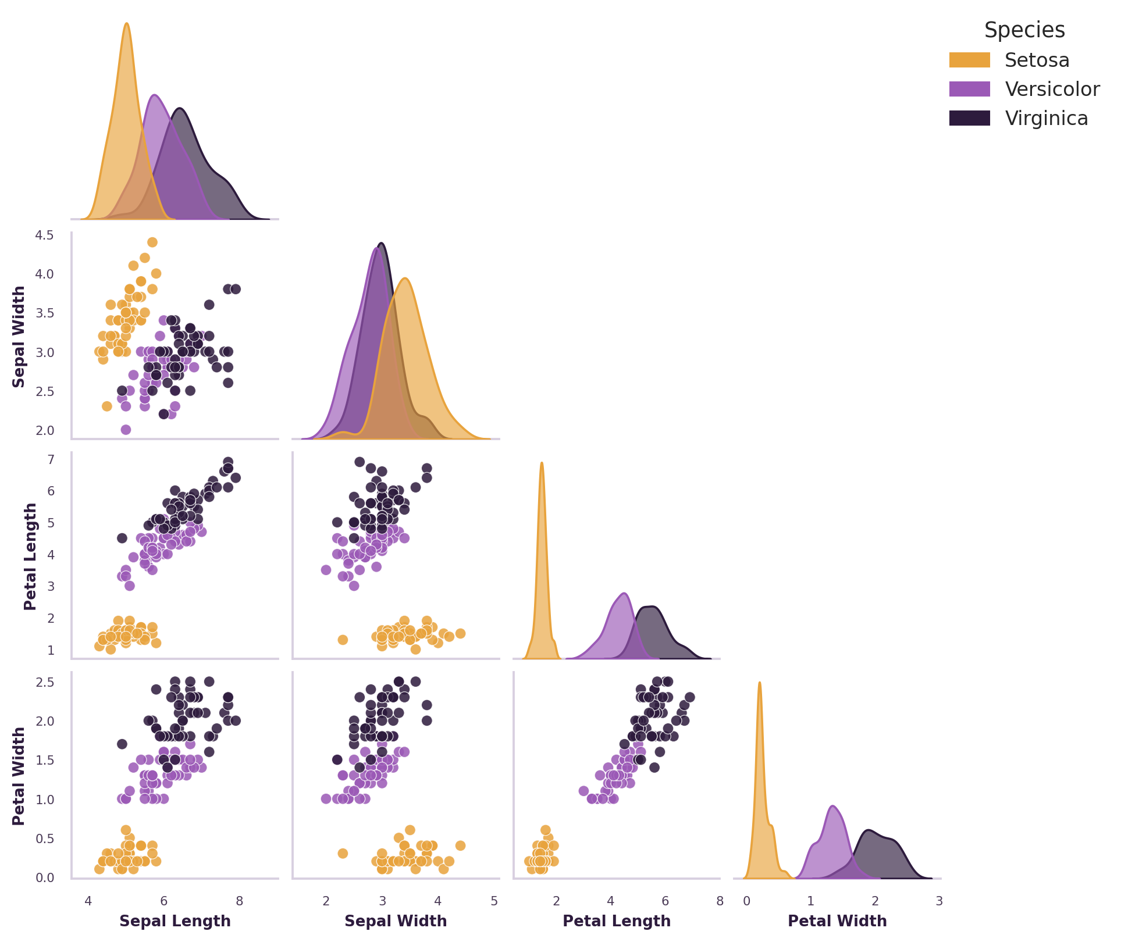
Exploratory Data Analysis
● Petal length and width provide the strongest separation between species.
● Setosa is linearly separable from Versicolor and Virginica across every feature pair.
● Versicolor and Virginica overlap slightly in petal dimensions — motivating margin-based classifiers such as SVM.
Pairplot generated from all 150 samples across the 4 features.
Iris Flower Classification with Machine Learning
4

Slide 5
Model Benchmarking Results
Test-Set Accuracy by Model
BEST MODEL
100%
Linear SVM — zero misclassifications on the held-out test set.
Standardized features + a maximum-margin hyperplane cleanly separated all three species.
Evaluated on a stratified 20% hold-out test set (30 samples) after StandardScaler normalization.
Iris Flower Classification with Machine Learning
5

Slide 6
Ensemble Learning & Key Challenge
V
Soft Voting
V
Hard Voting
Averages predicted class probabilities across all base models — SVM, Logistic Regression, Decision Tree, Random Forest — and selects the class with the highest combined confidence.
Each base model casts a single vote for its predicted class; the majority class across all models becomes the final ensemble prediction.
CHALLENGE
SOLUTION
Versicolor and Virginica show non-linear, overlapping distributions in raw petal measurements — difficult to separate with a simple linear boundary.
Feature standardization (z = (x − μ) / σ) combined with a maximum-margin hyperplane (Linear SVM) cleanly resolved the overlap — achieving 100% test accuracy.
Iris Flower Classification with Machine Learning
6

Slide 7
Key Takeaways
● Linear SVM achieved a perfect 100% test accuracy — zero misclassifications after feature standardization.
● Soft Voting matched the strongest individual models at 93.33%, confirming the robustness of ensemble consensus.
● Standardization plus a maximum-margin hyperplane fully resolved the Versicolor–Virginica overlap.
● The Iris dataset remains an excellent benchmark for validating a classical multi-class ML pipeline end-to-end.
100%
Best Accuracy
Linear SVM
Thank you — questions welcome.

