Slide 1
3.7 Should facial recognition systems be regulated?

Slide 2
What is facial recognition?
Facial recognition is a way of identifying or confirming an individual’s identity using their face. Facial recognition systems can be used to identify people in photos, videos, or in real-time.
Facial recognition is a category of biometric security. Other forms of biometric software include voice recognition, fingerprint recognition, and eye retina or iris recognition. The technology is mostly used for security and law enforcement, though there is increasing interest in other areas of use.
COMMON USES:
Unlocking phones
Law enforcement
Airports and border control
Finding missing persons
Reducing retail crime
Improving retail experiences
Banking
Marketing and advertising
Healthcare
Tracking student or worker attendance
Recognizing drivers

Slide 3
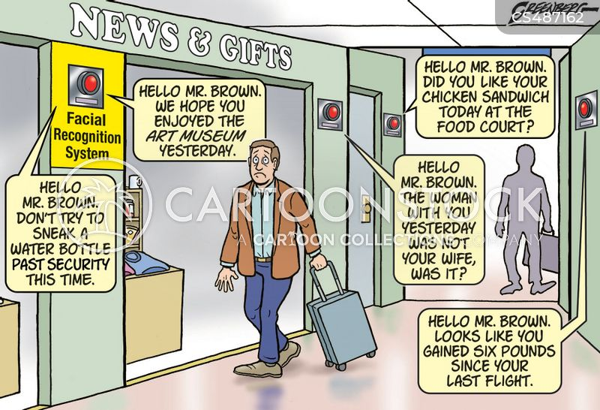

Slide 4
Advantages of face recognition
Increased security
Removing bias from stop and search
Greater convenience for paying in shops etc
Faster processing airports
Integration with other technologies

Slide 5
Disadvantages of face recognition
Surveillance
Scope for error
Breach of privacy
Massive data storage

Slide 6
How should Facial recognition be regulated?
There is a need for regulation around privacy and human rights of using facial recognition
Places that it is being used in. is it ok to use in public places, schools, workplaces?
need for certain consent to take and store images
Should people be made aware what their images are being used for and how it is being stored and used?

Slide 7
Issues causing errors in accuracy of facial recognition
Inadequate cameras
Poor presentation (only accepting frontal, neutral expressions,)
Tampering with images leads to poorer quality

Slide 8
WAYS to Improve accuracy of facial recognition
Using new generation of camera specific to face recognition
Including protection against tampering or manipulating the images

