Slide 1
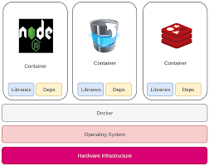
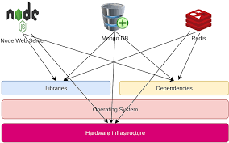
Why Docker?
Compatibility issues

Slide 2
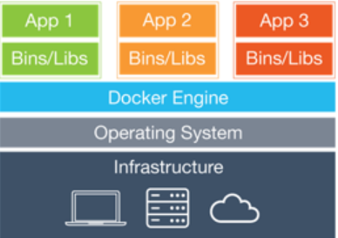
What are containers
Virtual environments

Slide 3
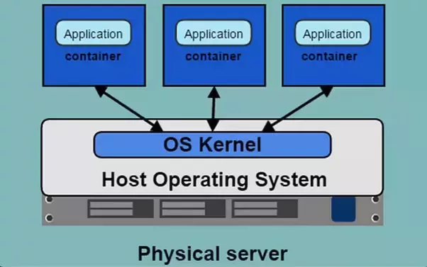
How does it work?
Containers share the Os’s host kernel

Slide 4
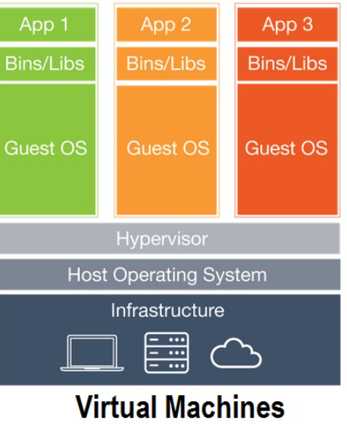
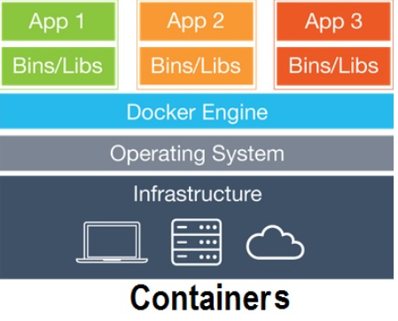
Containers vs VMs
It’s all about the Application and not the Env

Slide 5
Containers and Images
Images are the templates for the applications
Containers supply the virtual environment on which the image runs

Slide 6
Installing Docker on Ubuntu
Let’s run these commands on our Terminal:
$ curl -fsSL https://get.docker.com -o get-docker.sh
$ sudo sh get-docker.sh
$ sudo docker run hello-world

Slide 7
Basic commands
$docker run some_Image
Starts a container with the image “some_Image”.
If the image “some_Image” was already downloaded then Docker will use it, otherwise it will pull it from Docker Hub

Slide 8
$ docker ps – lists all running containers
$ docker ps –a – lists all the containers
$docker rm “id_or_name” – removes the container with the id or name “id_or_name”
$docker images – lists all images downloaded in the system
$docker rm –i “image_name” – removes the image “image_name” from the system

Slide 9
A Little challenge
Write a Script that outputs “ubuntu is downloaded” if there is an Ubuntu image installed on your host and “download ubuntu, it’s great” if it isn’t.
Make it a two liner !

Slide 10
The Two Lines Solution
[ $( docker image | awk ‘{print $1}’ | grep –c –E ‘^ubuntu$’) –eq 1 ] && echo “ubuntu is installed”
[ $( docker image | awk ‘{print $1}’ | grep –c –E ‘^ubuntu$’ ) –eq 1 ] || echo “install ubuntu, it’s great”

Slide 11
The Run command
Let’s run an Ubuntu image
What did we expect to happen?
Why do you think it happened the way it did?
Try running this:
$docker run ubuntu sleep 5

Slide 12
Run flags
Run: $docker run –i ubuntu
Try typing in some basic commands
What is missing?
Run $docker run –it ubuntu

Slide 13
More flags
How to set an environment var within the docker
Run $docker run –ite os=ubuntu ubuntu
Try ‘echo $os’
How can we save data that was stored in the docker?
$docker run –v host_dir:docker_dir ‘some_image’

Slide 14
Docker Images
How to create my own image?
Let’s imagine we want to containerize the app Openvpn
Think about the steps you would’ve made:
Choosing the Os
Downloading Openvpn
Connecting to the Server

Slide 15
The Dockerfile
Let’s us our Ubuntu image for the task
We write those steps in a designated file called a ‘Dockerfile’ for example:
FROM Ubuntu
COPY ./hello_world.sh /home
CMD bash home/hello_world.sh
This will be the instructions to a simple application that echoes ‘hello world’ that are saved in the file ‘simple_build’

Slide 16
Basic Instructions
FROM – the base of other Image
RUN – runs a command on the terminal
COPY – copies a directory form the context to the host
What is the ‘build context’?

Slide 17
CMD vs ENTRYPOINT
CMD/ENTRYPOINT – default command
Example: Ubuntu image CMD is ‘bash’
If you append a command after the image name it would replace the CMD
If you append a command after the image name it would append it to the ENTRYPOINT

Slide 18
Examples: CMD
Consider the following Build File
FROM ubuntu
CMD sleep 5
If we run this image without adding any arguments: $docker run ‘sleep_image’
the container will execute the default CMD command ‘sleep 5’
On the other hand if we append a command:
$docker run ‘sleep_image’ echo hello
The container will override the CMD command and use the appended command

Slide 19
Example ENTRYPOINT
Consider the following:
FROM ubuntu
ENTRYPOINT sleep
If we run this image without adding any arguments: $docker run ‘sleep_image’
the container will execute the ENTRYPOINT : sleep and we would get an error.
On the other hand if we attach a parameter: $docker run ‘sleep_image’ 5
The container will sleep for 5 seconds.

Slide 20
Who is the best?
USE BOTH!
FROM ubuntu
ENTRYPOINT sleep
CMD 5
This way if no parameter was inserted the container will use the default ‘5’ as the parameter

Slide 21
Containerize Openvpn
First thing first: create a new direcotry that contains all the files and directories used by the Docker Build
In The file:
Declare base Image
Update
Download dependencies
copy folder containing the Openpvn configuration file
Run the command that runs Openvpn

Slide 22
Let’s Create the File
You have got 10 minutes to write the build file for our Openvpn image

Slide 23
How to create the image
Run the command:
$docker build –t ‘simple_app’ –f ‘your_path_simple_build’ ‘your_build_context’
This will create an image ‘simple_app’ from the instructions specified in the file ‘simple_build’ and save it locally

Slide 24
Docker on Windows
How can I run a linux kernel based image on a Windows Host ?
That’s a no brainer they use a VM!

Slide 25
Where to Continue from here?
We covered in this presentation the basics of Docker there several more advanced topics you should check out:
Docker Networking
Docker Compose
Docker Registry
Kubernetes

