Slide 1
print(@Readonly Object x) {
List<@NonNull String> lst;
…
}
Preventing errors before they happen: Lightweight verification
via pluggable type-checking
Michael D. Ernst
University of Washington (Seattle, WA, USA)
University of Buenos Aires
Joint work with Werner Dietl and many others
http://CheckerFramework.org/

Slide 2
Schedule
Part 1 (11:00 – 12:30)
pluggable type-checking: what and why
demo of the Checker Framework
relevance to your programming problems
Part 2 (14:00 – 15:30)
how to create your own type system
hands-on practice in using pluggable types

Slide 3
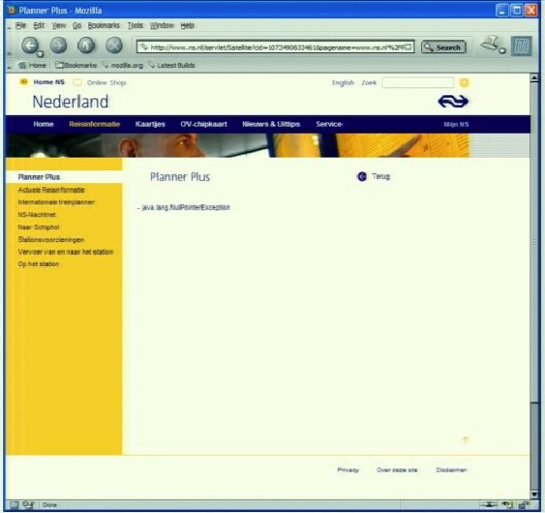
Motivation
Sofware bugs cost money
$312 billion per year (2013)
$440 million loss by Knight Capital Group in 30 minutes
$6 billion: 2003 blackout in northeastern USA & Canada
Software bugs cost lives
2003: 11 deaths: blackout
1997: 225 deaths: jet crash caused by radar software
1991: 28 deaths: Patriot missile guidance system
1985-2000: >8 deaths: Radiation therapy
java.lang.NullPointerException

Slide 4
Java’s type checking is too weak
Type checking prevents many bugs
int i = "hello"; // type error
Type checking doesn’t prevent enough bugs
System.console().readLine();
NullPointerException
Collections.emptyList().add("One");
UnsupportedOperationException
Notes:
Programmers wish to prevent these.

Slide 5
Some errors are silent
Date date = new Date(0); myMap.put(date, "Java epoch"); date.setYear(70); myMap.put(date, "Linux epoch");
Corrupted map
dbStatement.executeQuery(userInput);
SQL injection attack
Initialization, data formatting, equality tests, …
Goal: Find errors at compile time
… before testing, customers, or hackers find them
Notes:
Also: UnsupportedOperationException, SQLException

Slide 6
Solution: Pluggable type systems
Design a type system to solve a specific problem
Write type qualifiers in code (or, use type inference)
@Immutable Date date = new Date(0);
date.setTime(70); // compile-time error
Type checker warns about violations (bugs)
% javac -processor NullnessChecker MyFile.java
MyFile.java:149: dereference of possibly-null reference bb2
allVars = bb2.vars;
^

Slide 7
Outline
Type qualifiers
Pluggable type checkers
Writing your own checker
Verification vs. bug finding
Conclusion

Slide 8
Type qualifiers
In Java 8: annotations on types
@Untainted String query;
List<@NonNull String> strings;
myGraph = (@Immutable Graph) tmpGraph;
@English String @ReadOnly [] words;
class UnmodifiableList<T>
implements @Readonly List<@Readonly T> {}
Backward-compatible: with any Java compiler
List</*@NonNull*/ String> strings;

Slide 9
Benefits of type qualifiers
Find bugs in programs
Guarantee the absence of errors
Improve documentation
Improve code structure & maintainability
Aid compilers, optimizers, and analysis tools
Reduce number of run-time checks
Possible negatives:
Must write the types (or use type inference)
False positives are possible (can be suppressed)

Slide 10
Outline
Type qualifiers
Pluggable type checkers
Writing your own checker
Verification vs. bug finding
Conclusion

Slide 11
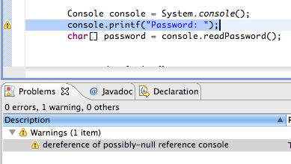
Using a checker
Run in IDE or on command line
Works as a compiler plug-in (annotation processor)
Familiar workflow and error messages
% javac –processor NullnessChecker MyFile.java
MyFile.java:9: incompatible types. nonNullVar = nullableValue; ^ found : @Nullable String required: @NonNull String

Slide 12
Optional Type Checking
No errors
Source
Compiler
Executable
Fix bugs
Errors
Change types

Slide 13
Optional Type Checking
No errors
Source
Compiler
Executable
Guaranteed behavior
Fix bugs
Optional Type Checker
Errors
Change types
Fix bugs
Warnings
Add/change annotations

Slide 14
Optional Type Checking
No errors
Source
Compiler
Executable
Guaranteed behavior
Fix bugs
Optional Type Checker
Errors
Optional Type Checker
Change types
Optional Type Checker
Fix bugs
Warnings
Add/change annotations

Slide 15
Nullness and mutation demo
Detect errors
Guarantee the absence of errors
Verify the correctness of optimizations

Slide 16
Checkers are effective
Practical: in daily use at Google, on Wall Street, etc.
Scalable: > 6 MLOC checked at UW
Selected case study results:
Signature strings: 28 errors in OpenJDK, ASM, AFU
Nullness: >200 errors in Google Collections, javac, Daikon
Interning: >200 problems in Xerces, Lucene
Format strings: 104 errors, only 107 annotations required
Regular expressions: 56 errors in Apache, etc.; 200 annos
Fake enumerations: problems in Swing, JabRef
Compiler messages: 8 wrong keys in Checker Framework

Slide 17
Comparison: other nullness tools
 | Null pointer errors |  | False warnings | Annotations written
 | Found | Missed
Checker Framework | 8 | 0 | 4 | 35
FindBugs | 0 | 8 | 1 | 0
Jlint | 0 | 8 | 8 | 0
PMD | 0 | 8 | 0 | 0
Checking the Lookup program for file system searching (4KLOC)
False warnings are suppressed via an annotation or assertion

Slide 18
Checkers are featureful
Full type systems: inheritance, overriding, generics (type polymorphism), etc.
Type qualifier polymorphism
Flow-sensitive type qualifier inference
no need to write annotations within method bodies
Qualifier defaults
Pre-/post-conditions, side effect annotations
Warning suppression

Slide 19
Checkers are usable
Integrated with toolchain
javac, Eclipse, Ant, Maven
Annotations are not too verbose
@NonNull: 1 per 75 lines
with program-wide defaults, 1 per 2000 lines
@Interned: 124 annotations in 220 KLOC revealed 11 bugs
@Format: 107 annotations in 2.8 MLOC revealed 104 bugs
Possible to annotate part of program
Fewer annotations in new code
Inference tools add annotations to your program
Few false positives
First-year CS majors preferred using checkers to not

Slide 20
What a checker guarantees
The program satisfies the type property. There are:
no bugs (of particular varieties)
no wrong annotations
Caveat 1: only for code that is checked
Native methods
Reflection
Code compiled without the pluggable type checker
Suppressed warnings
Indicates what code a human should analyze
Checking part of a program is still useful
Caveat 2: The checker itself might contain an error

Slide 21
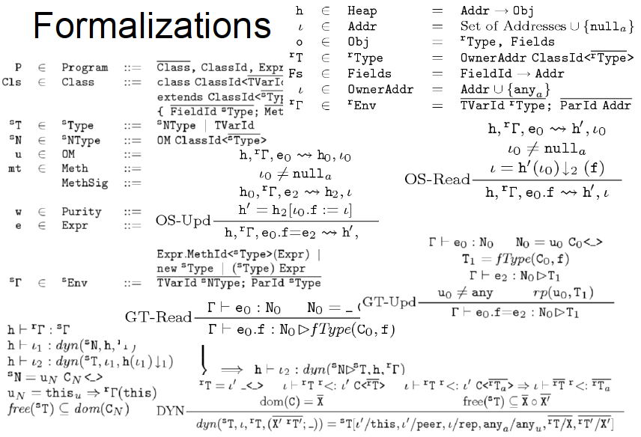

Slide 22
Annotating libraries
Each checker comes with JDK annotations
For signatures, not bodies
Finds errors in clients, but not in the library itself
Inference tools for annotating new libraries

Slide 23
What bugs can you detect & prevent?
The property you care about:
The annotation you write:
Null dereferences @NonNull
Mutation and side-effects @Immutable
Concurrency: locking @GuardedBy
Security: encryption, @Encrypted tainting @OsTrusted, @Untaint…
Aliasing @Linear
Equality tests @Interned
Strings: localization, @Localized regular expression syntax, @Regex signature representation, @FullyQualified format string syntax @Format
Enumeractions @Fenum
Typestate (e.g., open/closed files) @State
Users can write their own checkers!

Slide 24
Outline
Type qualifiers
Pluggable type checkers
Writing your own checker
Verification vs. bug finding
Conclusion

Slide 25
Example: Regular expressions
// Prints the first matching group.
// For example:
// java RegexExample ([0-9]*):([0-9]*) 23:59
// prints “Group 1 = 23”
public static void main(String[] args) {
String regex = args[0];
String content = args[1];
Pattern pat = Pattern.compile(regex);
Matcher mat = pat.matcher(content);
if (mat.matches()) {
System.out.println("Group 1 = "
+ mat.group(1));
}
}
PatternSyntaxException
IndexOutOfBoundsException

Slide 26
Regular expression type system
What runtime errors to prevent? PatternSyntaxException and IndexOutOfBoundsException.
What operations are legal? Pattern.compile only on valid regex. Matcher.group(i) only if >i groups.
What properties of data should hold? Strings: valid regex vs. invalid. Number of groups in a regex.

Slide 27
Example: Encrypted communication
void send(@Encrypted String msg) {…}
@Encrypted String msg1 = ...; send(msg1); // OK
String msg2 = ...; send(msg2); // Warning!

Slide 28
Encryption type system
What runtime exceptions to prevent? Invalid information flow.
What operations are legal? send() only on encrypted data.
What properties of data should hold? Separate encrypted from plaintext strings.

Slide 29
Brainstorming new type checkers
What runtime exceptions to prevent?
What operations are legal and illegal?
What properties of data should hold?
Type-system checkable properties:
Dependency on values
Not on program structure, timing, ...

Slide 30
Brainstorming
What runtime exceptions to prevent?
What operations are legal and illegal?
What properties of data should hold?

Slide 31
Outline
Type qualifiers
Pluggable type checkers
Writing your own checker
Verification vs. bug finding
Conclusion

Slide 32
SQL injection attack
Server code bug: SQL query constructed using unfiltered user input
query = “SELECT * FROM users ”
+ “WHERE name=‘” + userInput + “’;”;
User inputs: a’ or ‘1’=‘1
Result:
query ⇒ SELECT * FROM users
WHERE name=‘a’ or ‘1’=‘1’;
Query returns information about all users

Slide 33
Taint checker
@TypeQualifier
@SubtypeOf(Unqualified.class)
@ImplicitFor(trees = {STRING_LITERAL})
public @interface Untainted { }
To use it:
Write @Untainted in your program
List getPosts(@Untainted String category) {…}
Compile your program
javac -processor BasicChecker -Aquals=Untainted MyProgram.java

Slide 34
Taint checker demo
Detect SQL injection vulnerability
Guarantee absence of such vulnerabilities

Slide 35
Defining a type system
@TypeQualifier
public @interface NonNull { }

Slide 36
Defining a type system
Qualifier hierarchy – rules for assignment
Type introduction – types for expressions
Type rules – checker-specific errors
@TypeQualifier
public @interface NonNull { }

Slide 37
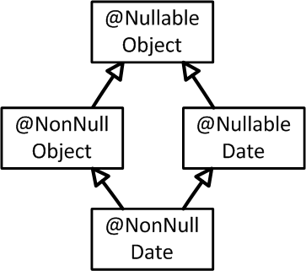
Defining a type system
What assignments are legal:
Qualifier hierarchy
Type introduction
Type rules
@TypeQualifier
@SubtypeOf( Nullable.class )
public @interface NonNull { }
Notes:
Also method call, overriding, etc.

Slide 38
Defining a type system
Gives the type of expressions:
Qualifier hierarchy
Type introduction
Type rules
@TypeQualifier
@SubtypeOf( Nullable.class )
@ImplicitFor(trees={ NEW_CLASS,
PLUS,
BOOLEAN_LITERAL, ... } )
public @interface NonNull { }
new Date()
"hello " + getName()
Boolean.TRUE

Slide 39
Defining a type system
Errors for unsafe code:
Qualifier hierarchy
Type introduction
Type rules
void visitSynchronized(SynchronizedTree node) {
ExpressionTree expr = node.getExpression();
AnnotatedTypeMirror type = getAnnotatedType(expr);
if (! type.hasAnnotation(NONNULL))
checker.report(Result.failure(...), expr);
}
synchronized (expr) {
…
}
Warn if expr may be null

Slide 40
Outline
Type qualifiers
Pluggable type checkers
Writing your own checker
Verification vs. bug finding
Conclusion

Slide 41
Verification
Bug-finding
Goal: prove that no bug exists
Specifications: user provides
False negatives: none
False positives: user suppresses warnings
Downside: user burden
Goal: find some bugs at low cost
Specifications: infer likely specs
False negatives: acceptable
False positives: heuristics focus on most important bugs
Downside: missed bugs
Neither is “better”; each is appropriate in certain circumstances. The approaches are converging.
Notes:
Verification: User even has to provide specifications for libraries. Inference is still possible.
Bug-finding: Specifications may be inaccurate
Neither one leads to more user confusion; verification might even lead to less
My research agenda enables verification; Coverity’s profitable business model focuses on bug-finding. The two are converging.

Slide 42
Other design considerations
Visibility of specifications and warning suppressions
In the source code
documentation aids programer understanding
In the tool
reduces code clutter
Analysis comprehensibility
A transparent tool gives understandable outcomes
requires more upfront effort; more false positives
An opaque tool can use more powerful analyses
requires more effort to understand warnings
Notes:
This is orthogonal to the previous issue.

Slide 43
Outline
Type qualifiers
Pluggable type checkers
Writing your own checker
Verification vs. bug finding
Hands-on practice
Conclusion

Slide 44
How to get started
Write the specification
Search the Javadoc for occurrences of “null”
Replace the wordy English text by @Nullable
Can also search code, but no annos in methods
Run Nullness Checker: verify/improve spec
For each warning:
Reason about whether the code is safe
Express that reasoning as annotations
Consider improving the code’s design

Slide 45
Tips
What to type-check:
Only type-check properties that matter to you
Use subclasses (not type qualifiers) if possible
Choose part of your code to type-check first
Eliminate raw types such as List; use List<String>
While you are doing type-checking:
Write the spec first (and think of it as a spec)
Avoid warning suppressions when possible

Slide 46
Your turn to improve your code!
Choose a project you care about
Improve it
Apply an existing checker to your code, or
Create a new domain-specific type checker
Or, try the tutorial: http://types.cs.washington.edu/checker-framework/tutorial

Slide 47
Outline
Type qualifiers
Pluggable type checkers
Writing your own checker
Verification vs. bug finding
Conclusion

Slide 48
Pluggable type-checking
Java 8 syntax for type annotations
Checker Framework for creating type checkers
Featureful, effective, easy to use, scalable
Prevent bugs at compile time
Create custom type-checkers
Learn more, or download the Checker Framework: http://CheckerFramework.org/ (or, web search for “Checker Framework”)
Notes:
Catch me anytime for a demo.

