Slide 1

Best café in Bronx

Slide 2
Background
We rely on a cup of coffee every morning to start with the day.
This report is to look for the best café around in Bronx based on two most valuable factors by analyzing data from Foursquare location data.
Further analysis will be discussed in discussion session in this report.

Slide 3

Object
To find out the best café around Bronx area for office workers who can enjoy the best coffee for a day. This will improve efficiency of work and remain enthusiasm to office.

Slide 4
Data for analysis
Location data about venues and details venues were retrieved from Foursquare. We first define the location as “Bronx, New York, NY” as we will only focus on café in Bronx.
In order to get fair number of café near Bronx, we define the radius as 1000 which represents 1 kilometer around Bronx.
By applying search value “café”, we are able to retrieve 17 rows of data in Bronx.

Slide 5
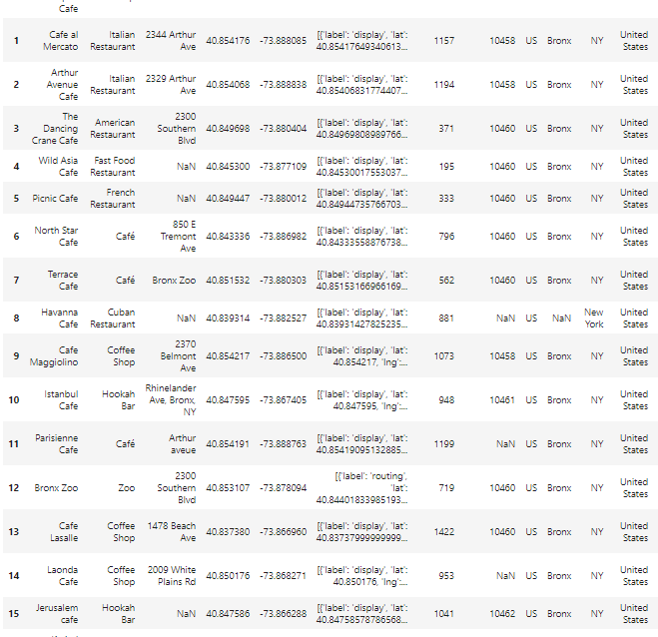
Data for analysis

Slide 6
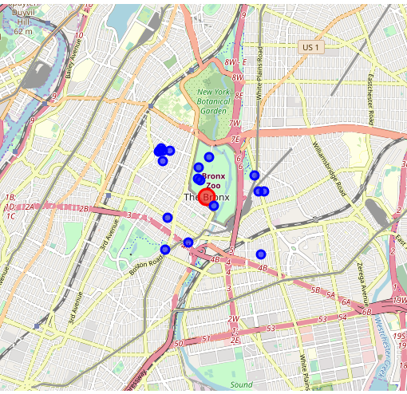
Café Map

Slide 7
Café details
Rating and price of each café will be retrieved and set into a data frame.
Efforts to retrieve more details such as hours and tips have been tried, but due to the limitation on the number premium calls this is not workable at this stage.
Value with “-1” indicates that no rating or no price information has been given to the café on Foursquare.
The smaller number in price a café has, the lower price it offers.

Slide 8
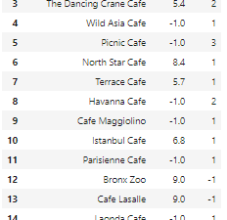
Café details

Slide 9

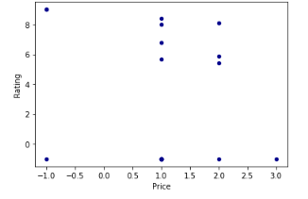
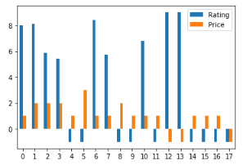
Methodology and Analysis

Slide 10
Analysis
Majority of café in Bronx offer a fair price, which is in line with the expectation.
Two café receive 9 points and both can be the strong candidates to be deemed as the best.
Combining the data frame we can now names of both café, Bronx Zoo and Café Lasalle.
The difficulty to figure out the result is that both strong candidates with 9 points rating do not offer price information

Slide 11
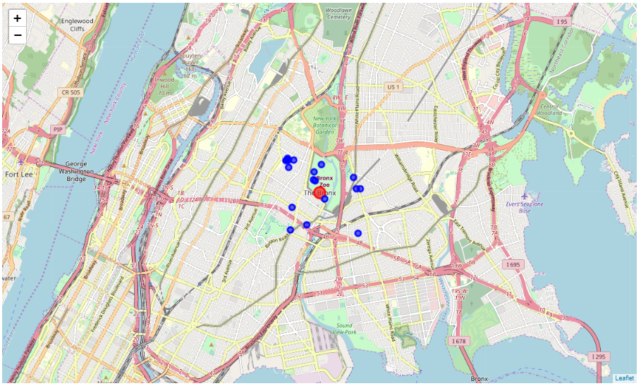
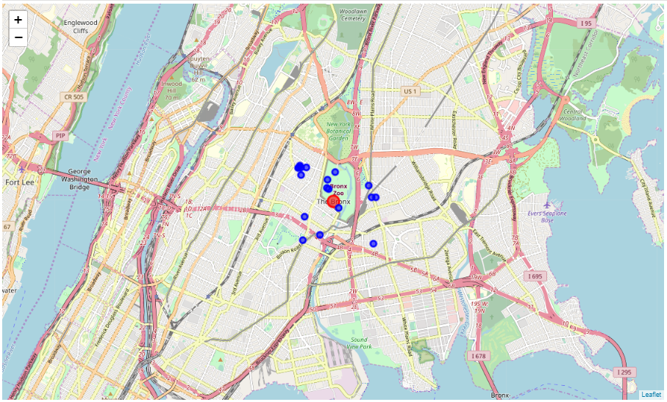
Price Comparison

Slide 12
Result
We further compare the location of both café they are actually neighbour in Bronx zoo, which may also indicate that both will most likely to offer at similar price range for competitiveness.
By the two-factor comparison, we can only conclude that Bronx Zoo and Café Lasalle both can be the best choice for a coffee in Bronx.

Slide 13
Discussion
We will need more information to finally get the only one as the best café in Bronx. By having these dataset, we can then do a more thorough comparison among the list which may give a different café name against the result of this report.
If permitted, more details such as:
menu (to compare which café offer wider range of coffee and dishes)
tips (to compare how many good comments left for each café)
popular hour (to compare the traffic of each café in different period of time).

