Slide 1
Social Network Analysis - Link Prediction
MSLab Wei-Ming
2014 tutorial

Slide 2

Self-Introduction
陳韋銘
NTU CSIE 1st grade of master degree
Experiences:
NTU CSIE Bachelor
Minor in Social Worker
椰晴小泰陽泰北服務隊
慈幼山友團
台大中友會

Slide 3
Schedule
00:00 ~ 00:45 | Introduction to final practice Lecture Reviewing sample codes
00:45 ~ 02:15 | Practice and Lecture
02:15 ~ 02:30 | Discussion and QA

Slide 4
Outline
What is Link Prediction problem.
Introduction to final practice
How to make link prediction
What is machine learning?
Workflow of data-driven approach
Feature Extraction

Slide 5
What is Link Prediction problem?
^_^
^_^
^_^
^_^
^_^
^_^
^_^
^_^
?
^_^
^_^
^_^

Slide 6
What is Link Prediction problem?
Predict the information on edges.
1. Link existence prediction: to classify whether each edge is 0(not exist) or 1(exist)
2. Link type classification: to classify the type of edges (e.g. student-teacher, student-student …)
3. Link regression: to predict the weight of link (importance, rating …)

Slide 7
Outline
What is Link Prediction problem.
Introduction to final practice
How to make link prediction
What is machine learning?
Workflow of data-driven approach
Feature Extraction

Slide 8
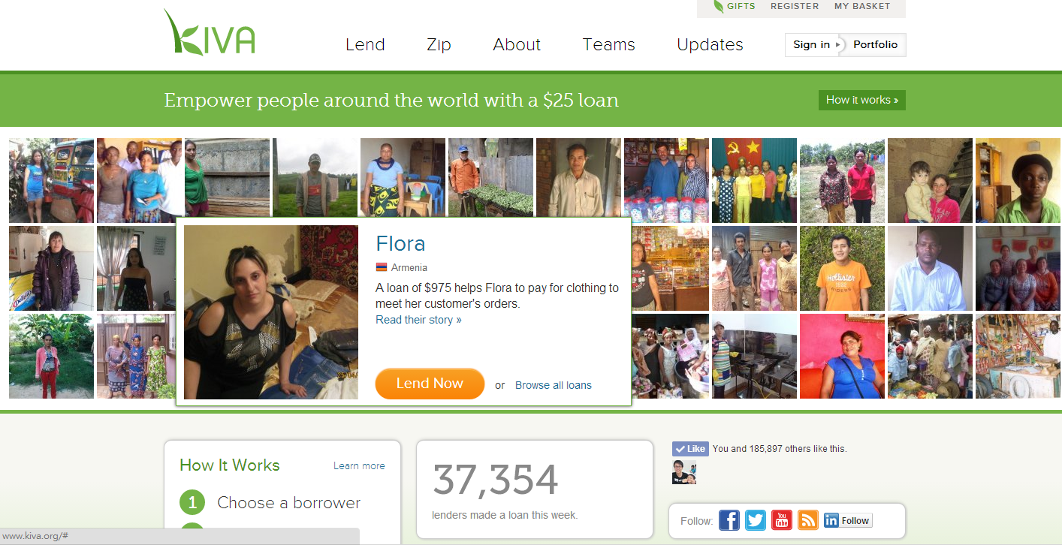
Data description(1)
Kiva (http://www.kiva.org/) is a non-profit organization which aims at providing a micro-loan crowding-sourcing platform to alleviate poverty.

Slide 9
Data description(2)
Lender
Loan
Task: to predict whether a lender
will lend to certain loan or not
2014/01/08 - 2014/01/15
#Lender: 15,870
#Loan: 4,872
#Transaction: 38026
Training: 26617
Testing: 11409 (+) and randomly
sample 11409 (-)
train.csv test.csv
?
?

Slide 10
Data description(3)
Lender’s information:
lender_id
country_code
inviter_id
invitee_count
loan_count
lender.csv
Loan’s information:
loan_id
Sector
Amount
Borrowers
Country
geo
loan.csv

Slide 11
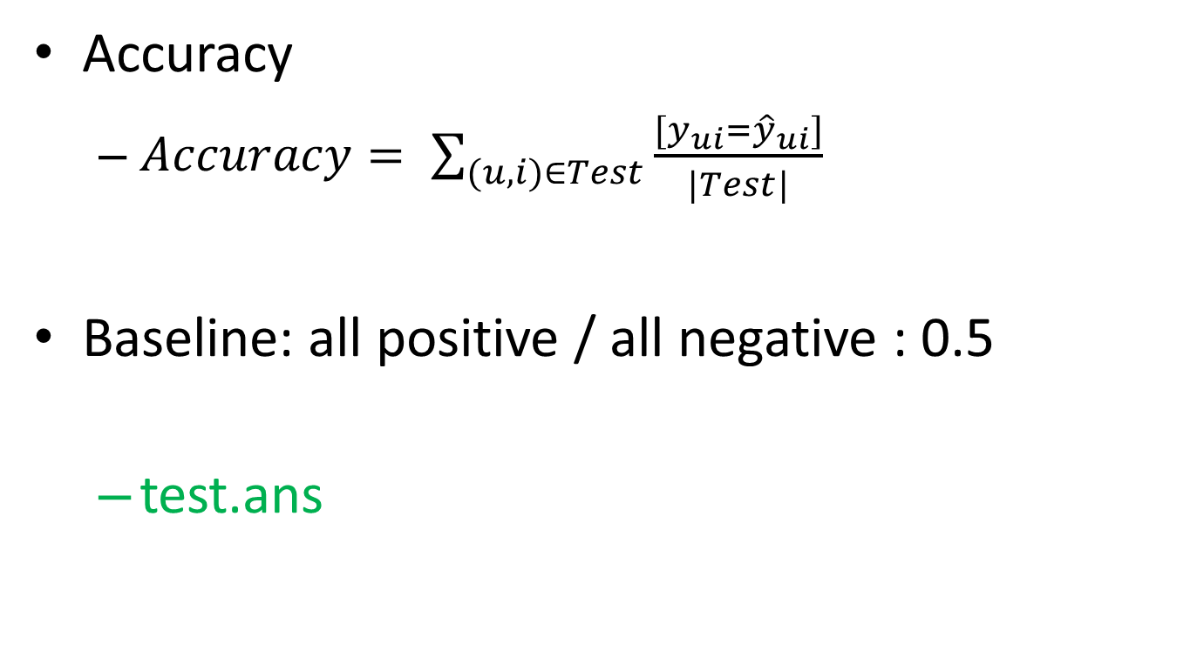
Evaluation
Accuracy
$Accuracy= \sum_{(u,i)∈Test}{\frac{[y_{ui}={\hat{y}}_{ui}]}{|Test|}}$
Baseline: all positive / all negative : 0.5
test.ans

Slide 12
Outline
What is Link Prediction problem.
Introduction to final practice
How to make link prediction
What is machine learning?
Workflow of data-driven approach
Feature Extraction

Slide 13
How to make link prediction
Two different strategies:
1. Knowledge-driven strategy: produce some rules for
prediction
– E.g.: if degree <10, then predict it as a college node.
– Cons: Need domain experts. Could miss patterns that
were unknown.
2. Data-driven approach: Machine learning approach
– Suppose you are given a social network, while some nodes have labels (professors, department, keywords… etc.) and some don’t.
– The goal is to predict the labels of some of them.

Slide 14
Outline
What is Link Prediction problem.
Introduction to final practice
How to make link prediction
What is machine learning?
Workflow of data-driven approach
Feature Extraction

Slide 15
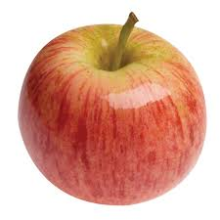

What is machine learning?
How can you distinguish apples / orange?
Color / shape …

Slide 16
What is machine learning?
But if we have 1 billion pictures with 200 types of fruit to be classified ?
Let machine(computer) learn it automatically!
y = f(x)
X = { picture of fruit }
Y = { type of fruit } e.g. ‘apple’, ‘orange’ …
Given lots of (x, y) pairs, learn y=f(x)

Slide 17
Brief introduction to common classifier
denotes +1
denotes -1
How can we classify this data?

Slide 18
Brief introduction to common classifier
denotes +1
denotes -1

Slide 19
Brief introduction to common classifier
denotes +1
denotes -1

Slide 20
Brief introduction to common classifier
denotes +1
denotes -1

Slide 21
Brief introduction to common classifier
denotes +1
denotes -1
Any of these would be fine..
..but which is best?

Slide 22



Support Vector Machine
A+
A-

Slide 23
Package of SVM
Liblinear
http://www.csie.ntu.edu.tw/~cjlin/liblinear/
LibSVM
http://www.csie.ntu.edu.tw/~cjlin/libsvm/

Slide 24
Outline
What is Link Prediction problem.
Introduction to final practice
How to make link prediction
What is machine learning?
Workflow of data-driven approach
Feature Extraction

Slide 25
Workflow - Data-driven approach(1)
1. Determine what is considered to be the ‘instance’ for classification
Node or link?
Multi-class or single class?
2. Obtaining features for the instance
Topological features (e.g. degree, centrality)
Attributes of instances (e.g. time info, relation type of edges) Attributes of instances (e.g. time info, relation type of edges)
Social features (the information about neighbors)

Slide 26
Workflow - Data-driven approach(2)
3. Determine a classifier to use.
E.g. Liblinear, LibSVM, Weka ...
4. Train a classifier and evaluate the results using held-out data (i.e. data not used for training). If the performance is not satisfiable, go back to (2) and (3).

Slide 27
Goal
Lender
Loan
+1 1:0.34 2:0.96 3:-0.5
-1 1:0.9 2: 0.1 3: 0.3
+1 1:0.28 2:0.77 3:-0.6
-1 1:1.0 2: 0.2 3: 0.4
…
?
?

Slide 28
Outline
What is Link Prediction problem.
Introduction to final practice
How to make link prediction
What is machine learning?
Workflow of data-driven approach
Feature Extraction

Slide 29
Feature extraction(1)
Topological feature
Shortes path length
Edge Embeddedness
Number of common neighbors of node u and v
Jaccard’s coefficient
Adamic/Adar
Preferential attachment
Katz score
Hitting time
expected umber of steps of random walk from x to y.

Slide 30
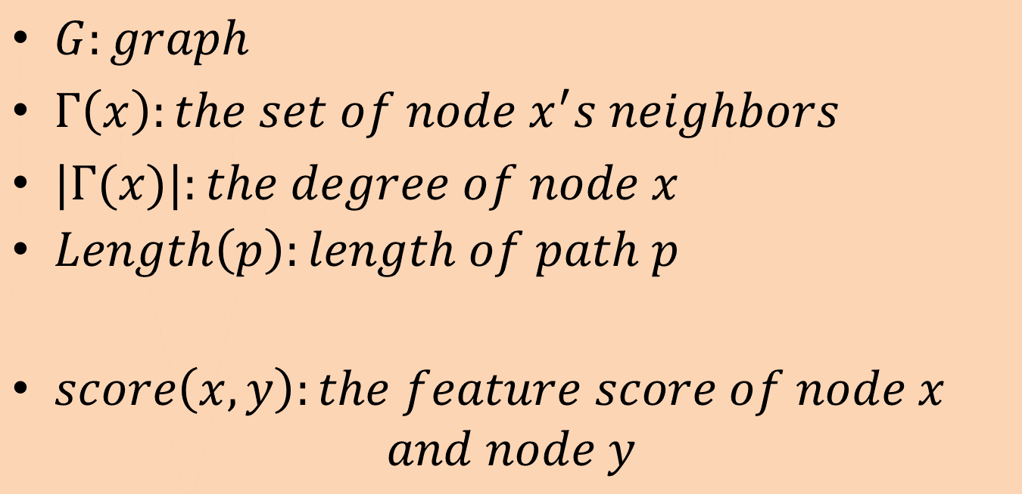
Notation
$G:graph$
$Γ\left(x\right):the set of node x^{′}s neighbors$
$|Γ(x)|:the degree of node x$
$Length\left(p\right):length of path p$
$score\left(x, y\right):the feature score of node x$
$$and node y$$

Slide 31
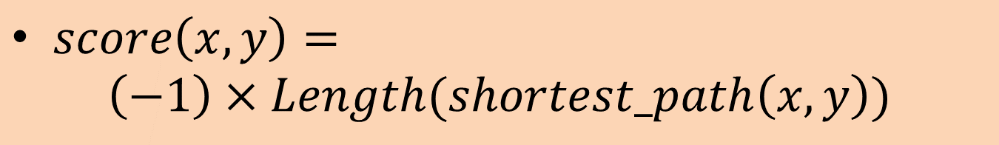
Shortest-Path
The length of shortes path from node x to node y
$score\left(x, y\right)=$
$$\left(−1\right)×Length(shortest_path\left(x,y\right))$$

Slide 32

Betweenness centrality
X

Slide 33
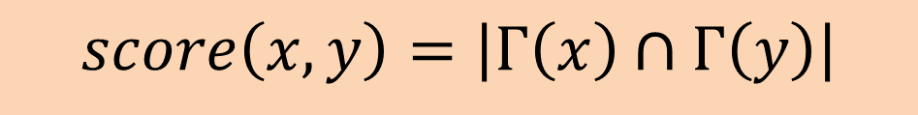
Edge Embeddedness
The number of common neighbors of node x and y
$$score\left(x, y\right)=\left|Γ\left(x\right)∩Γ\left(y\right)\right|$$

Slide 34
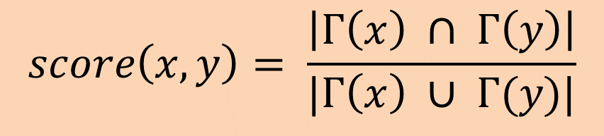
Jaccard’s coefficient
$$score\left(x, y\right)= \frac{\left|Γ\left(x\right) ∩ Γ\left(y\right)\right|}{|Γ\left(x\right) ∪ Γ(y)|}$$
Measure how likely a neighbor of x is to be a neighbor of y and vice versa to be a neighbor of y and vice versa

Slide 35
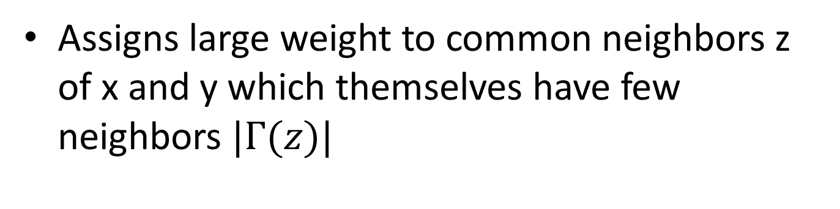
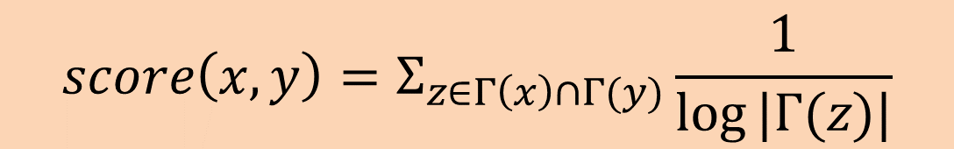
Adamic/Adar
$$score\left(x, y\right)=Σ_{z∈Γ\left(x\right)∩Γ(y)}\frac{1}{log⁡|Γ(z)|}$$
Assigns large weight to common neighbors z of x and y which themselves have few neighbors $|Γ(z)|$

Slide 36

Preferential Attachment
$$score\left(x, y\right)=\left|Γ\left(x\right)\right|×|Γ\left(y\right)|$$
Researchers found empirical evidence to suggest that co-authorship is correlated with the product of the neighborhood sizes

Slide 37
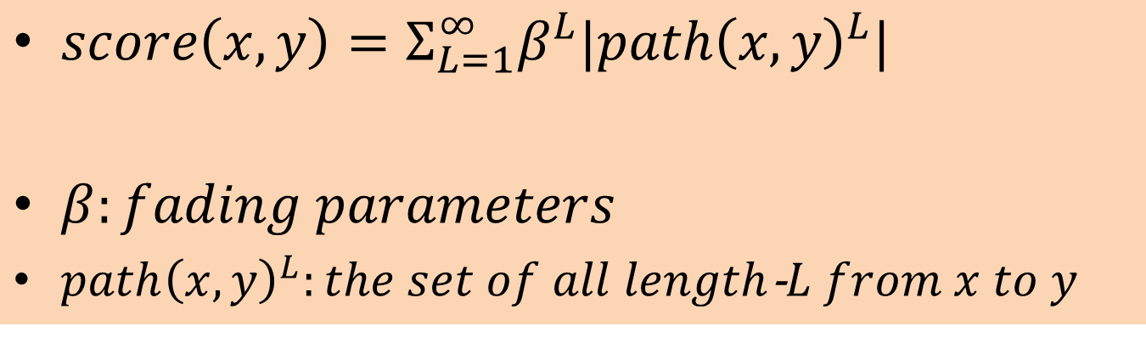

Katz$β$ measure
Sums over all possible paths between x and y, giving higher weight to shorter paths
$score\left(x, y\right)=Σ_{L=1}^{∞}β^{L}|path{\left(x,y\right)}^{L}|$
$β:fading parameters$
$path{\left(x,y\right)}^{L}:the set of all length$-$L from x to y$

Slide 38
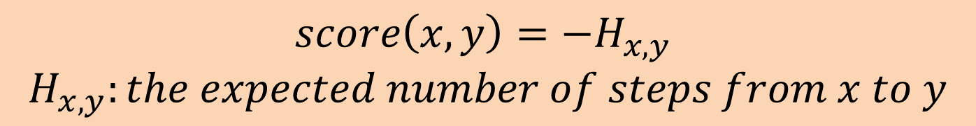
Hitting time
$$score\left(x, y\right)=−H_{x,y}$$
$$H_{x,y}:the expected number of steps from x to y$$

Slide 39

Rooted PageRank
??

Slide 40
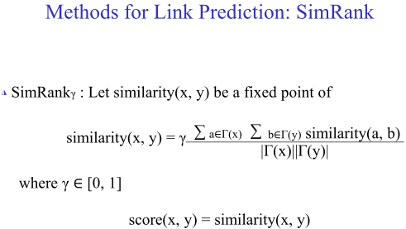
SimRank

Slide 41
Feature extraction(2)
Latent topological feature
Graph factorization

Slide 42
Feature extraction(3)
Content-based feature
Totally depends on your DATA
There some small tips
Dummy variable (indicator variable)
Scaling

Slide 43
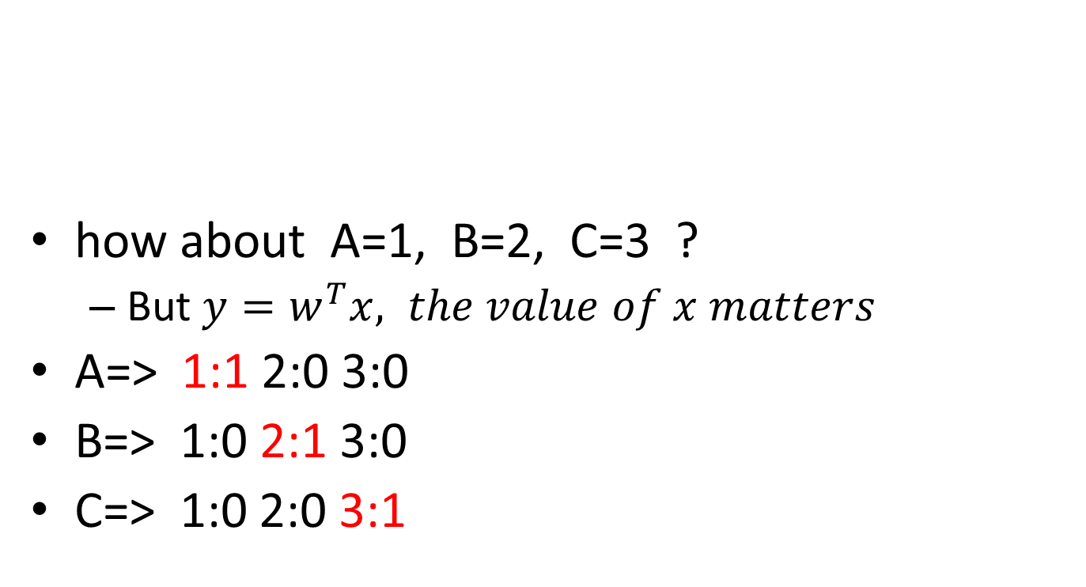
Dummy variable
how about A=1, B=2, C=3 ?
But $y=w^{T}x, the value of x matters$
A=> 1:1 2:0 3:0
B=> 1:0 2:1 3:0
C=> 1:0 2:0 3:1
node | A | B | C
Type | ‘person’ | ‘animal’ | ‘Item’

Slide 44
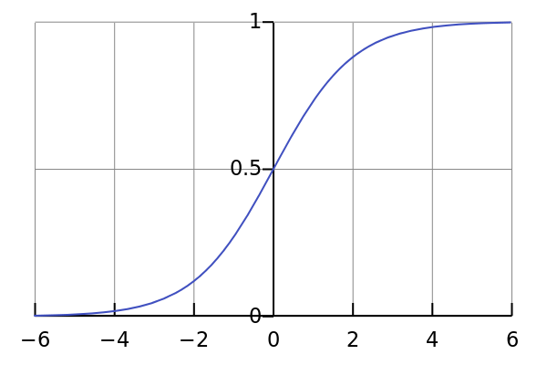
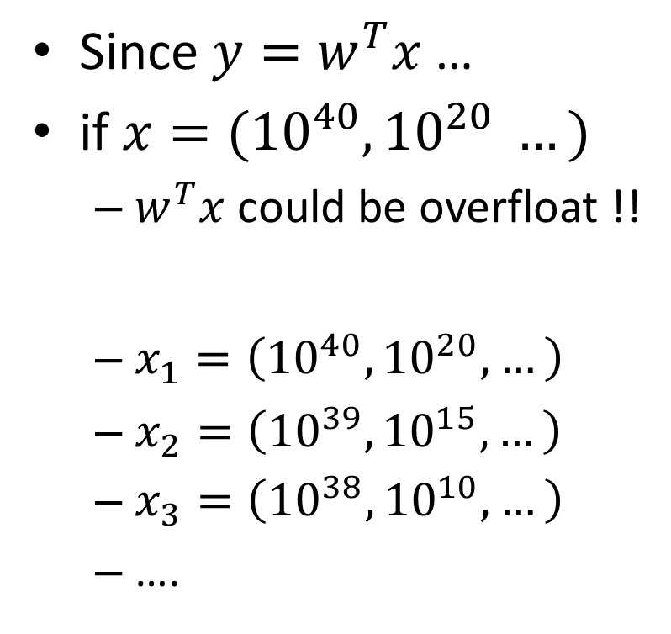
Scaling
Since $y=w^{T}x$ …
if $x=({10}^{40}, {10}^{20} …)$
$w^{T}x$ could be overfloat !!
$x_{1}=\left({10}^{40}, {10}^{20}, …\right)$
$x_{2}=\left({10}^{39}, {10}^{15}, …\right)$
$x_{3}=\left({10}^{38}, {10}^{10}, …\right)$
….
Divided by MAX
Sigmoid function
[-1, 1]
[-1, 1]

Slide 45
Coding Time !
https://github.com/barry800414/sample-codes/archive/master.zip

Slide 46
Task 1
task1/extract_feature.py - Line 22
Please find shortest path from node x to node y
Hint: Please browse networkx documents

Slide 47
Task 2
task2/extract_feature.py – Line 40
Please find the number of common neighbors of node x and node y
Hint: Please browse networkx documents

Slide 48
Task 3
task3/extract_feature.py – Line 51
Calculate jaccards_coefficients for node x and node y
Hint: python has built-in type : set()
There are “union” and “intersect” operation

Slide 49
Task 4
task4/extract_feature.py – Line 62
Complete adamic_adar_score function

Slide 50
Task 5
task5/convert_feature.py – Line 17
Normalize the column by the maximum of absolute value in a column
Hint: python has built in max function

Slide 51
Task 6
task6/convert_feature.py – Line 36
Convert categorical feature to dummy / indicator variable

Slide 52
Task 7
Using liblinear to train a model by training data, and predict the value on testing data
See the accuracy value

Slide 53
QA & Discussion

