Slide 1
Social Network Analysis - Link Prediction - Practice
Lecture for ITRI Shou-De Lin, CSIE, NTU
TA: Wei-Ming Chen

Slide 2

Data description(1)
Pokec is the most popular on-line social network in Slovakia. The popularity of network has not changed even after the coming of Facebook.

Slide 3
Data description(2)
Task: to predict whether the future friendship
#User: 3000
#Edges: 12433
Training: 8703
Testing: 3730(+) and randomly sample 3730 (-)
train.csv, test.csv

Slide 4
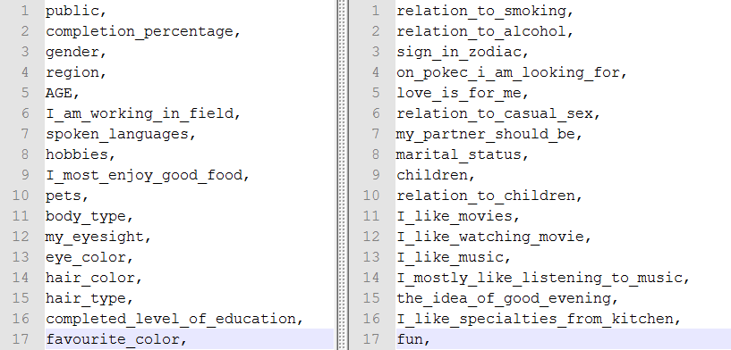
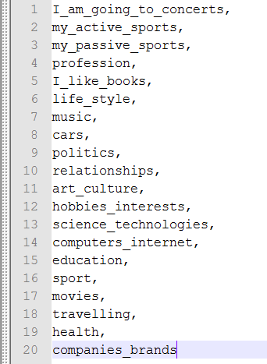
Data description(3)
A lot of information about users
pre_nodes_profile.csv

Slide 5
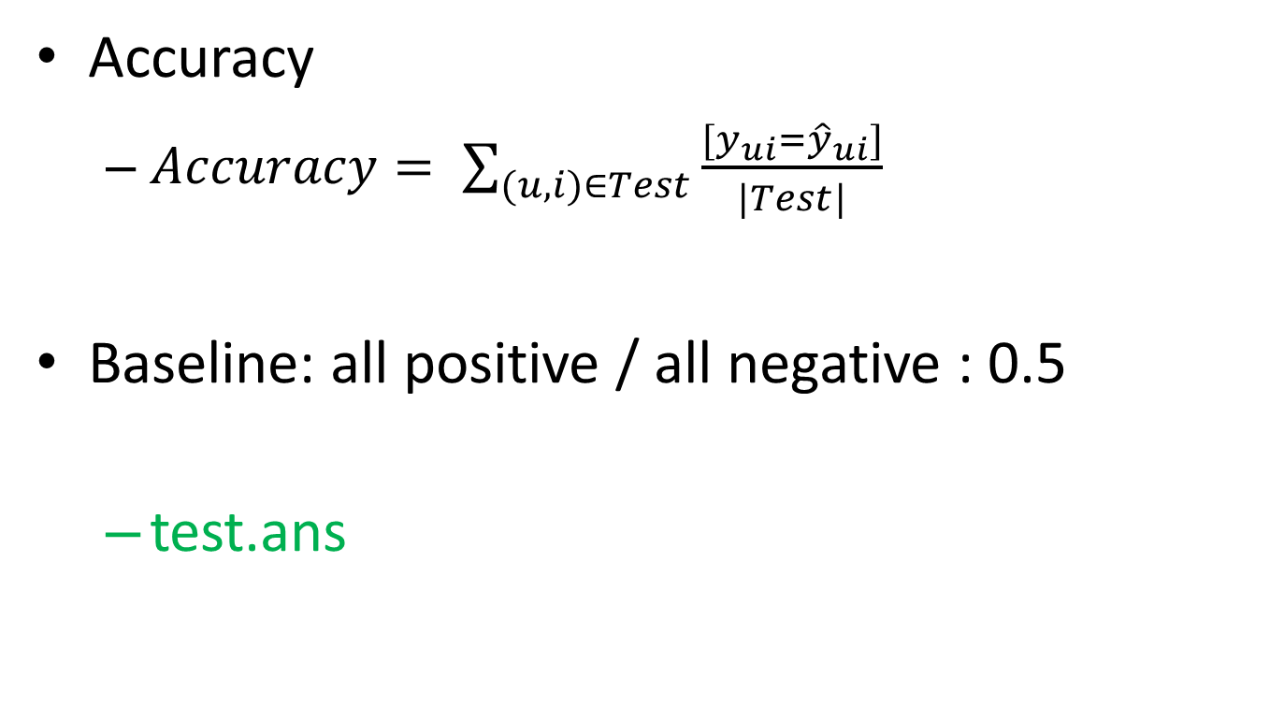
Evaluation
Accuracy
$Accuracy= \sum_{(u,i)∈Test}{\frac{[y_{ui}={\hat{y}}_{ui}]}{|Test|}}$
Baseline: all positive / all negative : 0.5
test.ans

Slide 6
Coding Time !
https://github.com/barry800414/sna_lecture/archive/master.zip

Slide 7
Preparation
Enter liblinear directory: make
run.sh / run.bat

Slide 8
Task 1
task1/extract_feature.py - Line 33
Please find shortest path from node x to node y
Hint: Please browse networkx documents

Slide 9
Task 2
task2/extract_feature.py – Line 44
Please find the number of common neighbors of node x and node y
Hint: Please browse networkx documents

Slide 10
Task 3
task3/extract_feature.py – Line 46
Calculate jaccards_coefficients for node x and node y
Hint: python has built-in type : set()
There are “union” and “intersect” operation

Slide 11
Task 4
task4/extract_feature.py – Line 58
Complete adamic_adar_score function

Slide 12
Task 5
task5/extract_feature.py – Line 88
Calculate clustering coefficient score
Hint: networkx has built-in function to calculate clustering coefficients for all nodes in graph.

Slide 13
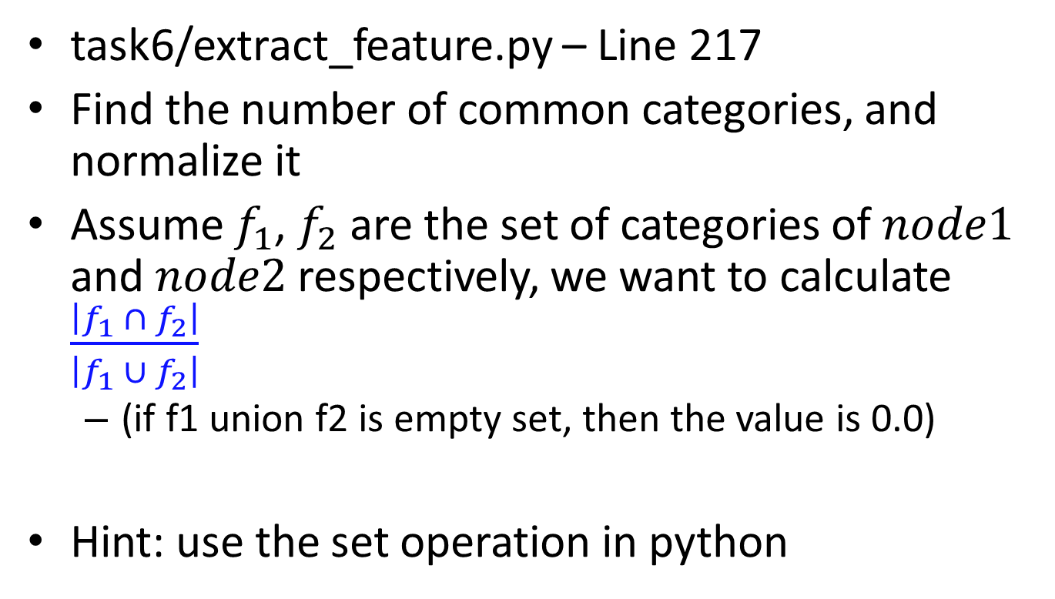
Task 6
task6/extract_feature.py – Line 217
Find the number of common categories, and normalize it
Assume $f_{1}$, $f_{2}$ are the set of categories of $node1$ and $node2$ respectively, we want to calculate $\frac{\left|f_{1} ∩ f_{2}\right|}{\left|f_{1} ∪ f_{2}\right|}$
(if f1 union f2 is empty set, then the value is 0.0)
Hint: use the set operation in python

Slide 14
Task 7
task7/convert_feature.py – Line 16
normalize the data by the maximum of absolute value in a column

Slide 15
QA & Discussion

