Slide 1
Social Network Analysis Tools: Python+ NetworkX
Shou-De Lin
CSIE, NTU
TA: 黃彥樺 r02944055@ntu.edu.tw

Slide 2
NetworkX (in python)
Advantage: very fast and easy to code
Disadvantage: less interactive GUI
Ref: http://networkx.github.io/documentation/latest/

Slide 3
Start Networkx(1)
First we should import it in python.
import networkx as nx
nx is just the abbreviation of networkx. When you call it frequently . You’d like to use it.
For example nx.Graph()
nx.Digraph()

Slide 4

Start Networkx(2)
There are some definition of edge and node.
In social network, node can be a person or company and so on. Edge can be any relationship between the nodes

Slide 5
Start Networkx(3-1)
Declare what kind of graph we want.
import networkx as nx
graph1=nx.Graph() #Undirected graphs with self loops
graph2=nx.DiGraph() #Directed graphs with self loops

Slide 6
Start Networkx(3-2)
What’s the example of Graph and DiGraph
Graph DiGraph
A and B are classmates. A likes B.
A
B
A
B

Slide 7
Start Networkx(3-3)
What’s more
import networkx as nx
graph3=nx.MultiGraph() #Undirected graphs with self loops and parallel edges
graph4=nx.MultiDiGraph() #Directed graphs with self loops and parallel edges

Slide 8
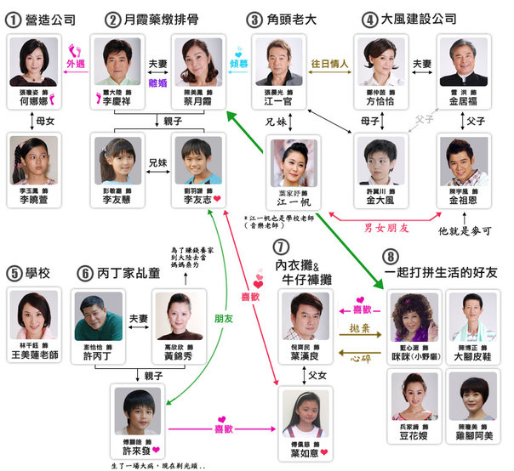
Start Networkx(3-4)
What’s the example of MultiGraph and MultiDiGraph?

Slide 9
NetworkX API(1) – basic method
Here we want to introduce some basic method to generate the graph.
G.add_edge(v1,v2)
G.add_node(v)
G.add_path([v1,v2….vn]): add (v1,v2) ,(v2,v3)…, (vn-1,vn)
G.add_cycle([v1,v2,…vn])
G.add_star([v1,v2,…vn]) :v1 is the central.

Slide 10

Example code
1
2
3
4
5

Slide 11
NetworkX API(1) – basic method
Here we introduce some basic method to generate the graph.
G.remove_edge([v1,v2])
G.remove_node(v)
G.number_of_edges()
G.number_of_nodes()

Slide 12
Exercise 1
Sherry has many friends. We use 1 to 10 to represent them. Here is the information.
1. 1-2, 1-3, 2-3 are friends.
2. 6-9 are friends.
Q1: How many edges are in the social network?
Q2: Hank is Sherry’s boyfriend. Unfortunately they broke up, so Hank decides to leave the social network. How many edges are left after he leaves? What did you find from the operation of Q2?

Slide 13
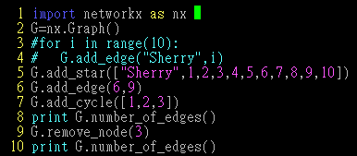
Answer 1:
1. 14 edges
2. 11 edges , when the node is removed, edge of the node will be removed too.

Slide 14
Common mistakes
Wrong Correct
1.G=nx.graph() -> G=nx.Graph()
2.G.add_edges(1,2) -> G.add_edge(1,2)
3.G.add_edge([1,2]) -> G.add_edge(1,2)
4.G.add_cycle(1,2,3) -> G.add_cycle([1,2,3])
5.G.remove_node(“3”) -> G.remove_node(3)

Slide 15
NetworkX API(1) – basic method
How to obtain information from a Social network
G.nodes() : to get all nodes
G.edges() : to get all edges
They return a list, so you can use len to calculate the number instead of number_of_node we mentioned.
G.degree(v) : to get # of neighbors
G.neighbors(v) :the same as degree in undirected graph

Slide 16
NetworkX API(1) – basic method
DG.in_degree(v)
DG.out_degree(v)
DG.successors(v): if v=2 return 3
DG.predecessor(v): if v=2 return 1
G.has_edge(v1,v2): return T/F
G.has_node(v)
1
2
3

Slide 17
Exercise 2
We try to model the relationship of a group of friends. If A likes B, there will be an edge from A to B. Read from Networkx_exercise2.txt and answer the following question.
1. How many people in the Social Network?
2. Who likes Mary?
3. What will happen if you use DG.neighbors(John) ?

Slide 18
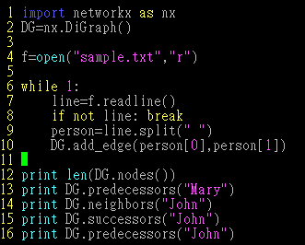
Answer 2:

Slide 19
Answer 2
1: 30
2:['Ryo', 'Kyo', 'Sam', 'Billy', 'Robert', 'Harry', 'Tim', 'Andy', 'Joe', 'Martin', 'Paul', 'Henry', 'Eric']
3. DG.neighbors() only return the sucessors
['Sharon', 'Wendy', 'Jessie', 'Mandy', 'Lucy', 'Amy', 'Claire', 'Betty', 'Annie', 'Sherry', 'Yuri', 'Emily']
['Sharon', 'Wendy', 'Jessie', 'Mandy', 'Lucy', 'Amy', 'Claire', 'Betty', 'Annie', 'Sherry', 'Yuri', 'Emily']
['Jessie', 'Annie', 'Mandy', 'Lucy', 'Angela', 'Amy', 'Claire', 'Yuri', 'Wendy', 'Sherry', 'Betty', 'Mary', 'Emily']

Slide 20
NetworkX API(2) – centrality
networkx.algorithms.centrality.degree_centrality(G)
networkx.algorithms.centrality.betweenness_centrality(G, normalized=True, weight=None, endpoints=False)
networkx.algorithms.centrality.closeness_centrality (G, v=None, distance=None, normalized=True)

Slide 21
Exercise 3
Calculate the degree ,closeness and betweenness centrality on the network of sample.txt. Who has the biggest centrality (degree ,closeness and betweenness)?

Slide 22
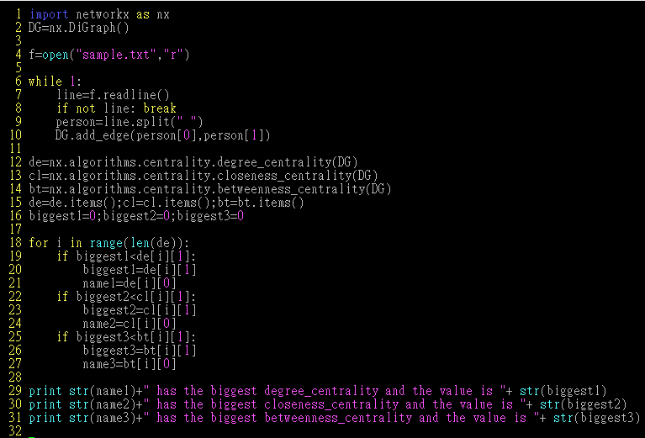
Answer 3

Slide 23
NetworkX API(3) – generative model
WS Model:
networkx.generators.random_graphs.newman_watts_strogatz_graph(n, k, p, create_using=None, seed=None)
BA Model:
networkx.generators.random_graphs.barabasi_albert_graph(n, m, create_using=None, seed=None)

Slide 24
NetworkX API(4) – other algorithms
http://networkx.lanl.gov/search.html?q=algorithm
networkx.algorithms.clique.find_cliques()
networkx.algorithms.cluster.clustering()
networkx.algorithms.components.connected.is_connected()
networkx.algorithms.distance_measures.diameter()
networkx.algorithms.flow.max_flow()
networkx.algorithms.isomorphism.DiGraphMatcher.is_isomorphic()

Slide 25
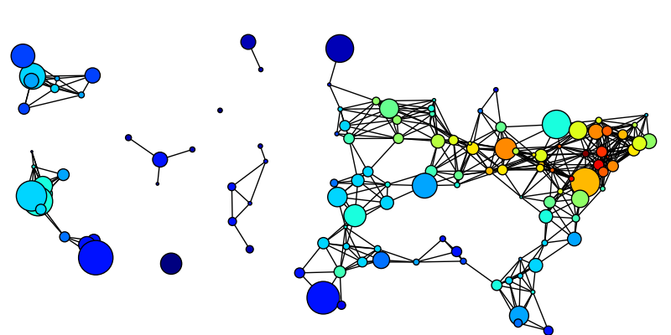
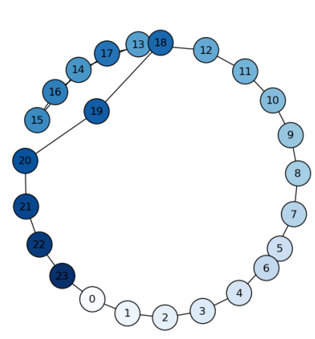
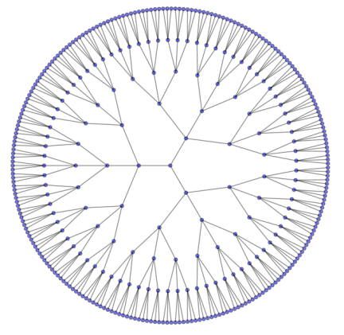
NetworkX API(5) – Visualization
Install:
matplotlib: http://matplotlib.sourceforge.net/
pygraphviz: http://networkx.lanl.gov/pygraphviz/
Tutorial:
http://networkx.github.io/documentation/latest/tutorial/tutorial.html#drawing-graphs

Slide 26
Sample code
try:
import matplotlib.pyplot as plt except:
raise import networkx as nx G=nx.path_graph(8)
nx.draw(G) plt.savefig("simple_path.png") plt.show() # display

Slide 27
More packages
igraph(C)
http://igraph.sourceforge.net/
The Boost Graph Library (C++)
http://www.boost.org/doc/libs/1_40_0/libs/graph/doc/index.html
Visualization: NodeXL
http://nodexl.codeplex.com/
Prefuse(Java)
http://prefuse.org/

