Slide 1
python basics
Lecture for ITRI Shou-De Lin, CSIE, NTU
TA: Wei-Ming Chen

Slide 2
Running
執行: python ooxx.py argv1 argv2 …
直譯式: 不用先compile
動態語言: 不用先宣告變數
語法簡單

Slide 3
Output
print ‘Hello World’
print “I’m %s” % (name)

Slide 4
If-elif-else while for
if ooxx == ‘123’:
do something
elif ooxx == ‘124’:
do something
else:
do something
for i in range(0, 10):
from 0 to 9
for e in e_list:
Iterate over all elements
while ooxx<123:
Do something

Slide 5
Data structure - list
Variable length array
Consecutive memory allocation
t = list() //initialization
t.append(123) //add new element at the end
len(t)
//length of list
t.extend([333, 444])
//add new elements at the end
t.remove(333)
//remove an element
in t / not in t
//check existence of an element

Slide 6
Data structure - dictionary
map / dictionary
key-value pairs
d = dict()
//initialization
d[‘a’] = 1
//add new element (‘a’ => 1)
d[‘a’], d.get(‘a’)
//get element with key = ‘a’
del d[‘a’]
//del element with key = ‘a’
len(d)
//return the size of dictionary object
d.keys()
//return the list of keys of dictionary object
d.values()
//return the list of values of dictionary object
d.items()
//return the list of (key,value) pairs of dictionary object
in d / not in d
//check existence of an element

Slide 7
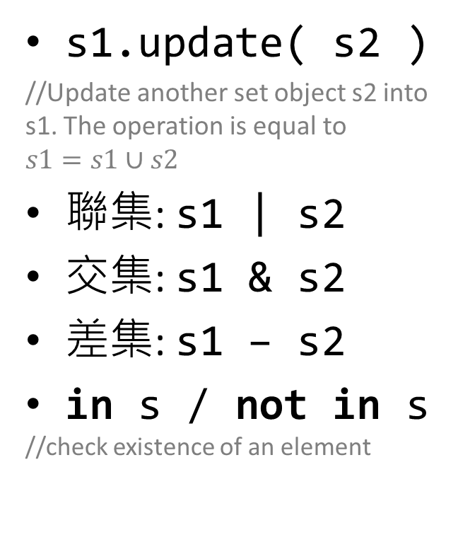
Data structure - set
Unordered set
s1 = set()
//initialization
len(s1)
//return the size of set object
s1.add(1)
//add new element 1 into the set
s1.remove(1)
//remove element 1 from the set
s1.update( s2 )
//Update another set object s2 into s1. The operation is equal to $s1=s1∪s2$
聯集: s1 | s2
交集: s1 & s2
差集: s1 – s2
in s / not in s
//check existence of an element

