Slide 1
JUNG
Lecture for ITRI Shou-De Lin, CSIE, NTU
TA: Chin-Chi Hsu

Slide 2
JUNG (in Java)
Java Universal Network / Graph Framework
Many APIs for graph data structures and related algorithms
Advantage:
Rich functions, extendable
Powerful (interactive) graphical user interface
Disadvantage:
Running slowly
Not easy to code
Website
http://jung.sourceforge.net/

Slide 3
Using JUNG APIs (1)
When compiling and running programs, add the argument “-cp” to locate JUNG jar files
Assume the jar files are under a directory “jung”
Windows
-cp .;jung\*
Unix
-cp .:jung/\*
Notes:
Compilation: javac -cp .:jung_dir/\* XXX.java
Execution: java -cp .:jung_dir/\* XXX
If the OS is one of Windows series, the colon“:”is replaced with the semicolon “;”.

Slide 4
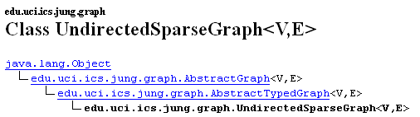
Using JUNG APIs (2)
Notice where to import necessary classes in JUNG Javadoc
Example: To conveniently use the class UndirectedSparseGraph, write “import edu.uci.ics.jung.graph.*;” in Java
Notes:
Compilation: javac -cp .:jung_dir/\* XXX.java
Execution: java -cp .:jung_dir/\* XXX
If the OS is one of Windows series, the colon“:”is replaced with the semicolon “;”.

Slide 5
Graph Classes
DirectedGraph<V, E>
Tree<V, E>
DirectedSparseGraph<V, E>
DirectedSparseMuitigraph<V, E>
UndirectedGraph<V, E>
UndirectedSparseGraph<V, E>
UndirectedSparseMultigraph<V, E>
Variable type
V: Vertex (node) (plural vertices)
E: Edge
Notes:
Directed v.s. Undirected: Edges are directed or not.
V: The type of vertex variable.
E: The type of edge variable.
Graph v.s. multigraph: Allowing multiple edges between two vertices or not.
Both Graph and Multigraph allow self-loops: Both endpoints of an edge are actually the same vertex.

Slide 6
Graph Methods: Construction
Addition
boolean b = addEdge(E e, V v1 ,V v2)
boolean b = addVertex(V v)
Removal
boolean b = removeVertex(V v)
boolean b = removeEdge(E e)
Information
int N = getVertexCount()
int M = getEdgeCount()
Collection<V> cv = getVertices()
Collection<E> ce = getEdges()
Notes:
Note that we need to name every edge.
If addEdge() contains an endpoint not in the graph, the endpoint will be added to the graph.

Slide 7
Example (1)
0
5
1
6
2
7
3
8
4
These are vertex / edge IDs, not weights of vertices / edges!
Notes:
ID

Slide 8
Example Code (1)
import edu.uci.ics.jung.graph.*;
public class Example01{
public static void main(String[] argv){
DirectedGraph<Integer, Integer> g = new
DirectedSparseGraph<Integer, Integer>();
for(int v = 0; v <= 4; v ++){
g.addVertex(v);
}
for(int v = 0; v <= 3; v ++){
int e = v + 5;
g.addEdge(e, v, v + 1);
}
System.out.println(g);
}
}
Notes:
Actually, the loop for addVertex() can be eliminated since addEdge() will add new vertices to the graph.

Slide 9
Graph Methods: Retrieval
Retrieval
boolean b = containsVertex(V v)
boolean b = containsEdge(E e)
E e = findEdge(V v1,V v2)
Pair<V> p = getEndpoints(E e)
V v1 = p.getFirst(), v2 = p.getSecond()
V v = getSource(E e)
V v = getDest(E e)
V v = getOpposite(V v, E e)
boolean b = isIncident(V v, E e)
Notes:
getSource() and getDest() work only for directed edges; they return null for undirected edges.
containsVertex(): Whether the graph contains the vertex or not.
containsEdge(): Whether the graph contains the edge or not.
findEdge(): Given two vertices, return the edge between them, or null if no edge between them.
getEndpoints(): Given an edge, return the two vertices adjacent to the edge.
Pair: A special class defined by JUNG, including two objects.
getSource(): Given a directed edge, return the vertex that is the source of the edge.
getDest(): Given a directed edge, return the vertex that is the destination of the edge.
getOpposite(): Given an edge and its adjacent vertex, return the other vertex adjacent to the edge.
isIncident(): Given an edge and a vertex, verify whether they are adjacent.

Slide 10
Graph Methods: Neighbors
Degree
int di = inDegree(V v)
int do = outDegree(V v)
int d = degree(V v)
Collection<E> ce = getIncidentEdges(V v)
Neighbor
Collection<V> cv = getSuccessors(V v)
Collection<V> cv = getPredecessors(V v)
Collection<V> cv = getNeighbors(V v)
int n = getNeighborCount(V v)
Notes:
If the graph is undirected, then inDegree(v) == outDegree(v) == degree(v).
A self-loop is counted once.
degree() is unequal to getNeighborCount().
degree(): The number of incident edges of a vertex.
getNeighborCount(): The number of incident vertices of a vertex.
If there are two edges between the same pair of vertices (u, v), then degree(u) returns 2, while getNeighborCount(u) returns 1.
Both degree() and getNeighborCount() count a self-loop once.

Slide 11
Example Code (2)
// Print details of each vertex in the graph g
for(int v: g.getVertices()){
System.out.printf(
“Vertex %d\n”, v);
System.out.printf(
“Neighbor count %d\n”,g.getNeighborCount(v));
System.out.printf(
“Out-degree %d\n”, g.outDegree(v));
for(int x: g.getSuccessors(v)){
System.out.printf(“\tNeighbor %d\n”, x);
}
System.out.println();
}
Notes:
Actually, the loop for addVertex() can be eliminated since addEdge() will add new vertices to the graph.

Slide 12
Extra information of vertices and edges
If we want to append information (e.g. weights) to vertices and edges, we must define specific classes
class Vertex{
public int id;
public String name;
public double weight;
public Vertex(int id, String name, double weight){
this.id = id;
this.name = name;
this.weight = weight;
}
}

Slide 13
Example Code (3)
// Construct a graph instance
UndirectedGraph<Vertex, Edge> g = new
UndirectedSparseGraph<Vertex, Edge>();
// Add vertices and edges into the graph
Vertex zero = new Vertex(0, “zero”, 3.14);
Vertex one = new Vertex(1, “one”, 2.72);
g.addVertex(zero);
g.addVertex(one);
g.addEdge(new Edge(0, “zero-one”, 22.46), zero, one);
// Show the weight of each vertex in the graph
System.out.println("Vertex:");
for(Vertex v: g.getVertices()){
System.out.printf
("\t%d\t%s\t%f\n", v.id, v.name, v.weight);
}
Notes:
We assume that the class Edge has the same variables as Vertex.

Slide 14
Algorithm Classes
Many authors provide JUNG class implementation of graph algorithms
Classes have similar writing styles but different usage details
Always look up the JUNG Javadoc
Example: Dijkstra shortest path algorithm
DijkstraShortestPath<V, E> dijkstra = new DijkstraShortestPath<V, E>(g);
List<E> path = dijkstra.getPath(v1, v2);
Notes:
Writing style of algorithm classes in JUNG:
1. Assign a graph object to the algorithm classes in its constructor.
2. Call methods of such classes to run the algorithm and obtain the results.

Slide 15
Centrality Classes
Centrality: Important vertices of a graph
ClosenessCentrality<V, E>
BetweennessCentrality<V, E>
PageRank<V, E>
A variant of eigenvector centrality
“Transformer” variable as a parameter of the constructors
Tell algorithms our defined vertex, edge weights
Notes:
Closeness centrality: A vertex is the most important if it has the minimum sum of distances from all other vertices.
Betweenness centrality: A vertex is the most important if there are the most shortest paths passing the vertex.
Eigenvector centrality: A vertex if the most important if it is the most likely for the vertex to be connected to other high centrality-score vertices.

Slide 16
Example Code (4)
// Assume we already have a graph g
// Construct a transformer
Transformer<Edge, Double> transformer = new
Transformer<Edge, Double>(){
public Double transform(Edge e){
return e.weight;
}
};
// Call the closeness centrality class
ClosenessCentrality<Vertex, Edge> cc = new
ClosenessCentrality<Vertex, Edge>
(g, transformer);
// Run the algorithm to obtain scores
for(Vertex v: g.getVertices()){
System.out.println(cc.getVertexScore(v));
}
Notes:
We assume that the class Edge has the same variables as Vertex.
Some paths should be imported:
ClosenessCentrality: edu.uci.ics.jung.algorithms.scoring.*;
Transformer: org.apache.commons.collections15.*;
Transformer class needs to declare the method transform().

Slide 17
Generative Model Classes
Generative model: Artificial social networks
BarabasiAlbertGenerator
ErdosRenyiGenerator
EppsteinPowerLawGenerator
KleinbergSmallWorldGenerator
MixedRandomGraphGenerator
“Factory” variable as a parameter of the constructors
Tell models how to generate an instance of graph, vertex or edge classes

Slide 18
Example Code (5)
// Construct a factory for graph instances
// Vertex (vf) and edge (ef) factories are similar
Factory< Graph<Vertex, Edge> > gf = new
Factory< Graph<Vertex, Edge> >(){
public Graph<Vertex, Edge> create(){
return new UndirectedSparseGraph
<Vector, Edge>();
}
};
// BA model requires a set to put vertices
Set<Vertex> seedVertices = new HashSet<Vertex>();
// Call the BA model class
BarabasiAlbertGenerator<Vertex, Edge> ba
= new BarabasiAlbertGenerator
<Vertex, Edge> (gf, vf, ef,
10, 3, 0, seedVertices);
// Run the model to obtain an artificial graph
ba.evolveGraph(50);
Graph<Vertex, Edge> g = ba.create();
Notes:
Factory class needs to declare the method create().

Slide 19
Visualization
Displaying a graph
Graph instance
Layout: Locations of vertices and edges
BasicVisualizationServer class: A GUI Panel
GUI APIs: Java Swing

Slide 20
Example Code (6)
// Assume we have a undirected graph g with both vertices and edges of integer IDs
// Construct an appropriate layout for the graph
Layout<Integer, Integer> layout = new
CircleLayout<Integer, Integer>(g);
layout.setSize(new Dimension(300, 300));
BasicVisualizationServer<Integer, Integer> vv = new
BasicVisualizationServer<Integer, Integer>
(layout);
vv.setPreferredSize(new Dimension(350, 350));
// Show the graph with Java Swing
JFrame frame = new JFrame(“Graph");
frame.setDefaultCloseOperation(JFrame.EXIT_ON_CLOSE);
frame.getContentPane().add(vv);
frame.pack();
frame.setVisible(true);
Notes:
setSize(): Set the size of the layout.
setPreferredSize(): Set the size of the graph panel.
Import these libraries:
import edu.uci.ics.jung.graph.*;
import edu.uci.ics.jung.visualization.*;
import org.apache.commons.collections15.*;
import edu.uci.ics.jung.algorithms.layout.*;
import javax.swing.*;
import java.awt.*;

Slide 21
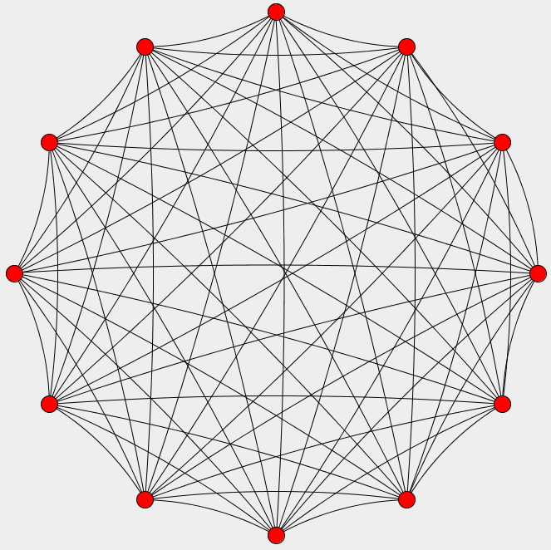
Example (2)
Clique (complete graph) of 12 vertices

Slide 22
More Visualization APIs
Graph style: Color, stroke, label, …
Class RenderContext
Class Transformer is frequently used here
Interactivity: Mouse, keyboard operations
Class BasicVisualizationServer is replaced with VisualizationViewer
Class DefaultModalGraphMouse

Slide 23
References
JUNG website
http://jung.sourceforge.net/
JUNG APIs
http://jung.sourceforge.net/doc/api/
JUNG tutorial: More visualization details
http://www.grotto-networking.com/JUNG/JUNG2-Tutorial.pdf

