Slide 1
NetworkX
Lecture for ITRI Shou-De Lin, CSIE, NTU
TA: Yen-Hua Huan

Slide 2
Outline
NetworkX(Python)

Slide 3
NetworkX (in python)
Advantage: very fast and easy to code
Disadvantage: less interactive GUI
Ref: http://networkx.github.io/documentation/latest/

Slide 4
Start Networkx(1)
First we should import it in python.
import networkx as nx
nx is just the abbreviation of networkx. When you call it frequently . You’d like to use it.
For example nx.Graph()
nx.Digraph()

Slide 5

Start Networkx(2)
There are some definition of edge and node.
In social network, node can a person or company and so on. Edge can be the relationship between the node.

Slide 6
Start Networkx(3-1)
Then we should declare what kind of graph we want.
import networkx as nx
graph1=nx.Graph() #Undirected graphs with self loops
graph2=nx.DiGraph() #Directed graphs with self loops

Slide 7
Start Networkx(3-2)
What’s the example of Graph and DiGraph
Graph DiGraph
A and B are classmates. A likes B.
A
B
A
B

Slide 8
Start Networkx(3-3)
What’s more
import networkx as nx
graph3=nx.MultiGraph() #Undirected graphs with self loops and parallel edges
graph4=nx.MultiDiGraph() #Directed graphs with self loops and parallel edges

Slide 9
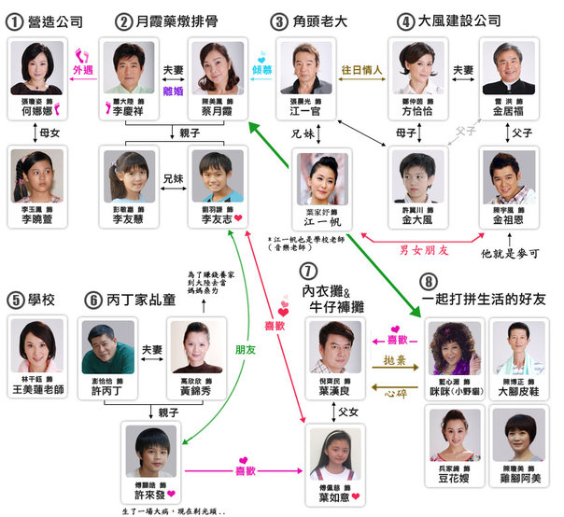
Start Networkx(3-4)
What’s the example of MultiGraph and MultiDiGraph?

Slide 10
NetworkX API(1) – basic method
Here we want to introduce some basic method to generate the graph.
G.add_edge(v1,v2)
G.add_node(v)
G.add_path([v1,v2….vn]): add (v1,v2) ,(v2,v3)…, (vn-1,vn)
G.add_cycle([v1,v2,…vn])
G.add_star([v1,v2,…vn]) :v1 is the central.

Slide 11

Example code
1
2
3
4
5

Slide 12
NetworkX API(1) – basic method
Here we want to introduce some basic method to generate the graph.
G.remove_edge([v1,v2])
G.remove_node(v)
G.number_of_edges()
G.number_of_nodes()

Slide 13
Exercise 1
Sherry has many friends. We use 1 to 10 to represent them. Here is the information.
1. 1~3 are all friends.
2. 6 and 9 are friends.
Q1: How many edges are in the social network?
Q2: Hank(#3) is Sherry’s boyfriend. Unfortunately they broke up, so Hank was leaving from the social network. Now many edges? What did you find from the operation of Q2?

Slide 14
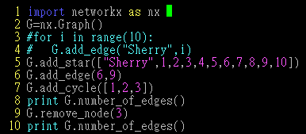
Answer 1:
1. 14 edges
2. 11 edges , when the node is removed, edge of the node will be removed too.

Slide 15
Common mistakes
Wrong Correct
1.G=nx.graph() -> G=nx.Graph()
2.G.add_edges(1,2) -> G.add_edge(1,2)
3.G.add_edge([1,2]) -> G.add_edge(1,2)
4.G.add_cycle(1,2,3) -> G.add_cycle([1,2,3])
5.G.remove_node(“3”) -> G.remove_node(3)

Slide 16
NetworkX API(1) – basic method
Here we should know how to get information from Social network.
G.nodes() : to get all nodes
G.edges() : to get all edges
They return a list, so you can use len to calculate the number instead of number_of_node we mentioned.
G.degree(v) : to get # of neighbors
G.neighbors(v) :the same as degree in undirected graph

Slide 17
NetworkX API(1) – basic method
DG.in_degree(v)
DG.out_degree(v)
DG.successors(v): if v=2 return 3
DG.predecessor(v): if v=2 return 1
G.has_edge(v1,v2): return T/F
G.has_node(v)
1
2
3

Slide 18
Exercise 2
We try to model the relationship of a group of friend. If A likes B, there will be an edge from A to B. Read from Networkx_exercise2.txt and answer the following question.
1. How many people are in the Social Network?
2. Who likes Mary?
3. What will happen if you use DG.neighbors(John)?

Slide 19
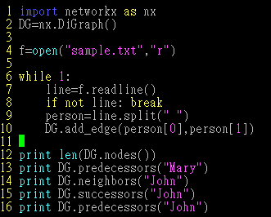
Answer 2:

Slide 20
Answer 2
1: 30
2:['Ryo', 'Kyo', 'Sam', 'Billy', 'Robert', 'Harry', 'Tim', 'Andy', 'Joe', 'Martin', 'Paul', 'Henry', 'Eric']
3. DG.neighbors() only return the sucessors
['Sharon', 'Wendy', 'Jessie', 'Mandy', 'Lucy', 'Amy', 'Claire', 'Betty', 'Annie', 'Sherry', 'Yuri', 'Emily']
['Sharon', 'Wendy', 'Jessie', 'Mandy', 'Lucy', 'Amy', 'Claire', 'Betty', 'Annie', 'Sherry', 'Yuri', 'Emily']
['Jessie', 'Annie', 'Mandy', 'Lucy', 'Angela', 'Amy', 'Claire', 'Yuri', 'Wendy', 'Sherry', 'Betty', 'Mary', 'Emily']

Slide 21
NetworkX API(2) – centrality
networkx.algorithms.centrality.degree_centrality(G)
networkx.algorithms.centrality.betweenness_centrality(G, normalized=True, weight=None, endpoints=False)
networkx.algorithms.centrality.closeness_centrality (G, v=None, distance=None, normalized=True)

Slide 22
Exercise 3
Calculate the degree ,closeness and betweenness centrality on the network of sample.txt.Who has the biggest centrality (degree ,closeness and betweenness)?
Annie,Angela,Annie

Slide 23
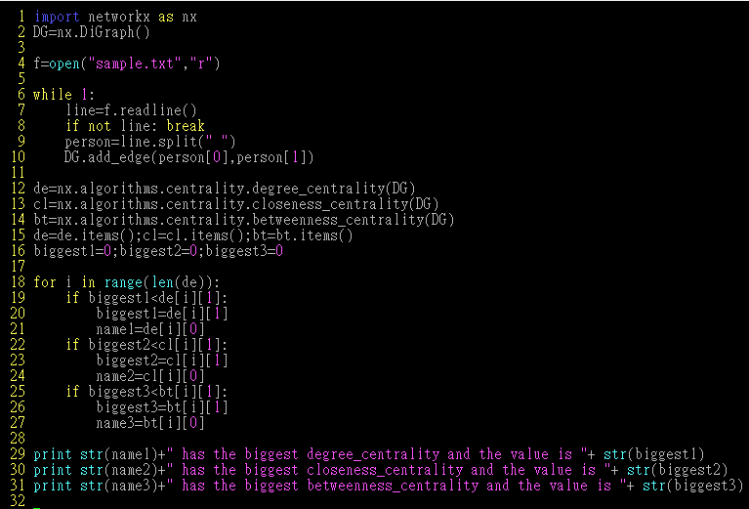
Answer 3

Slide 24
NetworkX API(3) – generative model
WS Model:
networkx.generators.random_graphs.newman_watts_strogatz_graph(n, k, p, create_using=None, seed=None)
BA Model:
networkx.generators.random_graphs.barabasi_albert_graph(n, m, create_using=None, seed=None)

Slide 25
NetworkX API(4) – some algorithms
http://networkx.lanl.gov/search.html?q=algorithm
networkx.algorithms.clique.find_cliques()
networkx.algorithms.cluster.clustering()
networkx.algorithms.components.connected.is_connected()
networkx.algorithms.distance_measures.diameter()
networkx.algorithms.flow.max_flow()
networkx.algorithms.isomorphism.DiGraphMatcher.is_isomorphic()

Slide 26
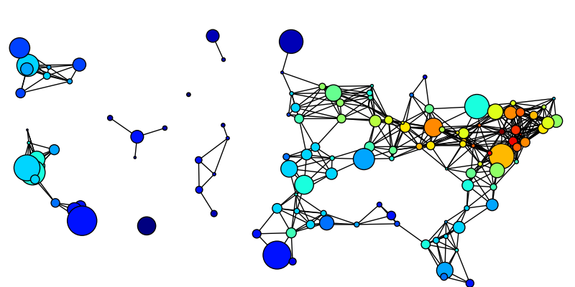
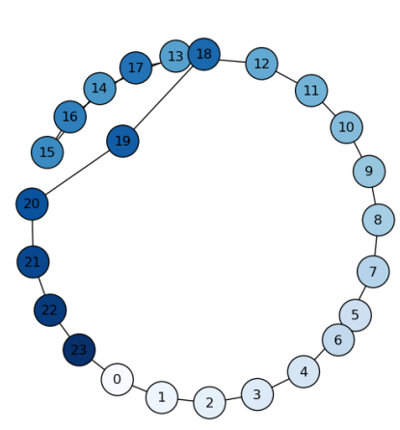
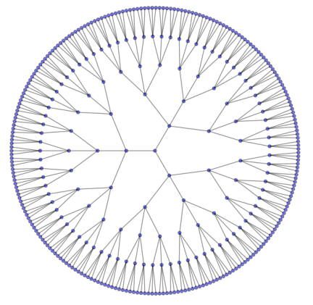
NetworkX API(5) – Visualization
Install:
matplotlib: http://matplotlib.sourceforge.net/
pygraphviz: http://networkx.lanl.gov/pygraphviz/
Tutorial:
http://networkx.github.io/documentation/latest/tutorial/tutorial.html#drawing-graphs

Slide 27
Sample code
try:
import matplotlib.pyplot as plt except:
raise import networkx as nx G=nx.path_graph(8)
nx.draw(G) plt.savefig("simple_path.png") plt.show() # display

Slide 28
More packages
igraph(C)
http://igraph.sourceforge.net/
The Boost Graph Library (C++)
http://www.boost.org/doc/libs/1_40_0/libs/graph/doc/index.html
Visualization: NodeXL
http://nodexl.codeplex.com/
Prefuse(Java)
http://prefuse.org/

Slide 29

Q&A

