Slide 1
Social Network Analysis - Link Prediction
MSLab Wei-Ming
2014 tutorial

Slide 2
Schedule
00:00 ~ 01:30 | Introduction to final practice Lecture Python basics Reviewing sample codes
01:30 ~ 02:45 | Practice
02:45 ~ 03:00 | Discussion and QA
Notes:
Introduction to final practice 5min
Lecture 50min
Python basics 10min
Reviewing sample codes 10min

Slide 3
Outline
What is Link Prediction problem.
Introduction to final practice
How to make link prediction
What is machine learning?
Workflow of data-driven approach
Feature Extraction

Slide 4
What is Link Prediction problem?
^_^
^_^
^_^
^_^
^_^
^_^
^_^
^_^
?
^_^
^_^
^_^

Slide 5
What is Link Prediction problem?
Predict the information on edges.
1. Link existence prediction: to classify whether each edge is 0(not exist) or 1(exist)
2. Link type classification: to classify the type of edges (e.g. student-teacher, student-student …)
3. Link regression: to predict the weight of link (importance, rating …)

Slide 6
Application
Recommendation system in E-commerce
The edges between users and items
Friends recommendation in online social network
Web site hyper-link prediction
Protein-protein interaction
….

Slide 7
Outline
What is Link Prediction problem.
Introduction to final practice
How to make link prediction
What is machine learning?
Workflow of data-driven approach
Feature Extraction

Slide 8
Outline
What is Link Prediction problem.
Introduction to final practice
How to make link prediction
What is machine learning?
Workflow of data-driven approach
Feature Extraction

Slide 9
How to make link prediction
Two different strategies:
1. Knowledge-driven strategy: produce some rules for
prediction
– E.g.: if common friends >100, predict that the edge exists
– Cons: Need domain experts. Could miss patterns that
were unknown.
2. Data-driven approach: Machine learning approach
–You are given a social network with many edges to learn the pattern how the edges be constructed
– The goal is to predict the existence of future edges

Slide 10
Outline
What is Link Prediction problem.
Introduction to final practice
How to make link prediction
What is machine learning?
Workflow of data-driven approach
Feature Extraction

Slide 11
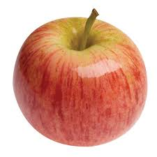

What is machine learning?
How can you distinguish apples / banana?
Color / shape …

Slide 12
What is machine learning?
But if we have 1 billion pictures with 200 types of fruit to be classified ?
Let machine(computer) learn it automatically!
y = f(x)
X = { picture of fruit }
Y = { type of fruit } e.g. ‘apple’, ‘orange’ …
Given lots of (x, y) pairs, to learn f automatically.

Slide 13
Brief introduction to common classifier
denotes +1
denotes -1
How can we classify this data?

Slide 14
Brief introduction to common classifier
denotes +1
denotes -1

Slide 15
Brief introduction to common classifier
denotes +1
denotes -1

Slide 16
Brief introduction to common classifier
denotes +1
denotes -1

Slide 17
Brief introduction to common classifier
denotes +1
denotes -1
Any of these would be fine..
..but which is best?

Slide 18



Support Vector Machine
A+
A-

Slide 19
Package of SVM
Liblinear
http://www.csie.ntu.edu.tw/~cjlin/liblinear/
LibSVM
http://www.csie.ntu.edu.tw/~cjlin/libsvm/

Slide 20
Outline
What is Link Prediction problem.
Introduction to final practice
How to make link prediction
What is machine learning?
Workflow of data-driven approach
Feature Extraction

Slide 21
Workflow - Data-driven approach(1)
1. Determine what is considered to be the ‘instance’ for classification (what is x? what is y?)
Node or link?
Multi-class or single class?
2. Obtaining features for the instance
Topological features (e.g. degree, centrality)
Attributes of instances (e.g. time info, relation type of edges)
Social features (the information from neighbors)

Slide 22
Workflow - Data-driven approach(2)
3. Determine a classifier to use.
E.g. Liblinear, LibSVM, Weka ...
4. Train a classifier and evaluate the results using held-out data (i.e. data not used for training). If the performance is not satisfiable, go back to (2) and (3).

Slide 23
Workflow - Data-driven approach(3)
Feature
Extraction
Training
Data
Training
Model
1
2
Feature
Extraction
5
3
Testing
4
Testing
Data
Social Network
Prediction

Slide 24
Goal
+1 1:0.34 2:0.96 3:-0.5
-1 1:0.9 2: 0.1 3: 0.3
+1 1:0.28 2:0.77 3:-0.6
-1 1:1.0 2: 0.2 3: 0.4
…
?
?

Slide 25
Outline
What is Link Prediction problem.
Introduction to final practice
How to make link prediction
What is machine learning?
Workflow of data-driven approach
Feature Extraction

Slide 26
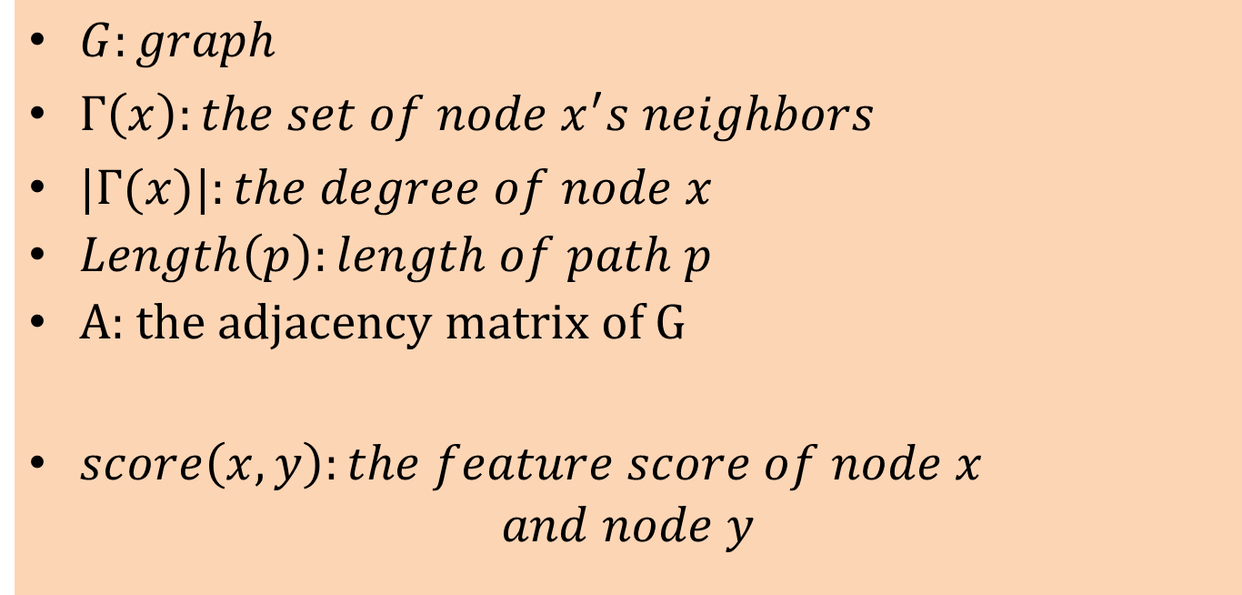
Notation
$G:graph$
$Γ\left(x\right):the set of node x^{′}s neighbors$
$|Γ(x)|:the degree of node x$
$Length\left(p\right):length of path p$
A: the adjacency matrix of G
$score\left(x, y\right):the feature score of node x$
$$and node y$$

Slide 27
Background knowledge - Adjacency matrix
to
 | 1 | 2 | 3 | 4 | 5
1 | 0 | 0 | 1 | 0 | 0
2 | 0 | 0 | 1 | 0 | 1
3 | 1 | 1 | 0 | 1 | 0
4 | 0 | 0 | 1 | 0 | 1
5 | 0 | 1 | 0 | 1 | 0
1
2
5
3
4
from

Slide 28
Background knowledge - Random Walk
1
2
3
P=1
Starting node
7
6
4
5

Slide 29
Background knowledge - Random Walk
1
2
P=1/6
P=1/6
P=1/6
3
7
P=1/6
6
P=1/6
4
P=1/6
5

Slide 30

Background knowledge - Random Walk with Restart
1
2
3
P=0.6
Starting node
7
6
4
P=0.4
$$α=0.6$$
5

Slide 31
Background knowledge - Random Walk with Restart
1
2
P=0.1
P=0.1
P=0.1
3
Starting node
P=0.1
7
6
P=0.1
4
P=0.1
P=0.4
$$α=0.6$$
5

Slide 32
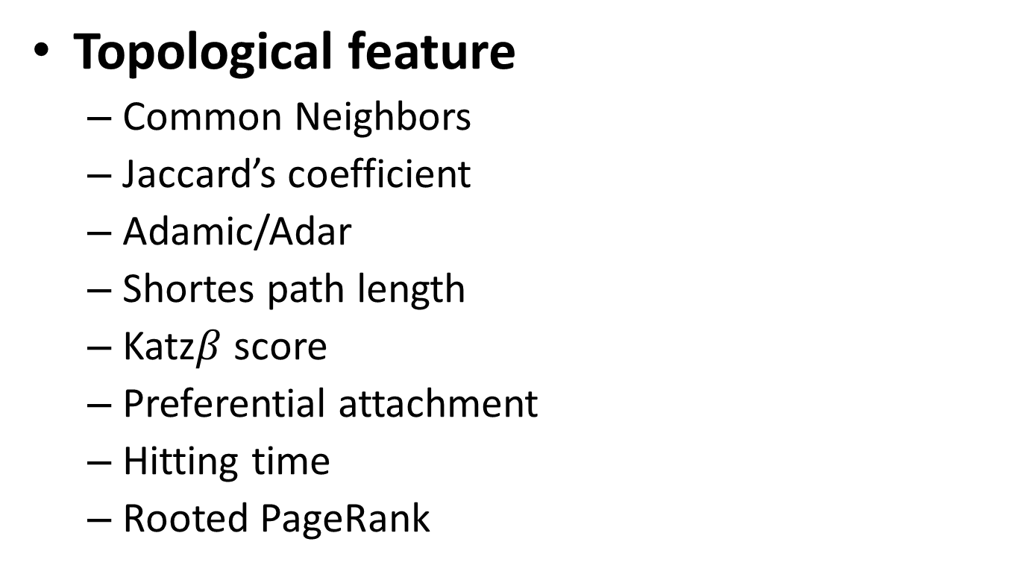
Feature extraction(1)
Topological feature
Common Neighbors
Jaccard’s coefficient
Adamic/Adar
Shortes path length
Katz$β$ score
Preferential attachment
Hitting time
Rooted PageRank

Slide 33
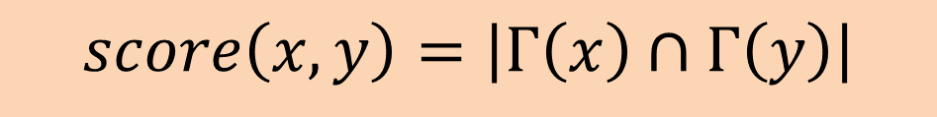
Common Neighbors
The number of common neighbors of node x and y (also be called Edge Embeddedness)
$$score\left(x, y\right)=\left|Γ\left(x\right)∩Γ\left(y\right)\right|$$

Slide 34
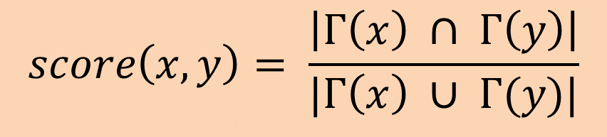
Jaccard’s coefficient
$$score\left(x, y\right)= \frac{\left|Γ\left(x\right) ∩ Γ\left(y\right)\right|}{|Γ\left(x\right) ∪ Γ(y)|}$$
Conceptually, it defines the probability that a common neighbor of a pair of vertices x and y would be selected if the selection is made randomly from the union of the neighbor-sets of x and y .

Slide 35
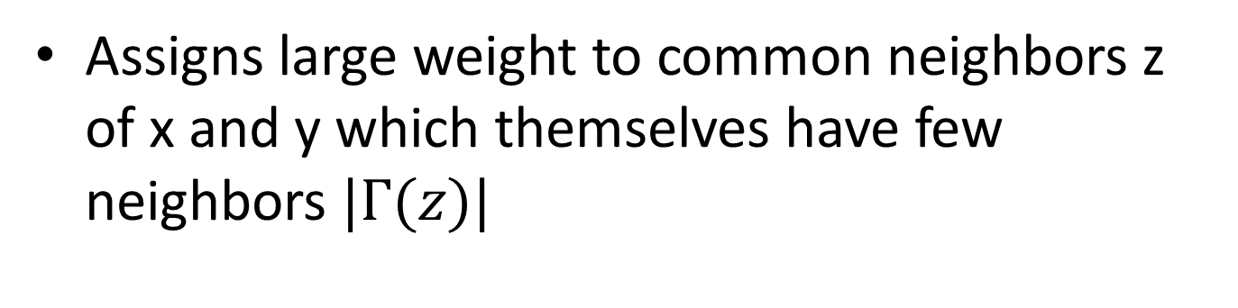
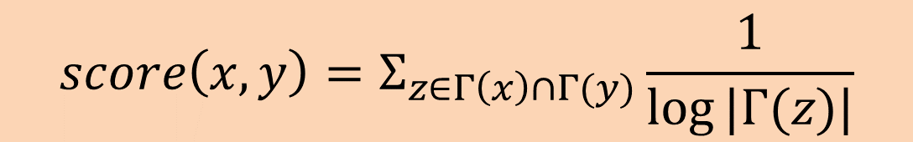
Adamic/Adar
$$score\left(x, y\right)=Σ_{z∈Γ\left(x\right)∩Γ(y)}\frac{1}{log⁡|Γ(z)|}$$
Assigns large weight to common neighbors z of x and y which themselves have few neighbors $|Γ(z)|$

Slide 36
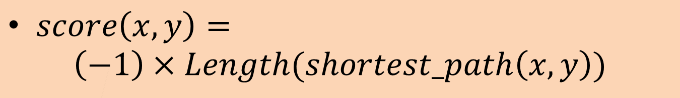
Shortest-Path Length
The length of shortest path from node x to node y
$score\left(x, y\right)=$
$$\left(−1\right)×Length(shortest_path\left(x,y\right))$$

Slide 37
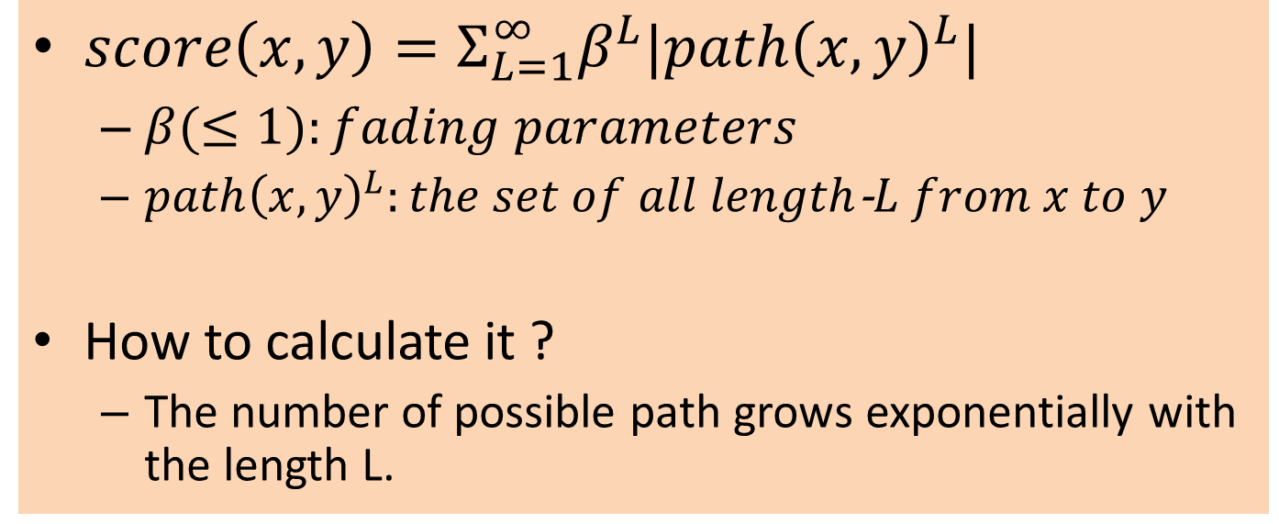

$katz_{β}$ score
Sums over all possible paths between x and y, giving higher weight to shorter paths
$score\left(x, y\right)=Σ_{L=1}^{∞}β^{L}|path{\left(x,y\right)}^{L}|$
$β(≤1):fading parameters$
$path{\left(x,y\right)}^{L}:the set of all length$-$L from x to y$
How to calculate it ?
The number of possible path grows exponentially with the length L.
Katz, Leo. (1953) A new status index derived from sociometric analysis. Psychometrika, 18(1):39-43.

Slide 38

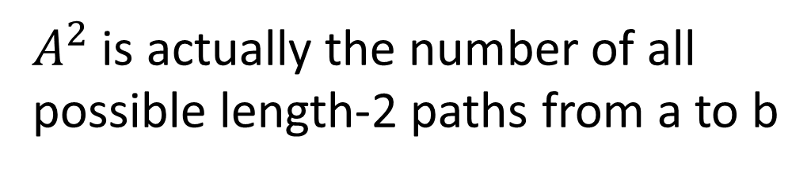

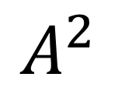


Multiplication of adjacency matrix
1
$A^{2}$ is actually the number of all
possible length-2 paths from a to b
2
5
3
4
$$A$$
$$A$$
$$A^{2}$$
 | 1 | 2 | 3 | 4 | 5
1 | 0 | 0 | 1 | 0 | 0
2 | 0 | 0 | 1 | 0 | 1
3 | 1 | 1 | 0 | 1 | 0
4 | 0 | 0 | 1 | 0 | 1
5 | 0 | 1 | 0 | 1 | 0
 | 1 | 2 | 3 | 4 | 5
1 | 0 | 0 | 1 | 0 | 0
2 | 0 | 0 | 1 | 0 | 1
3 | 1 | 1 | 0 | 1 | 0
4 | 0 | 0 | 1 | 0 | 1
5 | 0 | 1 | 0 | 1 | 0
 | 1 | 2 | 3 | 4 | 5
1 | 1 | 1 | 0 | 1 | 0
2 | 1 | 0 | 0 | 2 | 0
3 | 0 | 0 | 3 | 0 | 2
4 | 1 | 2 | 0 | 2 | 0
5 | 0 | 0 | 2 | 0 | 2
$$×$$
$$=$$
4->3->2, 4->5->2

Slide 39
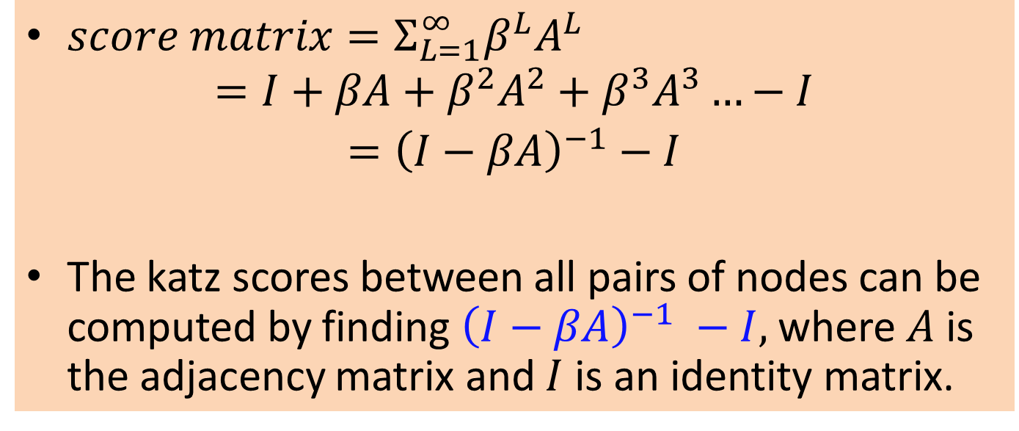

$katz_{β}$ score
$score matrix=Σ_{L=1}^{∞}β^{L}A_{}^{L}$
$$=I+βA+β^{2}A^{2}+β^{3}A^{3}…−I$$
$={\left(I−βA\right)}^{−1}−I$
The katz scores between all pairs of nodes can be computed by finding ${\left(I−βA\right)}^{−1} −I,$where $A$ is the adjacency matrix and $I$ is an identity matrix.

Slide 40
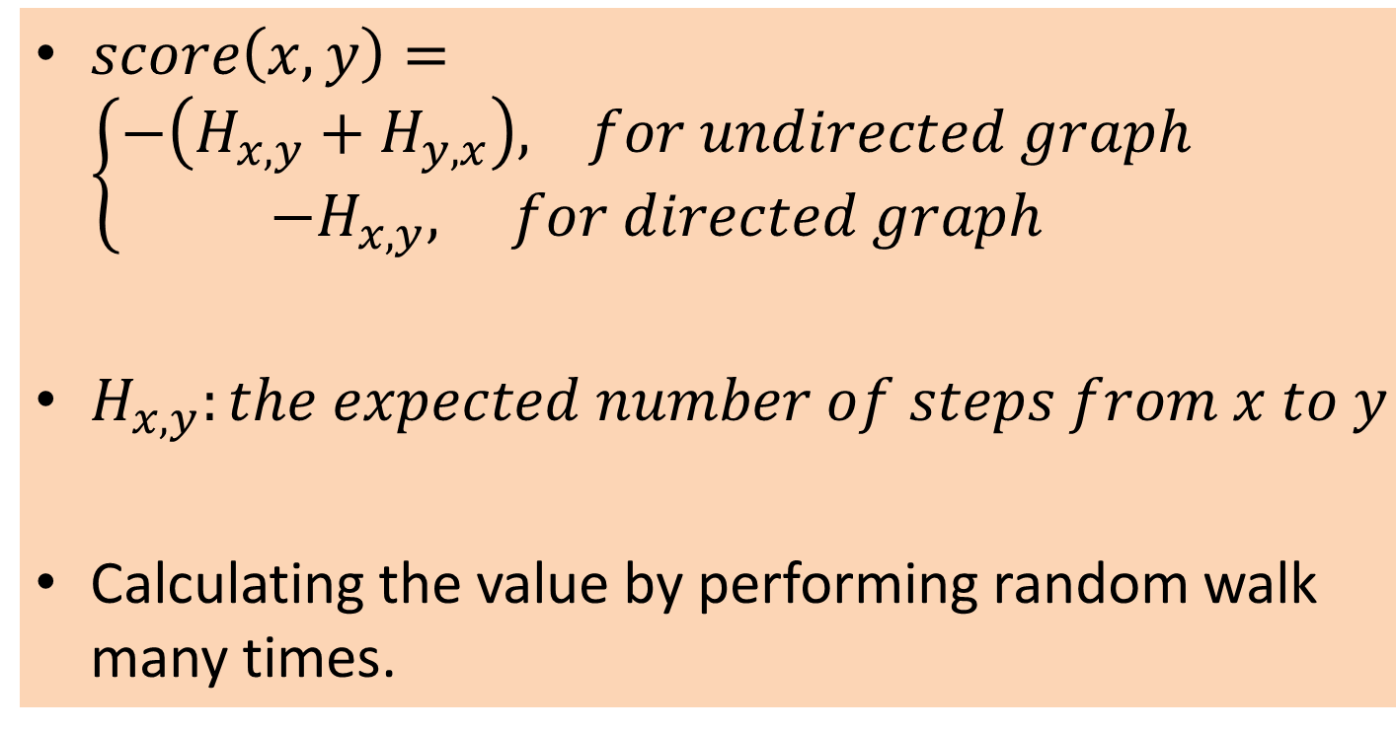
Hitting time
$score\left(x, y\right)=\left\{\begin{aligned}−\left(H_{x,y}+H_{y,x}\right), for undirected graph \\ −H_{x,y}, for directed graph\end{aligned}\right.$
$H_{x,y}:the expected number of steps from x to y$
Calculating the value by performing random walk many times.

Slide 41

Rooted PageRank
$score\left(x, y\right)=$ the stationary distribution weight(probability) of x to y under the following random walk with restart:
If starts from x, each step of random walk has probability $1−α$ to return to x, and $α$ to move to a random neighbor of x.
Stationary distribution: the stable probability distribution after running many (infinite) random walk steps.
Intuition:
The probability that starting from node x to reach node y after infinite steps in random walk.

Slide 42





Random Walk
Let D be a diagonal degree matrix with $D\left[i,j\right]=\sum_{j}{A[i,j]}.$ Let $N=D^{−1}A$ denote the adjacency matrix with row sums normalized to 1.
 | 1 | 2 | 3 | 4 | 5
1 | 0 | 0 | 1 | 0 | 0
2 | 0 | 0 | 1/2 | 0 | 1/2
3 | 1/3 | 1/3 | 0 | 1/3 | 0
4 | 0 | 0 | 1/2 | 0 | 1/2
5 | 0 | 1/2 | 0 | 1/2 | 0
 | 1 | 2 | 3 | 4 | 5
1 | 0 | 0 | 1 | 0 | 0
2 | 0 | 0 | 1/2 | 0 | 1/2
3 | 1/3 | 1/3 | 0 | 1/3 | 0
4 | 0 | 0 | 1/2 | 0 | 1/2
5 | 0 | 1/2 | 0 | 1/2 | 0
$N^{2}$[x,y] is the
probability starting
from x to y for
a 2-step random
walk
$$×$$
$$N$$
$$N$$

Slide 43
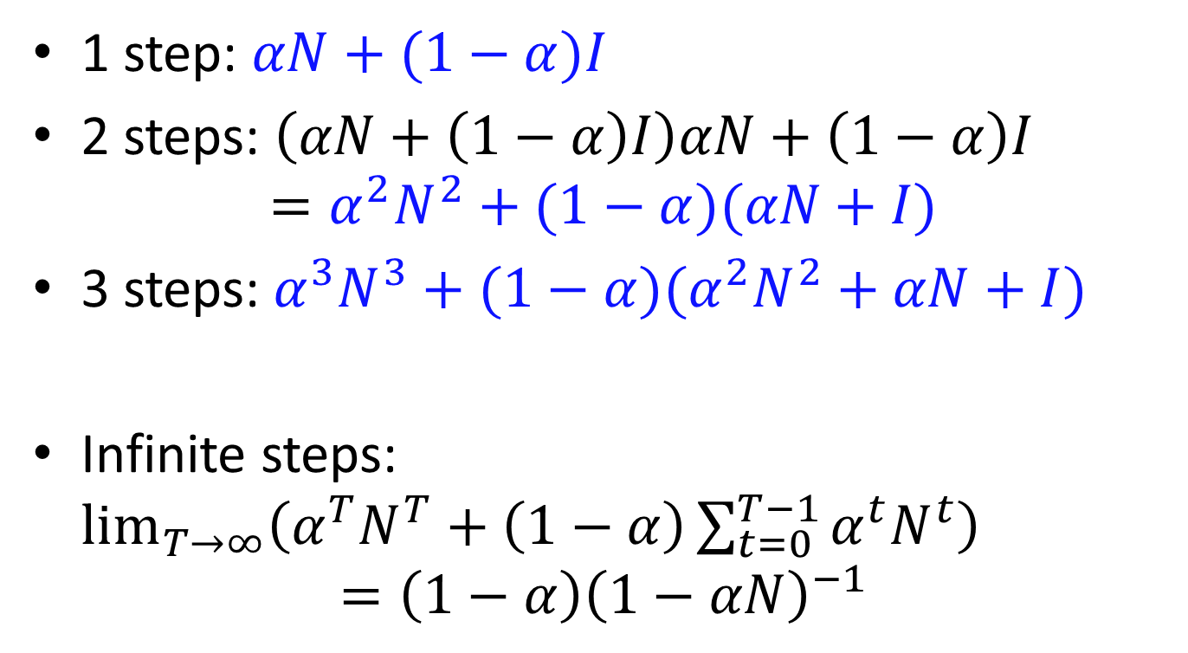
Random Walk with restart
1 step: $αN+(1−α)I$
2 steps: $\left(αN+\left(1−α\right)I\right)αN+\left(1−α\right)I$
$$=α^{2}N^{2}+(1−α)(αN+I)$$
3 steps:$α^{3}N^{3}+(1−α)(α^{2}N^{2}+αN+I)$
Infinite steps: $\lim_{T→∞}\left(α^{T}N^{T}+\left(1−α\right)\sum_{t=0}^{T−1}{α^{t}N^{t}}\right)$
$$=\left(1−α\right){\left(1−αN\right)}^{−1}$$

Slide 44
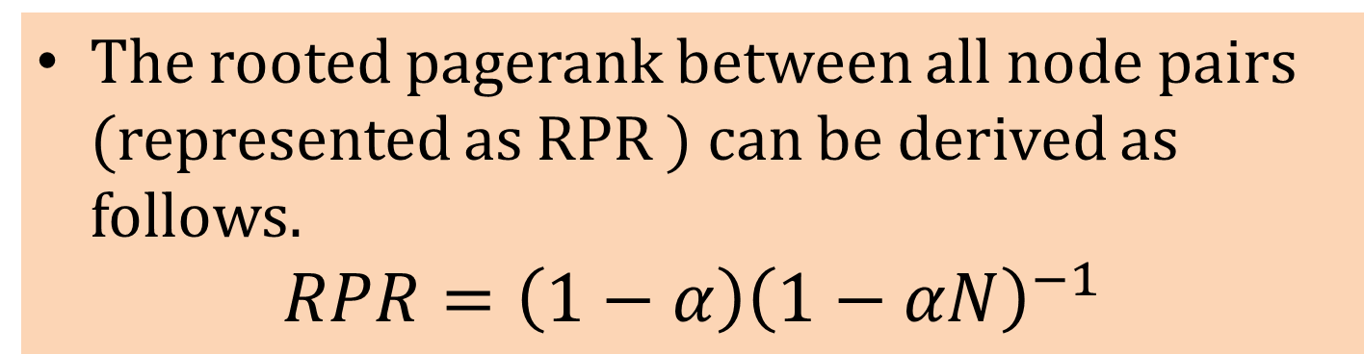
Rooted PageRank
The rooted pagerank between all node pairs (represented as RPR ) can be derived as follows.
$$RPR=\left(1−α\right){\left(1−αN\right)}^{−1}$$

Slide 45
Feature extraction(2)
Preferential Attachment Score
Clustering Coefficient Score
Generic SimRank

Slide 46

Preferential Attachment
$$score\left(x, y\right)=\left|Γ\left(x\right)\right|×|Γ\left(y\right)|$$
Researchers found empirical evidence to suggest that co-authorship is correlated with the product of the neighborhood sizes

Slide 47
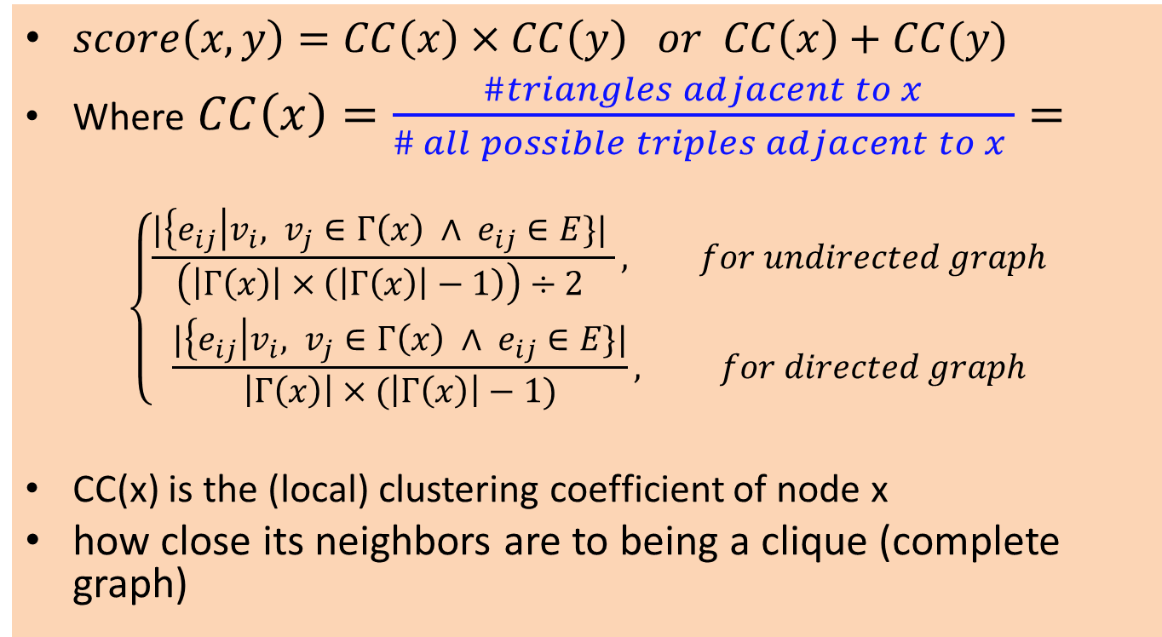
Clustering coefficient
$score\left(x, y\right)=CC\left(x\right)×CC\left(y\right) or CC\left(x\right)+CC(y)$
Where $CC\left(x\right)=\frac{\#triangles adjacent to x}{\# all possible triples adjacent to x }=$
$$\left\{\begin{aligned}\frac{|\left\{e_{ij}\right|v_{i}, v_{j}∈Γ\left(x\right) ∧ e_{ij}∈E\}| }{\left(\left|Γ\left(x\right)\right|×\left(\left|Γ\left(x\right)\right|−1\right)\right)÷2 }, for undirected graph \\ \frac{|\left\{e_{ij}\right|v_{i}, v_{j}∈Γ\left(x\right) ∧ e_{ij}∈E\}|}{\left|Γ\left(x\right)\right|×(\left|Γ\left(x\right)\right|−1)}, for directed graph\end{aligned}\right.$$
CC(x) is the (local) clustering coefficient of node x
how close its neighbors are to being a clique (complete graph)

Slide 48

Clustering coefficient
E.g.
CC($v_{3}$) = $\frac{1 }{\left(3×2\right)÷2}=\frac{1}{3}$
CC($v_{2}$) = $\frac{2 }{\left(3×2\right)÷2}=\frac{2}{3}$
1
2
5
3
4

Slide 49
Extended Graph Formulation
Each kind of node attribute is represented as an additional node.
The original node connects to an additional node if the original node has the attribute.
The additional nodes can connect to themselves based on co-existence of other similarity measurement.
All the feature values can be re-calculated under this formulation.

Slide 50

Generic SimRank
“Two objects are similar if they are similar to two similar objects”
$score\left(x, y\right)=fixed point of similarity\left(x,y\right)$
$$=γ\frac{\sum_{a∈Γ(x)}{\sum_{b∈Γ(y)}{similarity(a,b)}}}{\left|Γ\left(x\right)\right|×|Γ(y)|}$$
Where $γ∈[0, 1]$
Calculate this feature value recursively.

Slide 51

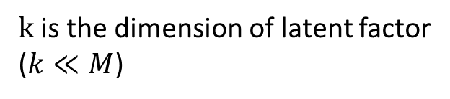




Feature extraction(3)
Latent topological feature
Graph factorization – factorize adjacency matrix into two smaller matrix (low rank approximation)
$$≅$$
$$×$$
$$k×M$$
$$M×M$$
$$M×k$$
$k$ is the dimension of latent factor
($k≪M$)

Slide 52
Feature extraction(4)
Content-based feature
Totally depends on your DATA
There some small tips
Dummy variable (indicator variable)
Scaling

Slide 53
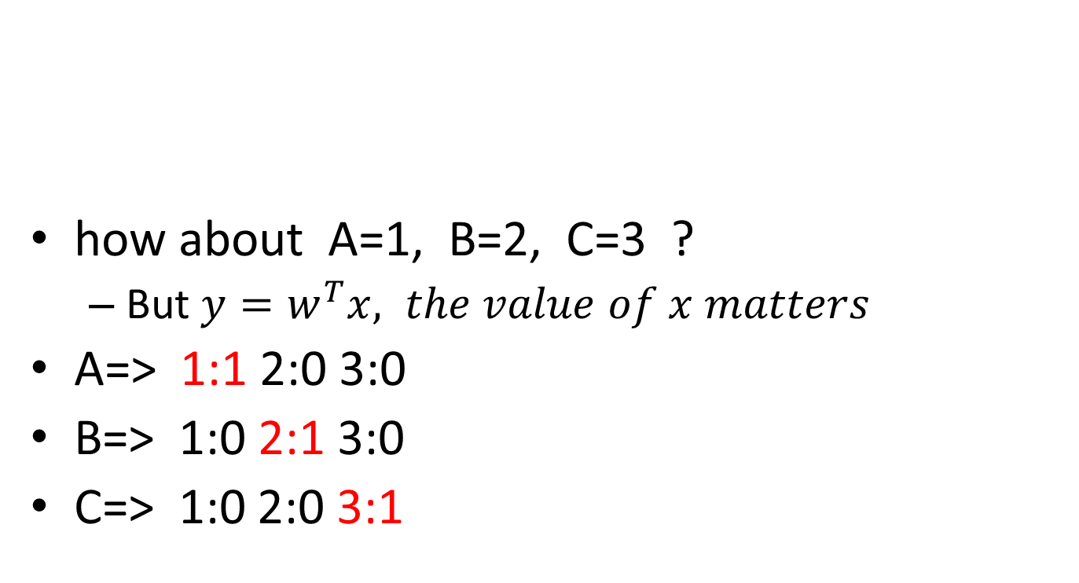
Dummy variable
how about A=1, B=2, C=3 ?
But $y=w^{T}x, the value of x matters$
A=> 1:1 2:0 3:0
B=> 1:0 2:1 3:0
C=> 1:0 2:0 3:1
node | A | B | C
Type | ‘person’ | ‘animal’ | ‘Item’

Slide 54
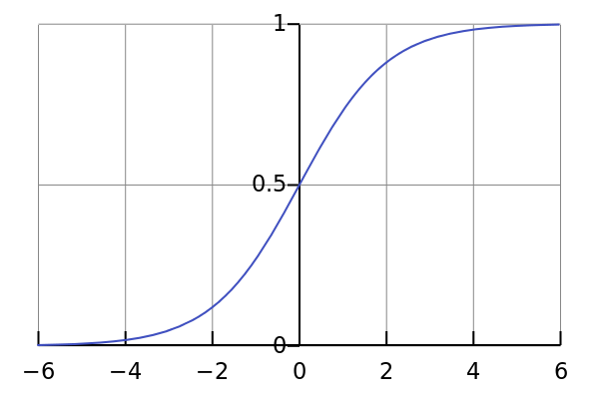
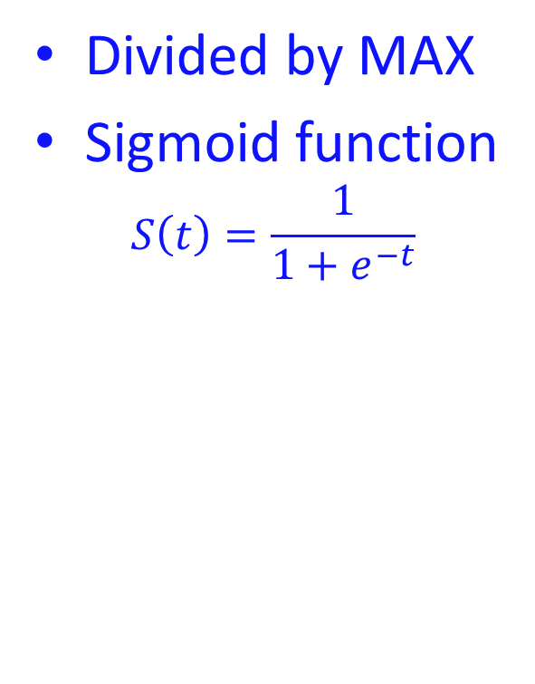
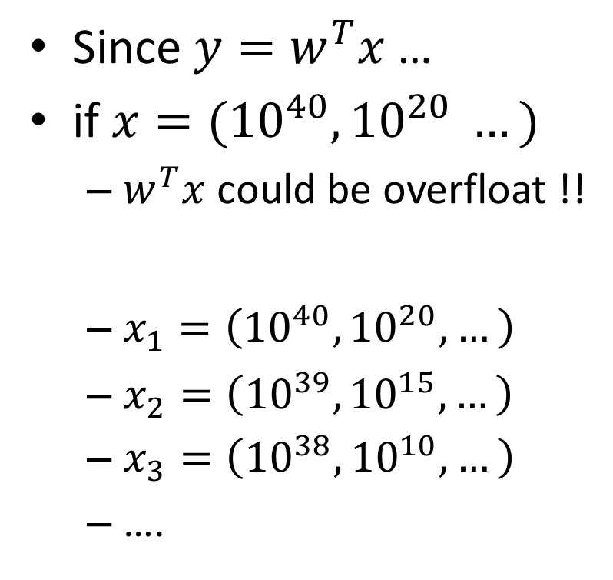
Scaling
Since $y=w^{T}x$ …
if $x=({10}^{40}, {10}^{20} …)$
$w^{T}x$ could be overfloat !!
$x_{1}=\left({10}^{40}, {10}^{20}, …\right)$
$x_{2}=\left({10}^{39}, {10}^{15}, …\right)$
$x_{3}=\left({10}^{38}, {10}^{10}, …\right)$
….
Divided by MAX
Sigmoid function
$$S\left(t\right)=\frac{1}{1+e^{−t}}$$
[-1, 1]
[-1, 1]

Slide 55
Coding Time !
https://github.com/barry800414/sna_tutorial/archive/master.zip

Slide 56
QA & Discussion

