Slide 1
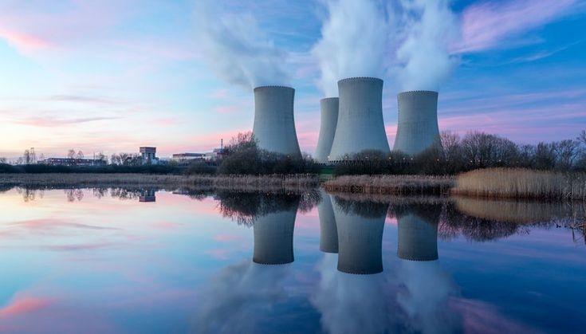

STUDENTS OF
DR.MGR EDUCATIONAL AND RESEARCH INSTITUTE

Slide 2

PROBLEM STATEMENT
Location Selection Based on Spatial Demand and Risk Minimization
Peak Demand Synchronization Challenge
Environmental and Safety Impact Analysis
Public Acceptance
Slow Nuclear Expansion due to acquiring
necessary clearances and land acquisition issues.
India operates 22 nuclear reactors and aims to
increase its nuclear capacity to 13.08 GWe by 2029
with seven new reactors. this growth is hindered by
regulatory challenges, land acquisition issues, and
reliance on international nuclear agreements,
exacerbated by sanctions following
India’s nuclear tests.
INDIA TODAY
INDIA BRIEFING
CAPS INDIA

Slide 3
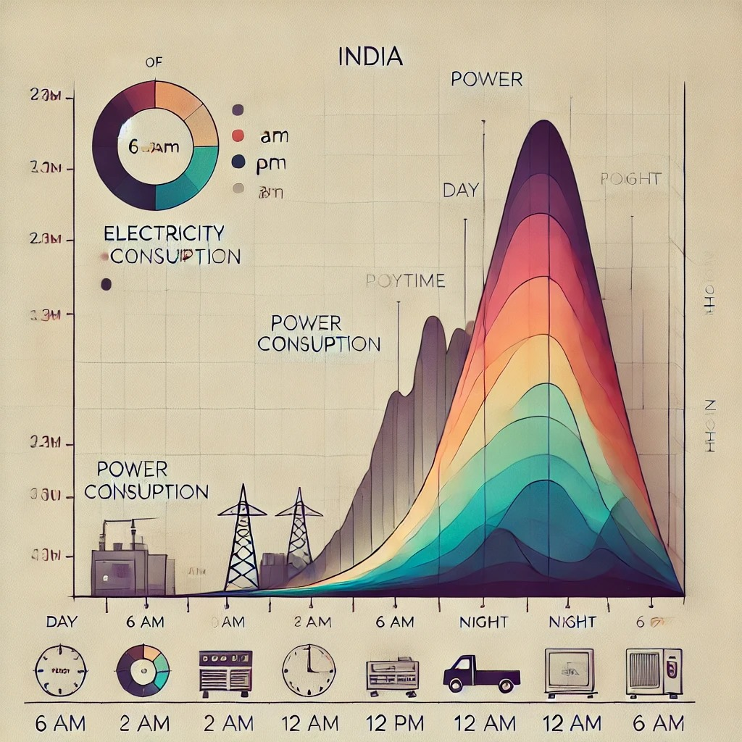
OUR OBJECTIVE
In order to demonstrate the good effect of the release
A 4D proposal for the efficient and reliable placement and operation of a nuclear power plant (NPP) in India involves the following:
3D Component (Spatial Arrangement)
+1D Component (Time Frame)
AIM TO CREATE A WEBSITE WHICH MONITERS & ANALYSIS THE DATA BASED TO THE SECTOR OF,
Ecological and Geological Sustainability
Population Density
Water Proximity
Daytime and nighttime power consumption,
along with population density checks, is essential to
accurately predict the amount of power required to
meet demand across different periods.

Slide 4
UNIQUE VALUE PROPOSITION
Technological innovation
1
3
Add content
Intelligent Site Selection Based on Ecological, Geological, and Population Factors
Population Density and Safety Zone Management
2
Add
Comprehensive Transportation and Infrastructure Analysis for NPP Accessibility
4
Dynamic Power Consumption Analysis for Day/Night Energy Usage Optimization

Slide 5

SDG GOALS
the good effect of the release
07
Affordable and Clean Energy
13
Climate Action
09
Industry, Innovation, and Infrastructure
12
RESPONSIBLE CONSUMPTION AND PRODUCTION

Slide 6
THANKYOU !
so much for your interest and attention.

