Slide 1
R Markdown

Slide 2
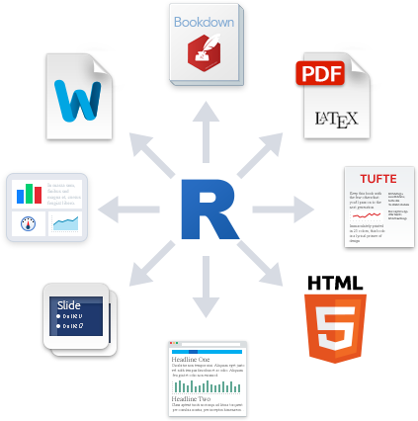
What is Markdown
Markdown is a simple formatting syntax for authoring HTML, PDF, and MS Word documents
Notes:
More formats have been added including slideshows,

Slide 3
WHY use R Markdown
Reproducible record of your work
Notebook interface - Weave together narrative and code
Produce interactive documents dynamically
With Github Pages you can easily publish your projects from your github repository (if your organization allows)
Notes:
Interactive documents can contain charts, tables and maps that you can interact with
Producing them dynamically means you can create cyclical reports quickly, easily and consistently

Slide 4
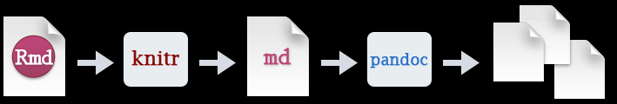
How it works
Notes:
Creating documents with R Markdown starts with an .Rmd file that contains a combination of markdown (content with simple text formatting) and R code chunks. The .Rmd file is fed to knitr ⧉, which executes all of the R code chunks and creates a new markdown (.md) document which includes the R code and it’s output.
The markdown file generated by knitr is then processed by pandoc ⧉ which is responsible for creating a finished web page, PDF, MS Word document, slide show, handout, book, dashboard, package vignette or other format.
This may sound complicated, but R Markdown makes it extremely simple by encapsulating all of the above processing into a single render function. Better still, RStudio includes a “Knit” button that enables you to render an .Rmd and preview it using a single click or keyboard shortcut.

Slide 5
Installing
Like the rest of R, R Markdown is free and open source.
You can install the R Markdown package from CRAN with:

Slide 6
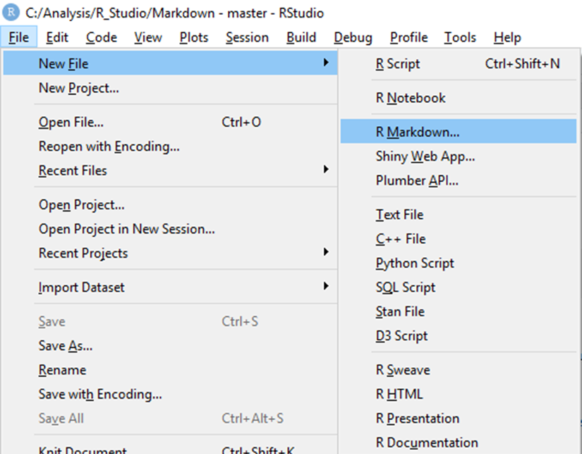
Create a new R markdown document
Markdown documents are created using File> New File>R Markdown

Slide 7
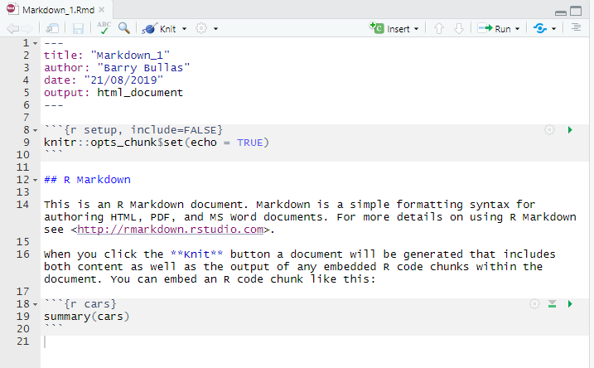
Document structure
YAML header
Text
Code
Notes:
YAML Header is optional
Text can be formatted using markdown, for example the two hashes before the R Markdown format it as a level 2 header
Code chunks are the grey section

Slide 8
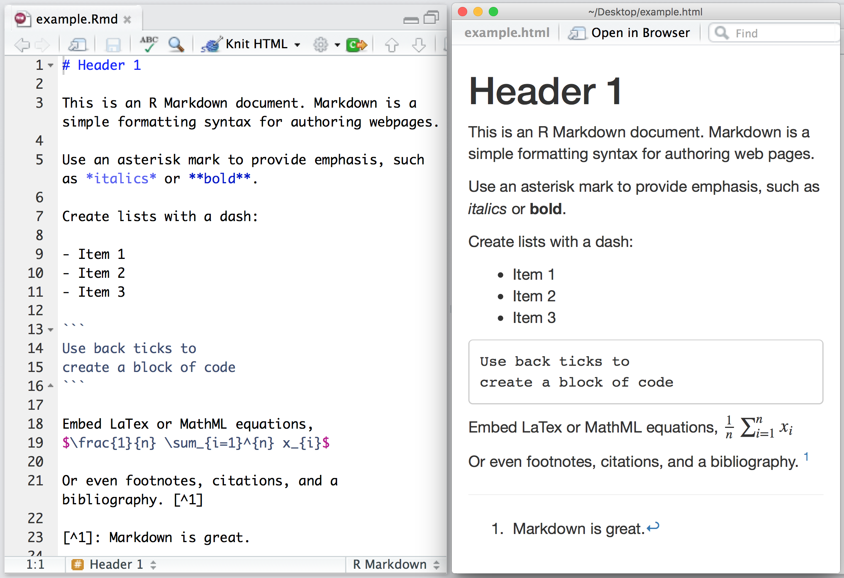
Markdown basics

Slide 9
Headers
# Header 1 | Header 1
## Header 2 | Header 2
### Header 3 | Header 3
#### Header 4 | Header 4
##### Header 5 | Header 5
###### Header 6 | Header 6

Slide 10
Text formatting
Plain text
*italics*
**bold**
~~strikethrough~~
* unordered list
+ sub-item 1
+ sub-item 2
sub-sub-item 1
* item 2
Plain text
Italics
Bold
Strikethrough
unordered list
sub-item 1
sub-item 2
sub-sub-item 1
item 2
Notes:
Many of the Heading/list items need a carriage return before/after or both in order for them to work.
It can be a little fiddley to start with

Slide 11

Links & images
<Hyperlink text>
[link](www.rstudio.com)
image:
![Caption](smallorb.png)
Hyperlink text
Image:
Caption

Slide 12
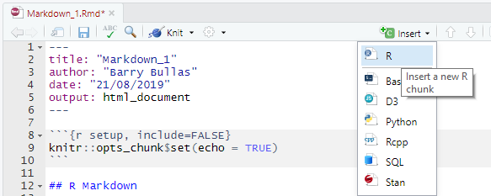
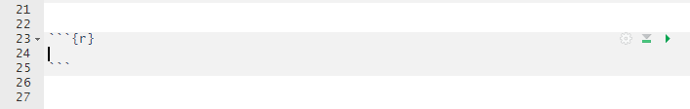
Code chunks
New code chunks are added using the insert menu
Code chunk starts and ends with three backticks
{r} can be expanded to include additional options
Notes:
Code can be added in several different languages (SQL, Python, R, D3…)
First code chunk is a good place to do initial setup, loading of libraries etc

Slide 13
Code chunk options
include = FALSE prevents code and results from appearing in the finished file. R Markdown still runs the code in the chunk, and the results can be used by other chunks.
echo = FALSE prevents code, but not the results from appearing in the finished file. This is a useful way to embed figures.
message = FALSE prevents messages that are generated by code from appearing in the finished file.
warning = FALSE prevents warnings that are generated by code from appearing in the finished.
fig.cap = "..." adds a caption to graphical results.
Notes:
More options are available in the Markdown guide

Slide 14
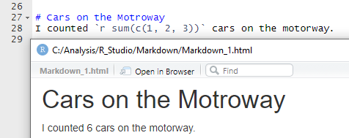
Inline code
You can use code in the text of your document using inline code.
Inline code starts with `r and ends with a `

Slide 15
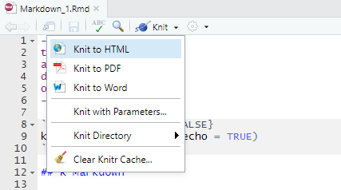

Render
When using R Studio the quickest way to render your document is to use the Knit button.
Alternatively you can render using code

Slide 16
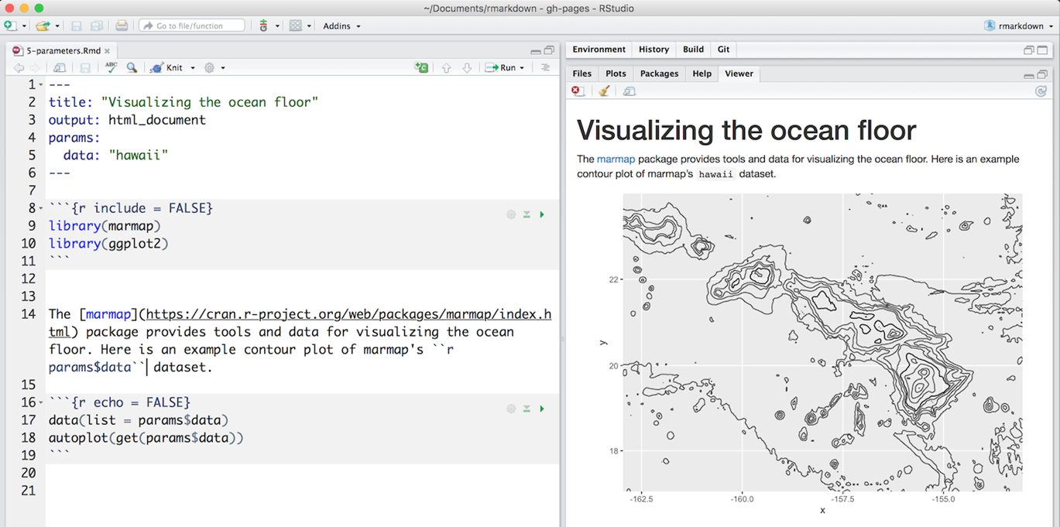
parameters
Notes:
R Markdown documents can include one or more parameters whose values can be set when you render the report.
The example uses a data parameter that determines which data set to plot.

Slide 17
Guidance
The R Markdown Cheatsheet
The R Markdown Reference Guide
The R Markdown Quick Tour
Github Pages

Slide 18
Markdown Example
This project explains how to use vis network diagrams
Repo: https://github.com/faisal-samin/visnetwork-demo
Published page: https://faisal-samin.github.io/visnetwork-demo/markdown.html
Notes:
This project uses a table of contents, Data Table and Visnetwork diagram

