Slide 1
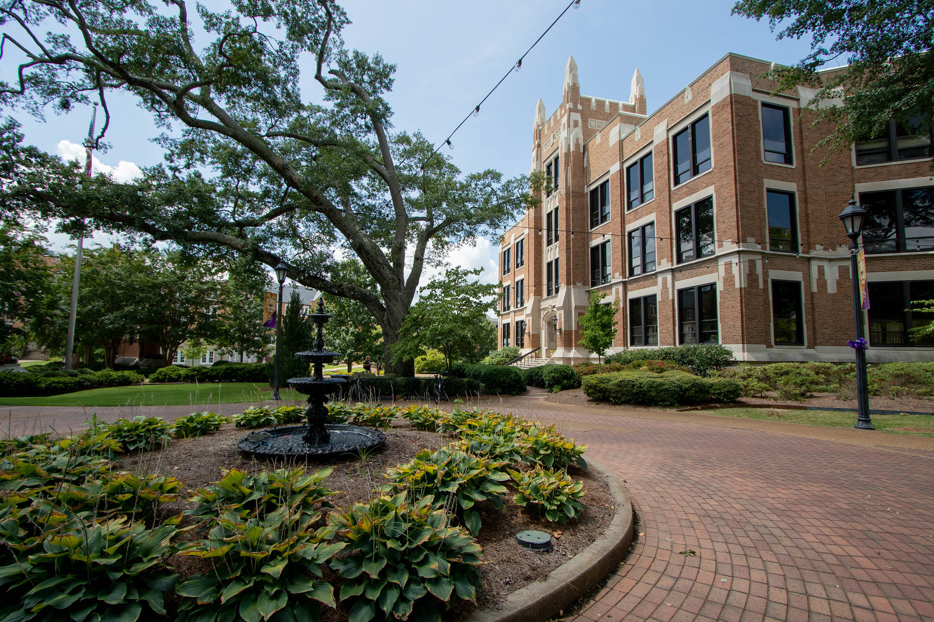

Incorporating the Student Perspective in Designing a Virtual Team Classroom Environment:
An Elaborated Action Design Science Research Approach
19 JAN 2022
DRS. KUTZ & CUMBIE
Notes:
Font for White title: Avenir Next Medium
Font for Yellow Subtitle: Playfair Display
Slide Transitions: Fade set to 1.50 duration by mouse click and “apply to all” slides
Colors: Purple is HEX#4B298A , Yellow is HEX#DB9F11

Slide 2

Brief Overview
Teaching
FOCUS
Suboptimal student team experiences for
instructors & students; the teamwork dilemma
GAP
Instructor-driven pedagogical approaches often overlook the student voice
APPROACH
Elaborated Action Design Science Research Approach to formulated a collaborative virtual team environment
Team Memes

Slide 3
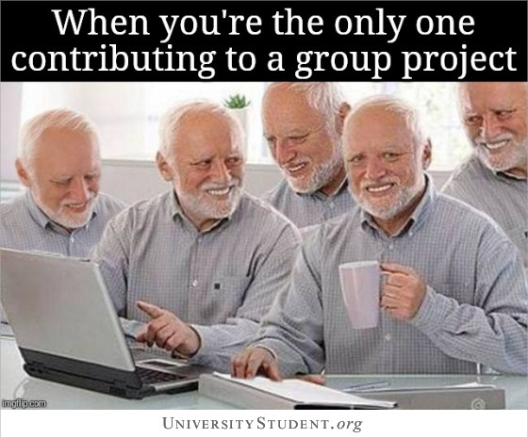

Slide 4
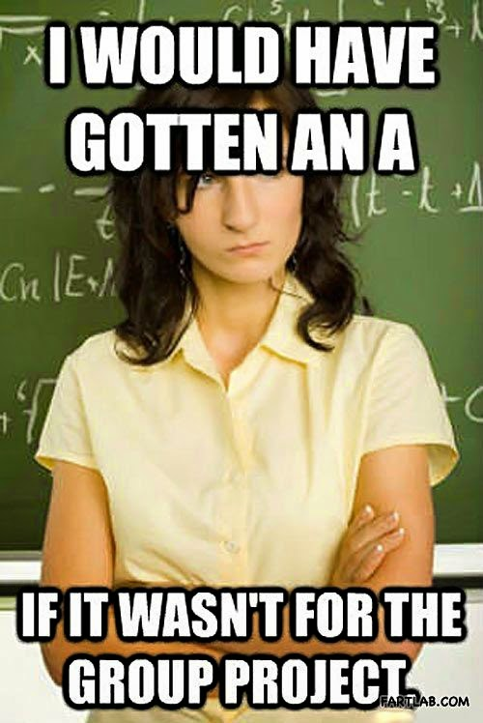

Slide 5
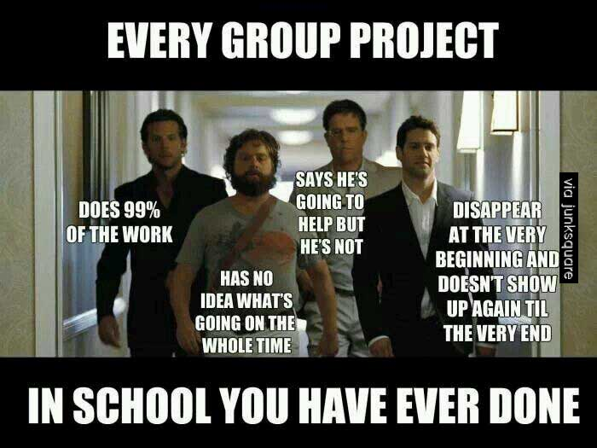

Slide 6
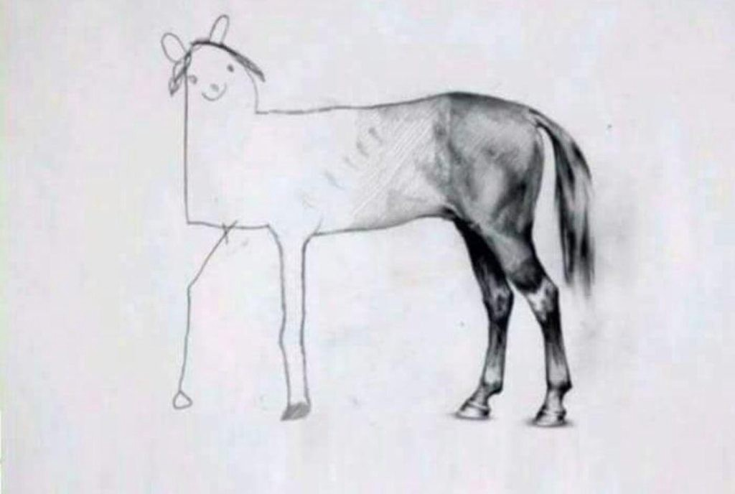

Slide 7
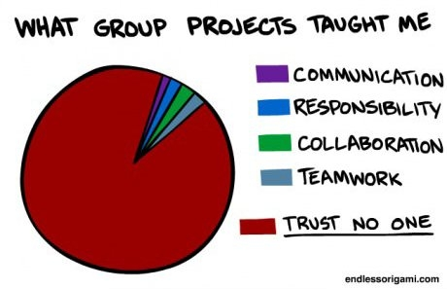

Slide 8
Importance of Teams
Emphasis on Virtual
Highly-sought skill
“ability to work in a team” = 2nd highest-rated skill sought by employers (NACE, 2019)
unchanged since 2016 (Morgan & Stewart, 2017)
Pandemic-driven work-from-home and virtual team structures
(Al-Jallad, 2020)
Therefore: imparting virtual team experience is paramount in higher-education

Slide 9
Background & Approach
TEAM-BASED RESEARCH
Instructor-Driven Team Pedagogical Interventions
Virtual Team Development
Virtual Student Team Development
ELABORATED ACTION DESIGN SCIENCE RESEARCH APPROACH

Slide 10
Instructor-Driven Team Pedagogical Interventions
DSJIE’s 1st article:
500 students in 130 teams found that small teams, balanced by cumulative GPA, with an emphasis on graded peer evaluations, are effective teaching strategies to promote effective student teams.
GOAL: goal to “...provide guidance to instructors in creating a cooperative learning environment for students” (p. 16).
(Koppenhave & Shrade, 2003)
Tradition: instructor-driven pedagogical interventions followed by assessing the outcomes on some facet of the team concept

Slide 11
Global Teams
Self-Organized Teams
A study of 110 students (48 U.S. and 62 French) in 22 self-organized global teams reported the majority of students experienced positive learning outcomes and offered propositions covering
managed expectations,
conflict, satisfaction,
team outcomes,
communication, and
prior experience, as well as recommendations for forming global teams covering team formation, communication, and conflict management
(Bartel-Radic, Moos, & Long, 2015)

Slide 12
Team Decision Quality
Wiki Technologies
Wiki technologies in student teams,
the control group (195 students in 49 teams) outperformed
the treatment group (190 students in 48 teams),
Wiki technology may inhibit team performance
Yet could lead to higher collaborative decision quality
(Heidrich, Kása, Shu, & Chandler, 2015)

Slide 13
Team Formation
Web-based tool
Recognizing the perennial issues of assessing individual efforts in student team submissions,
Related a pedagogical design & efficiency improvement process:
Web-based tool to form teams and track individual contributions
(Morgan & Stewart, 2017)

Slide 14
Team Trust
Mobile Apps
Gap of mobile apps among research of technology-driven team development:
273 students in 54 teams explored real-time group feedback via a researcher-created mobile app
Empirical support for greater team trust and team commitment associated with the use of the app
(Blau, Petrucci, Rivera, & Ghate, 2019)

Slide 15
Team Cohesion
Gamification
Team-based gamification in online learning environment:
187 students working in teams
Students’ perceived team cohesion is an important predictor of
concentration,
perceived control, and
perceived enjoyment
(Zhao, Srite, Kim, & Lee, 2021)

Slide 16
Team Formation
Decision Support System
Team: important but challenges of forming fair teams:
Use of a team formation decision support system
Teams formed using this system outperformed teams created by a subject matter expert
(Bergey & King, 2014)

Slide 17
Team-Based Research
Summary
Pedagogical interventions are instructor-originated and produced.
Created themselves / informed by theory or experience
Enacted solutions to achieve learning objectives and improve the total student and team experience
Half of the equation?
In the area of peer evaluations, the student perspective was recognized as underreported (Jassawalla & Sashittal, 2017)
In the area of team development, the student perspective is also underreported.

Slide 18
Research Background
TEAM-BASED RESEARCH
Instructor-Driven Team Pedagogical Interventions
Virtual Team Development
Virtual Student Team Development
ELABORATED ACTION DESIGN SCIENCE RESEARCH APPROACH

Slide 19
Virtual Team
Prominence
Increasingly, teams break traditional
geographical,
temporal, and
relational boundaries
as facilitated by ICT
(Martins, Gilson, & Maynard, 2004)
Nearly 80% of knowledge works…
In a 2014 study, 79% of 1,700 knowledge workers reported that they “always” or “frequently” work in dispersed teams
(Ferrazzi, 2014)

Slide 20
Team Development
Formal
Team Development
Formal efforts to modify existing processes
Tuckman’s (1965) team development model
forming
storming (tension of task-recognition)
norming
performing

Slide 21
Team Building
Informal / Relationships
Team Building
Informal process initiated by the members to establish social structures and work processes effective for the team (Kozlowski and Ilgen (2006).
Continuous process over the team’s life (Bell & Kozlowski, 2002)
Relationship building during the forming phase:
Up front attention, shorter subsequent phases
Relationship factors = the “glue” that bond team members to each other (Hackman, 1992)

Slide 22
Virtual Teams
Unique Challenges
Virtual teams face different challenges than in-person, co-located teams:
including varying leadership skills (Pauleen, 2003)
and other methods of building trust (Ferrazzi, 2012)

Slide 23
Team Relationships
Unique Challenges
Team Relationship Building:
Goal-setting, developing interpersonal relations, clarifying roles, and employing problem-solving techniques.
Naturally progress in co-located teams, spontaneous interaction
(Aga, Noorderhaven, and Vallejo, 2016)
Must actively develop in virtual teams (Liao, 2017)
Communication & Coordination-Focused Tech
➔ virtual team trust
Via fulfilled commitments, vulnerability, acting for the collective good of the team, sharing personal values and experiences, and frequent communication.
(Ferrell and Kline, 2018)

Slide 24
Research Background
TEAM-BASED RESEARCH
Instructor-Driven Team Pedagogical Interventions
Virtual Team Development
Virtual Student Team Development
ELABORATED ACTION DESIGN SCIENCE RESEARCH APPROACH

Slide 25
Student Team Development
Team Context: Organizational ≠ Student
Notable differences are
project duration - academic term vs. market-driven
time allocation - class time vs. full-time job obligation
scheduling - presence of dedicated work block
cultural - organizational onboarding or not)
ingrained standards - assignment instructions vs. enforced company policy
motivation - optimal effort for grade vs. long-term job and career performance)
authoritative roles - egalitarian and emergent vs. structural
cheating - plagiarism vs. encourage reuse
performance and evaluation - hypothetical vs. actualized
implications and consequences - constrained to a course and program vs. career shaping and impact to livelihood

Slide 26
Research Background
TEAM-BASED RESEARCH
Instructor-Driven Team Pedagogical Interventions
Virtual Team Development
Virtual Student Team Development
ELABORATED ACTION DESIGN SCIENCE RESEARCH APPROACH

Slide 27
Design Science Research
DSR
Solving wicked problems, where solution/problem domain are poorly understood
(Hevner, March, Park, & Ram, 2004)
Enhance human knowledge with the creation of innovative artifacts
Artifacts embody ideas, practices, technical capabilities, and products through which systems can be efficiently developed and effectively used
Artifact creation relies on existing laws and theories that are applied, tested, modified, and extended through the experience, creativity, intuition, and problem-solving capabilities of the researcher.
(Hevner et. al., 2004; Gregor & Hevner, 2013; Sein, Henfridsson, Purao, Rossi, & Lindgren, 2011; Mullarkey & Hevner, 2019)

Slide 28
Action
DSR ➔ ADSR
IS and IT are enhanced socio-technical systems often result from an iterative approach to the build and evaluation of multiple alternatives
(Gregor & Hevner, 2013)
Action DSR:
conducted in situ with participants
of the socio-technical system and
ideal for reciprocal shaping and mutually influential roles
(Sein et al., 2011)

Slide 29
Elaborated
ADSR ➔ eADSR
The Elaborated Action DSR (eADSR) method:
Guides the emergent design of artifacts.
Systematic iterate through a system, process, product, or service
Diagnosis
Design
Implementation
Evolution (next cycle)
(Mullarkey & Hevner, 2019),

Slide 30
Co-creation
eADSR
Traditionally:
companies engaging with end-users in value-creation activities
(Von Hippel, 1987)
A point-of-exchange between companies and consumers
(Prahalad & Ramaswamy, 2002)
End-user consumers take on specific company activities
(Voorberg, Bekkers, & Tummers, 2015)
Value-creation be for some or all participants
(Grönroos, 2012).

Slide 31
Virtual Student Teams
An eADSR Approach
DSR is problem-solving process in a dynamic context to address sticky, wicked problems
Action DSR denotes close interaction with participants of a socio-technical system
eADSR allows for exploration into non-obvious diagnoses of recurring problems & co-creation of design solutions of the socio-technical system
Optimizing learning using student teams is context-dependent and is accompanied by a set of difficult problems
The virtual collaborative team environment for student teams. Relies on IT from comm and content-production; touchpoints of social interactions
Pedagogical designs implemented & evaluated; lead to continual, cyclical re-diagnoses

Slide 32
ELABORATED ACTION DESIGN SCIENCE RESEARCH APPROACH
eADSR Cycle One
eADSR Cycle Two
DIAGNOSIS
DIAGNOSIS
DESIGN
DESIGN
IMPLEMENTATION
IMPLEMENTATION

Slide 33

eADSR Cycle One
eADSR Cycle One
Diagnosis, Design, & Implementation Phases
DIAGNOSIS
DESIGN
Goals:
Improve virtual student team collaboration
Create transparency for student team interactions
Initially informal trial and error process
Courses:
Undergraduate Project Management course
Face-to-face and online
Graduate Project Management courses
Graduate Leadership & Team Building Course
IMPLEMENTATION
eADSR Cycle Two
DIAGNOSIS
DESIGN
IMPLEMENTATION

Slide 34
eADSR Cycle One
eADSR Cycle One
Problem Diagnosis
DIAGNOSIS
DESIGN
Divide and conquer rather than collaboration
Copy/paste individual parts and submit as team effort
Morgan and Steward (2017) – integration by stapler
Results:
Team conflict
Missed deadlines
Low satisfaction with teamwork
Disjointed project submissions
Poor team performance
Lack of real-world experience of collaboration and virtual teamwork
IMPLEMENTATION
eADSR Cycle Two
DIAGNOSIS
DESIGN
IMPLEMENTATION

Slide 35
eADSR Cycle One
eADSR Cycle One
Problem Diagnosis
DIAGNOSIS
DESIGN
IMPLEMENTATION
Initial solution attempts included:
Initial video conference meeting intended to
Build team relationships
Engender team development
Results
Impatient, frustrated students
Post meeting minutes of all collaborative meetings
Provide transparency on team collaboration
Results
Forced collaboration
Limited details shared
eADSR Cycle Two
DIAGNOSIS
DESIGN
IMPLEMENTATION

Slide 36
eADSR Cycle One
Problem Diagnosis
More holistic approach is necessary
Conceptual Design Artifact developed

Slide 37
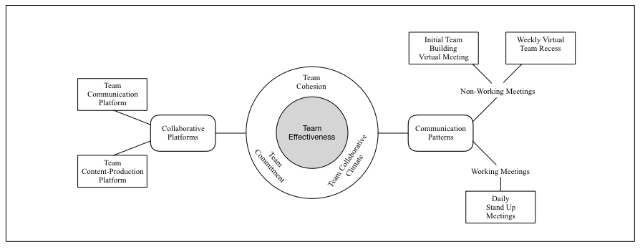
Conceptual Design Artifact
Measurements based on Huang et al,. 2003)

Slide 38
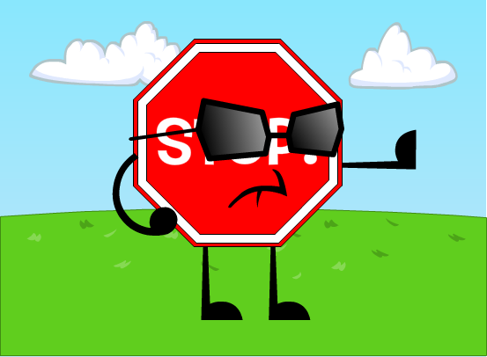
eADSR Cycle One
Problem Diagnosis
Instructor driven interventions have not led to past success
Why try the same approach and expect different results?
Solution: Incorporate the student voice
This Photo by Unknown Author is licensed under CC BY-NC

Slide 39
eADSR Cycle One
eADSR Cycle One
Co-Created Design
DIAGNOSIS
DESIGN
IMPLEMENTATION
Iterative Design Process
Course: Leading High-Performance Teams
Learning goal – building effective teams
Student Teams each iterated on one of the six design components
Created
Instantiated Design Artifact
aka - Virtual Team Classroom Environment
eADSR Cycle Two
DIAGNOSIS
DESIGN
IMPLEMENTATION

Slide 40
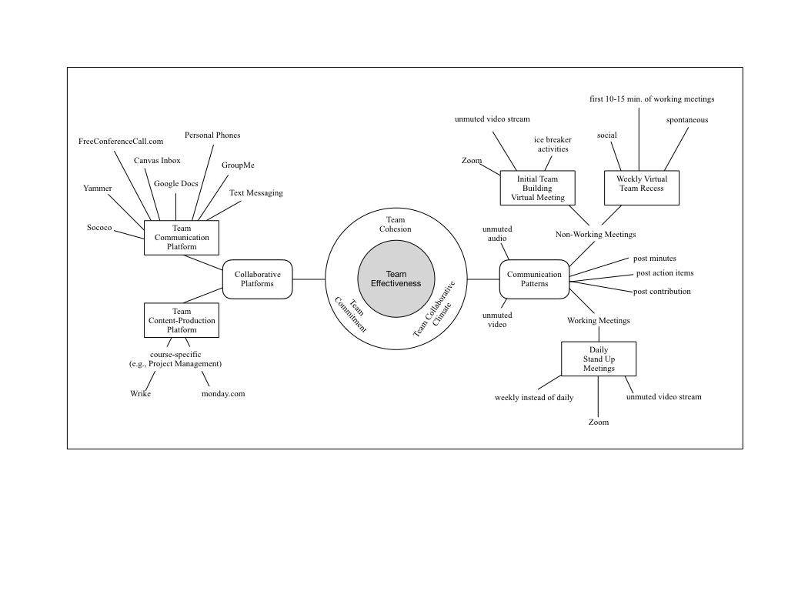
Instantiated Design Artifact
Notes:
Initial Team Building Video Conference Meeting
Ice breakers
Zoom
Unmuted video and audio stream
General conversation
Weekly Virtual “Standup” meetings
Weekly instead of daily to meet course goals
Three Questions
What was done during the past week
What is planned to be done in the upcoming week
What issues may hinder progress
Weekly Team Recess
10-15 minutes at beginning of a working meeting to just chat
social
Team Communication Patterns
Don’t mute audio or video feeds, except briefly for background noise
Post detailed meeting minutes
Post team member contributions
Post action items and next steps

Slide 41
Instantiated Design Artifact
Component | Recommendation
Basic Message / Text Communication | GroupMe
Email | Canvas Course Platform
Phone – Person to person | Cell Phones
Phone – Conference Call | Freeconferencecall.com
Video Conference | Zoom
Document Control & Change Revision Tracking | Google Docs
Virtual Water Cooler | Yammer or Sococo
Content-Production Collaborative Platform (course specific)
Project Management – Wrike or Monday.com
Notes:
Initial Team Building Video Conference Meeting
Ice breakers
Zoom
Unmuted video and audio stream
General conversation
Weekly Virtual “Standup” meetings
Weekly instead of daily to meet course goals
Three Questions
What was done during the past week
What is planned to be done in the upcoming week
What issues may hinder progress
Weekly Team Recess
10-15 minutes at beginning of a working meeting to just chat
social
Team Communication Patterns
Don’t mute audio or video feeds, except briefly for background noise
Post detailed meeting minutes
Post team member contributions
Post action items and next steps

Slide 42
eADSR Cycle One
eADSR Cycle One
Implementation
DIAGNOSIS
DESIGN
IMPLEMENTATION
Implemented in MBA Project Management course
Effectiveness evaluated pre-post test
Results
92% (N=81) students completed both pre-post survey
Results - not normally distributed
Wilcoxon Signed-Rank test used
Nonparametric equivalent of dependent t-test
eADSR Cycle Two
DIAGNOSIS
DESIGN
IMPLEMENTATION

Slide 43
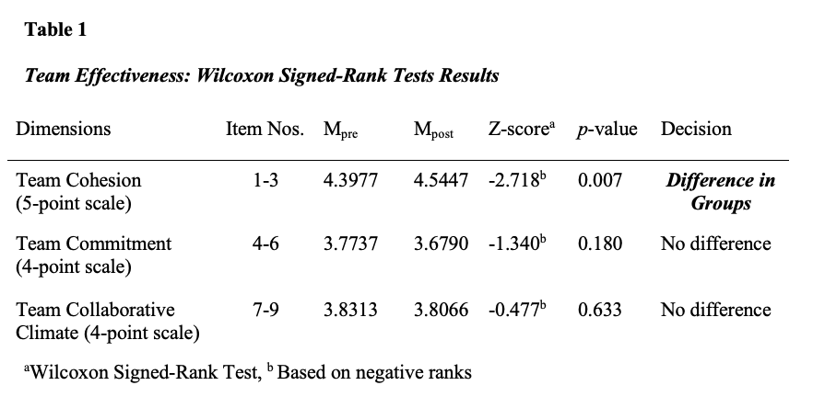

Slide 44
eADSR Cycle One
Implementation
Statistically significant improvement in team cohesion
Exploratory
Lacking structured hypothesis and experimental controls
Additional improvements
Transparency

Slide 45
eADSR Cycle Two
eADSR Cycle One
Diagnosis, Design, & Implementation Phases
DIAGNOSIS
DESIGN
IMPLEMENTATION
Continuous improvement
Revisit Instantiated Design Artifact
eADSR Cycle Two
DIAGNOSIS
DESIGN
IMPLEMENTATION

Slide 46
eADSR Cycle Two
eADSR Cycle One
Problem Diagnosis
DIAGNOSIS
DESIGN
IMPLEMENTATION
Variety of technologies / tools
Confusion
Disjointed
Start-up bulky
Tools not under the auspices of the university
Some not available to all students
Example - Group me is restrictive for use by international students
eADSR Cycle Two
DIAGNOSIS
DESIGN
IMPLEMENTATION

Slide 47
eADSR Cycle Two
eADSR Cycle One
Co-Created Design
DIAGNOSIS
DESIGN
IMPLEMENTATION
Considered Student Perspective
Reviewed course evaluations
Considered Technology Available
Microsoft Teams
Re-instantiated Design Artifact
Virtual Team Collaborative Environment
eADSR Cycle Two
DIAGNOSIS
DESIGN
IMPLEMENTATION

Slide 48
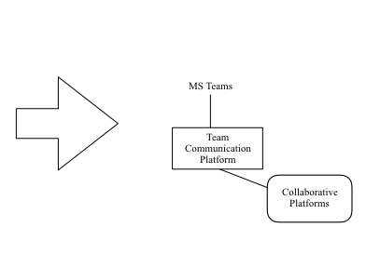
Re-instantiated Design Artifact

Slide 49
eADSR Cycle Two
eADSR Cycle One
Implementation
DIAGNOSIS
DESIGN
Implemented in all courses requiring teamwork
Undergraduate Project Management
Leading High-Performance Teams
MBA Project Management courses
Results
Student Course Evaluations
Greater satisfaction in team collaboration
Appreciation of using current tools
Students voluntarily using the platforms in other courses
Next Steps
Formally evaluate the satisfaction
IMPLEMENTATION
eADSR Cycle Two
DIAGNOSIS
DESIGN
IMPLEMENTATION

Slide 50
Conclusion
Importance
Addressed the gap of student perspective
eADSR can be used as a model for continuous improvement
Provides replicable method to include student voice to address pedagogical approaches
Provides a model (VTCE) that can be implemented in a virtual classroom to encourage team collaboration

Slide 51
Paper History
DBA Class Paper
Conference Paper
Journal Submission
Current State
Dr. Matt Mullarkey
Dr. Al Hevner
Design Science, 2018
Dr. Grandon Gill
Publication Course, 2019
Decision Sciences Annual Conference, 2019
Decision Sciences Journal of Innovative Education, 2021
Empirical Study – R & R
Repositioned as Teaching Brief - Reject
Looking for a journal home

Slide 52
Collaboration Opportunities
Annual EDBA Expectation & Outcome Index
TOPIC
TOPIC
Longitudinal: 2021-2024 @ UNA, USF (2 programs), + NiBS (Ghana, Africa)
DEMO/CONTROL | PERSONALITY | EXPECTATION/CONFIDENCE → OUTCOME/REFLECTION PSYCHOLOGICAL CAPITAL | ORG. CITIZENSHIP BEHAVIORS | IMPOSTER PHENOMENA
Data collection underway, Presenting at SEPA March 2022
MBA Imposter Phenomena & Professional Identity
Data Collection Fall 2021-Spring 2022, N = 649 and counting
Two MBA Courses: Early + Near Completion
DEMO/CONTROL | IMPOSTER PHENOMENA | PSYCHOLOGICAL CAPITAL | PEDAGOGICAL EXPERIENCES | PROFESSIONAL IDENTITY
Structural Equation Modelling assistance

Slide 53
THANK YOU!
Notes:
Thank you: Avenir Next Medium
Subtitle: Avenir Next Regular

