Slide 1
Modern Systems Analysis
and Design
Seventh Edition
Jeffrey A. Hoffer
Joey F. George
Joseph S. Valacich
Chapter 3
Managing the Information Systems Project

Slide 2
Learning Objectives
Explain the process of managing an information systems project.
Describe the skills required to be an effective project manager.
List and describe the skills and activities of a project manager during project initiation, project planning, project execution, and project closedown.
Explain what is meant by critical path scheduling and describe the process of creating Gantt charts and network diagrams.
Explain how commercial project management software packages can be used to assist in representing and managing project schedules.
Chapter 3
Copyright © 2014 Pearson Education, Inc. Publishing as Prentice Hall

Slide 3
Introduction
Project management (PM) may be the most important aspect of systems development.
Effective PM helps to ensure
  The meeting of customer expectations.
  The satisfying of budget and time constraints.
The nature of projects has changed from custom development to implementing packaged software and data warehousing.
PM skills are difficult and important to learn.
Chapter 3
Copyright © 2014 Pearson Education, Inc. Publishing as Prentice Hall

Slide 4
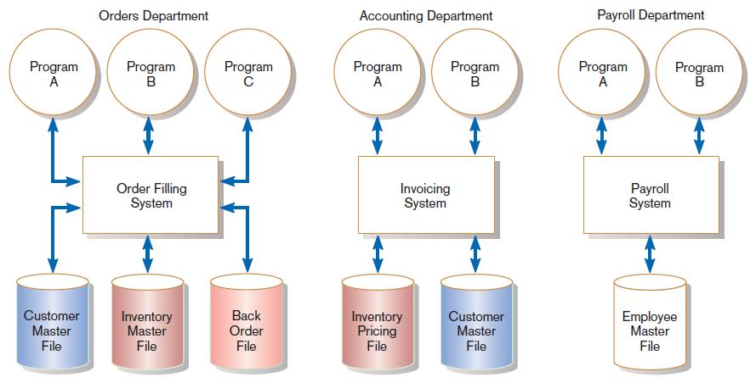
Pine Valley Application Project
FIGURE 3-1
Three computer applications at Pine Valley Furniture: order filling, invoicing, and payroll
Source: Hoffer, Ramesh, and Topi, 2011.
Chapter 3
Copyright © 2014 Pearson Education, Inc. Publishing as Prentice Hall

Slide 5
Managing the Information Systems Project
Project
  A planned undertaking of related activities to reach an objective that has a beginning and an end
Project management
  A controlled process of initiating, planning, executing, and closing down a project
Chapter 3
Copyright © 2014 Pearson Education, Inc. Publishing as Prentice Hall

Slide 6
Managing the Information Systems Project (cont.)
Project manager
  A systems analyst with a diverse set of skills—management, leadership, technical, conflict management, and customer relationship—who is responsible for initiating, planning, executing, and closing down a project
Deliverable
  The end product of an SDLC phase
Chapter 3
Copyright © 2014 Pearson Education, Inc. Publishing as Prentice Hall

Slide 7
Deciding on Systems Projects
System Service Request (SSR)
  A standard form for requesting or proposing systems development work within an organization
Feasibility study
  A study that determines whether a requested system makes economic and operational sense for an organization
Chapter 3
Copyright © 2014 Pearson Education, Inc. Publishing as Prentice Hall

Slide 8
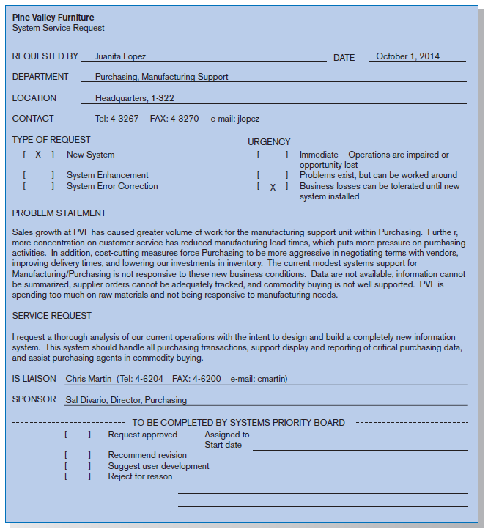
FIGURE 3-2
System Service Request for Purchasing Fulfillment System with name and contact information of the person requesting the system, a statement of the problem, and the name and contact information of the liaison and sponsor
Chapter 3
Copyright © 2014 Pearson Education, Inc. Publishing as Prentice Hall

Slide 9
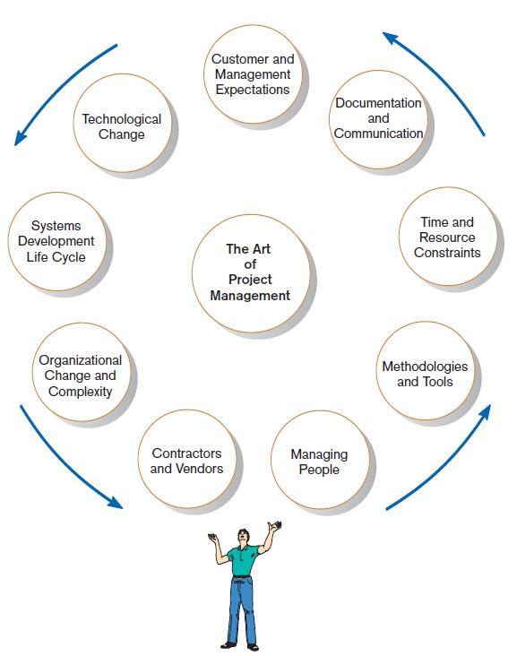
Project Management Activities
FIGURE 3-4
A project manager juggles numerous
activities
Chapter 3
Copyright © 2014 Pearson Education, Inc. Publishing as Prentice Hall

Slide 10
Phases of Project Management Process
Phase 1: Initiation
Phase 2: Planning
Phase 3: Execution
Phase 4: Closedown
Chapter 3
Copyright © 2014 Pearson Education, Inc. Publishing as Prentice Hall

Slide 11
PM Phase 1: Project Initiation
Assess size, scope and complexity, and establish procedures.
Establish:
  Initiation team
  Relationship with customer
  Project initiation plan
  Management procedures
  Project management environment and workbook
  Project charter
Chapter 3
Copyright © 2014 Pearson Education, Inc. Publishing as Prentice Hall

Slide 12
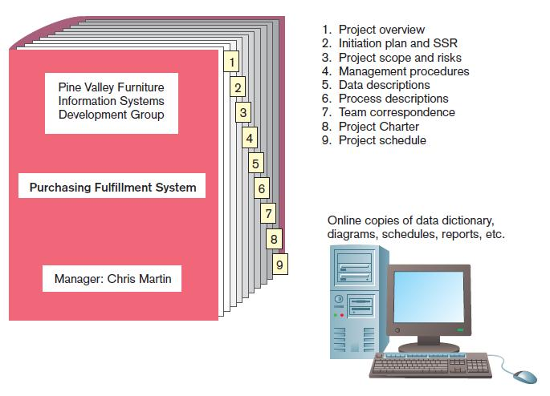
FIGURE 3-6
The project workbook for the Purchase Fulfillment System project contains nine key documents in both hard-copy and electronic form.
Chapter 3
Copyright © 2014 Pearson Education, Inc. Publishing as Prentice Hall

Slide 13
Project Charter
A short document prepared for the customer describing project deliverables and outlining the work required to complete the project
Elements:
  Title and authorization date
  Project manager name and contact information
  Customer name and contact information
  Project start and completion dates
  Key stakeholders, roles, responsibilities
  Project objectives and description
  Key assumptions
  Signatures of stakeholders
Chapter 3
Copyright © 2014 Pearson Education, Inc. Publishing as Prentice Hall

Slide 14
PM Phase 2: Project Planning
Define clear, discrete activities and the work needed to complete each activity. Tasks include:
Describing Project Scope, Alternatives, and Feasibility
Dividing the Project into Manageable Tasks
Estimating Resources and Creating a Resource Plan
Developing a Preliminary Schedule
Developing a Communication Plan
Determining Project Standards and Procedures
Identifying and Assessing Risk
Creating a Preliminary Budget
Developing a Project Scope Statement
Setting a Baseline Project Plan
Chapter 3
Copyright © 2014 Pearson Education, Inc. Publishing as Prentice Hall

Slide 15
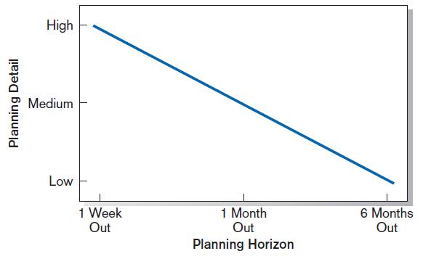
Planning Detail
FIGURE 3-8
Level of project planning detail should be high in the short term, with less detail as time goes on.
Chapter 3
Copyright © 2014 Pearson Education, Inc. Publishing as Prentice Hall

Slide 16
Project Scope, Alternatives, and Feasibility
What problem or opportunity does the project address?
What are the quantifiable results to be achieved?
What needs to be done?
How will success be measured?
How will we know when we are finished?
Chapter 3
Copyright © 2014 Pearson Education, Inc. Publishing as Prentice Hall

Slide 17
Dividing Project into Manageable Tasks
Work Breakdown Structure (WBS)
  Division of project into manageable and logically ordered tasks and subtasks
Scheduling Diagrams
  Gantt chart: horizontal bars represent task durations
  Network diagram: boxes and links represent task dependencies
Chapter 3
Copyright © 2014 Pearson Education, Inc. Publishing as Prentice Hall

Slide 18
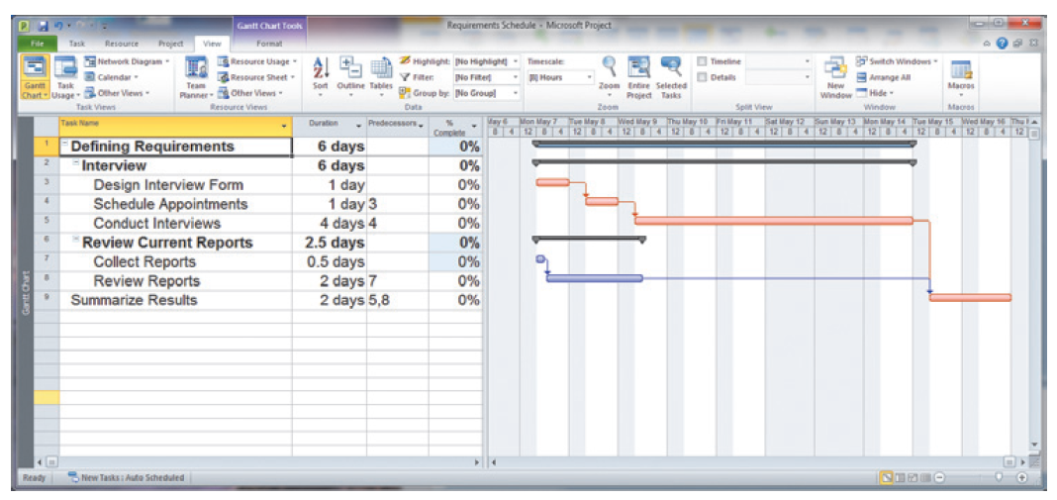
Developing a Preliminary Schedule
WBS
Gantt Chart
FIGURE 3-10
Gantt chart showing project tasks, duration times for those tasks, and predecessors
Chapter 3
Copyright © 2014 Pearson Education, Inc. Publishing as Prentice Hall

Slide 19
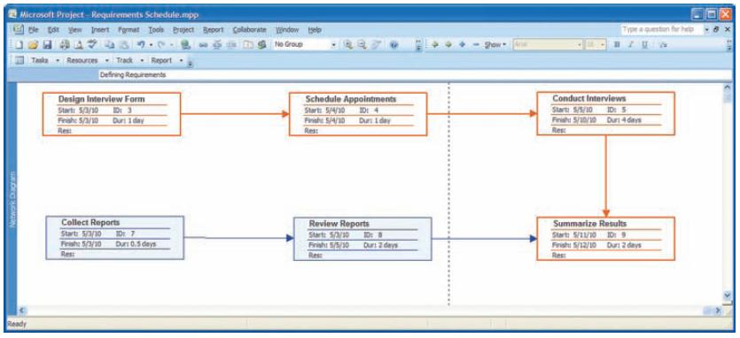
Scheduling Diagrams Network Diagram
FIGURE 3-13
A network diagram illustrating tasks with rectangles (or ovals) and the relationships and sequences of those activities with arrows (Source: Microsoft Corporation.)
Chapter 3
Copyright © 2014 Pearson Education, Inc. Publishing as Prentice Hall

Slide 20
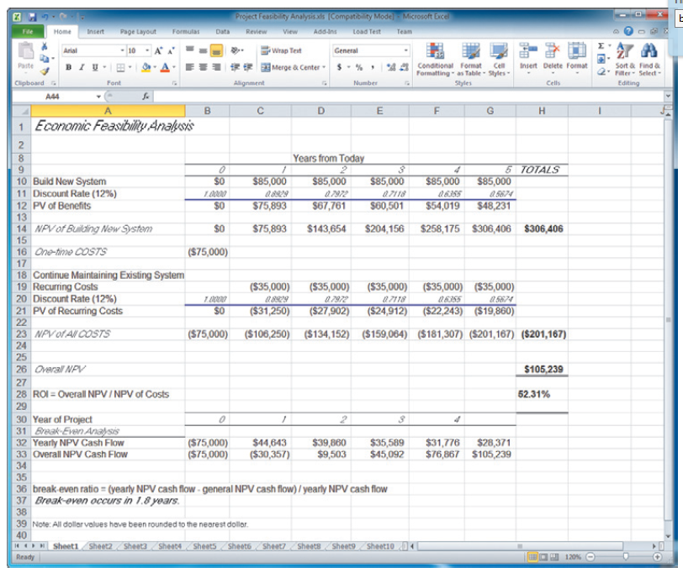
Developing a Preliminary Budget
FIGURE 3-15
A financial cost and benefit analysis for a systems development project (Source: Microsoft Corporation.)
Spreadsheet software is good for this.
Chapter 3
Copyright © 2014 Pearson Education, Inc. Publishing as Prentice Hall

Slide 21
Developing a Communication Plan
Who are stakeholders?
What information does each stakeholder need?
When should information be produced?
What are sources of information?
Who will collect, store and validate info?
Who will organize and document info?
Who is the contact person for each stakeholder?
What is the appropriate/best format for info?
What communication medium should be used?
Chapter 3
Copyright © 2014 Pearson Education, Inc. Publishing as Prentice Hall

Slide 22
Setting a Baseline Project Plan
A Baseline Project Plan provides an estimate of the project’s tasks and resource requirements and is used to guide the next project phase—execution. As new information is acquired during project execution, the baseline plan will continue to be updated.
Chapter 3
Copyright © 2014 Pearson Education, Inc. Publishing as Prentice Hall

Slide 23
PM Phase 3: Project Execution
Plans created in prior phases are put into action.
Actions
  Execute baseline project plan.
  Monitor progress against baseline plan.
  Manage changes in baseline plan.
  Maintain project workbook.
  Communicate project status.
Chapter 3
Copyright © 2014 Pearson Education, Inc. Publishing as Prentice Hall

Slide 24
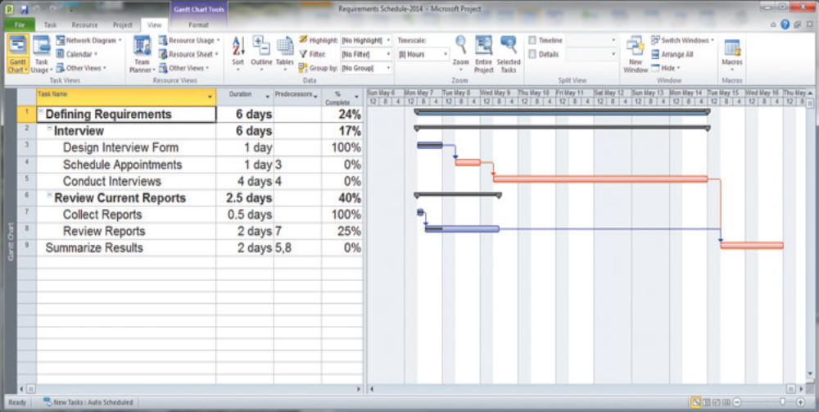
Monitoring Progress with a Gantt Chart
FIGURE 3-17
Gantt chart with tasks 3 and 7 completed and task 8 partially completed (Source: Microsoft Corporation.)
Red bars indicate critical path; lines through bars indicate percent complete.
Chapter 3
Copyright © 2014 Pearson Education, Inc. Publishing as Prentice Hall

Slide 25
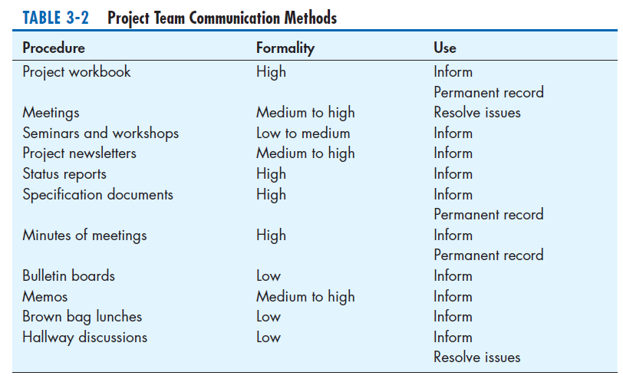
Communication Methods
Chapter 3
Copyright © 2014 Pearson Education, Inc. Publishing as Prentice Hall

Slide 26
PM Phase 4: Project Closedown
Bring the project to an end.
Actions
  Close down the project.
  Conduct post-project reviews.
  Close the customer contract.
Chapter 3
Copyright © 2014 Pearson Education, Inc. Publishing as Prentice Hall

Slide 27
Representing and Scheduling Project Plans
Gantt Charts
Network Diagrams
PERT Calculations
Critical Path Scheduling
Project Management Software
Chapter 3
Copyright © 2014 Pearson Education, Inc. Publishing as Prentice Hall

Slide 28
Gantt Charts vs. Network Diagrams
Gantt charts
  Show task durations.
  Show time overlap.
  Show slack time in duration.
Network diagrams
  Show task dependencies.
  Do not show time overlap, but show parallelism.
  Show slack time in boxes.
Chapter 3
Copyright © 2014 Pearson Education, Inc. Publishing as Prentice Hall

Slide 29
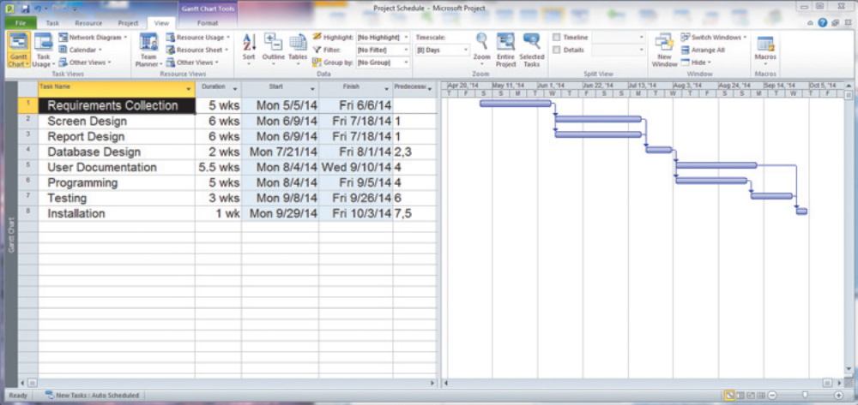
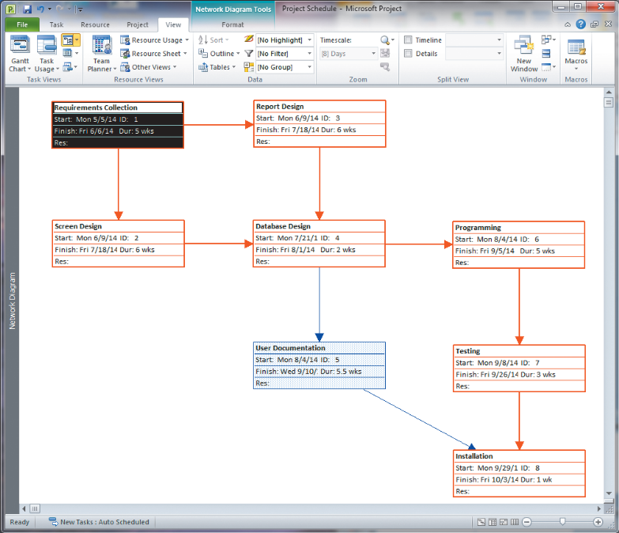
Gantt Charts vs. Network Diagrams (Cont.)
Figure 3-19
Graphical diagrams that depict project
plans
(a) A Gantt chart
(b) A network diagram
(Source: Microsoft Corporation.)
Chapter 3
Copyright © 2014 Pearson Education, Inc. Publishing as Prentice Hall

Slide 30
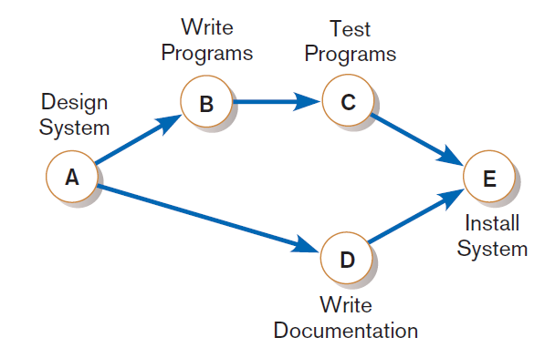
Gantt Charts vs. Network Diagrams (Cont.)
Figure 3-21
A network diagram showing activities
(represented by circles) and sequence of
those activities (represented by arrows)
Chapter 3
Copyright © 2014 Pearson Education, Inc. Publishing as Prentice Hall

Slide 31
Estimating Task Duration
PERT: Program Evaluation Review Technique
Technique that uses optimistic (o), pessimistic (p), and realistic (r) time estimates to determine expected task duration
Formula for Estimated Time:
  ET = (o + 4r + p)/6
Copyright © 2014 Pearson Education, Inc. Publishing as Prentice Hall

Slide 32
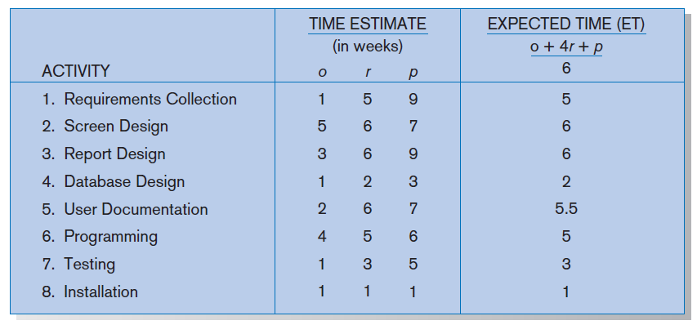
Example PERT Analysis
FIGURE 3-22
Estimated time calculations for the SPTS project
Copyright © 2014 Pearson Education, Inc. Publishing as Prentice Hall

Slide 33
Critical Path Scheduling
A scheduling technique whose order and duration of a sequence of task activities directly affect the completion
Critical path: the shortest time in which a project can be completed
Slack time: the time an activity can be delayed without delaying the project
Copyright © 2014 Pearson Education, Inc. Publishing as Prentice Hall

Slide 34
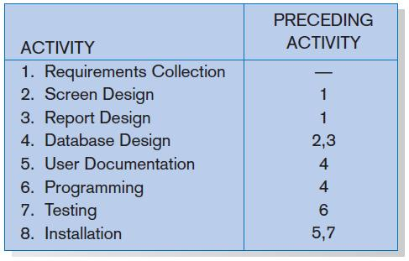
Critical Path Example
(dependencies between tasks)
PRECEDING ACTIVITIES indicate the activities that must be completed before the specified activity can begin.
FIGURE 3-23 Sequence of Activities within the SPTS project
Copyright © 2014 Pearson Education, Inc. Publishing as Prentice Hall

Slide 35
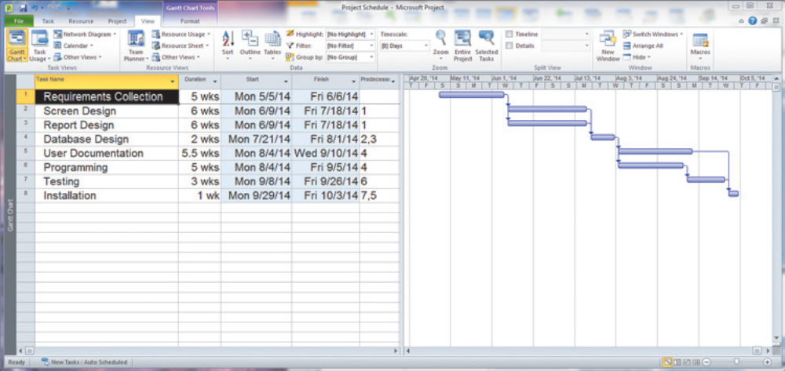
Critical Path Example (Cont.)
Figure 3-24
Gantt chart that illustrates the sequence
and duration of each activity of the SPTS
project
(Source: Microsoft Corporation.)
Copyright © 2014 Pearson Education, Inc. Publishing as Prentice Hall

Slide 36
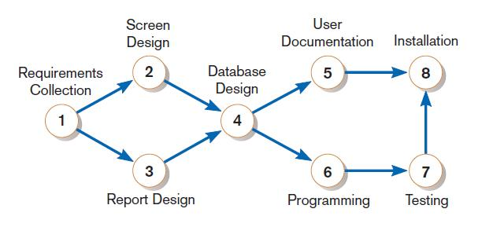
Critical Path Example (Cont.)
Network diagram shows dependencies
FIGURE 3-25
A network diagram that illustrates the activities (circles) and the sequence (arrows) of those activities
Chapter 3
Copyright © 2014 Pearson Education, Inc. Publishing as Prentice Hall

Slide 37
Determining the Critical Path
Calculate the earliest possible completion time for each activity by summing the activity times in the longest path to the activity. This gives total expected project time.
Calculate the latest possible completion time for each activity by subtracting the activity times in the path following the activity from the total expected time. This gives slack time for activities.
Critical path contains no activities with slack time.
Chapter 3
Copyright © 2014 Pearson Education, Inc. Publishing as Prentice Hall

Slide 38
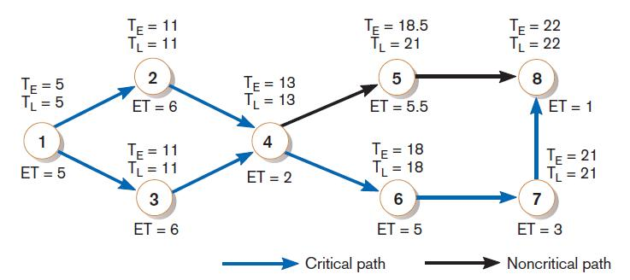
Critical Path Calculation
FIGURE 3-26
A network diagram for the SPTS project showing estimated times for each activity and the earliest and latest expected completion time for each activity
Early and late time calculations are determined and critical path established. (Note: Activity #5 can begin late without affecting project completion time.)
Chapter 3
Copyright © 2014 Pearson Education, Inc. Publishing as Prentice Hall

Slide 39
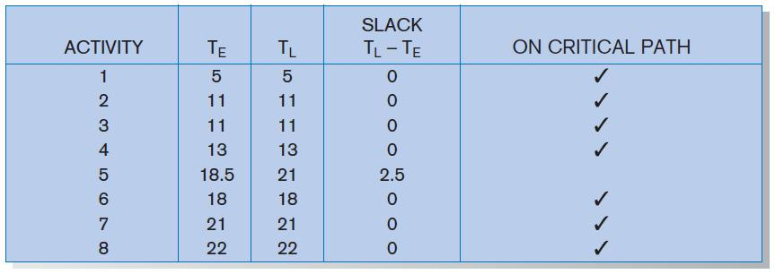
Critical Path Calculation (cont.)
FIGURE 3-27
Activity slack time calculations for the SPTS project; all activities except number 5 are on the critical path
Note the slack time in Activity #5.
Chapter 3
Copyright © 2014 Pearson Education, Inc. Publishing as Prentice Hall

Slide 40
Using Project Management Software
Many powerful software tools exist for assisting with project management.
Example: Microsoft Project can help with
  Entering project start or end date.
  Establishing tasks and task dependencies.
  Viewing project information as Gantt or Network diagrams.
Chapter 3
Copyright © 2014 Pearson Education, Inc. Publishing as Prentice Hall

Slide 41
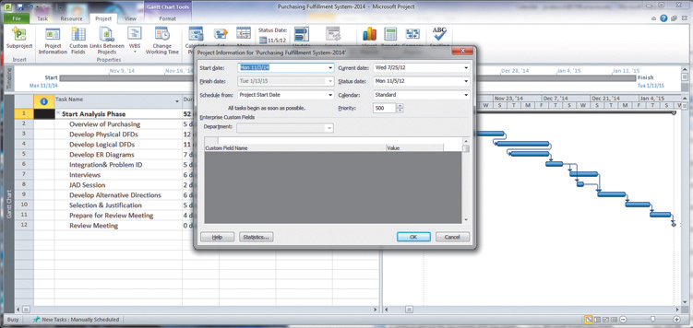
Project Start Date
FIGURE 3-28
Establishing a project starting date in Microsoft Project for Windows (Source: Microsoft Corporation.)
Chapter 3
Copyright © 2014 Pearson Education, Inc. Publishing as Prentice Hall

Slide 42
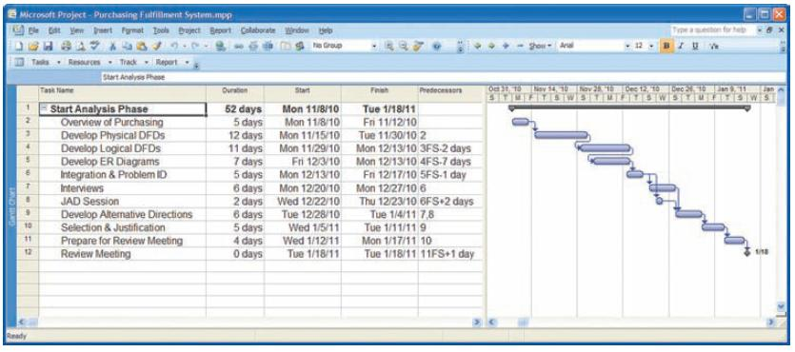
Entering Tasks
FIGURE 3-29
Entering tasks and assigning task relationships in Microsoft project
for Windows (Source: Microsoft Corporation.)
Chapter 3
Copyright © 2014 Pearson Education, Inc. Publishing as Prentice Hall

Slide 43
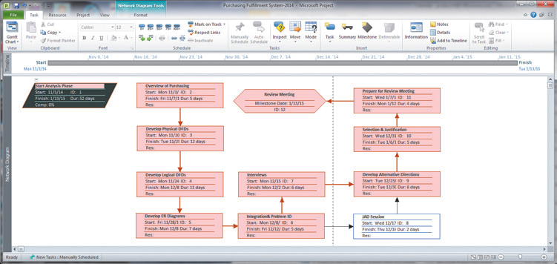
Viewing Network Diagram
FIGURE 3-30
Viewing project information as a network diagram in Microsoft Project for Windows (Source: Microsoft Corporation.)
Red boxes and arrows indicate critical path (no slack).
Hexagon shape indicates a milestone.
Chapter 3
Copyright © 2014 Pearson Education, Inc. Publishing as Prentice Hall

Slide 44
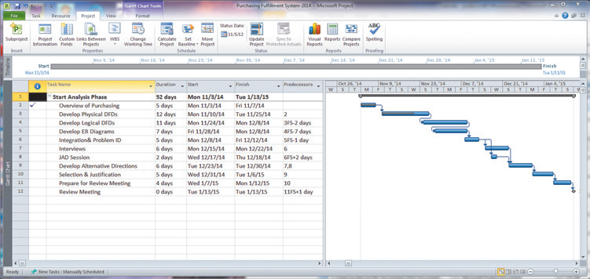
Viewing Gantt Chart
FIGURE 3-31
Gantt chart showing progress of activities (right frame) versus planned activities (left frame)
Black line at top indicates a summary activity (composed of subtasks).
Diamond shape indicates a milestone.
Chapter 3
Copyright © 2014 Pearson Education, Inc. Publishing as Prentice Hall

Slide 45
Summary
In this chapter you learned how to:
  Explain the process of managing an information systems project.
  Describe the skills required to be an effective project manager.
  List and describe the skills and activities of a project manager during project initiation, project planning, project execution, and project closedown.
  Explain what is meant by critical path scheduling and describe the process of creating Gantt charts and network diagrams.
  Explain how commercial project management software packages can be used to assist in representing and managing project schedules.
Chapter 3
Copyright © 2014 Pearson Education, Inc. Publishing as Prentice Hall

Slide 46

Copyright © 2014 Pearson Education, Inc.
Publishing as Prentice Hall

