Slide 1
Modern Systems Analysis
and Design
Seventh Edition
Jeffrey A. Hoffer
Joey F. George
Joseph S. Valacich
Chapter 5
Initiating and Planning Systems Development Projects

Slide 2
Learning Objectives
Describe the steps involved in the project initiation and planning process.
Explain the need for and the contents of a Project Scope Statement and Baseline Project Plan.
List and describe various methods for assessing project feasibility.
Describe the differences between tangible and intangible benefits and costs, and between one-time vs. recurring benefits and costs.
Chapter 5
Copyright © 2014 Pearson Education, Inc. Publishing as Prentice Hall

Slide 3
Learning Objectives (Cont.)
Perform cost-benefit analysis and describe what is meant by the time value of money, present value, discount rate, net present value, return on investment, and break-even analysis.
Describe the general rules for evaluating technical risks associated with a systems development project.
Describe the activities and participant roles within a structured walkthrough.
Chapter 5
Copyright © 2014 Pearson Education, Inc. Publishing as Prentice Hall

Slide 4
Initiating and Planning Systems Development Projects
What must be considered when making the decision on the division between project initiation and planning (PIP) and analysis?
How much effort should be expended on the PIP process?
Who is responsible for performing the PIP process?
Why is PIP such a challenging activity?
Chapter 5
Copyright © 2014 Pearson Education, Inc. Publishing as Prentice Hall

Slide 5
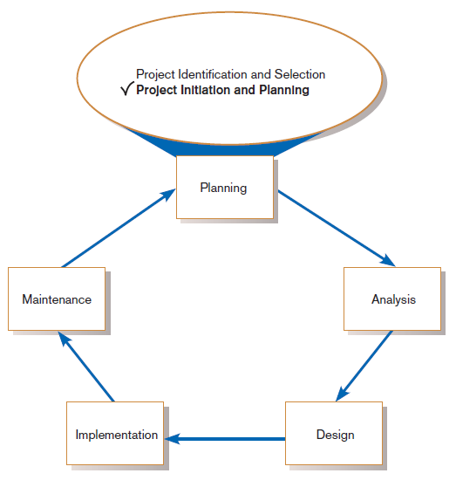
The Process of Initiating and Planning IS Development Projects
FIGURE 5-1
Systems development life cycle
with project initiation and
planning highlighted
Chapter 5
Copyright © 2014 Pearson Education, Inc. Publishing as Prentice Hall

Slide 6
The Process of Initiating and Planning IS Development Projects (Cont.)
Project initiation focuses on activities designed to assist in organizing a team to conduct project planning.
Chapter 5
Copyright © 2014 Pearson Education, Inc. Publishing as Prentice Hall

Slide 7
The Process of Initiating and Planning IS Development Projects (Cont.)
Establishing the Project Initiation Team
Establishing a Relationship with the Customer
Establishing the Project Initiation Plan
Establishing Management Procedures
Establishing the Project Management Environment and Project Workbook
Developing the Project Charter (see Ch 3)
Chapter 5
Copyright © 2014 Pearson Education, Inc. Publishing as Prentice Hall

Slide 8
The Process of Initiating and Planning IS Development Projects (Cont.)
The key activity of project planning is the process of defining clear, discrete activities and the work needed to complete each activity within a single project.
The objective of the project planning process is the development of a Baseline Project Plan (BPP) and the Project Scope Statement (PSS).
Chapter 5
Copyright © 2014 Pearson Education, Inc. Publishing as Prentice Hall

Slide 9
The Process of Initiating and Planning IS Development Projects (Cont.)
Business Case
  Justification for an information system
  Presented in terms of the tangible and intangible economic benefits and costs
  The technical and organizational feasibility of the proposed system
Chapter 5
Copyright © 2014 Pearson Education, Inc. Publishing as Prentice Hall

Slide 10
Elements of Project Planning
Describe project scope, alternatives, feasibility.
Divide project into tasks.
Estimate resource requirements and create resource plan.
Develop preliminary schedule.
Develop communication plan.
Chapter 5
Copyright © 2014 Pearson Education, Inc. Publishing as Prentice Hall

Slide 11
Elements of Project Planning (Cont.)
Determine standards and procedures.
Identify and assess risk.
Create preliminary budget.
Develop a statement of work.
Set baseline project plan.
Chapter 5
Copyright © 2014 Pearson Education, Inc. Publishing as Prentice Hall

Slide 12
Deliverables and Outcomes (Cont.)
Baseline Project Plan (BPP)
  A major outcome and deliverable from the PIP phase
  Contains the best estimate of a project’s scope, benefits, costs, risks, and resource requirements
Chapter 5
Copyright © 2014 Pearson Education, Inc. Publishing as Prentice Hall

Slide 13
Deliverables and Outcomes (Cont.)
Project Scope Statement (PSS)
  A document prepared for the customer
  Describes what the project will deliver
  Outlines at a high level all work required to complete the project
Chapter 5
Copyright © 2014 Pearson Education, Inc. Publishing as Prentice Hall

Slide 14
Assessing Project Feasibility
Economic
Technical
Operational
Scheduling
Legal and contractual
Political
Chapter 5
Copyright © 2014 Pearson Education, Inc. Publishing as Prentice Hall

Slide 15
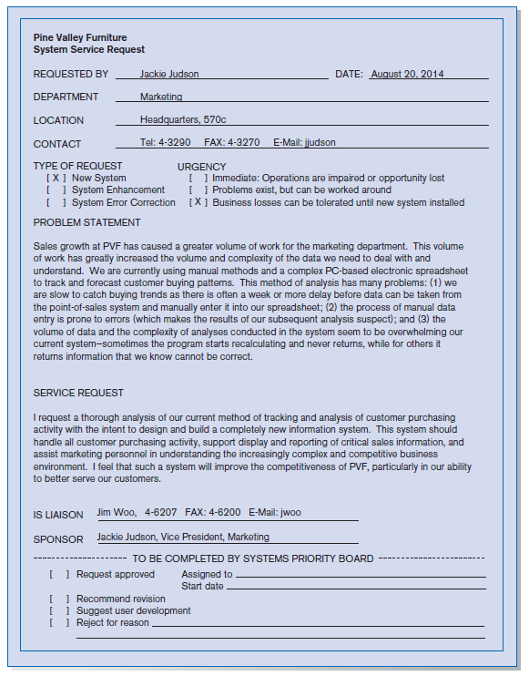
Assessing Project Feasibility (Cont.)
FIGURE 5-2
System Service Request for Customer Tracking System (Pine Valley Furniture)
Chapter 5
Copyright © 2014 Pearson Education, Inc. Publishing as Prentice Hall

Slide 16
Assessing Project Feasibility (Cont.)
Economic feasibility: a process of identifying the financial benefits and costs associated with a development project
  Often referred to as a cost-benefit analysis
  Project is reviewed after each SDLC phase in order to decide whether to continue, redirect, or kill a project
Chapter 5
Copyright © 2014 Pearson Education, Inc. Publishing as Prentice Hall

Slide 17
Determining Project Benefits
Tangible benefits refer to items that can be measured in dollars and with certainty.
Examples include:
  reduced personnel expenses
  lower transaction costs, or
  higher profit margins.
Chapter 5
Copyright © 2014 Pearson Education, Inc. Publishing as Prentice Hall

Slide 18
Determining Project Benefits (Cont.)
Most tangible benefits will fit within the following categories:
  Cost reduction and avoidance
  Error reduction
  Increased flexibility
  Increased speed of activity
  Improvement of management planning and control
  Opening new markets and increasing sales opportunities
Chapter 5
Copyright © 2014 Pearson Education, Inc. Publishing as Prentice Hall

Slide 19
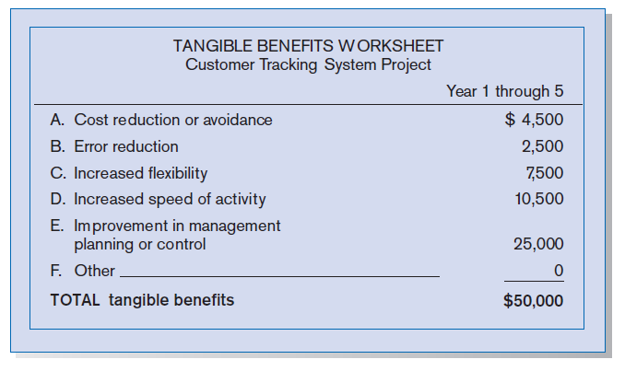
Determining Project Benefits (Cont.)
Figure 5-3
Tangible benefits for Customer Tracking
System (Pine Valley Furniture)
Chapter 5
Copyright © 2014 Pearson Education, Inc. Publishing as Prentice Hall

Slide 20
Determining Project Benefits (Cont.)
Intangible benefits are benefits derived from the creation of an information system that cannot be easily measured in dollars or with certainty.
  May have direct organizational benefits, such as the improvement of employee morale
  May have broader societal implications, such as the reduction of waste creation or resource consumption
Chapter 5
Copyright © 2014 Pearson Education, Inc. Publishing as Prentice Hall

Slide 21
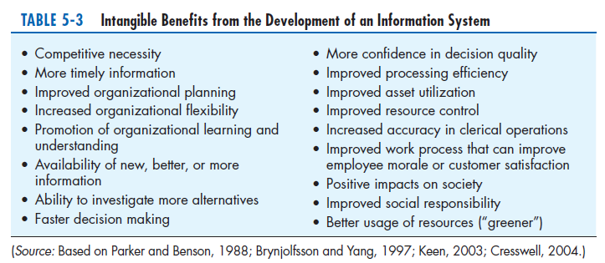
Determining Project Benefits (Cont.)
Chapter 5
Copyright © 2014 Pearson Education, Inc. Publishing as Prentice Hall

Slide 22
Determining Project Costs
Tangible cost: a cost associated with an information system that can be measured in dollars and with certainty
IS development tangible costs include:
  Hardware costs
  Labor costs, or
  Operational costs, including employee training and building renovations.
Chapter 5
Copyright © 2014 Pearson Education, Inc. Publishing as Prentice Hall

Slide 23
Determining Project Costs (Cont.)
Intangible cost: a cost associated with an information system that cannot be easily measured in terms of dollars or with certainty
Intangible costs can include:
  Loss of customer goodwill,
  Employee morale, or
  Operational inefficiency.
Chapter 5
Copyright © 2014 Pearson Education, Inc. Publishing as Prentice Hall

Slide 24
Determining Project Costs (Cont.)
One-time cost: a cost associated with project start-up and development or system start-up
These costs encompass activities such as:
  Systems development,
  New hardware and software purchases,
  User training,
  Site preparation, and
  Data or system conversion.
Chapter 5
Copyright © 2014 Pearson Education, Inc. Publishing as Prentice Hall

Slide 25
Determining Project Costs (Cont.)
Recurring cost: a cost resulting from the ongoing evolution and use of a system
Examples of these costs include:
  Application software maintenance
  Incremental data storage expenses
  Incremental communications
  New software and hardware leases, and
  Supplies and other expenses (i.e., paper, forms, data center personnel).
Chapter 5
Copyright © 2014 Pearson Education, Inc. Publishing as Prentice Hall

Slide 26
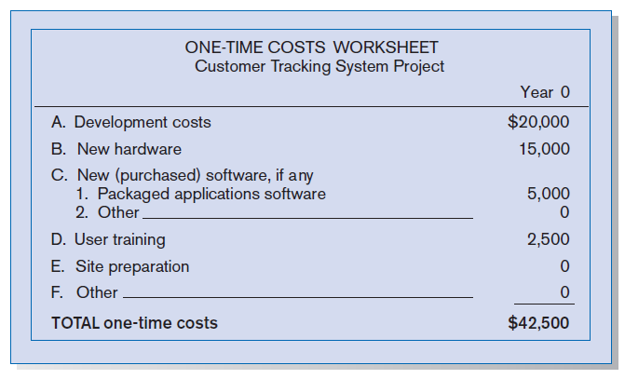
Determining Project Costs (Cont.)
Figure 5-4
One-time costs for Customer Tracking System (Pine Valley Furniture)
Chapter 5
Copyright © 2014 Pearson Education, Inc. Publishing as Prentice Hall

Slide 27
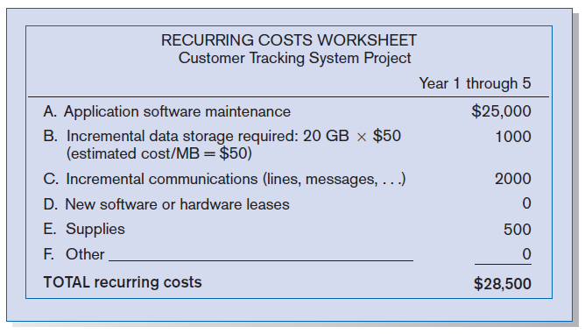
Determining Project Costs (Cont.)
Figure 5-5
Recurring costs for Customer Tracking System (Pine Valley Furniture)
Chapter 5
Copyright © 2014 Pearson Education, Inc. Publishing as Prentice Hall

Slide 28
Determining Project Costs (Cont.)
Both one-time and recurring costs can consist of items that are fixed or variable in nature.
Fixed costs are billed or incurred at a regular interval and usually at a fixed rate.
  Example: facility lease payment
Variable costs are items that vary in relation to usage.
  Example: long-distance charges
Chapter 5
Copyright © 2014 Pearson Education, Inc. Publishing as Prentice Hall

Slide 29
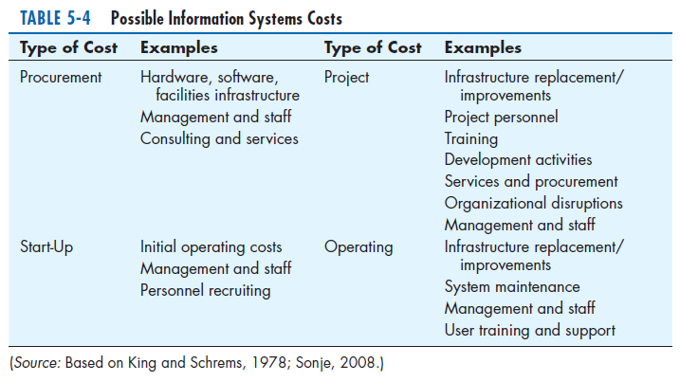
Determining Project Costs (Cont.)
Chapter 5
Copyright © 2014 Pearson Education, Inc. Publishing as Prentice Hall

Slide 30
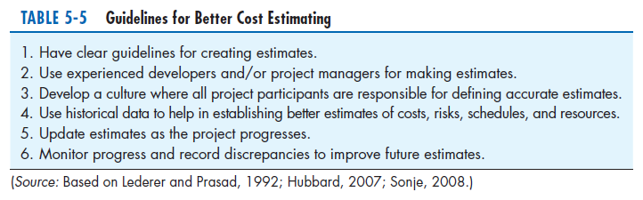
Determining Project Costs (Cont.)
Chapter 5
Copyright © 2014 Pearson Education, Inc. Publishing as Prentice Hall

Slide 31
The Time Value of Money
Time value of money (TVM): the concept that money available today is worth more than the same amount tomorrow
Discount rate: the rate of return used to compute the present value of future cash flows (the cost of capital)
Present value: the current value of a future cash flow
Chapter 5
Copyright © 2014 Pearson Education, Inc. Publishing as Prentice Hall

Slide 32
The Time Value of Money
Net Present Value (NPV)
  Use discount rate to determine present value of cash outlays and receipts
Return on Investment (ROI)
  Ratio of cash receipts to cash outlays
Break-Even Analysis (BEA)
  Amount of time required for cumulative cash flow to equal initial and ongoing investment
Chapter 5
Copyright © 2014 Pearson Education, Inc. Publishing as Prentice Hall

Slide 33
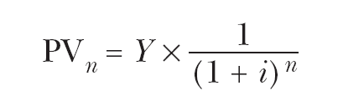
The Time Value of Money (Cont.)
Net Present Value
  PVn = present value of Y dollars n years from now based on a discount rate of i.
  NPV = sum of PVs across years.
  Calculates time value of money
Chapter 5
Copyright © 2014 Pearson Education, Inc. Publishing as Prentice Hall

Slide 34

The Time Value of Money (Cont.)
Break-even analysis: a type of cost-benefit analysis to identify at what point (if ever) benefits equal costs
Chapter 5
Copyright © 2014 Pearson Education, Inc. Publishing as Prentice Hall

Slide 35
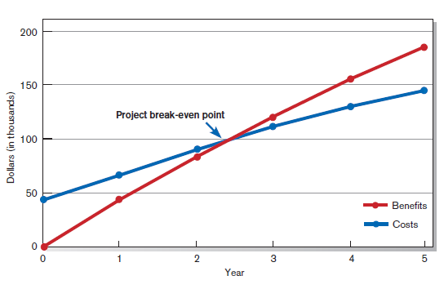
The Time Value of Money (Cont.)
Figure 5-7
Break-even analysis for Customer Tracking System (Pine Valley Furniture)
Chapter 5
Copyright © 2014 Pearson Education, Inc. Publishing as Prentice Hall

Slide 36
Assessing Technical Feasibility
Technical feasibility: a process of assessing the development organization’s ability to construct a proposed system
Chapter 5
Copyright © 2014 Pearson Education, Inc. Publishing as Prentice Hall

Slide 37
Assessing Technical Feasibility (Cont.)
The potential consequences of not assessing and managing risks can include:
  Failure to attain expected benefits from the project
  Inaccurate project cost estimates.
  Inaccurate project duration estimates.
  Failure to achieve adequate system performance levels.
  Failure to adequately integrate the new system with existing hardware, software, or organizational procedures.
Chapter 5
Copyright © 2014 Pearson Education, Inc. Publishing as Prentice Hall

Slide 38
Project Risk Factors
Project size
  Team size, organizational departments, project duration, programming effort
Project structure
  New vs. renovated system, resulting organizational changes, management commitment, user perceptions
Development group
  Familiarity with platform, software, development method, application area, development of similar systems
User group
  Familiarity with IS development process, application area, use of similar systems
Chapter 5
Copyright © 2014 Pearson Education, Inc. Publishing as Prentice Hall

Slide 39
Assessing Technical Feasibility (Cont.)
Four general rules emerged as technical risk assessments:
  Larger projects are riskier than smaller projects.
  A system in which the requirements are easily obtained and highly structured will be less risky than one in which requirements are messy, ill structured, ill defined, or subject to the judgment of an individual.
Chapter 5
Copyright © 2014 Pearson Education, Inc. Publishing as Prentice Hall

Slide 40
Assessing Technical Feasibility (Cont.)
  The development of a system employing commonly used or standard technology will be less risky than one employing novel or nonstandard technology.
  A project is less risky when the user group is familiar with the systems development process and application area than if unfamiliar.
Chapter 5
Copyright © 2014 Pearson Education, Inc. Publishing as Prentice Hall

Slide 41
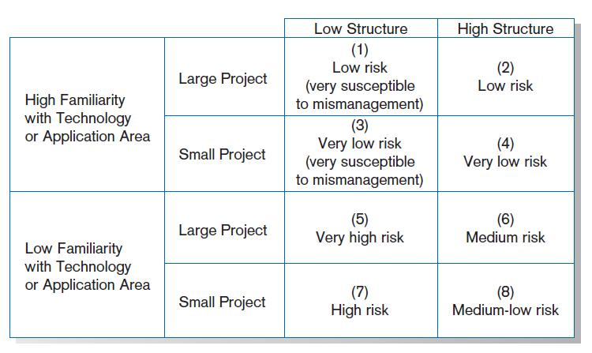
Assessing Technical Feasibility (Cont.)
FIGURE 5-8
Effects of degree of project structure, project size, and familiarity with
application area on project implementation risk (Source: Based on 7th Applegate, Austin, and McFarlan. 2007; Tech Republic, 2005.)
Chapter 5
Copyright © 2014 Pearson Education, Inc. Publishing as Prentice Hall

Slide 42
Assessing Other Feasibility Concerns
Operational
  Does the proposed system solve problems or take advantage of opportunities?
Scheduling
  Can the project time frame and completion dates meet organizational deadlines?
Legal and Contractual
  What are the legal and contractual ramifications of the proposed system development project?
Political
  How do key stakeholders view the proposed system?
Chapter 5
Copyright © 2014 Pearson Education, Inc. Publishing as Prentice Hall

Slide 43
Building the Baseline Project Plan
A Baseline Project Plan (BPP) is a document intended primarily to guide the development team.
Sections:
  Introduction
  System description
  Feasibility assessment
  Management issues
Chapter 5
Copyright © 2014 Pearson Education, Inc. Publishing as Prentice Hall

Slide 44
Building the Baseline Project Plan (Cont.)
Project Scope statement is part of the BPP introduction.
Sections:
  Problem statement
  Project objectives
  Project description
  Business benefits
  Deliverables
  Expected duration
Chapter 5
Copyright © 2014 Pearson Education, Inc. Publishing as Prentice Hall

Slide 45
Factors in Determining Scope
Organizational units affected by new system
Current systems that will interact with or change because of new system
People who are affected by new system
Range of potential system capabilities
Chapter 5
Copyright © 2014 Pearson Education, Inc. Publishing as Prentice Hall

Slide 46
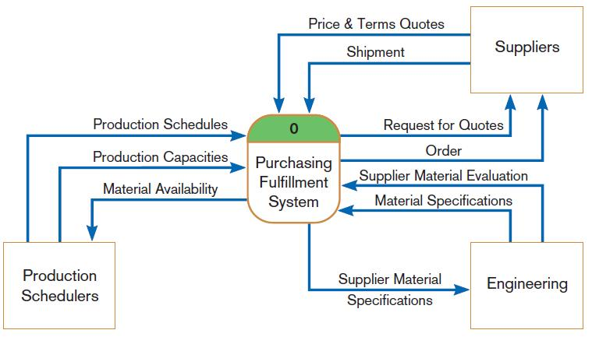
Diagram Depiction of Project Scope
FIGURE 5-11
Context-level data flow diagram showing project scope for Purchasing Fulfillment System (Pine Valley Furniture)
Chapter 5
Copyright © 2014 Pearson Education, Inc. Publishing as Prentice Hall

Slide 47
Building the Baseline Project Plan (Cont.)
System description section outlines possible alternative solutions.
Feasibility assessment section outlines issues related to project costs and benefits, technical difficulties, and other such concerns.
Management issues section outlines a number of managerial concerns related to the project.
Chapter 5
Copyright © 2014 Pearson Education, Inc. Publishing as Prentice Hall

Slide 48
Reviewing the Baseline Project Plan
Structured Walkthroughs: a peer-group review of any product created during the system development process
Roles: coordinator, presenter, user, secretary, standard-bearer, maintenance oracle
Can be applied to BPP, system specifications, logical and physical designs, program code, test procedures, manuals and documentation
Chapter 5
Copyright © 2014 Pearson Education, Inc. Publishing as Prentice Hall

Slide 49
Summary
In this chapter you learned how to:
  Describe steps involved in project initiation and planning.
  Explain the need for and contents of Statement of Work and Baseline Project Plan.
  List and describe methods for assessing project feasibility.
  Describe tangible vs. intangible costs and benefits, and one-time vs. recurring costs and benefits.
Chapter 5
Copyright © 2014 Pearson Education, Inc. Publishing as Prentice Hall

Slide 50
Summary (Cont.)
  Perform cost-benefit analysis, and understand time value of money, present value, discount rate, return on investment, and break-even analysis.
  Describe rules for evaluating technical risk of systems development projects.
  Describe activities and roles of structured walkthroughs.
Chapter 5
Copyright © 2014 Pearson Education, Inc. Publishing as Prentice Hall

Slide 51

Copyright © 2014 Pearson Education, Inc.
Publishing as Prentice Hall

