Slide 1
Modern Systems Analysis
and Design
Seventh Edition
Jeffrey A. Hoffer
Joey F. George
Joseph S. Valacich
Chapter 7 Appendix B
Object-Oriented Analysis and Design: Activity Diagrams

Slide 2
Learning Objectives
Understand how to represent system logic with activity diagrams.
Chapter 7 Appendix B
© 2014 Pearson Education, Inc. Publishing as Prentice Hall

Slide 3
Process Modeling: Activity Diagrams
Activity Diagrams
  Show the conditional logic for the sequence of system activities needed to accomplish a business process.
  Clearly show parallel and alternative behaviors.
  Can be used to show the logic of a use case.
Chapter 7 Appendix B
© 2014 Pearson Education, Inc. Publishing as Prentice Hall

Slide 4
Use Activity Diagrams to:
Depict the flow of control from activity to activity.
Help in use case analysis to understand what actions need to take place.
Help in identifying extensions in a use case.
Model work flow and business processes.
Model the sequential and concurrent steps in a computation process.
Chapter 7 Appendix B
© 2014 Pearson Education, Inc. Publishing as Prentice Hall

Slide 5
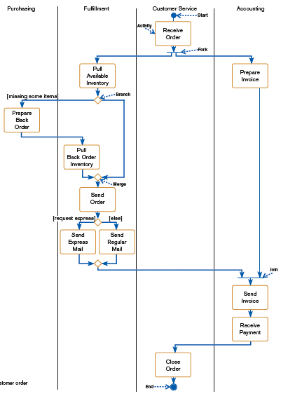
FIGURE 7-36
Activity diagram for a customer order
process
Chapter 7 Appendix B
© 2014 Pearson Education, Inc. Publishing as Prentice Hall

Slide 6
Process Modeling: Activity Diagrams (Cont.)
Elements of Activity Diagrams:
  Activity: a behavior that an object carries out while in a particular state
  Branch: a diamond symbol containing a condition whose results provide transitions to different paths of activities
  Merge: a circular symbol where different paths converge
Chapter 7 Appendix B
© 2014 Pearson Education, Inc. Publishing as Prentice Hall

Slide 7
Process Modeling: Activity Diagrams (Cont.)
  Fork: the beginning of parallel activities
  Join: the end of parallel activities
  Swimlanes: columns representing different organizational units of the system
Chapter 7 Appendix B
© 2014 Pearson Education, Inc. Publishing as Prentice Hall

Slide 8
Summary
In this appendix you learned how to:
Understand how to represent system logic with activity diagrams.
Chapter 7 Appendix B
© 2014 Pearson Education, Inc. Publishing as Prentice Hall

Slide 9

Copyright © 2014 Pearson Education, Inc.
Publishing as Prentice Hall

