Slide 1
Modern Systems Analysis
and Design
Seventh Edition
Jeffrey A. Hoffer
Joey F. George
Joseph S. Valacich
Chapter 7 Appendix C
Object-Oriented Analysis and Design: Sequence Diagrams

Slide 2
Learning Objectives
Understand how to represent system logic with sequence diagrams.
Chapter 7 Appendix C
© 2014 Pearson Education, Inc. Publishing as Prentice Hall

Slide 3
Dynamic Modeling: Sequence Diagrams
Sequence diagram: depicts the interactions among objects during a certain period of time
  May be presented either in a generic form or in an instance form.
  Generic form shows all possible sequences of interactions – sequences corresponding to all the scenarios of a use case.
  Instance form shows the sequence for only one scenario.
Chapter 7 Appendix C
© 2014 Pearson Education, Inc. Publishing as Prentice Hall

Slide 4
Dynamic Modeling: Sequence Diagrams (Cont.)
Elements of a sequence diagram
  Objects: represented by boxes at top of diagram
  Lifeline: the time during which an object exists
  Messages: means by which objects communicate with each other
Chapter 7 Appendix C
© 2014 Pearson Education, Inc. Publishing as Prentice Hall

Slide 5
Dynamic Modeling: Sequence Diagrams (Cont.)
Activation: the time period during which an object performs an operation
Synchronous message: a type of message in which the caller has to wait for the receiving object to finish executing the called operation before it can resume execution itself
Chapter 7 Appendix C
© 2014 Pearson Education, Inc. Publishing as Prentice Hall

Slide 6
Dynamic Modeling: Sequence Diagrams (Cont.)
Simple message: a message that transfers control from the sender to the recipient without describing the details of the communication
Asynchronous message: a message in which the sender does not have to wait for the recipient to handle the message
Chapter 7 Appendix C
© 2014 Pearson Education, Inc. Publishing as Prentice Hall

Slide 7
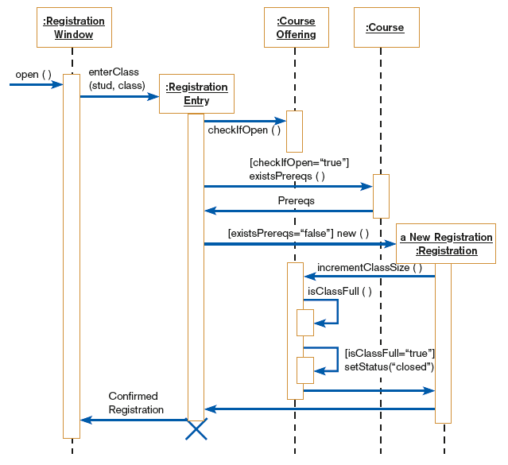
FIGURE 7-38
Sequence diagram for a class registration scenario without prerequisites
Chapter 7 Appendix C
© 2014 Pearson Education, Inc. Publishing as Prentice Hall

Slide 8
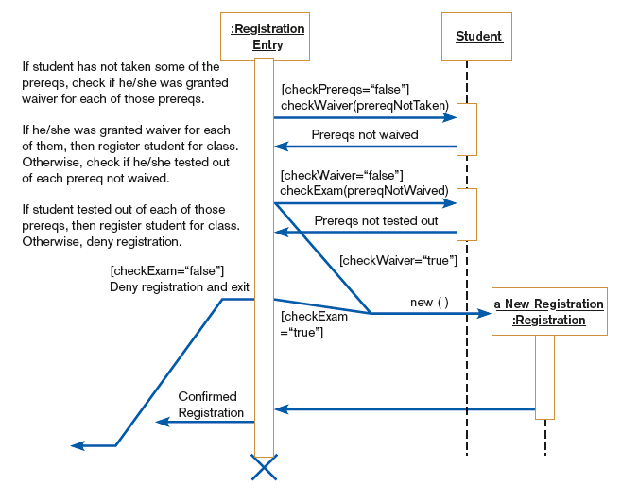
FIGURE 7-39
A generic sequence diagram for the prereq courses not completed use case
Chapter 7 Appendix C
© 2014 Pearson Education, Inc. Publishing as Prentice Hall

Slide 9
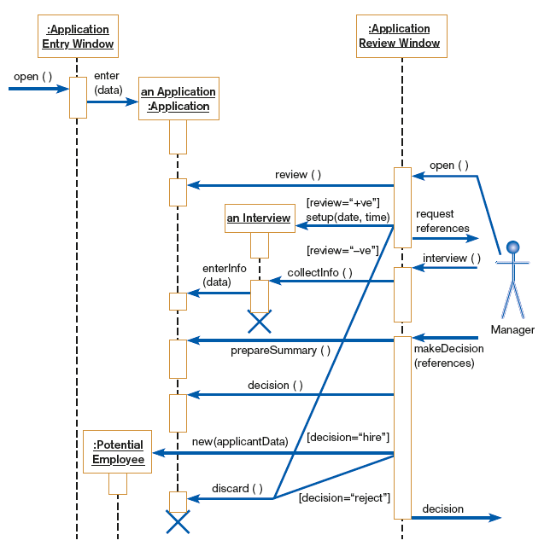
FIGURE 7-40
Sequence diagram for Hoosier Burger’s Hire employee use case
Chapter 7 Appendix C
© 2014 Pearson Education, Inc. Publishing as Prentice Hall

Slide 10
Summary
In this appendix you learned:
How to represent system logic with sequence diagrams.
Chapter 7 Appendix C
© 2014 Pearson Education, Inc. Publishing as Prentice Hall

Slide 11

Copyright © 2014 Pearson Education, Inc.
Publishing as Prentice Hall

