Slide 1
Modern Systems Analysis
and Design
Seventh Edition
Jeffrey A. Hoffer
Joey F. George
Joseph S. Valacich
Chapter 9
Designing Databases

Slide 2
Learning Objectives
Concisely define each of the following key database design terms: relation, primary key, normalization, functional dependency, foreign key, referential integrity, field, data type, null value, denormalization, file organization, index, and secondary key.
Explain the role of designing databases in the analysis and design of an information system.
Transform an entity-relationship (E-R) diagram into an equivalent set of well-structured (normalized) relations.
Chapter 9
© 2014 Pearson Education, Inc. Publishing as Prentice Hall

Slide 3
Learning Objectives (Cont.)
Merge normalized relations from separate user views into a consolidated set of well-structured relations.
Choose storage formats for fields in database tables.
Translate well-structured relations into efficient database tables.
Explain when to use different types of file organizations to store computer files.
Describe the purpose of indexes and the important considerations in selecting attributes to be indexed.
Chapter 9
© 2014 Pearson Education, Inc. Publishing as Prentice Hall

Slide 4
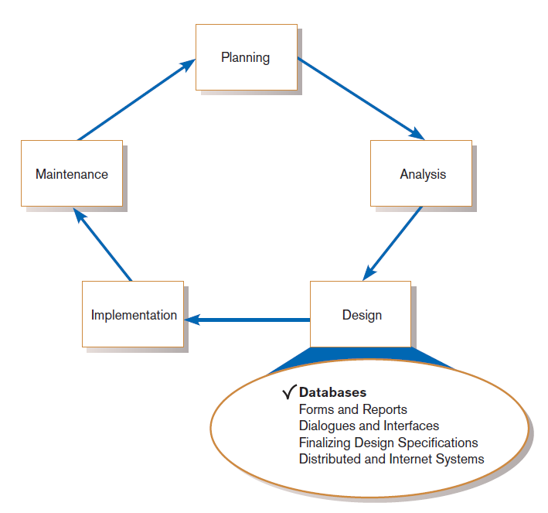
Introduction
FIGURE 9-1
Systems development life cycle with design phase highlighted
Chapter 9
© 2014 Pearson Education, Inc. Publishing as Prentice Hall

Slide 5
Database Design
File and database design occurs in two steps.
  Develop a logical database model, which describes data using notation that corresponds to a data organization used by a database management system.
    Relational database model
  Prescribe the technical specifications for computer files and databases in which to store the data.
    Physical database design provides specifications
Logical and physical database design in parallel with other system design steps
Chapter 9
© 2014 Pearson Education, Inc. Publishing as Prentice Hall

Slide 6
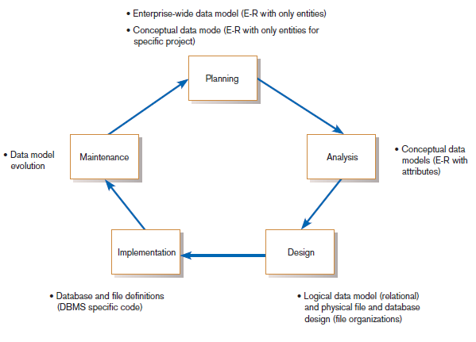
The Process of Database Design
FIGURE 9-2
Relationship between data modeling and the systems development life cycle
Chapter 9
© 2014 Pearson Education, Inc. Publishing as Prentice Hall

Slide 7
The Process of Database Design (Cont.)
Four key steps in logical database modeling and design:
  Develop a logical data model for each known user interface for the application using normalization principles.
  Combine normalized data requirements from all user interfaces into one consolidated logical database model (view integration).
  Translate the conceptual E-R data model for the application into normalized data requirements.
  Compare the consolidated logical database design with the translated E-R model and produce one final logical database model for the application.
Chapter 9
© 2014 Pearson Education, Inc. Publishing as Prentice Hall

Slide 8
Physical Database Design
Key physical database design decisions include:
  Choosing a storage format for each attribute from the logical database model.
  Grouping attributes from the logical database model into physical records.
  Arranging related records in secondary memory (hard disks and magnetic tapes) so that records can be stored, retrieved and updated rapidly.
  Selecting media and structures for storing data to make access more efficient.
Chapter 9
© 2014 Pearson Education, Inc. Publishing as Prentice Hall

Slide 9
Deliverables and Outcomes
Logical database design
  Must account for every data element on a system input or output
    Normalized relations are the primary deliverable.
Physical database design
  Converts relations into database tables
    Programmers and database analysts code the definitions of the database.
    Written in Structured Query Language (SQL)
Chapter 9
© 2014 Pearson Education, Inc. Publishing as Prentice Hall

Slide 10
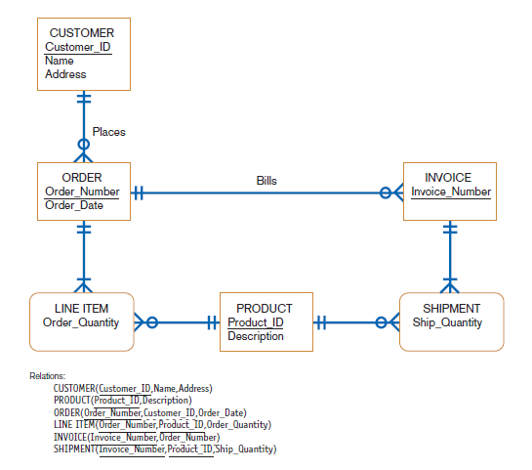
FIGURE 9-3 (d)
Conceptual data model and transformed relations
Chapter 9
© 2014 Pearson Education, Inc. Publishing as Prentice Hall

Slide 11
Relational Database Model
Relational database model: data represented as a set of related tables or relations
Relation: a named, two-dimensional table of data; each relation consists of a set of named columns and an arbitrary number of unnamed rows
Chapter 9
© 2014 Pearson Education, Inc. Publishing as Prentice Hall

Slide 12
Relational Database Model (Cont.)
Relations have several properties that distinguish them from nonrelational tables:
  Entries in cells are simple.
  Entries in columns are from the same set of values.
  Each row is unique.
  The sequence of columns can be interchanged without changing the meaning or use of the relation.
  The rows may be interchanged or stored in any sequence.
Chapter 9
© 2014 Pearson Education, Inc. Publishing as Prentice Hall

Slide 13
Well-Structured Relation and Primary Keys
Well-Structured Relation (or table)
  A relation that contains a minimum amount of redundancy
  Allows users to insert, modify, and delete the rows without errors or inconsistencies
Primary Key
  An attribute whose value is unique across all occurrences of a relation
All relations have a primary key.
  This is how rows are ensured to be unique.
  A primary key may involve a single attribute or be composed of multiple attributes.
Chapter 9
© 2014 Pearson Education, Inc. Publishing as Prentice Hall

Slide 14
Normalization and Rules of Normalization
Normalization: the process of converting complex data structures into simple, stable data structures
The result of normalization is that every nonprimary key attribute depends upon the whole primary key.
Chapter 9
© 2014 Pearson Education, Inc. Publishing as Prentice Hall

Slide 15
Normalization and Rules of Normalization (Cont.)
First Normal Form (1NF)
  Unique rows, no multivalued attributes
  All relations are in 1NF
Second Normal Form (2NF)
  Each nonprimary key attribute is identified by the whole key (called full functional dependency)
Third Normal Form (3NF)
  Nonprimary key attributes do not depend on each other (i.e. no transitive dependencies)
Chapter 9
© 2014 Pearson Education, Inc. Publishing as Prentice Hall

Slide 16
Functional Dependencies and Primary Keys
Functional Dependency: a particular relationship between two attributes
  For a given relation, attribute B is functionally dependent on attribute A if, for every valid value of A, that value of A uniquely determines the value of B.
  The functional dependence of B on A is represented by A→B.
Chapter 9
© 2014 Pearson Education, Inc. Publishing as Prentice Hall

Slide 17
Functional Dependencies and Primary Keys (Cont.)
Functional dependency is not a mathematical dependency.
Instances (or sample data) in a relation do not prove the existence of a functional dependency.
Knowledge of problem domain is most reliable method for identifying functional dependency.
Chapter 9
© 2014 Pearson Education, Inc. Publishing as Prentice Hall

Slide 18
Second Normal Form (2NF)
A relation is in second normal form (2NF) if any of the following conditions apply:
  The primary key consists of only one attribute.
  No nonprimary key attributes exist in the relation.
  Every nonprimary key attribute is functionally dependent on the full set of primary key attributes.
To convert a relation into 2NF, decompose the relation into new relations using the attributes, called determinants, that determine other attributes.
The determinants are the primary keys of the new relations.
Chapter 9
© 2014 Pearson Education, Inc. Publishing as Prentice Hall

Slide 19
Third Normal Form (3NF)
A relation is in third normal form (3NF) if it is in second normal form (2NF) and there are no functional (transitive) dependencies between two (or more) nonprimary key attributes.
Chapter 9
© 2014 Pearson Education, Inc. Publishing as Prentice Hall

Slide 20
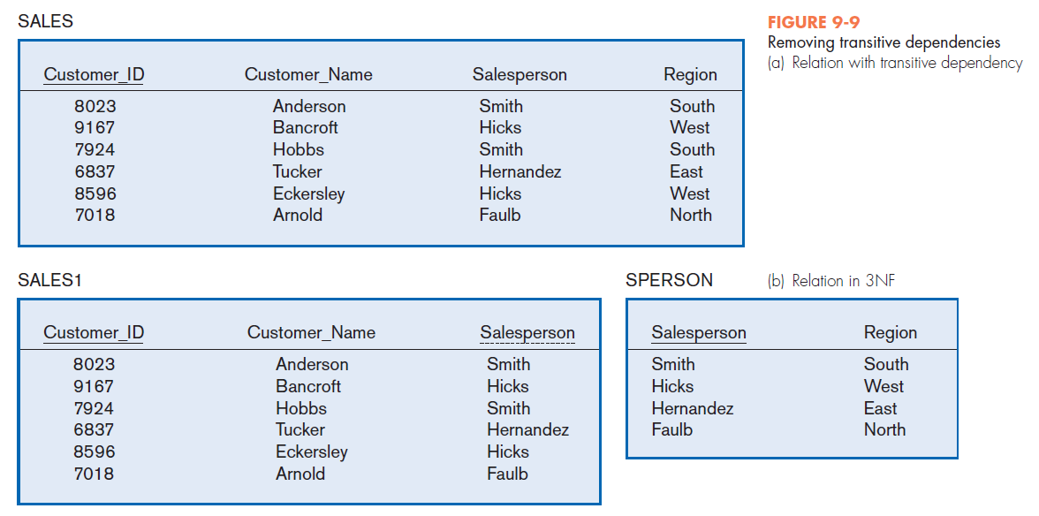
Chapter 9
© 2014 Pearson Education, Inc. Publishing as Prentice Hall

Slide 21
Third Normal Form (3NF) (Cont.)
Foreign Key: an attribute that appears as a nonprimary key attribute in one relation and as a primary key attribute (or part of a primary key) in another relation
Referential Integrity: an integrity constraint specifying that the value (or existence) of an attribute in one relation depends on the value (or existence) of the same attribute in another relation
Chapter 9
© 2014 Pearson Education, Inc. Publishing as Prentice Hall

Slide 22
Transforming E-R Diagrams into Relations
It is useful to transform the conceptual data model into a set of normalized relations.
Steps
  Represent entities.
  Represent relationships.
  Normalize the relations.
  Merge the relations.
Chapter 9
© 2014 Pearson Education, Inc. Publishing as Prentice Hall

Slide 23
Representing Entities
Each regular entity is transformed into a relation.
The identifier of the entity type becomes the primary key of the corresponding relation.
Chapter 9
© 2014 Pearson Education, Inc. Publishing as Prentice Hall

Slide 24
Representing Entities
The primary key must satisfy the following two conditions.
  The value of the key must uniquely identify every row in the relation.
  The key should be nonredundant.
The entity type label is translated into a relation name.
Chapter 9
© 2014 Pearson Education, Inc. Publishing as Prentice Hall

Slide 25
Binary 1:N and 1:1Relationships
The procedure for representing relationships depends on both the degree of the relationship—unary, binary, ternary—and the cardinalities of the relationship.
Binary 1:N Relationship is represented by adding the primary key attribute (or attributes) of the entity on the one side of the relationship as a foreign key in the relation that is on the many side of the relationship.
Chapter 9
© 2014 Pearson Education, Inc. Publishing as Prentice Hall

Slide 26
Binary 1:N and 1:1Relationships (Cont.)
Binary or Unary 1:1 Relationship is represented by any of the following choices:
  Add the primary key of A as a foreign key of B.
  Add the primary key of B as a foreign key of A.
  Both of the above
Chapter 9
© 2014 Pearson Education, Inc. Publishing as Prentice Hall

Slide 27
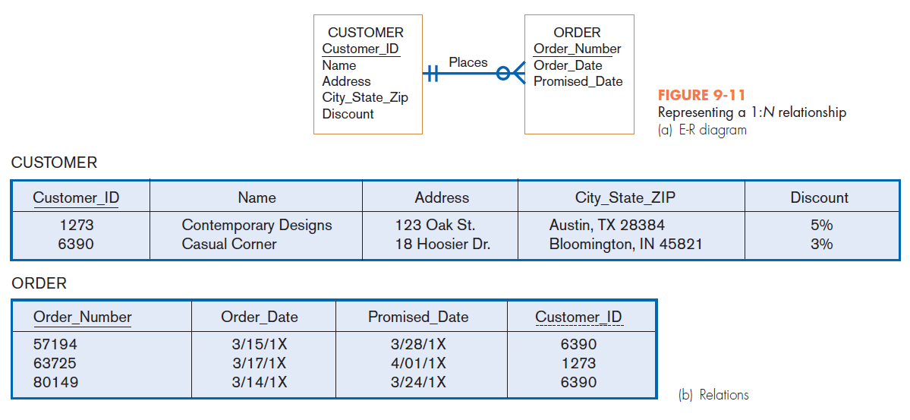
Chapter 9
© 2014 Pearson Education, Inc. Publishing as Prentice Hall

Slide 28
Binary and Higher-Degree M:N Relationships
Create another relation and include primary keys of all relations as primary key of new relation
Chapter 9
© 2014 Pearson Education, Inc. Publishing as Prentice Hall

Slide 29
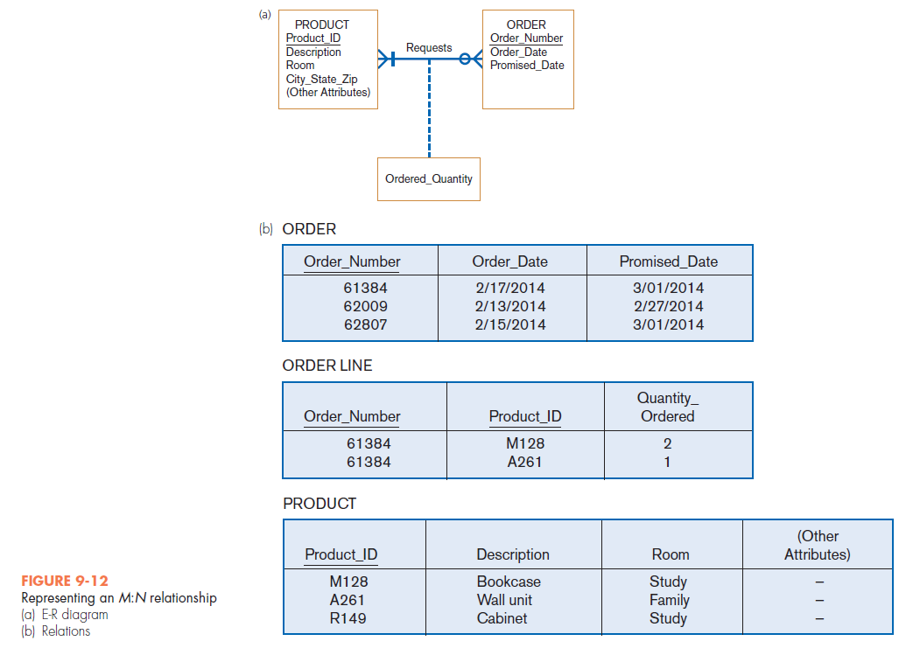
Chapter 9
© 2014 Pearson Education, Inc. Publishing as Prentice Hall

Slide 30
Unary Relationships
Unary 1:N Relationship
  Is modeled as a relation
  Primary key of that relation is the same as for the entity type
  Foreign key is added to the relation that references the primary key values
Recursive foreign key: a foreign key in a relation that references the primary key values of that same relation
Chapter 9
© 2014 Pearson Education, Inc. Publishing as Prentice Hall

Slide 31
Unary Relationships
Unary M:N Relationship
  Model as one relation, then
  Create a separate relation to represent the M:N relationship.
  The primary key of the new relation is a composite key of two attributes that both take their values from the same primary key.
  Any attribute associated with the relationship is included as a nonkey attribute in this new relation.
Chapter 9
© 2014 Pearson Education, Inc. Publishing as Prentice Hall

Slide 32
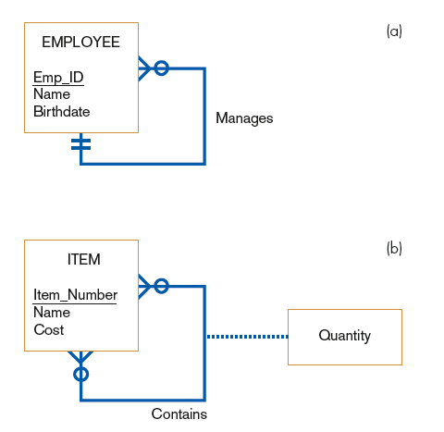

FIGURE 9-13
Two unary relationships
(a) EMPLOYEE with Manages
relationship (1:N)
(b) Bill-of-materials
structure (M:N)
Chapter 9
© 2014 Pearson Education, Inc. Publishing as Prentice Hall

Slide 33
Merging Relations
Purpose is to remove redundant relations
The last step in logical database design
Prior to physical file and database design
Chapter 9
© 2014 Pearson Education, Inc. Publishing as Prentice Hall

Slide 34
View Integration Problems
Must understand the meaning of the data and be prepared to resolve any problems that arise in the process
Synonyms: two different names used for the same attribute
  When merging, get agreement from users on a single, standard name.
Chapter 9
© 2014 Pearson Education, Inc. Publishing as Prentice Hall

Slide 35
View Integration Problems (Cont.)
Homonyms: a single attribute name that is used for two or more different attributes.
  Resolved by creating a new name
Dependencies between nonkeys— dependencies may be created as a result of view integration
  To resolve, the new relation must be normalized
Chapter 9
© 2014 Pearson Education, Inc. Publishing as Prentice Hall

Slide 36
View Integration Problems (Cont.)
Class/Subclass — relationships may be hidden in user views or relations
  Resolved by creating a new name
Chapter 9
© 2014 Pearson Education, Inc. Publishing as Prentice Hall

Slide 37
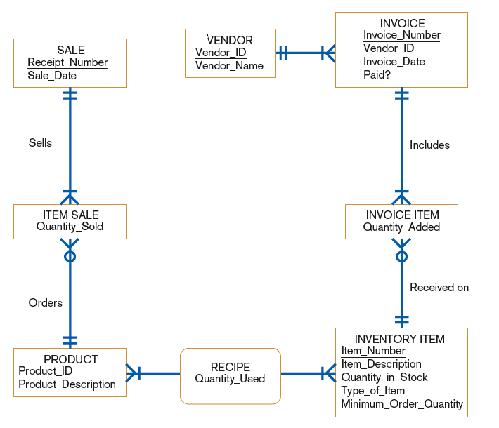
FIGURE 9-16
Class diagram corresponding to normalized relations of Hoosier Burger‘s inventory control system
Chapter 9
© 2014 Pearson Education, Inc. Publishing as Prentice Hall

Slide 38

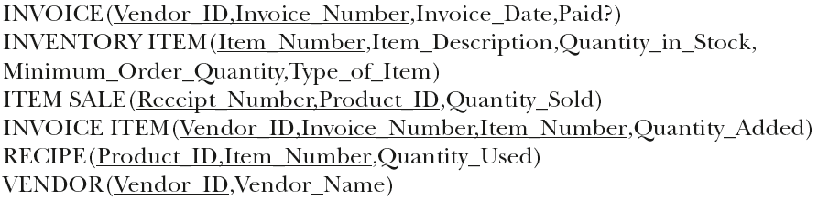
Relations for Hoosier Burger
Chapter 9
© 2014 Pearson Education, Inc. Publishing as Prentice Hall

Slide 39
Physical File and Database Design
The following information is required:
  Normalized relations, including volume estimates
  Definitions of each attribute
  Descriptions of where and when data are used, entered, retrieved, deleted, and updated (including frequencies)
  Expectations or requirements for response time and data integrity
  Descriptions of the technologies used for implementing the files and database
Chapter 9
© 2014 Pearson Education, Inc. Publishing as Prentice Hall

Slide 40
Designing Fields
Field: the smallest unit of named application data recognized by system software
  Attributes from relations will be represented as fields
Data Type: a coding scheme recognized by system software for representing organizational data
Chapter 9
© 2014 Pearson Education, Inc. Publishing as Prentice Hall

Slide 41
Choosing Data Types
Selecting a data type balances four objectives:
  Minimize storage space.
  Represent all possible values of the field.
  Improve data integrity of the field.
  Support all data manipulations desired on the field.
Chapter 9
© 2014 Pearson Education, Inc. Publishing as Prentice Hall

Slide 42
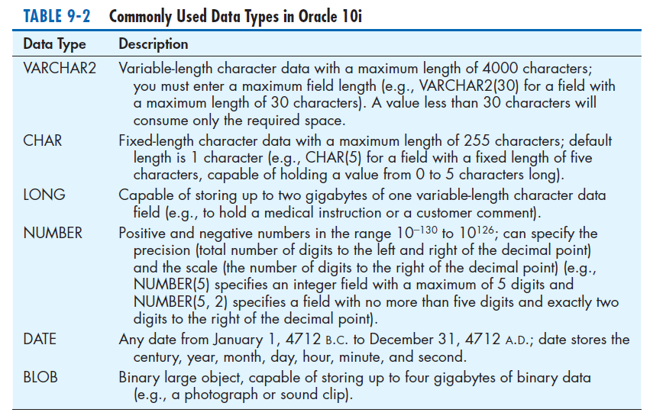
Chapter 9
© 2014 Pearson Education, Inc. Publishing as Prentice Hall

Slide 43
Calculated Fields
Calculated (or computed or derived) field: a field that can be derived from other database fields
It is common for an attribute to be mathematically related to other data.
The calculate value is either stored or computed when it is requested.
Chapter 9
© 2014 Pearson Education, Inc. Publishing as Prentice Hall

Slide 44
Controlling Data Integrity
Default Value: a value a field will assume unless an explicit value is entered for that field
Range Control: limits range of values that can be entered into field
  Both numeric and alphanumeric data
Referential Integrity: an integrity constraint specifying that the value (or existence) of an attribute in one relation depends on the value (or existence) of the same attribute in another relation
Null Value: a special field value, distinct from zero, blank, or any other value, that indicates that the value for the field is missing or otherwise unknown
Chapter 9
© 2014 Pearson Education, Inc. Publishing as Prentice Hall

Slide 45
Designing Physical Tables
Relational database is a set of related tables.
Physical Table: a named set of rows and columns that specifies the fields in each row of the table
Denormalization: the process of splitting or combining normalized relations into physical tables based on affinity of use of rows and fields
Denormalization optimizes certain data processing activities at the expense of others.
Chapter 9
© 2014 Pearson Education, Inc. Publishing as Prentice Hall

Slide 46
Designing Physical Tables (Cont.)
Three types of table partitioning:
  Range partitioning: partitions are defined by nonoverlapping ranges of values for a specified attribute
  Hash partitioning: a table row is assigned to a partition by an algorithm and then maps the specified attribute value to a partition
  Composite partitioning: combines range and hash partitioning by first segregating data by ranges on the designated attribute, and then within each of these partitions
Chapter 9
© 2014 Pearson Education, Inc. Publishing as Prentice Hall

Slide 47
Designing Physical Tables (Cont.)
Various forms of denormalization, which involves combining data from several normalized tables, can be done.
  No hard-and-fast rules for deciding
Three common situations where denormalization may be used:
  Two entities with a one-to-one relationship
  A many-to-many relationship (associative entity) with nonkey attributes
  Reference data
Chapter 9
© 2014 Pearson Education, Inc. Publishing as Prentice Hall

Slide 48
File Organizations
File organization: a technique for physically arranging the records of a file
Physical file: a named set of table rows stored in a contiguous section of secondary memory
Chapter 9
© 2014 Pearson Education, Inc. Publishing as Prentice Hall

Slide 49
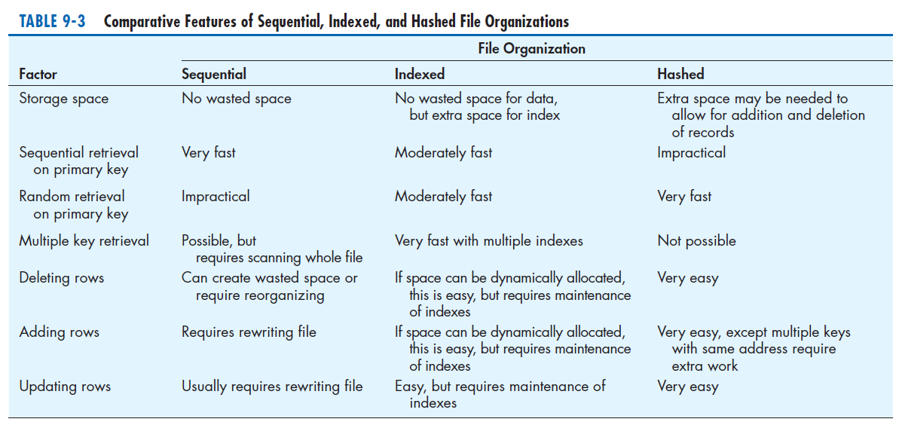
File Organizations (Cont.)
Chapter 9
© 2014 Pearson Education, Inc. Publishing as Prentice Hall

Slide 50
File Organizations (Cont.)
Sequential file organization: a file organization in which rows in a file are stored in sequence according to a primary key value
Hashed file organization: a file organization in which the address for each row is determined using an algorithm
Pointer: a field of data that can be used to locate a related field or row of data
Chapter 9
© 2014 Pearson Education, Inc. Publishing as Prentice Hall

Slide 51
Arranging Table Rows
Objectives for choosing file organization
  Fast data retrieval
  High throughput for processing transactions
  Efficient use of storage space
  Protection from failures or data loss
  Minimizing need for reorganization
  Accommodating growth
  Security from unauthorized use
Chapter 9
© 2014 Pearson Education, Inc. Publishing as Prentice Hall

Slide 52
Indexed File Organization
Indexed file organization: a file organization in which rows are stored either sequentially or nonsequentially, and an index is created that allows software to locate individual rows
Index: a table used to determine the location of rows in a file that satisfy some condition
Secondary keys: one or a combination of fields for which more than one row may have the same combination of values
Chapter 9
© 2014 Pearson Education, Inc. Publishing as Prentice Hall

Slide 53
Indexed File Organization (Cont.)
Main disadvantages:
  Extra space required to store the indexes
  Extra time necessary to access and maintain indexes
Main advantage:
  Allows for both random and sequential processing
Guidelines for choosing indexes
  Specify a unique index for the primary key of each table.
  Specify an index for foreign keys.
  Specify an index for nonkey fields that are referenced in qualification, sorting and grouping commands for the purpose of retrieving data.
Chapter 9
© 2014 Pearson Education, Inc. Publishing as Prentice Hall

Slide 54
Designing Controls for Files
Two of the goals of physical table design are protection from failure or data loss and security from unauthorized use.
These goals are achieved primarily by implementing controls on each file.
Two other important types of controls address file backup and security.
Chapter 9
© 2014 Pearson Education, Inc. Publishing as Prentice Hall

Slide 55
Designing Controls for Files (Cont.)
Techniques for file restoration include:
  Periodically making a backup copy of a file.
  Storing a copy of each change to a file in a transaction log or audit trail.
  Storing a copy of each row before or after it is changed.
Means of building data security into a file include:
  Coding, or encrypting, the data in the file.
  Requiring data file users to identify themselves by entering user names and passwords.
  Prohibiting users from directly manipulating any data in the file by forcing users to work with a copy (real or virtual).
Chapter 9
© 2014 Pearson Education, Inc. Publishing as Prentice Hall

Slide 56
Physical Database Design for Hoosier Burger
The following decisions need to be made:
  Decide to create one or more fields for each attribute and determine a data type for each field.
  For each field, decide if it is calculated; needs to be coded or compressed; must have a default value or picture; or must have range, referential integrity, or null value controls.
  For each relation, decide if it should be denormalized to achieve desired processing efficiencies.
  Choose a file organization for each physical file.
  Select suitable controls for each file and the database.
Chapter 9
© 2014 Pearson Education, Inc. Publishing as Prentice Hall

Slide 57
Electronic Commerce Application: Designing Databases
Designing databases for Pine Valley Furniture’s WebStore
  Review the conceptual model (E-R diagram).
  Examine the lists of attributes for each entity.
  Complete the database design.
  Share all design information with project team to be turned into a working database during implementation.
Chapter 9
© 2014 Pearson Education, Inc. Publishing as Prentice Hall

Slide 58
Summary
In this chapter you learned how to:
Concisely define each of the following key database design terms: relation, primary key, normalization, functional dependency, foreign key, referential integrity, field, data type, null value, denormalization, file organization, index, and secondary key.
Explain the role of designing databases in the analysis and design of an information system.
Transform an entity-relationship (E-R) diagram into an equivalent set of well-structured (normalized) relations.
Chapter 9
© 2014 Pearson Education, Inc. Publishing as Prentice Hall

Slide 59
Summary (Cont.)
Merge normalized relations from separate user views into a consolidated set of well-structured relations.
Choose storage formats for fields in database tables.
Translate well-structured relations into efficient database tables.
Explain when to use different types of file organizations to store computer files.
Describe the purpose of indexes and the important considerations in selecting attributes to be indexed.
Chapter 9
© 2014 Pearson Education, Inc. Publishing as Prentice Hall

Slide 60

Copyright © 2014 Pearson Education, Inc.
Publishing as Prentice Hall

