Slide 1
Modern Systems Analysis
and Design
Seventh Edition
Jeffrey A. Hoffer
Joey F. George
Joseph S. Valacich
Chapter 11
Designing Interfaces and Dialogues

Slide 2
Learning Objectives
Explain the process of designing interfaces and dialogues and the deliverables for their creation.
Contrast and apply several methods for interacting with a system.
List and describe various input devices and discuss usability issues for each in relation to performing different tasks.
Describe and apply the general guidelines for designing interfaces and specific guidelines for layout design, structuring data entry fields, providing feedback, and system help.
Chapter 11
© 2014 Pearson Education, Inc. Publishing as Prentice Hall

Slide 3
Learning Objectives (Cont.)
Design human-computer dialogues and understand how dialogue diagramming can be used to design dialogues.
Design graphical user interfaces.
Discuss guidelines for the design of interfaces and dialogues for Internet-based electronic commerce systems.
Chapter 11
© 2014 Pearson Education, Inc. Publishing as Prentice Hall

Slide 4
Designing Interfaces and Dialogues
User-focused activity
Prototyping methodology of iteratively:
  Collecting information
  Constructing a prototype
  Assessing usability
  Making refinements
Must answer the who, what, where, and how questions
Chapter 11
© 2014 Pearson Education, Inc. Publishing as Prentice Hall

Slide 5
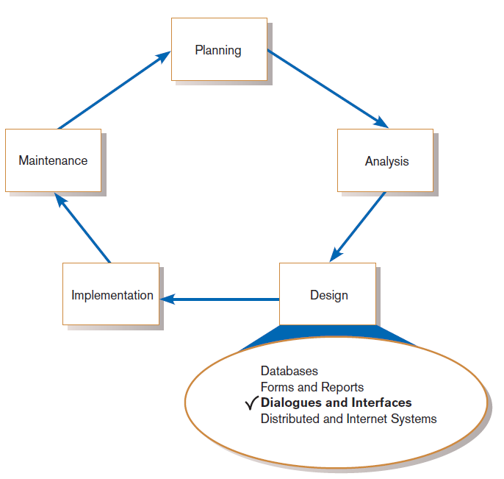
Designing Interfaces and Dialogues (Cont.)
FIGURE 11-1
Systems development life cycle (SDLC)
Chapter 11
© 2014 Pearson Education, Inc. Publishing as Prentice Hall

Slide 6
Deliverables and Outcomes
Creation of a design specification
  A typical interface/dialogue design specification is similar to form design, but includes multiple forms and dialogue sequence specifications.
Chapter 11
© 2014 Pearson Education, Inc. Publishing as Prentice Hall

Slide 7
Deliverables and Outcomes (Cont.)
The specification includes:
  Narrative overview
  Sample design
  Testing and usability assessment
  Dialogue sequence
Dialogue sequence—the ways a user can move from one display to another
Chapter 11
© 2014 Pearson Education, Inc. Publishing as Prentice Hall

Slide 8
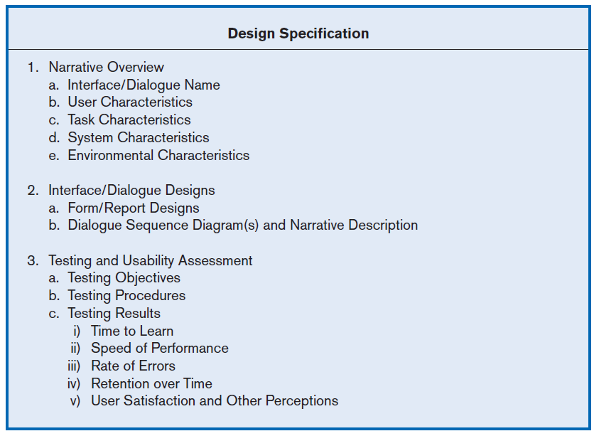
Figure 11-2
Specification outline for the design of interfaces and dialogues
Chapter 11
© 2014 Pearson Education, Inc. Publishing as Prentice Hall

Slide 9
Interaction Methods and Devices
Interface: a method by which users interact with an information system
All human-computer interfaces must:
  have an interaction style, and
  use some hardware device(s) for supporting this interaction.
Chapter 11
© 2014 Pearson Education, Inc. Publishing as Prentice Hall

Slide 10
Methods of Interacting
Command line
  Includes keyboard shortcuts and function keys
Menu
Form
Object-based
Natural language
Chapter 11
© 2014 Pearson Education, Inc. Publishing as Prentice Hall

Slide 11
Command Language Interaction
Command language interaction: a human-computer interaction method whereby users enter explicit statements into a system to invoke operations
Example from MS DOS:
  COPY C:PAPER.DOC A:PAPER.DOC
  Command copies a file from C: drive to A: drive
Chapter 11
© 2014 Pearson Education, Inc. Publishing as Prentice Hall

Slide 12
Menu Interaction
Menu interaction: a human-computer interaction method in which a list of system options is provided and a specific command is invoked by user selection of a menu option
Pop-up menu: a menu-positioning method that places a menu near the current cursor position
Chapter 11
© 2014 Pearson Education, Inc. Publishing as Prentice Hall

Slide 13
Menu Interaction (Cont.)
Drop-down menu is a menu-positioning method that places the access point of the menu near the top line of the display.
  When accessed, menus open by dropping down onto the display.
  Visual editing tools help designers construct menus.
Chapter 11
© 2014 Pearson Education, Inc. Publishing as Prentice Hall

Slide 14
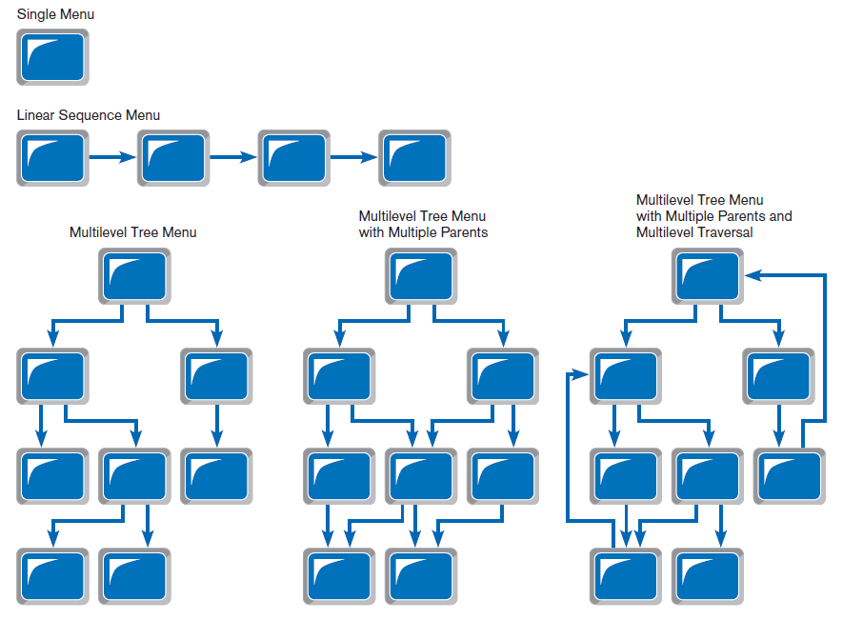
Figure 11-5
Various types of menu configurations
(Source: Based on Shneiderman et al., 2009.)
Chapter 11
© 2014 Pearson Education, Inc. Publishing as Prentice Hall

Slide 15
Menu Interaction (Cont.)
Guidelines for Menu Design
  Wording — meaningful titles, clear command verbs, mixed upper/lower case
  Organization — consistent organizing principle
  Length — all choices fit within screen length
  Selection — consistent, clear and easy selection methods
  Highlighting — only for selected options or unavailable options
Chapter 11
© 2014 Pearson Education, Inc. Publishing as Prentice Hall

Slide 16
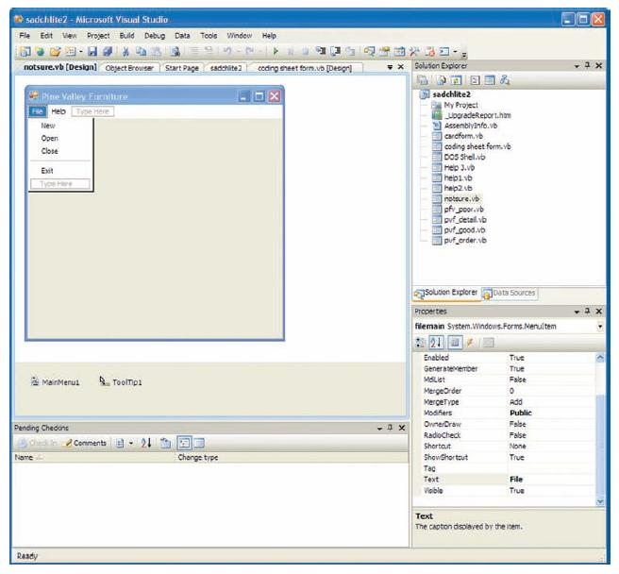
Menu Interaction (Cont.)
FIGURE 11-8
Menu building with Microsoft Visual Basic .NET
Chapter 11
© 2014 Pearson Education, Inc. Publishing as Prentice Hall

Slide 17
Form Interaction
Form interaction: a highly intuitive human-computer interaction method whereby data fields are formatted in a manner similar to paper-based forms
  Allows users to fill in the blanks when working with a system.
Chapter 11
© 2014 Pearson Education, Inc. Publishing as Prentice Hall

Slide 18
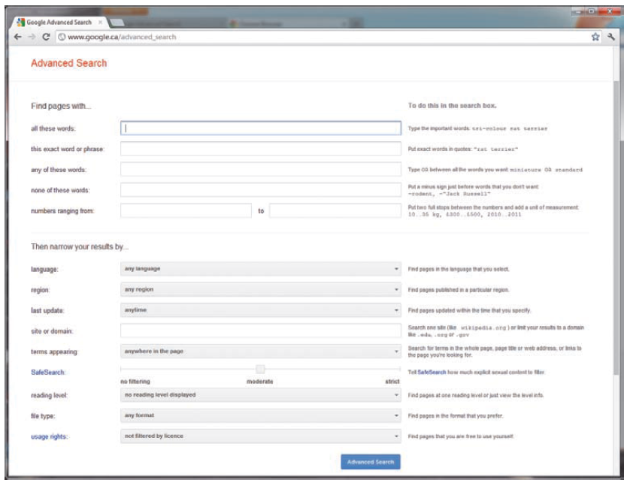
Form Interaction (Cont.)
FIGURE 11-9
Example of form interaction from the Google Advanced Search Engine
(Source: Google.)
Chapter 11
© 2014 Pearson Education, Inc. Publishing as Prentice Hall

Slide 19
Object-Based Interaction
Object-based interaction: a human-computer interaction method in which symbols are used to represent commands or functions
Icons: graphical pictures that represent specific functions within a system
  Use little screen space and are easily understood by users
Chapter 11
© 2014 Pearson Education, Inc. Publishing as Prentice Hall

Slide 20
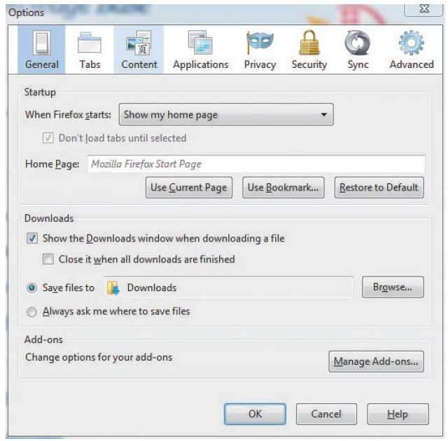
Object-Based Interaction (Cont.)
Figure 11-10
Object-based (icon) interface from the Option menu in the Firefox Web browser
Chapter 11
© 2014 Pearson Education, Inc. Publishing as Prentice Hall

Slide 21
Natural Language Interaction
Natural language interaction: a human-computer interaction method whereby inputs to and outputs from a computer-based application are in a conventional spoken language such as English
Based on research in artificial intelligence
Current implementations are tedious and difficult to work with, not as viable as other interaction methods.
Chapter 11
© 2014 Pearson Education, Inc. Publishing as Prentice Hall

Slide 22
Hardware Options for System Interaction
Keyboard
Mouse
Joystick
Trackball
Touch screen
Light Pen
Graphics Tablet
Voice
Chapter 11
© 2014 Pearson Education, Inc. Publishing as Prentice Hall

Slide 23
Usability Problems with Hardware Devices
Visual Blocking
  Extent to which device blocks display when using
User Fatigue
  Potential for fatigue over long use
Movement Scaling
  Extent to which device movement translates to equivalent screen movement
Durability
  Lack of durability or need for maintenance (e.g., cleaning) over extended use
Chapter 11
© 2014 Pearson Education, Inc. Publishing as Prentice Hall

Slide 24
Usability Problems with Hardware Devices (Cont.)
Adequate Feedback
  Extent to which device provides adequate feedback for each operation
Speed
  Cursor movement speed
Pointing Accuracy
  Ability to precisely direct cursor
(Source: Based on Blattner and Schultz, 1988.)
Chapter 11
© 2014 Pearson Education, Inc. Publishing as Prentice Hall

Slide 25
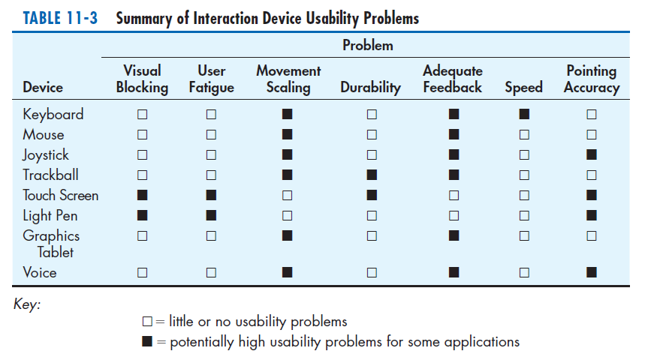
Usability Problems with Hardware Devices (Cont.)
Chapter 11
© 2014 Pearson Education, Inc. Publishing as Prentice Hall

Slide 26
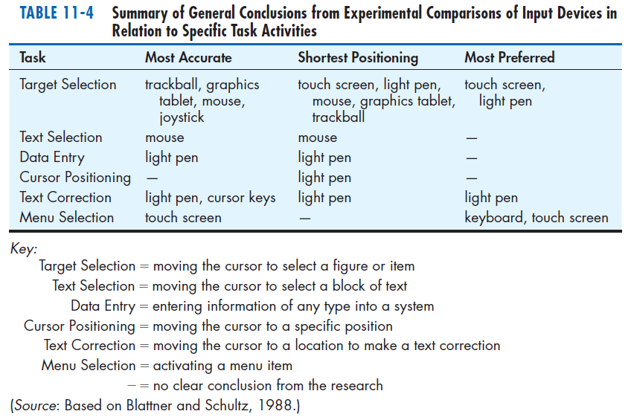
Usability Problems with Hardware Devices (Cont.)
Chapter 11
© 2014 Pearson Education, Inc. Publishing as Prentice Hall

Slide 27
Designing Interfaces
Forms have several general areas in common:
  Header information
  Sequence and time-related information
  Instruction or formatting information
  Body or data details
  Totals or data summary
  Authorization or signatures
  Comments
Chapter 11
© 2014 Pearson Education, Inc. Publishing as Prentice Hall

Slide 28
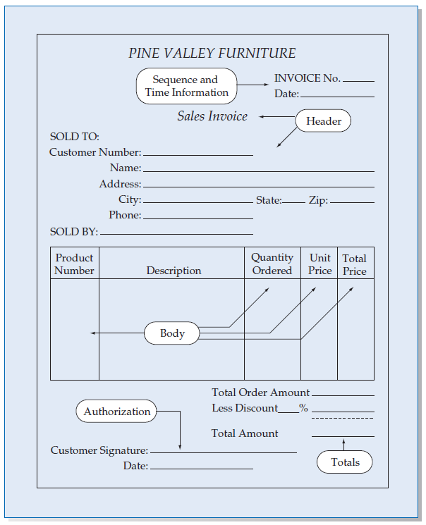
Figure 11-11
Paper-based form for reporting customer
sales activity (Pine Valley Furniture)
Chapter 11
© 2014 Pearson Education, Inc. Publishing as Prentice Hall

Slide 29
Designing Interfaces (Cont.)
Use standard formats similar to paper-based forms and reports.
Use left-to-right, top-to-bottom navigation.
Chapter 11
© 2014 Pearson Education, Inc. Publishing as Prentice Hall

Slide 30
Designing Interfaces (Cont.)
Flexibility and consistency:
  Free movement between fields
  No permanent data storage until the user requests
  Each key and command assigned to one function
Chapter 11
© 2014 Pearson Education, Inc. Publishing as Prentice Hall

Slide 31
Structuring Data Entry
Entry | Never require data that are already online or that can be computed
Defaults | Always provide default values when appropriate
Units | Make clear the type of data units requested for entry
Replacement | Use character replacement when appropriate
Captioning | Always place a caption adjacent to fields
Format | Provide formatting examples
Justify | Automatically justify data entries
Help | Provide context-sensitive help when appropriate
Chapter 11
© 2014 Pearson Education, Inc. Publishing as Prentice Hall

Slide 32
Controlling Data Input
Objective: Reduce data entry errors
Common sources of data entry errors in a field:
  Appending: adding additional characters
  Truncating: losing characters
  Transcripting: entering invalid data
  Transposing: reversing sequence of characters
Chapter 11
© 2014 Pearson Education, Inc. Publishing as Prentice Hall

Slide 33
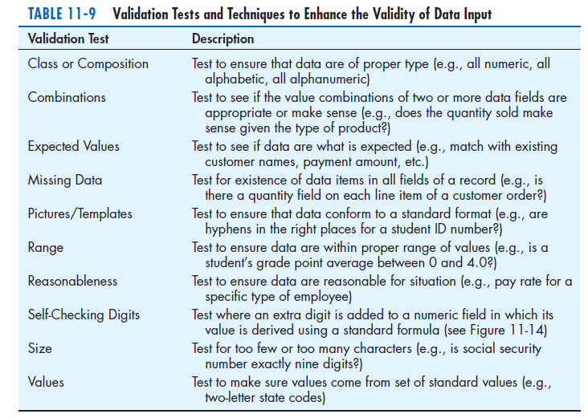
Chapter 11
© 2014 Pearson Education, Inc. Publishing as Prentice Hall

Slide 34
Providing Feedback
Three types of system feedback:
  Status information: keep user informed of what’s going on, helpful when user has to wait for response
  Prompting cues: tell user when input is needed, and how to provide the input
  Error or warning messages: inform user that something is wrong, either with data entry or system operation
Chapter 11
© 2014 Pearson Education, Inc. Publishing as Prentice Hall

Slide 35
Providing Help
Place yourself in user’s place when designing help.
Guidelines for designing usable help:
  Simplicity — Help messages should be short and to the point.
  Organize — Information in help messages should be easily absorbed by users.
  Show — It is useful to explicitly show users how to perform an operation.
Chapter 11
© 2014 Pearson Education, Inc. Publishing as Prentice Hall

Slide 36
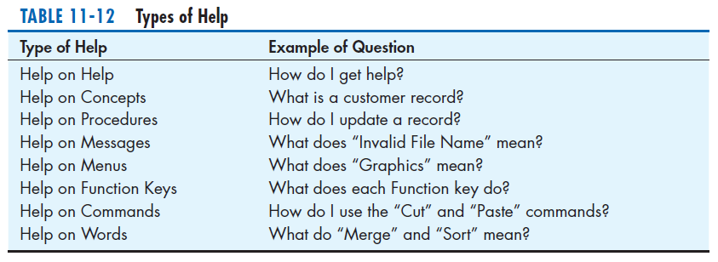
Types of Help
Chapter 11
© 2014 Pearson Education, Inc. Publishing as Prentice Hall

Slide 37
Designing Dialogues
Dialogue: the sequence of interaction between a user and a system
Dialogue design involves:
  Designing a dialogue sequence.
  Building a prototype.
  Assessing usability.
Chapter 11
© 2014 Pearson Education, Inc. Publishing as Prentice Hall

Slide 38
Designing the Dialogue Sequence
Typical dialogue between user and Customer Information System:
  Request to view individual customer information.
  Specify the customer of interest.
  Select the year-to-date transaction summary display.
  Review the customer information.
  Leave system.
Chapter 11
© 2014 Pearson Education, Inc. Publishing as Prentice Hall

Slide 39
Guidelines for Designing Human-Computer Dialogues
Consistency
Shortcuts and Sequence
Feedback
Closure
Error Handling
Reversal
Control
Ease
Chapter 11
© 2014 Pearson Education, Inc. Publishing as Prentice Hall

Slide 40
Designing the Dialogue Sequence (Cont.)
Dialogue diagramming: a formal method for designing and representing human-computer dialogues using box and line diagrams
Chapter 11
© 2014 Pearson Education, Inc. Publishing as Prentice Hall

Slide 41
Designing the Dialogue Sequence (Cont.)
Three sections of the box:
  Top—contains a unique display reference number used by other displays for referencing it
  Middle—contains the name or description of the display
  Bottom—contains display reference numbers that can be accessed from the current display
Chapter 11
© 2014 Pearson Education, Inc. Publishing as Prentice Hall

Slide 42
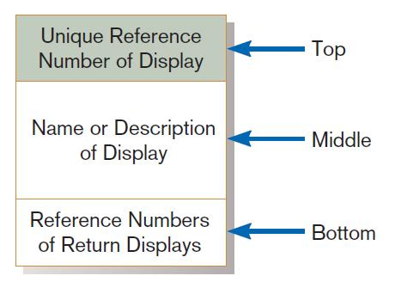
Designing the Dialogue Sequence (Cont.)
FIGURE 11-17
Sections of a dialogue diagramming box
Chapter 11
© 2014 Pearson Education, Inc. Publishing as Prentice Hall

Slide 43
Designing the Dialogue Sequence (Cont.)
Dialogue diagrams depict the sequence, conditional branching, and repetition of dialogues.
Chapter 11
© 2014 Pearson Education, Inc. Publishing as Prentice Hall

Slide 44
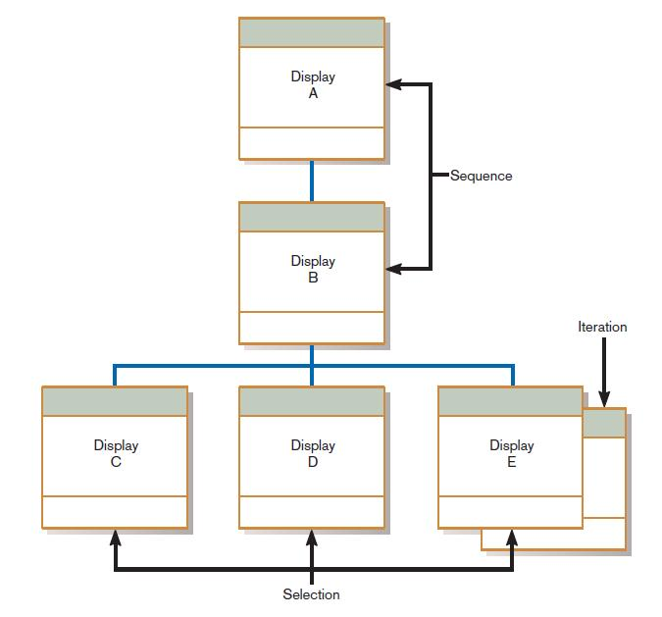
Designing the Dialogue Sequence (Cont.)
FIGURE 11-18
Dialogue diagram illustrating sequence, selection, and iteration
Chapter 11
© 2014 Pearson Education, Inc. Publishing as Prentice Hall

Slide 45
Building Prototypes and Assessing Usability
Optional activities
Building prototype displays using a graphical development environment
  Example: Microsoft’s Visual Studio .NET
  Easy-to-use input and output (form, report, or window) design utilities
Chapter 11
© 2014 Pearson Education, Inc. Publishing as Prentice Hall

Slide 46
Graphical Interface Design Issues
Become an expert user of the GUI environment.
  Understand how other applications have been designed.
  Understand standards.
Understand the available resources and how they can be used.
  Become familiar with standards for menus and forms.
Chapter 11
© 2014 Pearson Education, Inc. Publishing as Prentice Hall

Slide 47
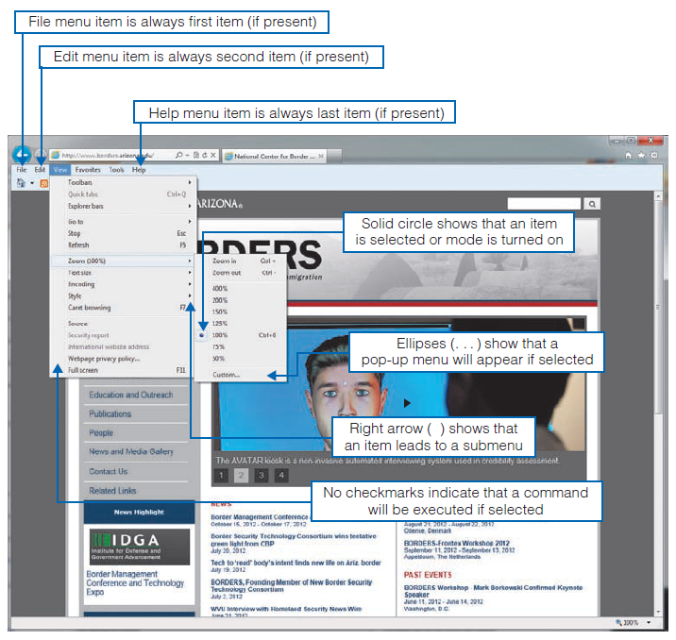
Graphical Interface Design Issues (Cont.)
Figure 11-20
Highlighting GUI design standards
(Source: University of Arizona.)
Chapter 11
© 2014 Pearson Education, Inc. Publishing as Prentice Hall

Slide 48
Electronic Commerce Application: Designing Interfaces and Dialogues for Pine Valley Furniture WebStore
Central and critical design activity
Where customer interacts with the company
  Care must be put in design!
Prototyping design process is most appropriate to design the human interface.
Several general design guidelines have emerged.
Chapter 11
© 2014 Pearson Education, Inc. Publishing as Prentice Hall

Slide 49
General Guidelines
Web’s single “click-to-act” method of loading static hypertext documents (i.e. most buttons on the Web do not provide click feedback)
Limited capabilities of most Web browsers to support finely grained user interactivity
Chapter 11
© 2014 Pearson Education, Inc. Publishing as Prentice Hall

Slide 50
General Guidelines
Limited agreed-upon standards for encoding Web content and control mechanisms
Lack of maturity of Web scripting and programming languages as well as limitations in commonly used Web GUI component libraries
Chapter 11
© 2014 Pearson Education, Inc. Publishing as Prentice Hall

Slide 51
Designing Interfaces and Dialogues for Pine Valley Furniture
Key feature PVF wants for their WebStore:
  Incorporate “menu-driven navigation with cookie crumbs” into design of interface
Chapter 11
© 2014 Pearson Education, Inc. Publishing as Prentice Hall

Slide 52
Menu-Driven Navigation with Cookie Crumbs
Cookie crumbs: the technique of placing “tabs” on a Web page that show a user where he or she is on a site and where he or she has been
  Allow users to navigate to a point previously visited and will assure they are not lost
  Clearly show users where they have been and how far they have gone from home
Chapter 11
© 2014 Pearson Education, Inc. Publishing as Prentice Hall

Slide 53
Common Errors in Web site Design
Opening new browser window
Breaking or slowing down the Back button
Complex URLs
Orphan Pages
Scrolling navigation pages
Lack of navigation support
Hidden links
Links that don’t provide enough information
Buttons that provide no click feedback
Chapter 11
© 2014 Pearson Education, Inc. Publishing as Prentice Hall

Slide 54
Summary
In this chapter you learned how to:
Explain the process of designing interfaces and dialogues and the deliverables for their creation.
Contrast and apply several methods for interacting with a system.
List and describe various input devices and discuss usability issues for each in relation to performing different tasks.
Describe and apply the general guidelines for designing interfaces and specific guidelines for layout design, structuring data entry fields, providing feedback, and system help.
Chapter 11
© 2014 Pearson Education, Inc. Publishing as Prentice Hall

Slide 55
Summary (Cont.)
Design human-computer dialogues and understand how dialogue diagramming can be used to design dialogues.
Design graphical user interfaces.
Discuss guidelines for the design of interfaces and dialogues for Internet-based electronic commerce systems.
Chapter 11
© 2014 Pearson Education, Inc. Publishing as Prentice Hall

Slide 56

Copyright © 2014 Pearson Education, Inc.
Publishing as Prentice Hall

