Slide 1
Modern Systems Analysis
and Design
Seventh Edition
Jeffrey A. Hoffer
Joey F. George
Joseph S. Valacich
Chapter 13
System Implementation

Slide 2
Learning Objectives
Describe the process of coding, testing, and converting an organizational information system and outline the deliverables and outcomes of the process.
Prepare a test plan for an information system.
Apply four installation strategies: direct, parallel, single-location, and phased installation.
List the deliverables for documenting the system and for training and supporting users.
Compare the many modes available for organizational information system training, including self-training and electronic performance support systems.
Chapter 13
© 2014 Pearson Education, Inc. Publishing as Prentice Hall

Slide 3
Learning Objectives (Cont.)
Discuss the issues of providing support for end-users.
Explain why system implementation sometimes fails.
Describe the threats to system security and remedies that can be applied.
Show how traditional implementation issues apply to electronic commerce applications.
Chapter 13
© 2014 Pearson Education, Inc. Publishing as Prentice Hall

Slide 4
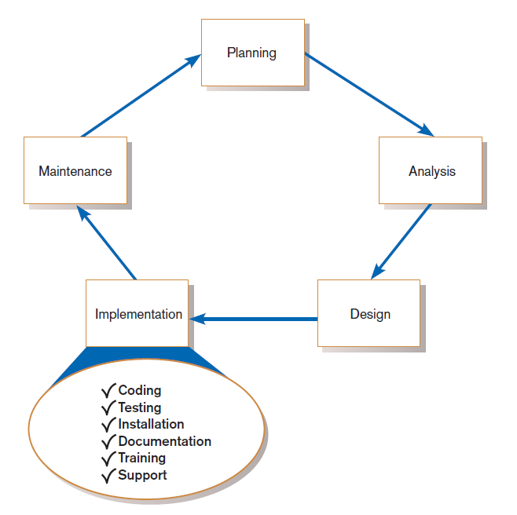
FIGURE 13-1
Systems development life cycle with the implementation phase highlighted
Chapter 13
© 2014 Pearson Education, Inc. Publishing as Prentice Hall

Slide 5
System Implementation
Six major activities:
  Coding
  Testing
  Installation
  Documentation
  Training
  Support
Chapter 13
© 2014 Pearson Education, Inc. Publishing as Prentice Hall

Slide 6
System Implementation (Cont.)
Purpose:
  To convert final physical system specifications into working and reliable software
  To document work that has been done
  To provide help for current and future users
Chapter 13
© 2014 Pearson Education, Inc. Publishing as Prentice Hall

Slide 7
The Process of Coding, Testing, and Installation
Coding
  Physical design specifications are turned into working computer code.
Testing
  Tests are performed using various strategies.
  Testing is performed in parallel with coding.
Installation
  The current system is replaced by a new system.
Chapter 13
© 2014 Pearson Education, Inc. Publishing as Prentice Hall

Slide 8
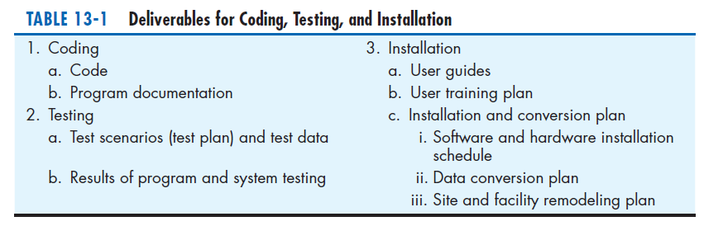
Chapter 13
© 2014 Pearson Education, Inc. Publishing as Prentice Hall

Slide 9
Documenting the System, Training Users, and Supporting Users
Two audiences for final documentation:
  Information systems personnel who will maintain the system throughout its productive life
  People who will use the system as part of their daily lives
User Training
  Application-specific
  General for operating system and off-the-shelf software
Chapter 13
© 2014 Pearson Education, Inc. Publishing as Prentice Hall

Slide 10
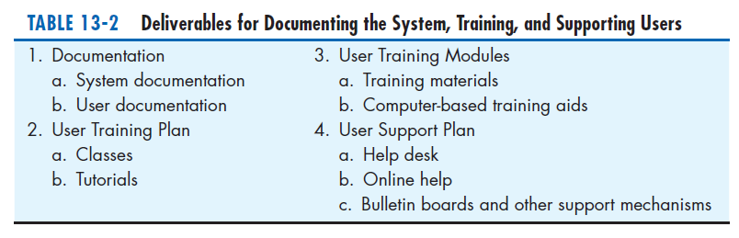
Chapter 13
© 2014 Pearson Education, Inc. Publishing as Prentice Hall

Slide 11
Software Application Testing
A master test plan is developed during the analysis phase.
During the design phase, unit, system and integration test plans are developed.
The actual testing is done during implementation.
Written test plans provide improved communication among all parties involved in testing.
Chapter 13
© 2014 Pearson Education, Inc. Publishing as Prentice Hall

Slide 12
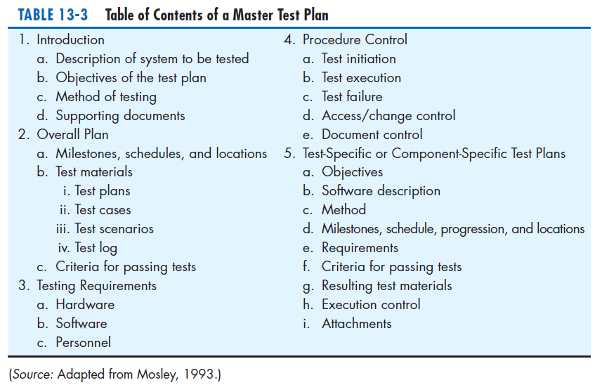
Chapter 13
© 2014 Pearson Education, Inc. Publishing as Prentice Hall

Slide 13
Seven Different Types of Tests
Static or dynamic techniques
  Static testing means that the code being tested is not executed.
  Dynamic testing involves execution of the code.
Test is automated or manual
  Automated means computer conducts the test.
  Manual means that people complete the test.
Chapter 13
© 2014 Pearson Education, Inc. Publishing as Prentice Hall

Slide 14
Seven Different Types of Tests
Inspection: a testing technique in which participants examine program code for predictable language-specific errors
Walkthrough: a peer group review of any product created during the systems development process, including code
Desk checking: a testing technique in which the program code is sequentially executed manually by the reviewer
Chapter 13
© 2014 Pearson Education, Inc. Publishing as Prentice Hall

Slide 15
Seven Different Types of Tests (Cont.)
Unit testing: each module is tested alone in an attempt to discover any errors in its code
Integration testing: the process of bringing together all of the modules that a program comprises for testing purposes
  Modules are typically integrated in a top-down incremental fashion.
Chapter 13
© 2014 Pearson Education, Inc. Publishing as Prentice Hall

Slide 16
Seven Different Types of Tests (Cont.)
System testing: the bringing together of all of the programs that a system comprises for testing purposes
  Programs are typically integrated in a top-down, incremental fashion.
Chapter 13
© 2014 Pearson Education, Inc. Publishing as Prentice Hall

Slide 17
Seven Different Types of Tests (Cont.)
Stub testing: a technique used in testing modules, especially where modules are written and tested in a top-down fashion, where a few lines of code are used to substitute for subordinate modules
Chapter 13
© 2014 Pearson Education, Inc. Publishing as Prentice Hall

Slide 18
The Testing Process
The purpose of testing is to confirm that the system satisfies the requirements.
Testing must be planned.
Test case is a specific scenario of transactions, queries or navigation paths.
Chapter 13
© 2014 Pearson Education, Inc. Publishing as Prentice Hall

Slide 19
The Testing Process (Cont.)
Test cases represent either:
  Typical system use
  Critical system use, or
  Abnormal system use.
Test cases and results should be thoroughly documented so they can be repeated for each revision of an application.
Chapter 13
© 2014 Pearson Education, Inc. Publishing as Prentice Hall

Slide 20
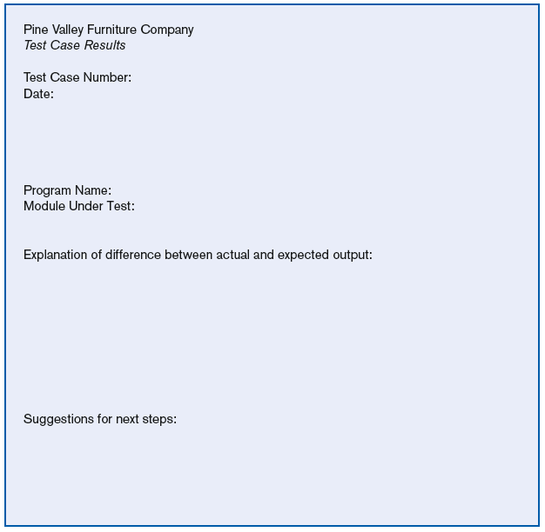
FIGURE 13-4
Test case results form
(Source: Adapted from
Mosley, 1993.)
Chapter 13
© 2014 Pearson Education, Inc. Publishing as Prentice Hall

Slide 21
Testing Harness
Automated testing environment
Reviews code for:
  Errors
  Standards violations
  Other design flaws
Expand the scope of the tests beyond the current development platform
Chapter 13
© 2014 Pearson Education, Inc. Publishing as Prentice Hall

Slide 22
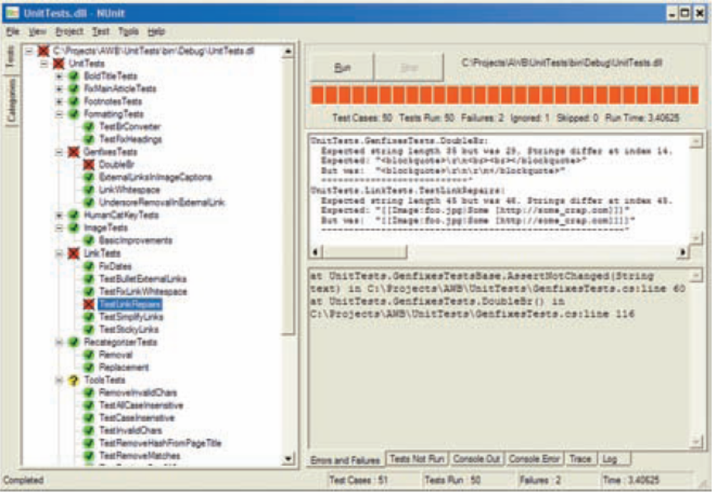
Testing Harness (Cont.)
Figure 13-5
NUnit, a unit testing framework for .NET
Chapter 13
© 2014 Pearson Education, Inc. Publishing as Prentice Hall

Slide 23
Combining Coding and Testing
Coding and testing often go together.
Big companies have dedicated test staff.
With eXtreme programming (XP) a common technique is refactoring.
Refactoring = making a program simpler after adding a new feature
Chapter 13
© 2014 Pearson Education, Inc. Publishing as Prentice Hall

Slide 24
Acceptance Testing by Users
Acceptance testing: the process whereby actual users test a completed information system, the end result of which is the users’ acceptance of it
Chapter 13
© 2014 Pearson Education, Inc. Publishing as Prentice Hall

Slide 25
Acceptance Testing by Users (Cont.)
Alpha testing: user testing of a completed information system using simulated data
Beta testing: user testing of a completed information system using real data in the real user environment
Chapter 13
© 2014 Pearson Education, Inc. Publishing as Prentice Hall

Slide 26
Acceptance Testing by Users (Cont.)
Types of Alpha Test:
  Recovery testing — forces software (or environment) to fail in order to verify that recovery is properly performed
  Security testing — verifies that protection mechanisms built into the system will protect it from improper penetration
  Stress testing — tries to break the system
  Performance testing — determines how the system performs on the range of possible environments in which it may be used
Chapter 13
© 2014 Pearson Education, Inc. Publishing as Prentice Hall

Slide 27
Installation
Installation: the organizational process of changing over from the current information system to a new one
Four installation strategies:
  Direct Installation
  Parallel Installation
  Single-location installation
  Phased Installation
Chapter 13
© 2014 Pearson Education, Inc. Publishing as Prentice Hall

Slide 28
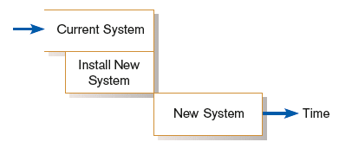
Direct Installation
Direct installation: changing over from the old system to a new one by turning off the old system when the new system is turned on
Chapter 13
© 2014 Pearson Education, Inc. Publishing as Prentice Hall

Slide 29
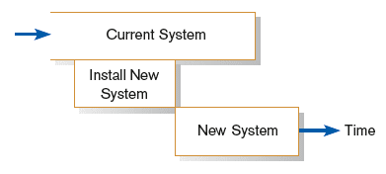
Parallel Installation
Parallel installation: running the old information system and the new one at the same time until management decides the old system can be turned off
Chapter 13
© 2014 Pearson Education, Inc. Publishing as Prentice Hall

Slide 30
Single-Location Installation
Single-location installation: trying out an information system at one site and using the experience to decide if and how the new system should be deployed throughout the organization
Also known as location or pilot installation
Chapter 13
© 2014 Pearson Education, Inc. Publishing as Prentice Hall

Slide 31
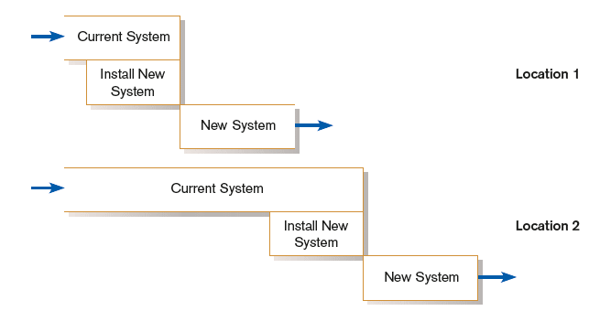
Single-Location Installation (cont.)
Chapter 13
© 2014 Pearson Education, Inc. Publishing as Prentice Hall

Slide 32
Phased Installation
Phased Installation: changing from the old information system to the new one incrementally, starting with one or a few functional components and then gradually extending the installation to cover the whole new system
Chapter 13
© 2014 Pearson Education, Inc. Publishing as Prentice Hall

Slide 33
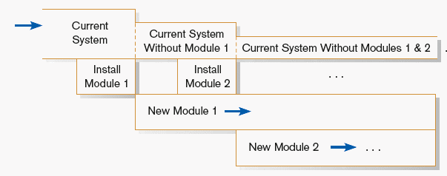
Phased Installation (cont.)
Chapter 13
© 2014 Pearson Education, Inc. Publishing as Prentice Hall

Slide 34
Planning Installation
Considerations
  Data conversion
    Error correction
    Loading from current system
  Planned system shutdown
  Business cycle of organization
Chapter 13
© 2014 Pearson Education, Inc. Publishing as Prentice Hall

Slide 35
Documenting the System
System documentation: detailed information about a system’s design specifications, its internal workings, and its functionality
User documentation: written or other visual information about an application system, how it works, and how to use it
Chapter 13
© 2014 Pearson Education, Inc. Publishing as Prentice Hall

Slide 36
Documenting the System (Cont.)
Internal documentation: system documentation that is part of the program source code or is generated at compile time
External documentation: system documentation that includes the outcome of structured diagramming techniques such as data flow and E-R diagrams
Chapter 13
© 2014 Pearson Education, Inc. Publishing as Prentice Hall

Slide 37
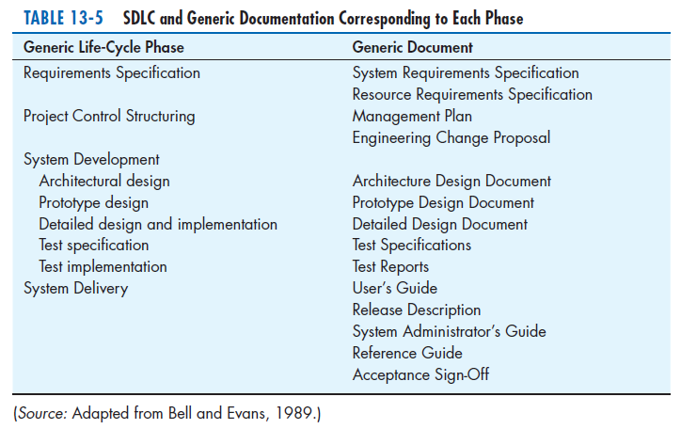
Chapter 13
© 2014 Pearson Education, Inc. Publishing as Prentice Hall

Slide 38
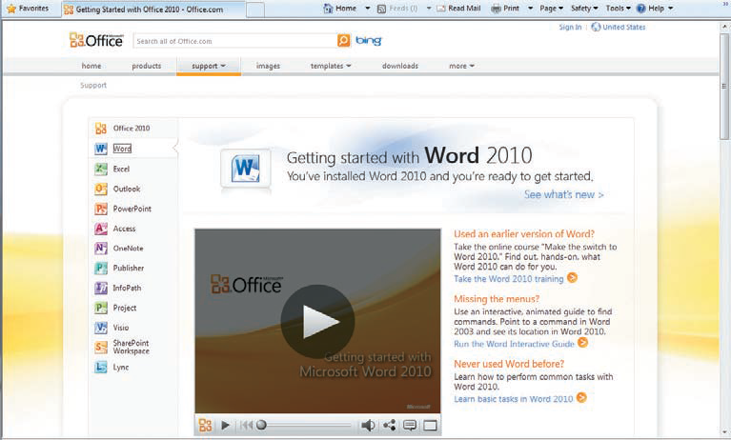
Figure 13-7
Example of online user documentation
(Source: Microsoft Corporation.)
Chapter 13
© 2014 Pearson Education, Inc. Publishing as Prentice Hall

Slide 39
Generic User’s Guide Outline
Preface
1. Introduction
  1.1. Configurations
  1.2 Function flow
2. User interface
  2.1 Display screens
  2.2 Command types
3. Getting started
  3.1 Login
  3.2 Logout
  3.3 Save
  3.4 Error recovery
  3.n [Basic procedure name]
n. [Task name]
Appendix A—Error Messages
([Appendix])
Glossary
Terms
Acronyms
Index
Source: Adapted from Bell and Evans, 1989.)
Chapter 13
© 2014 Pearson Education, Inc. Publishing as Prentice Hall

Slide 40
Training and Supporting Users
Support: providing ongoing educational and problem-solving assistance to information system users
For in-house developed systems, support materials and jobs will have to be prepared or designed as part of the implementation process.
Chapter 13
© 2014 Pearson Education, Inc. Publishing as Prentice Hall

Slide 41
Training Information Systems Users
Potential training topics
  Use of the system
  General computer concepts
  Information system concepts
  Organizational concepts
  System management
  System installation
Chapter 13
© 2014 Pearson Education, Inc. Publishing as Prentice Hall

Slide 42
Types of Training Methods
Resident expert
Traditional instructor-led classroom training
E-learning, distance learning
Blended learning (instructor plus e-learning)
Software help components
External sources (e.g. vendors)
Chapter 13
© 2014 Pearson Education, Inc. Publishing as Prentice Hall

Slide 43
Training Information Systems Users (Cont.)
Electronic performance support system (EPSS): component of a software package or an application in which training and educational information is embedded
An EPSS can take several forms, including a tutorial, an expert system shell, and hypertext jumps to reference materials.
Chapter 13
© 2014 Pearson Education, Inc. Publishing as Prentice Hall

Slide 44
Supporting Information Systems Users
Support is important to users, but has often been inadequate.
Providing support can be expensive and time-consuming.
Vendors usually charge for their support, using 900- numbers, or charge a fee for unlimited or monthly support.
Chapter 13
© 2014 Pearson Education, Inc. Publishing as Prentice Hall

Slide 45
Automating Support
One approach is through automation.
  Internet-based online support forums
  On-demand fax
  Voice response systems
  Knowledge bases
Chapter 13
© 2014 Pearson Education, Inc. Publishing as Prentice Hall

Slide 46
Providing Support Through a Help Desk
Help desk: a single point of contact for all user inquiries and problems about a particular information system or for all users in a particular department
Chapter 13
© 2014 Pearson Education, Inc. Publishing as Prentice Hall

Slide 47
Providing Support Through a Help Desk (Cont.)
Requires
  Technical skills: extensive knowledge about how to use the system and typical problems that can be encountered
  People skills: good listening and communication, dealing with complaints and frustrations
Chapter 13
© 2014 Pearson Education, Inc. Publishing as Prentice Hall

Slide 48
Support Issues for the Analyst to Consider
User questions and problems
Recovery and backup
Disaster recovery
PC maintenance
Writing newsletters
Setting up user groups
Chapter 13
© 2014 Pearson Education, Inc. Publishing as Prentice Hall

Slide 49
Organizational Issues in Systems Implementation
Why does implementation sometimes fail?
Traditional wisdom of primary success factors:
  Management support
  User involvement
  But these are not enough
Other important factors
  Commitment to project
  Commitment to change
  Extent of project definition and planning
Chapter 13
© 2014 Pearson Education, Inc. Publishing as Prentice Hall

Slide 50
Factors Influencing System Use
Personal stake of users
System characteristics
User demographics
Organizational support
Performance
Satisfaction
Chapter 13
© 2014 Pearson Education, Inc. Publishing as Prentice Hall

Slide 51
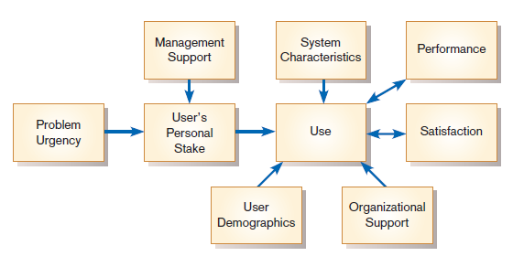
Success Factors
Figure 13-10
Implementation success
(Source: Adapted from Lucas, H. C. 1997.Information Technology for Management. New York: McGraw-Hill, with the permission of the McGraw-Hill Companies. All rights reserved.)
Chapter 13
© 2014 Pearson Education, Inc. Publishing as Prentice Hall

Slide 52
Security Issues
Increasingly important issue for organizations and their management
Malicious software (malware): includes Trojan horses, worms, viruses, and other kinds
External sources of threats include laptop theft, system penetration, and denial of service.
Chapter 13
© 2014 Pearson Education, Inc. Publishing as Prentice Hall

Slide 53
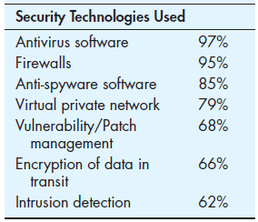
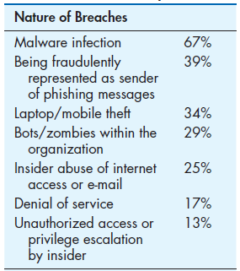
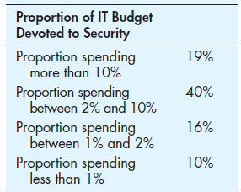
Table 13-8 Selected Statistics on IT Security
(Source: Data from Computer Security
Institute [Richardson], 2011.)
Chapter 13
© 2014 Pearson Education, Inc. Publishing as Prentice Hall

Slide 54
Electronic Commerce Application: System Implementation for Pine Valley Furniture’s WebStore
Developing test cases for the WebStore include testing categories as follows:
  Simple functionality
  Multiple functionality
  Function chains
  Elective functions
  Emergency/crisis
Chapter 13
© 2014 Pearson Education, Inc. Publishing as Prentice Hall

Slide 55
Developing Test Cases for WebStore
Test case forms had the following sections:
  Test Case ID
  Category/Objective of Test
  Description
  System Version
  Completion Date
  Participants
  Machine Characteristics (processor, operating system, memory, browser, etc.)
  Test Result
  Comments
Chapter 13
© 2014 Pearson Education, Inc. Publishing as Prentice Hall

Slide 56
Bug Tracking and System Evolution
Bug-tracking form has the following categories:
  Bug Number (simple incremental number)
  Test Case ID that Generated the Bug
  Is the Bug Replicable?
  Effects
  Description
  Resolution
  Resolution Date
  Comments
As batches of bugs are fixed, the version number of the software is incremented (below 1.0 during development and testing).
Chapter 13
© 2014 Pearson Education, Inc. Publishing as Prentice Hall

Slide 57
Alpha and Beta Testing the WebStore
Alpha Testing:
  PVF employees who actively participated received a t-shirt and $100 to shop.
  Development team conducted extensive recovery, security, stress, and performance testing.
Beta Testing
  PVF recruited several of their established customers to help in beta testing.
Chapter 13
© 2014 Pearson Education, Inc. Publishing as Prentice Hall

Slide 58
WebStore Installation
WebStore was ready to go online and development team recommended to top management that it was time to “flip the switch”.
Chapter 13
© 2014 Pearson Education, Inc. Publishing as Prentice Hall

Slide 59
Project Close-Down
Evaluate team.
  Reassign members to other projects.
Notify all affected parties that the development project is ending and that you are switching to operation and maintenance mode.
Conduct post project reviews.
Close out customer contract.
  Formal signoff
Chapter 13
© 2014 Pearson Education, Inc. Publishing as Prentice Hall

Slide 60
Summary
In this chapter you learned how to:
Describe the process of coding, testing, and converting an organizational information system and outline the deliverables and outcomes of the process.
Prepare a test plan for an information system.
Apply four installation strategies: direct, parallel, single-location, and phased installation.
List the deliverables for documenting the system and for training and supporting users.
Chapter 13
© 2014 Pearson Education, Inc. Publishing as Prentice Hall

Slide 61
Summary (Cont.)
Compare the many modes available for organizational information system training, including self-training and electronic performance support systems.
Discuss the issues of providing support for end-users.
Explain why system implementation sometimes fails.
Describe the threats to system security and remedies that can be applied.
Show how traditional implementation issues apply to electronic commerce applications.
Chapter 13
© 2014 Pearson Education, Inc. Publishing as Prentice Hall

Slide 62

Copyright © 2014 Pearson Education, Inc.
Publishing as Prentice Hall

