Slide 1
Modern Systems Analysis
and Design
Seventh Edition
Jeffrey A. Hoffer
Joey F. George
Joseph S. Valacich
Chapter 14
Maintaining Information Systems

Slide 2
Learning Objectives
Explain and contrast four types of system maintenance.
Describe several factors that influence the cost of maintaining an information system and apply these factors to the design of maintainable systems.
Describe maintenance management issues, including alternative organizational structures, quality measurement, processes for handling change requests, and configuration management.
Explain the role of CASE tools in maintaining information systems.
Chapter 14
© 2014 Pearson Education, Inc. Publishing as Prentice Hall

Slide 3
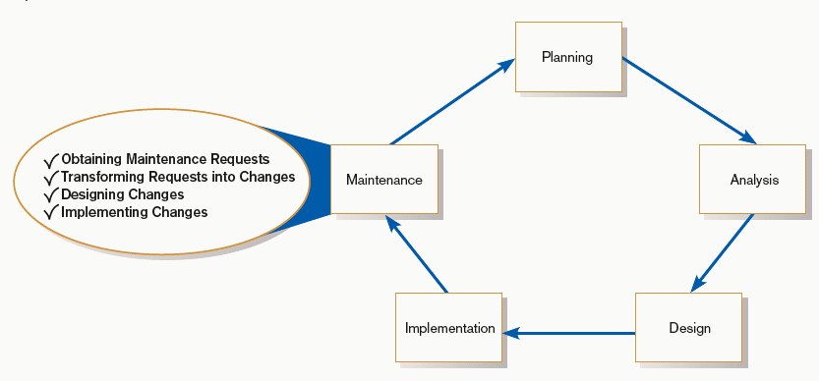
Maintaining Information Systems
FIGURE 14-1
Systems development life cycle
Chapter 14
© 2014 Pearson Education, Inc. Publishing as Prentice Hall

Slide 4
The Process of Maintaining Information Systems
Process of returning to the beginning of the SDLC and repeating development steps focusing on system change until the change is implemented
Maintenance is the longest phase in the SDLC.
Chapter 14
© 2014 Pearson Education, Inc. Publishing as Prentice Hall

Slide 5
The Process of Maintaining Information Systems (Cont.)
Four major activities:
  Obtaining maintenance requests
  Transforming requests into changes
  Designing changes
  Implementing changes
Chapter 14
© 2014 Pearson Education, Inc. Publishing as Prentice Hall

Slide 6
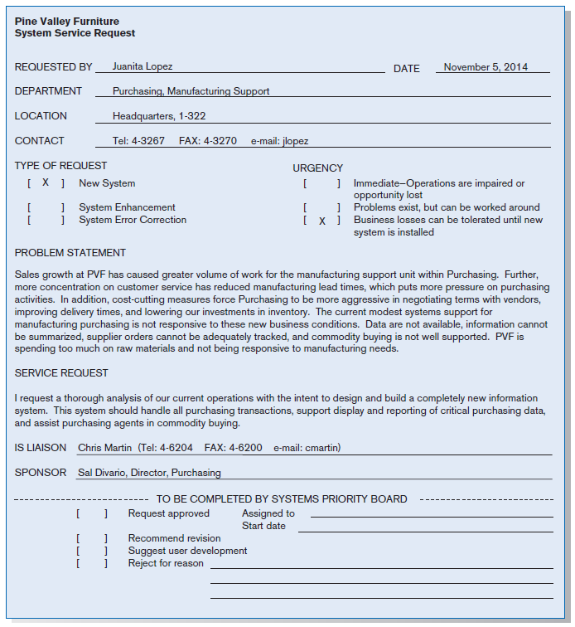
FIGURE 14-2
System Service Request for purchasing
fulfillment system (Pine Valley Furniture)
Chapter 14
© 2014 Pearson Education, Inc. Publishing as Prentice Hall

Slide 7
Deliverables and Outcome
The maintenance phase of the SDLC is basically a subset of the activities of the entire development process.
Chapter 14
© 2014 Pearson Education, Inc. Publishing as Prentice Hall

Slide 8
Deliverables and Outcome (Cont.)
The deliverables and outcomes from the process are the development of a new version of the software and new versions of all design documents created or modified during the maintenance effort.
Chapter 14
© 2014 Pearson Education, Inc. Publishing as Prentice Hall

Slide 9
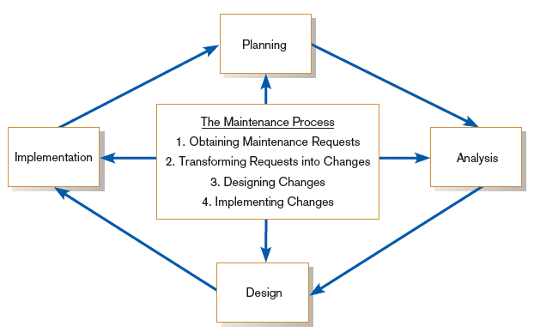
Deliverables and Outcome (Cont.)
FIGURE 14-3
Maintenance activities parallel those of
the SDLC
Chapter 14
© 2014 Pearson Education, Inc. Publishing as Prentice Hall

Slide 10
Types of System Maintenance
Maintenance: changes made to a system to fix or enhance its functionality
Chapter 14
© 2014 Pearson Education, Inc. Publishing as Prentice Hall

Slide 11
Types of System Maintenance (Cont.)
Corrective maintenance: changes made to a system to repair flaws in its design, coding, or implementation
Chapter 14
© 2014 Pearson Education, Inc. Publishing as Prentice Hall

Slide 12
Types of System Maintenance (Cont.)
Adaptive maintenance: changes made to a system to evolve its functionality to changing business needs or technologies
Chapter 14
© 2014 Pearson Education, Inc. Publishing as Prentice Hall

Slide 13
Types of System Maintenance (Cont.)
Perfective maintenance: changes made to a system to add new features or to improve performance
Chapter 14
© 2014 Pearson Education, Inc. Publishing as Prentice Hall

Slide 14
Types of System Maintenance (Cont.)
Preventive maintenance: changes made to a system to avoid possible future problems
Chapter 14
© 2014 Pearson Education, Inc. Publishing as Prentice Hall

Slide 15
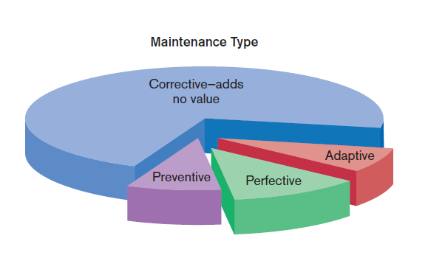
Types of System Maintenance (Cont.)
Figure 14-4
Value and non-value adding of different types of maintenance (Sources: Based on Andrews and Leventhal,1993; Pressman, 2005.)
Chapter 14
© 2014 Pearson Education, Inc. Publishing as Prentice Hall

Slide 16
The Cost of Maintenance
Many organizations allocate 60-80% of information systems budget to maintenance.
Maintainability: the ease with which software can be understood, corrected, adapted, and enhanced
Chapter 14
© 2014 Pearson Education, Inc. Publishing as Prentice Hall

Slide 17
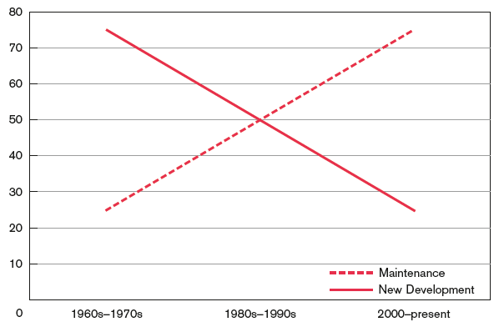
The Cost of Maintenance (Cont.)
FIGURE 14-5
New development versus maintenance as
a percentage of the software budget over the years
(Source: Based on Pressman, 2005.)
Chapter 14
© 2014 Pearson Education, Inc. Publishing as Prentice Hall

Slide 18
The Cost of Maintenance (Cont.)
Factors that influence system maintainability:
  Latent defects
  Number of customers for a given system
  Quality of system documentation
  Maintenance personnel
  Tools
  Well-structured programs
Chapter 14
© 2014 Pearson Education, Inc. Publishing as Prentice Hall

Slide 19
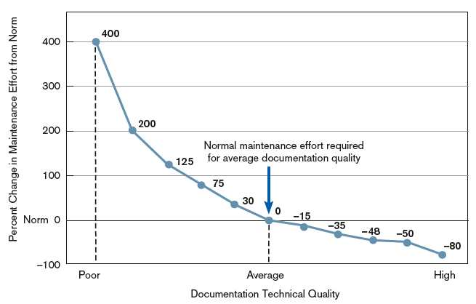
The Cost of Maintenance (Cont.)
FIGURE 14-6
Quality documentation eases Maintenance
(Source: Based on Hanna, M. 1992.
“Using Documentation as a Life-Cycle Tool.” Software Magazine [December]: 41–46.)
Chapter 14
© 2014 Pearson Education, Inc. Publishing as Prentice Hall

Slide 20
Managing Maintenance Personnel
Number of people working in maintenance has surpassed number working in development.
Maintenance work is often viewed negatively by IS personnel.
Chapter 14
© 2014 Pearson Education, Inc. Publishing as Prentice Hall

Slide 21
Managing Maintenance Personnel (Cont.)
Organizations often rotate personnel in and out of maintenance roles in order to lessen negative feelings about maintenance.
Organizations have historically rewarded people involved in new development better than maintenance personnel.
Chapter 14
© 2014 Pearson Education, Inc. Publishing as Prentice Hall

Slide 22
Managing Maintenance Personnel (Cont.)
Three possible organizational structures:
  Separate — maintenance group consists of different personnel than development group
  Combined — developers also maintain systems
  Functional — maintenance personnel work within the functional business unit
Chapter 14
© 2014 Pearson Education, Inc. Publishing as Prentice Hall

Slide 23
Managing Maintenance Personnel (Cont.)
Maintenance Organization Type | Advantages | Disadvantages
Separate | Improved system and documentation quality | Ignorance of critical undocumented information
Combined | Maintenance group knows all about system | Less emphasis on good documentation
Functional | Personnel have vested interest | Limited job mobility and human or technical resources
Chapter 14
© 2014 Pearson Education, Inc. Publishing as Prentice Hall

Slide 24
Measuring Maintenance Effectiveness
Must measure the following factors:
  Number of failures
  Time between each failure
  Type of failure
Chapter 14
© 2014 Pearson Education, Inc. Publishing as Prentice Hall

Slide 25
Measuring Maintenance Effectiveness (Cont.)
Mean time between failures (MTBF): a measurement of error occurrences that can be tracked over time to indicate the quality of a system
Chapter 14
© 2014 Pearson Education, Inc. Publishing as Prentice Hall

Slide 26
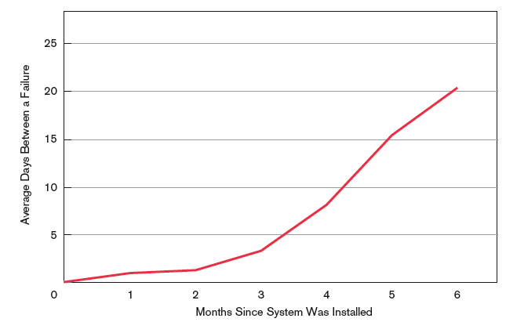
Measuring Maintenance Effectiveness (Cont.)
FIGURE 14-7
How the mean time between failures
should change over time
Chapter 14
© 2014 Pearson Education, Inc. Publishing as Prentice Hall

Slide 27
Controlling Maintenance Requests
Maintenance requests can be frequent.
Prioritize based on type and urgency of request.
Evaluations are based on feasibility analysis.
Chapter 14
© 2014 Pearson Education, Inc. Publishing as Prentice Hall

Slide 28
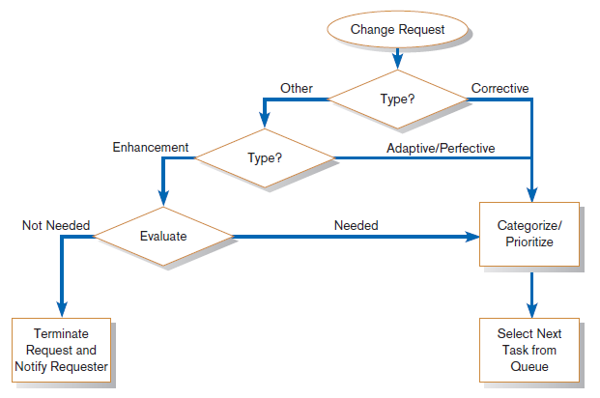
Controlling Maintenance Requests (Cont.)
FIGURE 14-8
How to prioritize maintenance requests
Chapter 14
© 2014 Pearson Education, Inc. Publishing as Prentice Hall

Slide 29
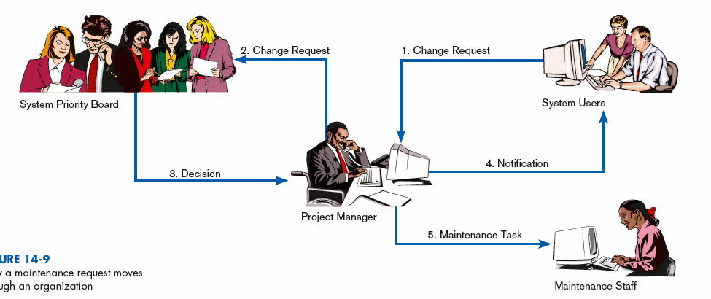
Controlling Maintenance Requests (Cont.)
FIGURE 14-9
How a maintenance request moves
through an organization
Chapter 14
© 2014 Pearson Education, Inc. Publishing as Prentice Hall

Slide 30
Configuration Management
Configuration management: the process of ensuring that only authorized changes are made to the system
Chapter 14
© 2014 Pearson Education, Inc. Publishing as Prentice Hall

Slide 31
Configuration Management (Cont.)
Baseline modules: software modules that have been tested, documented, and approved to be included in the most recently created version of a system
Chapter 14
© 2014 Pearson Education, Inc. Publishing as Prentice Hall

Slide 32
Configuration Management (Cont.)
System librarian: a person responsible for controlling the checking out and checking in of baseline modules when a system is being developed or maintained
Build routines: guidelines that list the instructions to construct an executable system from the baseline source code
Chapter 14
© 2014 Pearson Education, Inc. Publishing as Prentice Hall

Slide 33
Role of CASE and Automated Development Tools in Maintenance
Traditional systems development
  Emphasis is on coding and testing.
  Changes are implemented by coding and testing first.
  Documentation is done after maintenance is performed.
  Keeping documentation current is often neglected due to time-consuming nature of task.
Chapter 14
© 2014 Pearson Education, Inc. Publishing as Prentice Hall

Slide 34
Role of CASE and Automated Development Tools in Maintenance (Cont.)
Development with CASE
  Emphasis is on design documents.
  Changes are implemented in design documents.
  Code is regenerated using code generators.
  Documentation is updated during maintenance.
Chapter 14
© 2014 Pearson Education, Inc. Publishing as Prentice Hall

Slide 35
Role of CASE and Automated Development Tools in Maintenance (Cont.)
Reverse engineering: automated tools that read program source code as input and create graphical and textual representations of design-level information such as program control structures, data structures, logical flow, and data flow
Chapter 14
© 2014 Pearson Education, Inc. Publishing as Prentice Hall

Slide 36
Role of CASE and Automated Development Tools in Maintenance (Cont.)
Reengineering: automated tools that read program source code as input; perform an analysis of the program’s data and logic; and then automatically, or interactively with a systems analyst, alter an existing system in an effort to improve its quality or performance
Chapter 14
© 2014 Pearson Education, Inc. Publishing as Prentice Hall

Slide 37
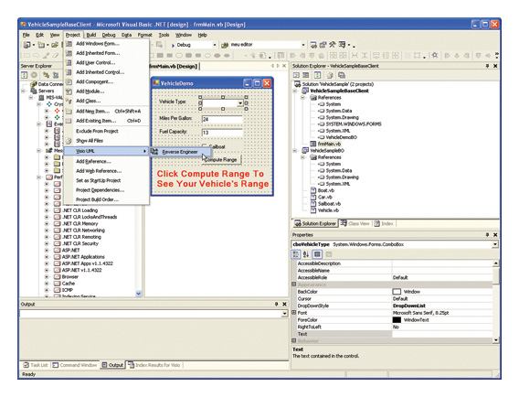
Role of CASE and Automated Development Tools in Maintenance (Cont.)
Figure 14-10 Visual Studio .NET engineer applications into Visio UML diagrams (Source: Microsoft Corporation.)
Chapter 14
© 2014 Pearson Education, Inc. Publishing as Prentice Hall

Slide 38
Web Site Maintenance
Special considerations:
  24 X 7 X 365
    Nature of continuous availability makes maintenance challenging.
    Pages under maintenance can be locked.
      Consider using date and time stamps to indicate when changes are made instead.
Chapter 14
© 2014 Pearson Education, Inc. Publishing as Prentice Hall

Slide 39
Web Site Maintenance (Cont.)
  Check for broken links
  HTML Validation
    Pages should be processed by a code validation routine before publication.
  Reregistration
    When content significantly changes, site may need to be reregistered with search engines.
Chapter 14
© 2014 Pearson Education, Inc. Publishing as Prentice Hall

Slide 40
Web Site Maintenance (Cont.)
  Future Editions
    Consistency is important to users.
    Post indications of future changes to the site.
    Batch changes.
Chapter 14
© 2014 Pearson Education, Inc. Publishing as Prentice Hall

Slide 41
Electronic Commerce Application: Maintaining an Information System for Pine Valley Furniture’s WebStore
To maintain PVF’s WebStore, the following questions need to be addressed:
  “How much is our Web site worth?”
  “How much does it cost our company when our Web site goes down?”
  “How reliable does our Web site need to be?”
Chapter 14
© 2014 Pearson Education, Inc. Publishing as Prentice Hall

Slide 42
Electronic Commerce Application: Maintaining an Information System for Pine Valley Furniture’s WebStore (Cont.)
Pine Valley Furniture needs to immediately develop a plan for addressing the WebStore’s service level problems.
Chapter 14
© 2014 Pearson Education, Inc. Publishing as Prentice Hall

Slide 43
Summary
In this chapter you learned how to:
Explain and contrast four types of system maintenance.
Describe several facts that influence the cost of maintaining an information system and apply these factors to the design of maintainable systems.
Describe maintenance management issues, including alternative organizational structures, quality measurement, processes for handling change requests, and configuration management.
Explain the role of CASE tools in maintaining information systems.
Chapter 14
© 2014 Pearson Education, Inc. Publishing as Prentice Hall

Slide 44

Copyright © 2014 Pearson Education, Inc.
Publishing as Prentice Hall

