Slide 1
Gas Price Data
By Andre Jacobs, Karla Hildebrand & Mandaline Thomas

Slide 2
Questions
How do gas prices fluctuate between 1992 to 2022?
What role does technology have on Gas Price?
Do certain time periods, within our range, differ in how gas prices fluctuate and how certain factors influence the price?

Slide 3
Dependent variable
The dependent variable is gas prices
This is the measured average national gas price
Not adjusted for inflation

Slide 4
Independent Variables
Net Imports of Crude Oil (Thousand barrels)
New Car Sales / Used Car Sales ratio (Millions of $)
Refinery Operable Activity (Percent)
CO2 Measurements
Measured in parts per million which means 1 part of co2 for the 100 parts of air, measured in micromoles

Slide 5
General Model Statement
Model Statement
Differenced Gas Price = f(Net Imports, New Cars / Used Cars, Refinery Operable Activity, CO2 Measurements, AR term (Differenced Gas Price))
Will compare models for different time periods.
1992 – 2000
2000 - 2010
2010 – 2020

Slide 6
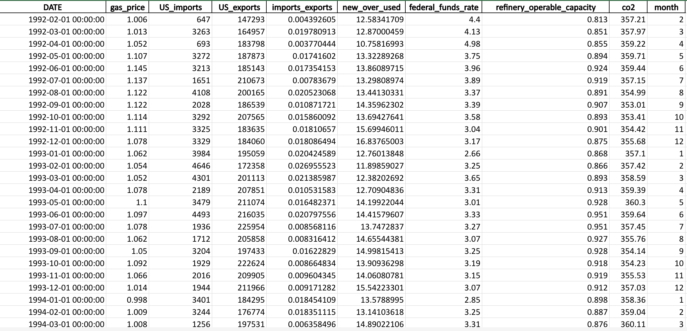
Picture of data

Slide 7
Variance Inflation Factor
 | Feature | VIF
1 | Crude Oil Imports / Exports | 3.153
2 | New Car sales / Used Car sales | 5.322
3 | Federal Funds Rate | 2.819
4 | Refinery Operable Capacity | 1.525
5 | CO2 Concentration | 11.791

Slide 8
Correlation Matrix
 | Gas Price | Net Imports of Crude Oil | New Car Sales / Used Car Sales | Federal Funds Rate | Refinery Operable Capacity | CO2 Measurements
Gas Price | 1 | 0.342993 | -0.75057 | -0.61391 | -0.29586 | 0.755329
Net Imports of Crude Oil | 0.342993 | 1 | -0.46121 | -0.30911 | -0.22589 | 0.71285
New Car Sales / Used Car Sales | -0.75057 | -0.46121 | 1 | 0.608805 | 0.449319 | -0.85014
Federal Funds Rate | -0.61391 | -0.30911 | 0.608805 | 1 | 0.432943 | -0.70383
Refinery Operable Capacity | -0.29586 | -0.22589 | 0.449319 | 0.432943 | 1 | -0.33377
CO2 Measurements | 0.755329 | 0.71285 | -0.85014 | -0.70383 | -0.33377 | 1

Slide 9
Summary Statistics
 | mean | std | min | max | n
Gas Price | 2.194611 | 0.927248 | 0.921 | 4.929 | 370
Net Imports of Crude Oil | 0.089699 | 0.170852 | 0.000192 | 0.664769 | 370
New Car Sales / Used Car Sales | 9.595 | 2.141055 | 5.788929 | 16.83765 | 370
Federal Funds Rate | 2.475108 | 2.224062 | 0.04 | 7.8 | 370
Refinery Operable Capacity | 0.900786 | 0.047274 | 0.702 | 0.999 | 370
CO2 Measurements | 385.0436 | 18.81653 | 353.01 | 420.99 | 370

Slide 10
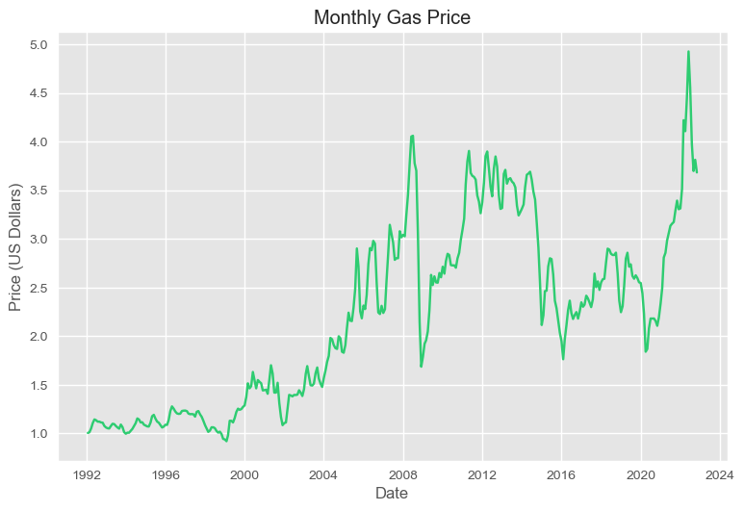
Gas Prices

Slide 11
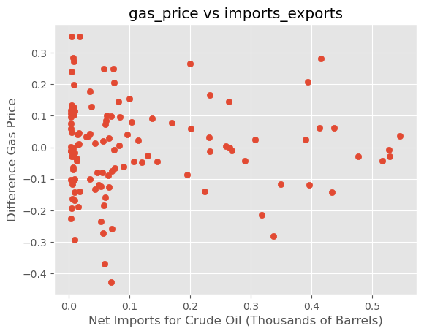
Net Imports of Crude Oil vs. Gas Price

Slide 12
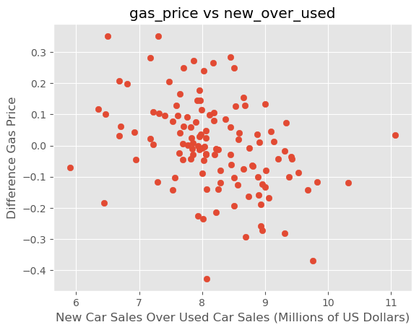
New Car Sales / Used Car Sales vs Gas Price

Slide 13
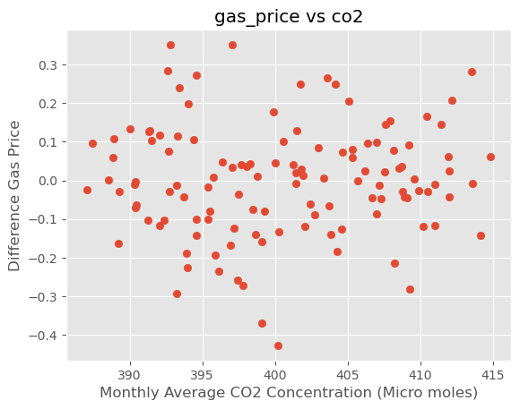
CO2 Concentration vs Gas Price

Slide 14
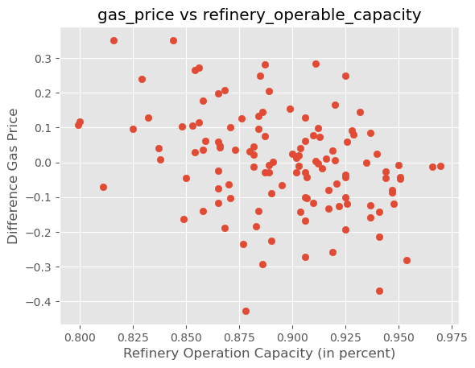
Refinery Capacity vs Gas Price

Slide 15
Correction Techniques
Autocorrelation was large
Used Differenced Dependent variable
Used AR term to control for previous prices influencing next periods price
To get model to work used 10-year periods

Slide 16
VIF
​ | Feature​ | VIF​
1​ | Crude Oil Imports / Exports​ | 5.958
2​ | New Car sales / Used Car sales​ | 1.043
3​ | Refinery Operable Capacity​ | 1.732
4​ | CO2 Concentration​ | 5.315
5​ | AR(1)​ | 1.276

Slide 17
Most Recent Model (2010 – 2020)
Variable | Coefficient | Standard Error | T-Statistic | P-Value | Durbin Watson | R-squared
Intercept | -1.283 | 1.859 | -0.690 | 0.491
New over used | -0.028 | 0.014 | -2.003 | 0.047
CO2 | -0.005 | 0.005 | 1.088 | 0.279
Refinery Capacity | -0.597 | 0.284 | -2.099 | 0.038
Net Imports | -0.292 | 0.226 | -1.293 | 0.198
AR(1) | 0.362 | 0.083 | 4.371 | 0.000
 |  |  |  |  | 1.83 | 0.24

Slide 18
VIF
​ | Feature​ | VIF​
1​ | Crude Oil Imports / Exports​ | 1.029
2​ | New Car sales / Used Car sales​ | 1.567
3​ | Refinery Operable Capacity​ | 1.150
4​ | CO2 Concentration​ | 1.559
5​ | AR(1)​ | 1.309

Slide 19
Model (2000 – 2010)
Variable​ | Coefficient​ | Standard Error​ | T-Statistic​ | P-Value​ | Durbin Watson​ | R-squared​
Intercept​ | -0.799​ | 2.389 | -0.334 | 0.739 | ​ | ​
New over used​ | 0.013​ | 0.017 | 0.756 | 0.451 | ​ | ​
CO2​ | 0.004​ | 0.006 | 0.684 | 0.495 | ​ | ​
Refinery Capacity​ | -0.912​ | 0.460 | -1.981 | 0.671 | ​ | ​
Net Imports​ | -3.217​ | 7.553 | -0.426 | 0.049 | ​ | ​
AR(1)​ | 0.512​ | 0.049 | 10.508 | 0.000 | ​ | ​
​ | ​ | ​ | ​ | ​ | 1.77 | 0.26

Slide 20
VIF
​ | Feature​ | VIF​
1​ | Crude Oil Imports / Exports​ | 1.066​
2​ | New Car sales / Used Car sales​ | 1.985​
3​ | Refinery Operable Capacity​ | 1.069​
4​ | CO2 Concentration​ | 2.223​
5​ | AR(1)​ | 1.256​

Slide 21
*Model (1992-2000)
Variable | Coefficient | Standard Error | T-Statistic | P-Value | Durbin Watson | R-squared
Intercept | -1.151 | 0.533 | -2.158 | 0.033
New over used | 0.004 | 0.005 | 0.909 | 0.365
CO2 | 0.003 | 0.001 | 2.330 | 0.022
Refinery Capacity | -0.069 | 0.145 | -0.472 | 0.638
Net Imports | 0.736 | 0.409 | 1.777 | 0.079
AR(1) | 0.150 | 0.067 | 2.181 | 0.032
 |  |  |  |  | 1.896 | 0.105

Slide 22
Limitations
To simplify this our model, we used one model rather than a model for supply and demand
Simultaneous Equation Model
Our model is incomplete and needs better independent variables
Need to consider inflation

Slide 23
Conclusion
New cars sales are statistically significant in more recent model
In the older models, this is not significant
More recent advances in technology improve fuel economy
This helps lower the demand for gas, which impacts price

Slide 24
Sources of Data
https://www.eia.gov/petroleum/data.php#imports
https://fred.stlouisfed.org/series/MRTSSM44112USN
https://fred.stlouisfed.org/series/MRTSSM44111USN
https://fred.stlouisfed.org/series/FEDFUNDS
https://www.eia.gov/dnav/pet/hist/LeafHandler.ashx?n=PET&s=MGIRIUS2&f=M
https://elements.visualcapitalist.com/what-key-factors-influence-gas-prices/

