Slide 1
Competition Report of COMP4433 House Price Prediction on Kaggle
Group: Gold Miner
Members:
DING Yukuan 18082849D
LIU Yanting 18082826D
ZHANG Caiqi 18085481D

Slide 2
Procedure
Explorative Data Visualization and Analysis
Feature Engineering
Data Cleaning
Non-numeric Data Transformation
Distribution Transformation
PCA Feature Transformation
Model Construction
Baseline Evaluation
Wrapper Feature Selection
Blend Model Experiment

Slide 3
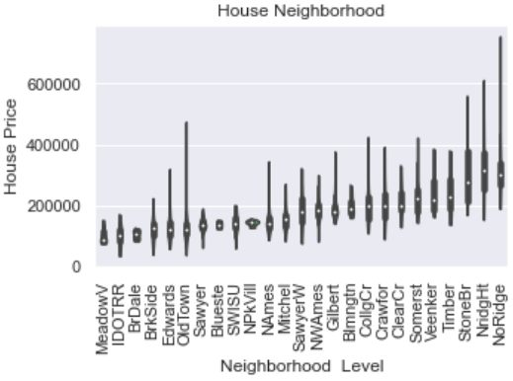
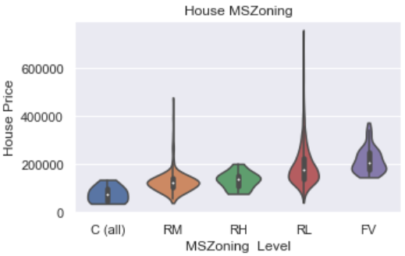
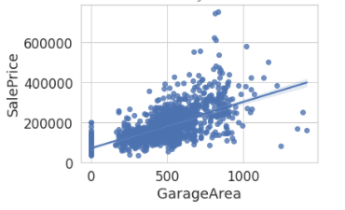
Explorative Data Visualization and Analysis
A first glimpse: 79 features, 3 forms
Numeric
Categorical
Ordinal (Rank Info)

Slide 4
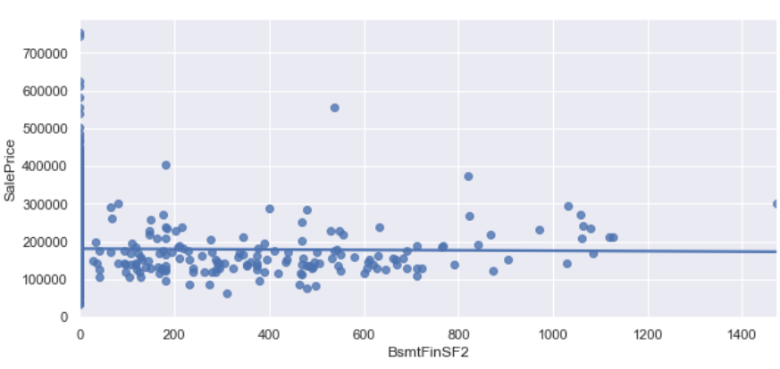
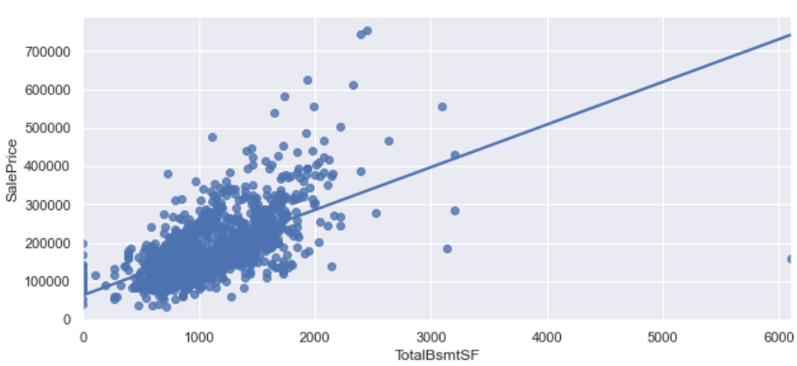
Explorative Data Visualization and Analysis: Numeric
Linear Correlation to SalePrice
Outliers

Slide 5
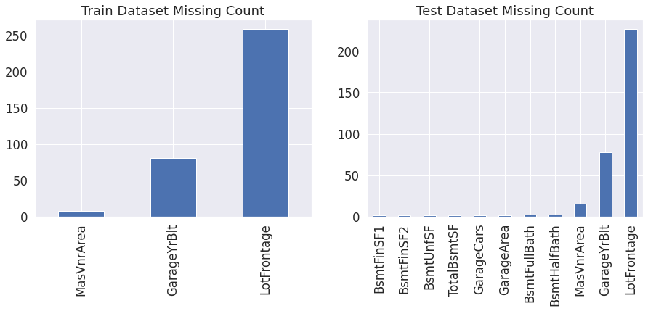
Feature Engineering: Numeric
Data Cleaning
Missing Values
Series missing: high possibility of the non-existence of corresponding equipment

Slide 6
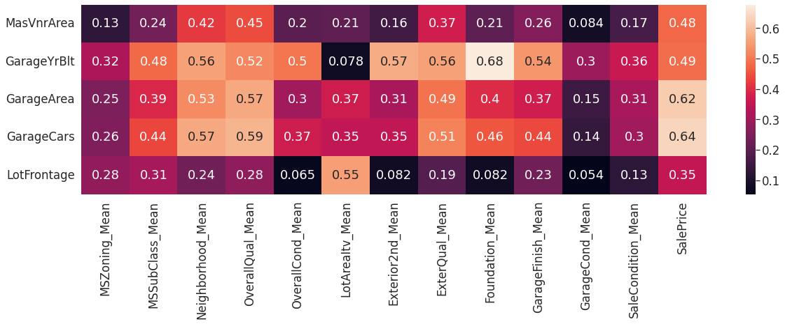
Feature Engineering: Numeric
PROBLEM: Cannot Set Correlation between Numeric and Qualitative Features!
SOLUTION: Average SalePrice ‘XXX_mean’ in each qualitative group. Find correlation between mean values and features with missing values.
Data Cleaning
Missing Values
Series missing
Large range missing: Correlation-Based Median Filling

Slide 7
Feature Engineering: Numeric
Feature Construction
Summation by real world experiences:
The overall living area of the house: Total House Area = Basement Area + 1st Floor Area + 2nd Floor Area
The overall property area of the house: Total Property Area = Basement Area + 1st Floor Area + 2nd Floor Area + Garage Area
The bathroom number in the house: Total Bathrooms=Full Bathroom + 0.5 * Half Bathrooms + Basement Full Bathrooms + 0.5 * Basement Half Bathrooms
The overall porch and wood deck area of the house: Total Porch Area = Open Porch + Eclosed Porch + 3 Season Porch + Screen Porch + Wood Deck Area

Slide 8
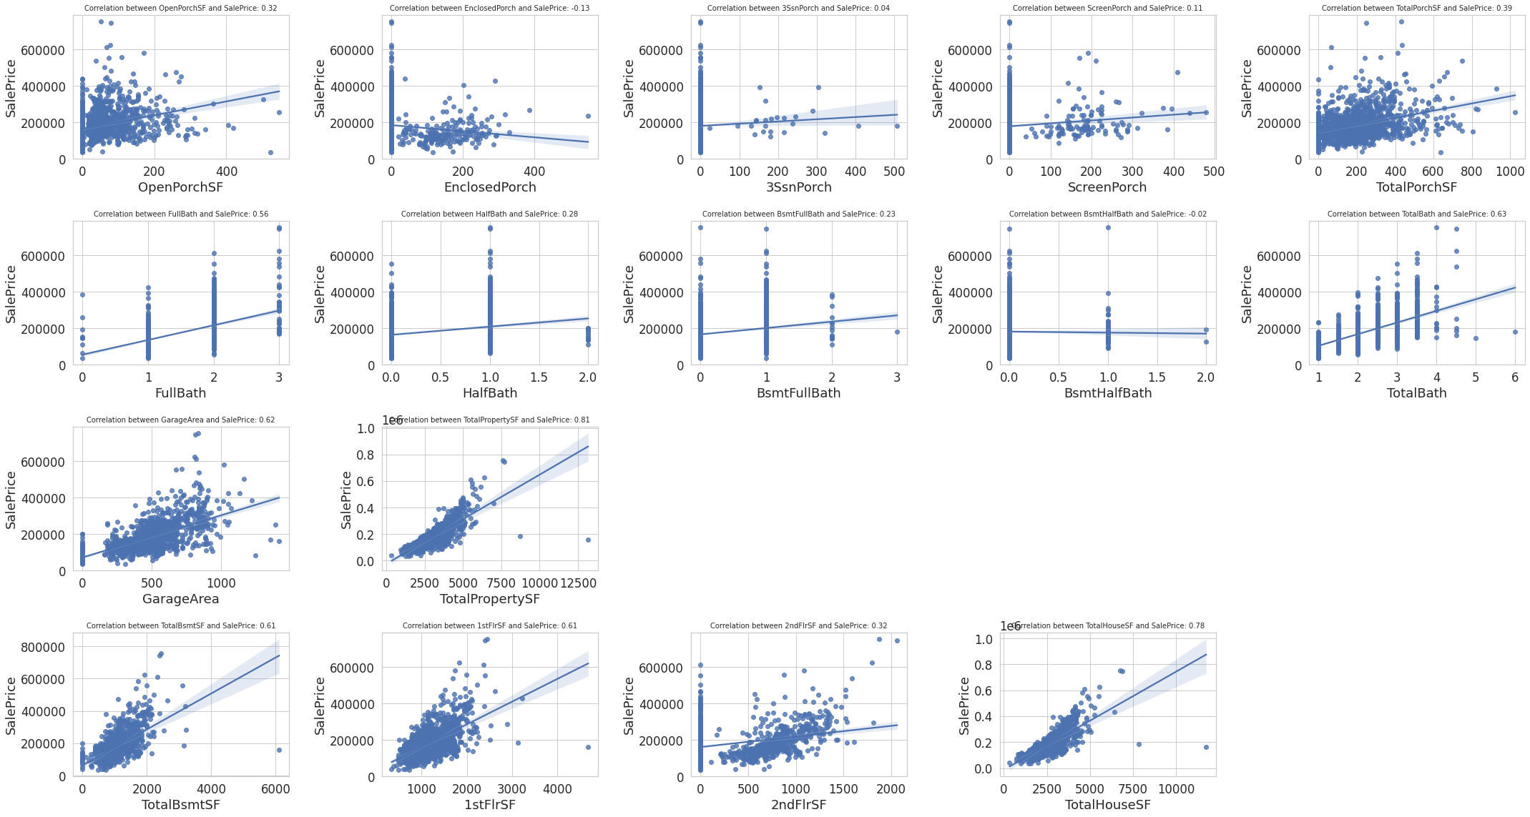
Feature Engineering: Numeric
Feature Construction
Summation by real world experiences: higher correlation towards SalePrice than the component features

Slide 9

Feature Engineering: Numeric
Feature Construction
Multiplication, inspired from physics formular
Garage Utilization Power: Garage Utilization Power = Garage Total Area ∗ Garage Car Capacity
In physics, electric power $P = U ∗ I,$while another formular shows $R=U/I$. An assumption could be:
$U$ is garage area
$I$ is garage car capacity
$R$ is average area for each car
Thus $P$ is something like $Power$

Slide 10
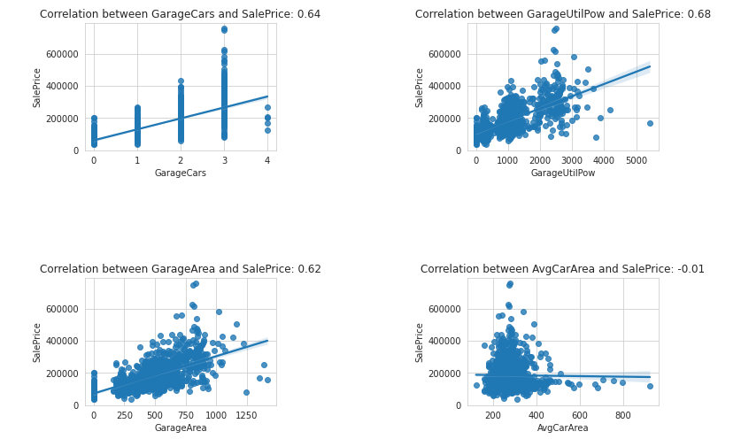
Feature Engineering: Numeric
Feature Construction
Multiplication
Surprisingly outperforms Average Area for Each Car

Slide 11
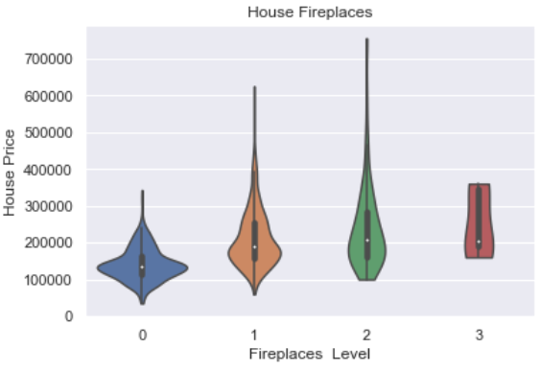
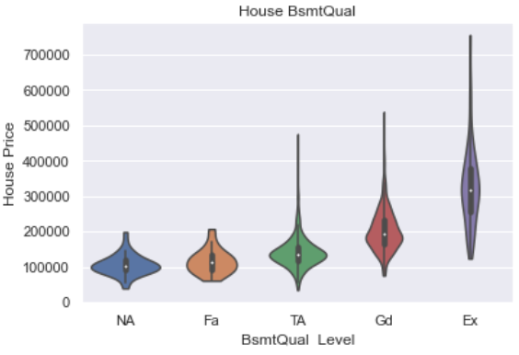
Feature Engineering: Numeric
Feature Construction
Existence
Based on observations in EDA, differences in SalePrice has shown with the existence of:
Fire Place
Basement

Slide 12
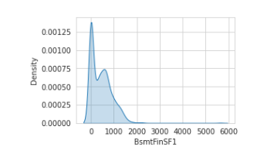
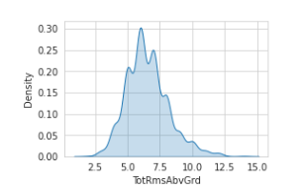
Feature Engineering: Numeric
Normality Preservation
Non-normal distribution of numeric features highly degrades the performance in regression models.
Skewness: how far is a feature from normal distribution.
High Skewness
Low Skewness (Nearly Normal)

Slide 13
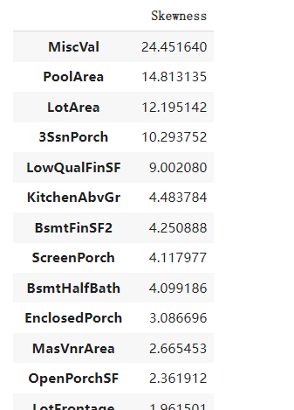
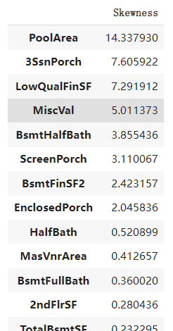


Feature Engineering: Numeric
Normality Preservation
Skewness calculation
YeoJohnson Transformation
Transform towards normality
Tolerable for zero values
Outperforms logarithm and box-cox method

Slide 14
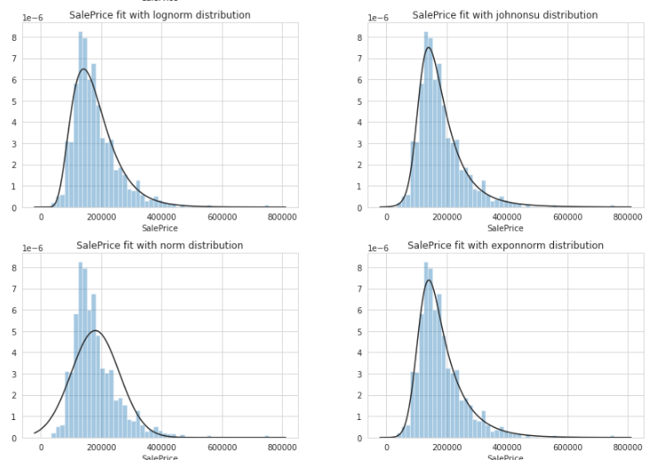

Feature Engineering: Numeric
Normality Preservation
Special treatment for SalePrice
Transformation method based on distribution
JohnsonSU distribution or exponentially modified Gaussian distribution
Box-Cox transformation
Suitable for exponential data sample

Slide 15
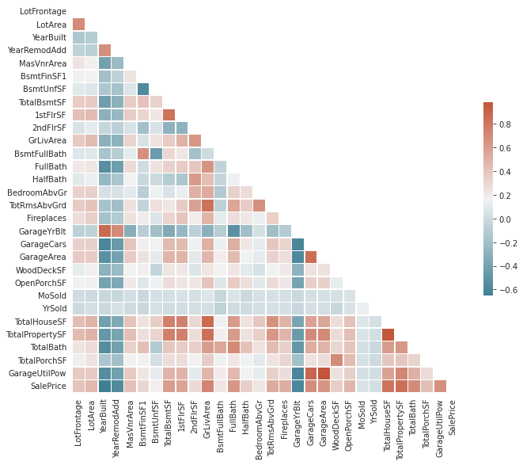
Feature Engineering: Numeric
Rough Feature Elimination
Correlation to SalePrice
Only features with correlation larger than threshold.

Slide 16
Catalog
Primary Feature Selection
Feature Encoding
Correlation Calculation
Results

Slide 17
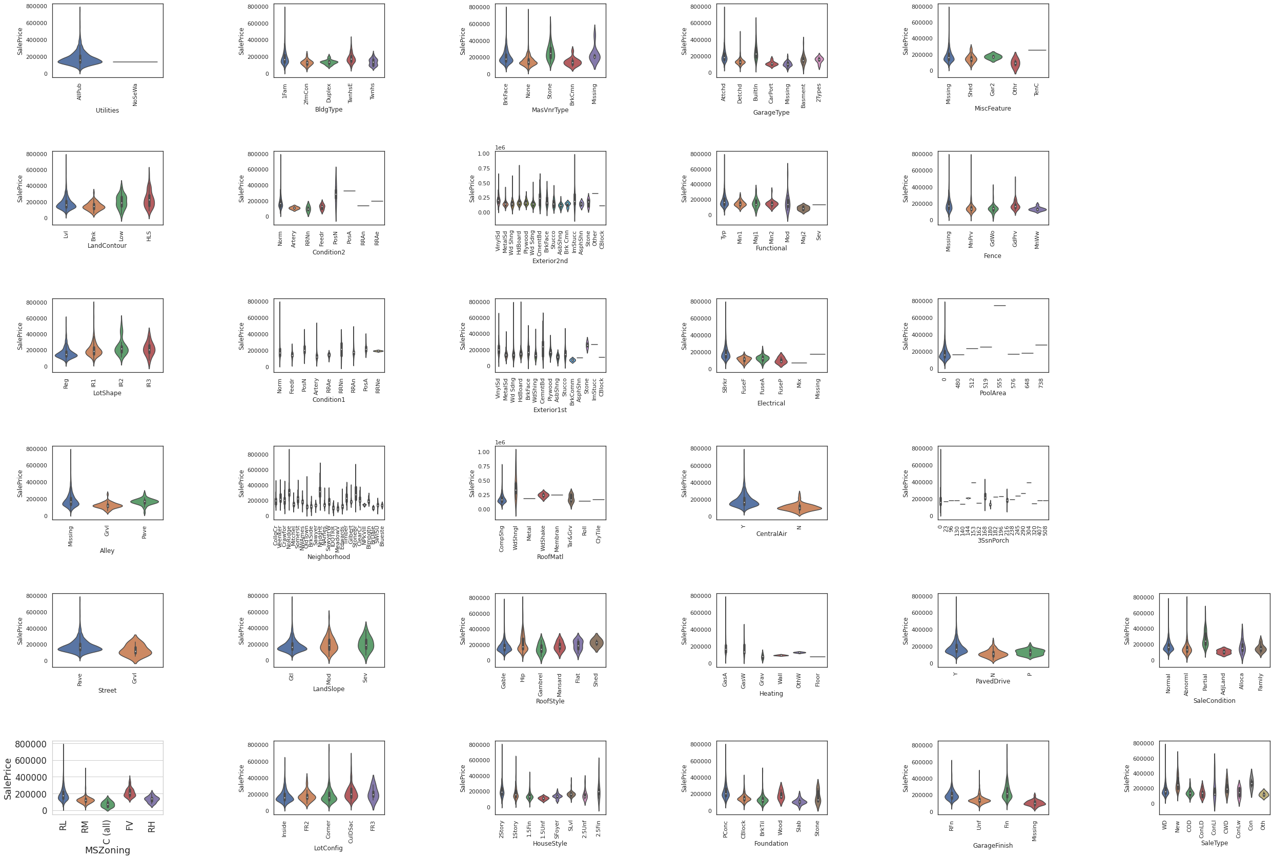
Primary Feature Selection
Handle Missing Values
Three Dimensions:
Obvious correlation
Missing values less than 20%
Same value less than 90%
Result:
['MSZoning', 'Neighborhood', 'HouseStyle', 'Exterior1st', 'Exterior2nd', 'Foundation', 'GarageType', 'GarageFinish', 'SaleType', 'SaleCondition']

Slide 18
Feature Encoding
SalePrice mean median count Neighborhood Blmngtn 194870.882353 191000 17 Blueste 137500.000000 137500 2 BrDale 104493.750000 106000 16 BrkSide 124834.051724 124300 58 ClearCr 212565.428571 200250 28 CollgCr 197965.773333 197200 150 Crawfor 210624.725490 200624 51 Edwards 128219.700000 121750 100 Gilbert 192854.506329 181000 79 IDOTRR 100123.783784 103000 37 MeadowV 98576.470588 88000 17 Mitchel 156270.122449 153500 49 NAmes 145847.080000 140000 225 NPkVill 142694.444444 146000 9 NWAmes 189050.068493 182900 73 NoRidge 335295.317073 301500 41 NridgHt 316270.623377 315000 77 OldTown 128225.300885 119000 113 SWISU 142591.360000 139500 25 Sawyer 136793.135135 135000 74 SawyerW 186555.796610 179900 59 Somerst 225379.837209 225500 86 StoneBr 310499.000000 278000 25 Timber 242247.447368 228475 38 Veenker 238772.727273 218000 11
categorical_test['Neighborhood'] = categorical_test['Neighborhood'].map
({'Blmngtn': 5, 'Blueste': 3, 'BrDale': 1, 'BrkSide': 2, 'ClearCr': 6, 'CollgCr': 5, 'Crawfor': 6, 'Edwards': 2, 'Gilbert': 5, 'IDOTRR': 1,
'MeadowV': 1, 'Mitchel': 4, 'NAmes': 4, 'NPKVill': 4, 'NWAmes': 5, 'NoRidge': 7, 'NridgHt': 7, 'OldTown': 2, 'SWISU': 4, 'Sawyer': 3, 'SawyerW': 5, 'Somerst': 6, 'StoneBr': 7, 'Timber': 6, 'Veenker': 6})
One-hot Coding
Small Training Data
High metrics sparsification
Value-mapping [1]
Sort single feature values using Median SalePrice and Average SalePrice
Map values to label number
[1] Reference: All You Need is PCA (LB: 0.11421, top 4%), MASSQUANTITY, https://www.kaggle.com/massquantity/all-you-need-is-pca-lb-0-11421-top-4 (2016).

Slide 19
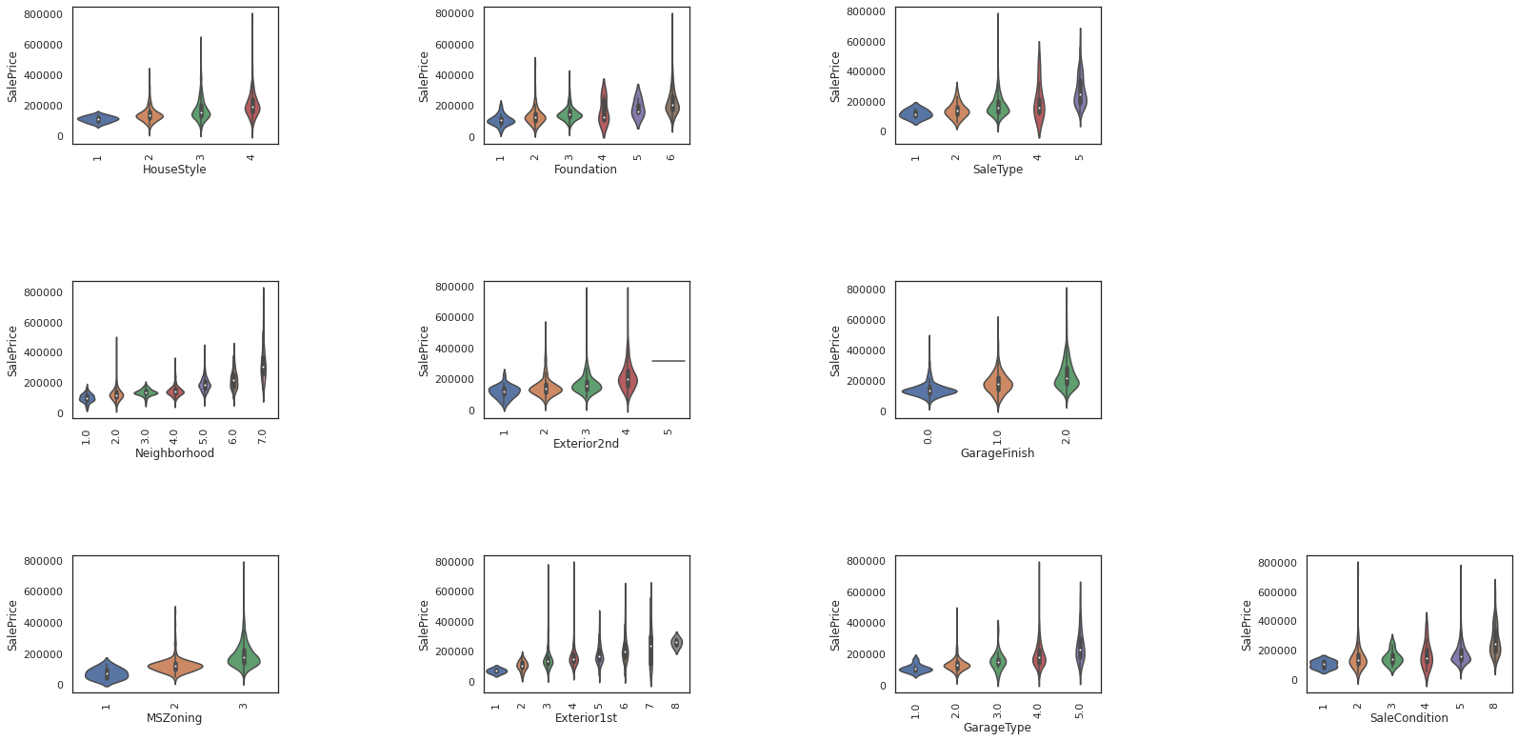
Correlation Calculation
Calculate Correlation and Violin pictures to encoded features
Select features with correlation higher than 0.35
MSZoning : PointbiserialrResult(correlation=0.3221987895999799, pvalue=1.283134900310385e-36) Neighborhood : PointbiserialrResult(correlation=0.6701797535279588, pvalue=5.1519941639699525e-191) HouseStyle : PointbiserialrResult(correlation=0.2917619253942099, pvalue=4.836529442916937e-30) Exterior1st : PointbiserialrResult(correlation=0.3846074438932704, pvalue=1.1282124736903266e-52) Exterior2nd : PointbiserialrResult(correlation=0.37607757234755024, pvalue=2.9094682641835423e-50) Foundation : PointbiserialrResult(correlation=0.5055031712897448, pvalue=1.550746357476438e-95) GarageType : PointbiserialrResult(correlation=0.402803120549104, pvalue=4.6095857912866875e-58) GarageFinish : PointbiserialrResult(correlation=0.48275441091028953, pvalue=4.263006940106301e-86) SaleType : PointbiserialrResult(correlation=0.3664118358581532, pvalue=1.2896178151245787e-47) SaleCondition : PointbiserialrResult(correlation=0.3332971035340395, pvalue=3.260018512245069e-39)
final_categorical = ['Neighborhood', 'Exterior1st', 'Exterior2nd', 'Foundation', 'GarageType', 'GarageFinish', 'SaleType']

Slide 20
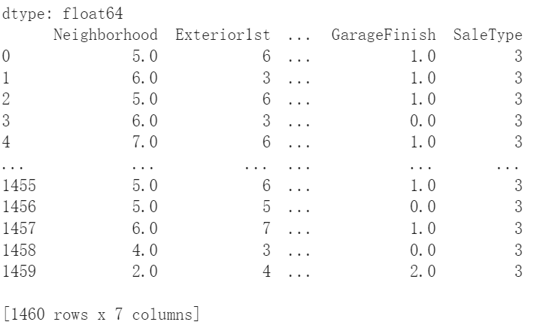
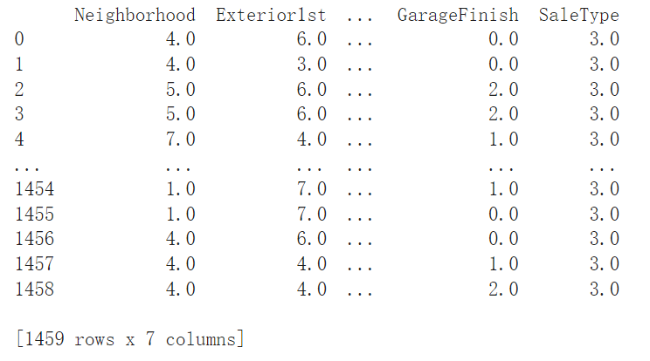
Results
Train Dataset
Test Dataset

Slide 21
Ordinal Features Handing
ZHANG Caiqi 18085481D
Notes:
Hello, I am Caiqi. I am mainly responsible for the ordinal features.

Slide 22
Catalog
Primary Feature Selection
Feature Encoding
Correlation Calculation
Results
Notes:
The catalog is similar to the categorical features. I will first introduce how I roughly select the features in the firstround and how I do the feature encoding specifically for the ordinal data. After that, I will calculate the correlation between each feature and the Saleprice and finalized the features for future training.

Slide 23
Primary Feature Selection
In ordinal features, there exists information about rank, which could be represented by quantitive attributes. e.g. Ex, Gd..
Two Dimensions:
Missing values less than 20% (e.g. PoolQC: 99% null)
Same value less than 90%
Result:
["MSSubClass", "OverallQual", "OverallCond", "ExterQual", "ExterCond", "BsmtQual", "BsmtCond", "HeatingQC", "KitchenQual", "FireplaceQu", "GarageQual", "GarageCond", "BsmtExposure", "BsmtFinType1", "BsmtFinType2"]
Notes:
Ordinal features are very similar to the categorical features, but they have minor difference. In ordinal features, **there exist information about rank, which could be represented by quantitive attributes.** For example, from the training data, when it refers to exter quality, it will use words like Excellent, Good, Average/Typical etc.
In this example, Ex and Gd represent different level of an attribute. Thus, in the following section, we will adopt label encoding, where a higher numeric value refers to a higher rank.
In the first round, we can filter some features which are very likely unuseful. Here are two matrics, missing value less than 20% and same value less than 90%. For example, Pool quality and condition: "PoolQC": As we discussed previously, we will not use this one because it have 99% null value.

Slide 24
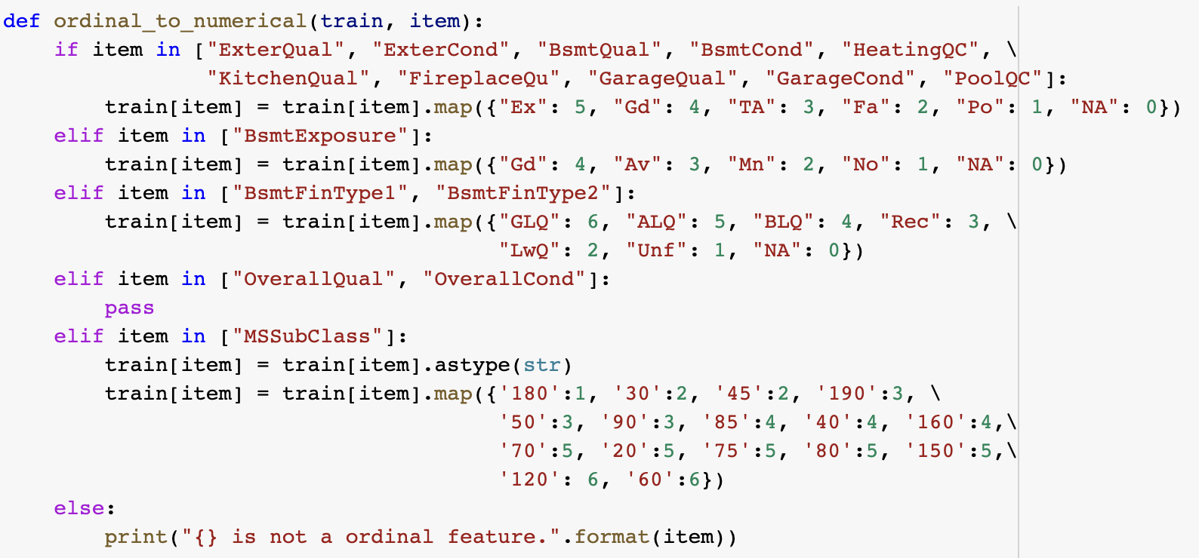
Feature Encoding
Value-mapping
Efficient way:
Categorize the features.
Notes:
Next we will use the value mapping, the rules can be found in this function. it sounds a little bit tedious to do so, but we actually have some smarter and more efficient way. We can categorize the features, some of them have same metrics. For example, Exter Qual, Exter condi, all use the ex, good, average matrics.

Slide 25
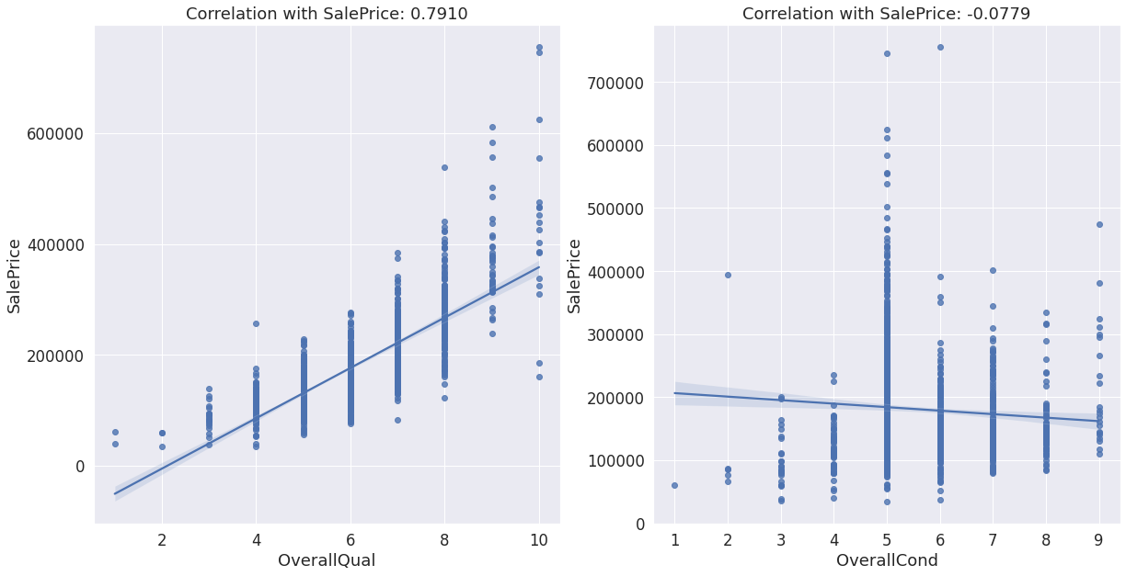
Correlation Calculation
Calculate correlation of each feature with the SalePrice.
Select features with correlation higher than 0.30.
Notes:
Calculate correlation of each feature with the SalePrice.
Select features with correlation higher than 0.30. here I just list two examples, details can be found in our notebook. We will keep the overall qual here but prune the overall condition, because the later is with too low correlation score.

Slide 26
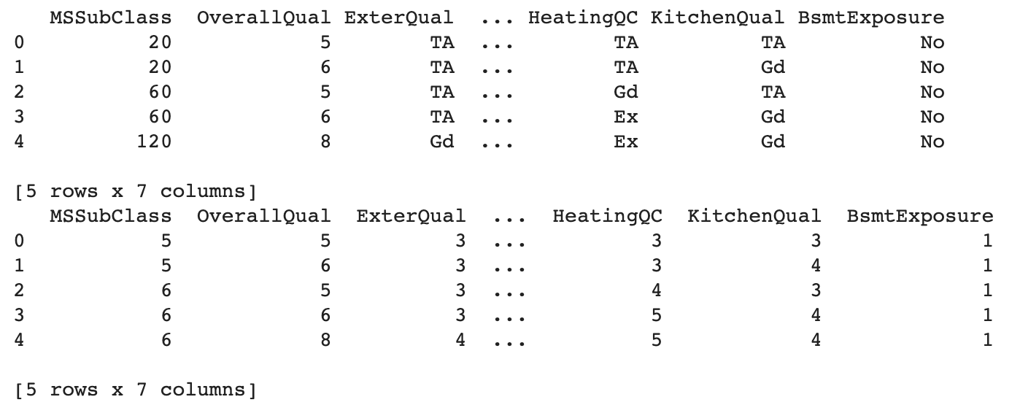
Results
Final selected ordinal features: ["MSSubClass", "OverallQual", "ExterQual", "BsmtQual", "HeatingQC", "KitchenQual", "BsmtExposure"]
Testset screenshot:
Notes:
finally, we can select the folwooing 7 features for the future training and tesing.

Slide 27
Model Construction
Principle Component Analysis (PCA)
Normalization: Robust Scaler for Outliers
Multicollinearity Reduction

Slide 28
Model Construction
Principle Component Analysis (PCA)
Single Model
Familiar models in former study:
Linear Regression
Ridge Regression
Lasso Regression
Random Forest Regression
Gradient Boosting Regression
Elastic Net
Stochasitic Gradient Regression
XGBoost Gradient Boosting Regression

Slide 29
Model Construction
Principle Component Analysis (PCA)
Single Model
Evaluation
RMLSE: Root Mean Squared Logarithmic error
Cross Validation: More reliable evaluation result
Model | Linear Regression | Ridge Regression | Lasso Regression | Random Forest Regression | Gradient Boosting Regression | Elastic Net | SGD Regression | XGBoost Regression
Train CV RMLSE | 0.0068 | 0.0068 | 0.0179 | 0.0071 | 0.0067 | 0.0067 | 0.0072 | 0.0067
Prediction RMLSE | 0.1490 | 0.1488 | 0.4163 | 0.2458 | 0.2153 | 0.1488 | 0.1545 | 0.2003

Slide 30
Model Construction
Principle Component Analysis (PCA)
Single Model
Evaluation
Wrapper Feature Selection Method
Recursive feature elimination model
Removal of the 'unimportant' features based on the coef attribute or feature importances.
Observation:
Performance remains the same as Single Model: Ridge Regression
Largely reduced performance: Elastic Net.

Slide 31
Model Construction
Principle Component Analysis (PCA)
Single Model
Evaluation
Wrapper Feature Selection Method
Blend Model
Simple way: average of several models prediction result as blend model’s result
Performance: 5-fold evaluation resulted an RMSLE of 0.00005.
Slight improvement on prediction results
Guess: Models’ strategies are similar

Slide 32
FIN Thank you for watching!

Slide 33
Reference
[1] Reference: All You Need is PCA (LB: 0.11421, top 4%), MASSQUANTITY, https://www.kaggle.com/massquantity/all-you-need-is-pca-lb-0-11421-top-4 (2016).
[2] Introduction to Feature Selection methods with an example (or how to select the right variables?) https://www.analyticsvidhya.com/blog/2016/12/introduction-to-feature-selection-methods-with-an-example-or-how-to-select-the-right-variables/
[3] Building A Custom Model in Scikit-Learn
https://towardsdatascience. com/building-a-custom-model-in-scikit-learn-b0da965a1299
[4] Houses Prices - Complete Solution
https://www.kaggle.com/mgmarques/houses-prices-complete-solution/notebook

