Slide 1

RecruitAssistant
Improving onboarding
Improving Resumes

Slide 2
Layout
1. Understanding the Project
The Problem
The Solution
Potential Customers
2. Architecture and Design
Technologies used
Requirements
Process **
Statistical Analysis
3. Prototype
Conclusions and Questions

Slide 3
What is the project?
A web application that assists users such as students in acquiring interviews by improving their Curriculum Vitae (CV)
It also assists employers in reducing the amount of CV’s they are required to read during a recruitment process
Achieved through:
Machine Learning
Artificial Intelligence (weighted scoring algorithms)
Natural Language Processing

Slide 4
The Problem
1. High cost of recruitment
Onboarding staff is essential to a business
2. Companies not responding to student’s applications
Lack of an online, cost effective tool to assist tailoring of cv

Slide 5
The Solution
1. Automate the process!
Reduce the duration of recruitment processes
Positive effect on time and cost management
2. An AI algorithm based on a statistical analysis!
Analysis of CV’s that received positive response from employers vs rejected ones

Slide 6
Aims
Complete all functionality within the project deadline
Create accurate algorithms based on credible statistics
Achieve commercial success
Reduce the workload of recruitment officers
Assist student’s in acquiring interviews

Slide 7
Potential Customers
Colleges/Universities that provide work place programs
Startups
Companies with large staff
Companies with frequent turnover of staff
Anyone seeking employment
Interview.ie - the only competitor

Slide 8






Technologies Used

Slide 9
Technologies Used
Python
Django
Azure
Bootstrap
Github
Atom

Slide 10
Requirements: Functional
The system will allow the student to upload their CV to the system.
The system will predict the probability of student’s CV being successful.
The system will provide analysis of how to improve the user’s CV.
The system will provide visual representations of the statistical analysis for the user.
The system will allow the employer to upload multiple CV’s to the system.
The system will filter CV’s for the employer
The system will generate an analysis of the CV filtration for the employer

Slide 11
Requirements: Data
4 Datasets for the statistical analysis
Student’s CV in txt/doc format
Employer CV’s zipped in txt/doc format
No Login or Database?

Slide 12
Requirements: Security
Data Protection – risks of saving user data?
Datasets separate to application
SQL Injections

Slide 13
Requirements: Performance
Heavy algorithms!
Cloud Based
Content Delivery Network (CDN)

Slide 14
System Process: High Level
Student uploads CV
System processes content of CV
Weighted scoring system applied
Returns probability and advice to student
Employer uploads multiple CV’s
System processes content of CV’s
Weighted scoring system applied
Returns zip of highest scoring files to employer

Slide 15
Statistical Analysis Process
Carried out to identify criteria for weighted scoring systems
NLP:
Tokenization
Sentiment Analysis
Stemming
Text Classification
Stopping
Consultation from 2 HR generalists for employer algorithm

Slide 16
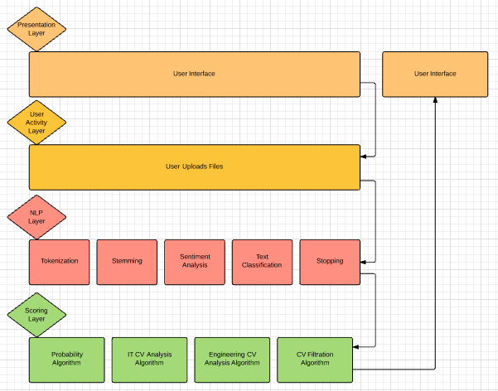
Process: Detailed

Slide 17
Prototype Showcase!

Slide 18
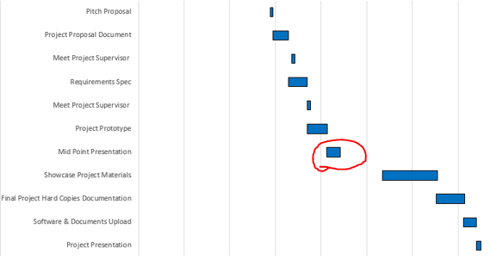
Conclusions
Current stage of development: Statistical Analysis (NLP)
Agile Development

Slide 19
Literature
Pattern Recognition and Machine Learning, Christopher M. Bishop, 2006
Artificial Intelligence, A Modern Approach, Stuart Russel, Third Edition 2016
Natural Language Processing with Python, Edward Loper, Steven Bird,2009

Slide 20
Questions?

