Slide 1
What is CHICAS?
Barry Rowlingson
January 2016
Faculty of Health and Medicine,
Lancaster University
http://chicas.lancaster-university.uk

Slide 2
“Combining Health Information, Computation, and Statistics”

Slide 3
Health Data Science?

Slide 4
What CHICAS isn't
Statistical Consultancy Service
  But we do like talking about statistics
  Can probably find you jobbing statisticians
Clinical Trials Research Unit
  Maths and Stats has this!
Service Teaching Group
  Although some staff do some teaching
  Do want to expand PG teaching...

Slide 5
Who is CHICAS?
Peter Diggle
Frank Dondelinger
Emanuele Giorgi
James Hensman
Chris Jewell
Tom Keegan
Jo Knight
Jon Read
Barry Rowlingson
Luigi Sedda
Ben Taylor
Plus three full-time PDRAs and 14 PhD Students.

Slide 6

Peter Diggle
Distinguished University Professor
RSS President (2014-2016)
Spatial and Longitudinal Analysis
Biomedical, Health, Environmental Applications

Slide 7

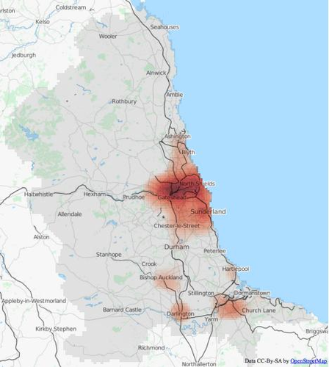
Campylobacter
Most common cause of GI illness in England and Wales
Integrating heterogeneous data collections
Produce incidence maps
Predict risk
Target controls

Slide 8

Frank Dondelinger
Anniversary Lecturer in Biostatistics
Statistical Genomics
Disease Outcome Prediction
Genetic Trait and Phenotype Prediction
Networks and Pathway Inference
Hierarchical Bayesian Modelling
Analysis of Heterogeneous Datasets
Systems Biology and Dynamical Modelling

Slide 9
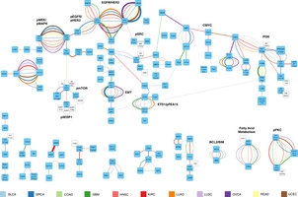
Signalling Pathway Reconstruction
Using a Pan-Cancer Proteomics Dataset
181 proteins in 11 tumour types
Graphical Gaussian models
Reconstruction of known and novel pathways.
Enabling new stratification and classification of cancer subtypes.

Slide 10
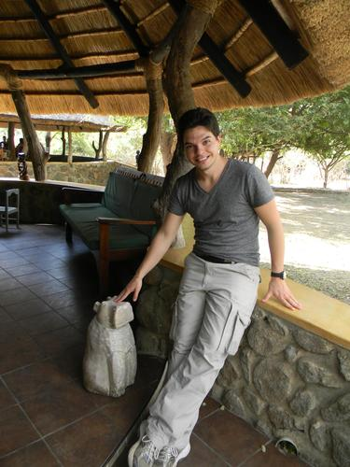
Emanuele Giorgi
MRC Research Fellow
Recent CHICAS PhD completion
Spatio-temporal Statistics
Prevalence Mapping

Slide 11
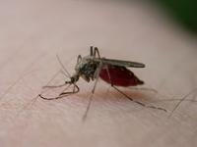
Malaria Control in Malawi
Intervention Effectiveness
Monitoring and Evaluation Tool
With Wageningen, Amsterdam, Malawi, Liverpool
Aiming for 80% morbidity reduction

Slide 12

James Hensman
MRC Fellowship Lecturer in Biostatistics
Statistical Machine Learning
Gaussian Process Models
Bioscience and Epidemiology Applications

Slide 13
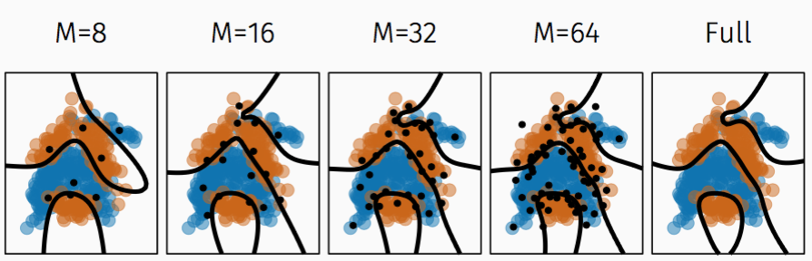
Scaling Gaussian Processes
GPs are popular and useful statistical models
Computation is O(n³)
Becomes slow with Big Data
Developed algorithm for better than O(n³) performance with little accuracy sacrifice

Slide 14

Chris Jewell
CHICAS Senior Lecturer
Disease Outbreak Response
Zoonotic Diseases
Stochastic Dynamic Infection Models
High Performance Computing, including GPU Programming

Slide 15
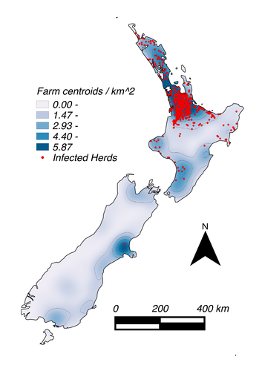
Vector-borne Disease Inference
Methodology for forecasting
Fitting algorithms from case data
Predicting risk surfaces
Data assimilation

Slide 16

Tom Keegan
Lecturer in Epidemiology
Environmental and Occupational Epidemiology
Exposure Measurement and Modelling

Slide 17
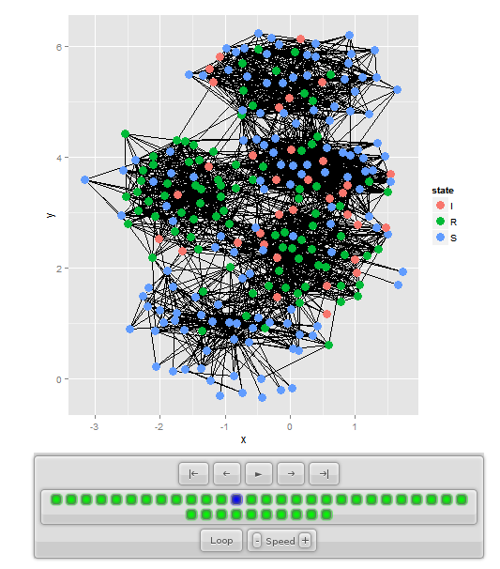
Infections and Networks
Influenza Transmission
Social Network Graph Models
Vaccination Scheme Design

Slide 18

Jo Knight
Anniversary Reader in Statistical Genetics
Psychiatric Genetics
Genetic Data Integration
Epigenetics

Slide 19

Jonathan Read
Senior Lecturer in Epidemiology
  Infectious diseases
  Pathogen transmission and evolution
  Human interaction patterns
  Field-based and modelling studies
  Worked on seasonal and pandemic influenza, Ebola, RSV, norovirus, rotavirus, pneumococci
  Studies in China, Hong Kong, UK, USA, Malawi, Thailand, Indonesia, Vietnam

Slide 20
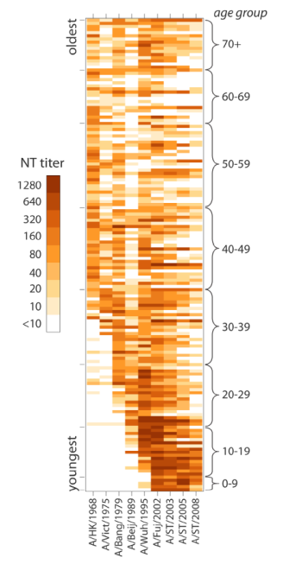
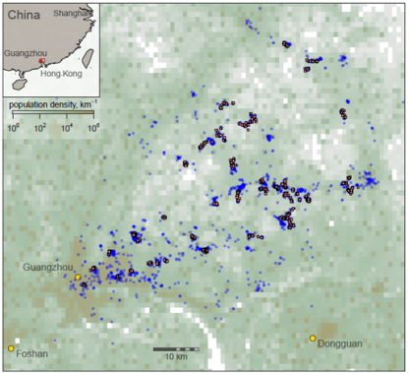
Fluscape
Open cohort study
  Guangdong province, China
  Approx. 1,000 households
  Approx. 2,000 individuals
  4 years field-work
  Measure contact and travel patterns
  Serological analysis of antibody titres to recent and historic influenza strains
  Statistical analysis and modelling (simulation)

Slide 21

Barry Rowlingson
CHICAS Research Fellow
Spatial Epidemiology
Statistical Software Development
Visualisation and Graphics
Geographic Information Systems
Web System Development

Slide 22
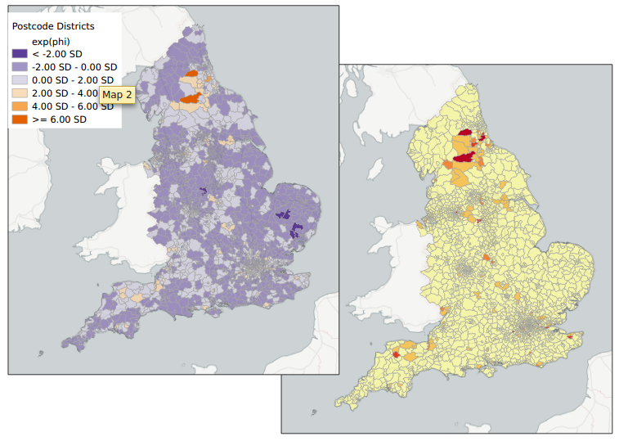
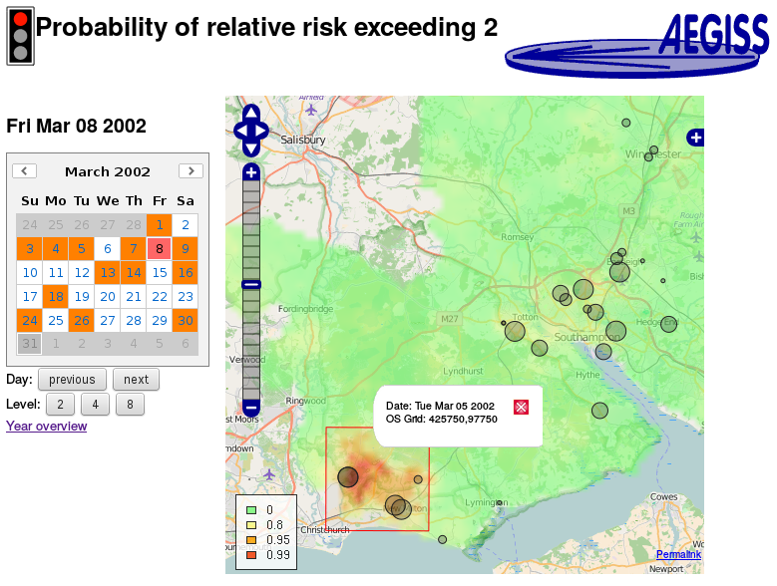
AEGISS2
Integration of Human and Veterinary Case Data
Vet Data via SAVSNET
Human Data via NHS111
Rapid Detection of Disease Outbreaks

Slide 23

Luigi Sedda
Anniversary Lecturer in Spatial Epidemiology
Vector-borne disease mapping
Emergence and spread
Species Distribution
Disease Control

Slide 24
Mapping Vector Hot-Spots
Determine vector and host population dynamics
Tsetse fly distribution analysis
Map stable/growing tsetse fly zones
With Lancaster, Liverpool STM, Southampton University

Slide 25

Ben Taylor
Lecturer in Statistics
  Methodological and computational aspects of log-Gaussian Cox Processes.
  Combining data recorded at multiple spatial scales.
  Filtering methodology and applications.
  Forecasting meningitis incidence in sub-Saharan Africa in collaboration with the World Health Organisation.
  Spatial prediction of campylobacter in the UK.
  Spatial modelling of survival outcomes

Slide 26
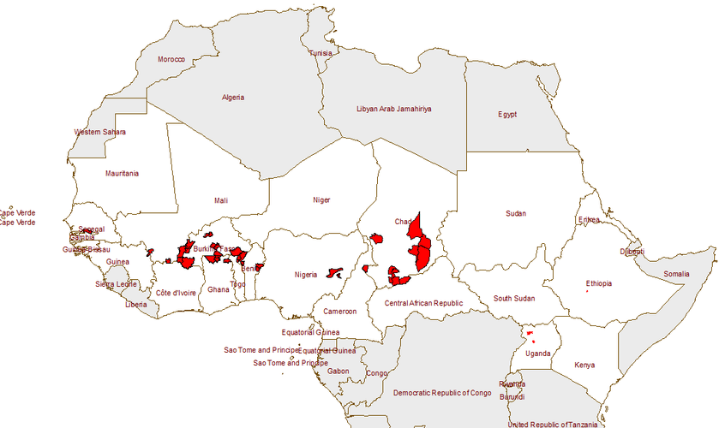
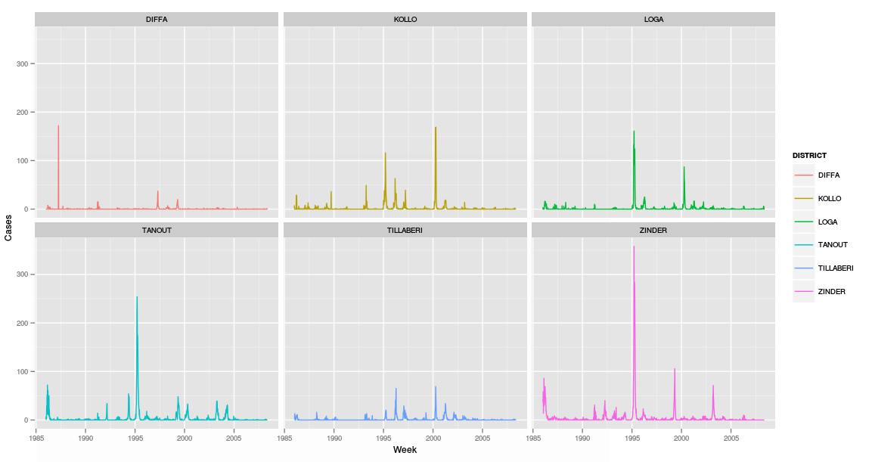
Meningitis Forecasting
Weekly District Case Counts
Dynamic Linear Model
Epidemic Alert and Forecast
Weekly Reports Delivered to WHO

Slide 27
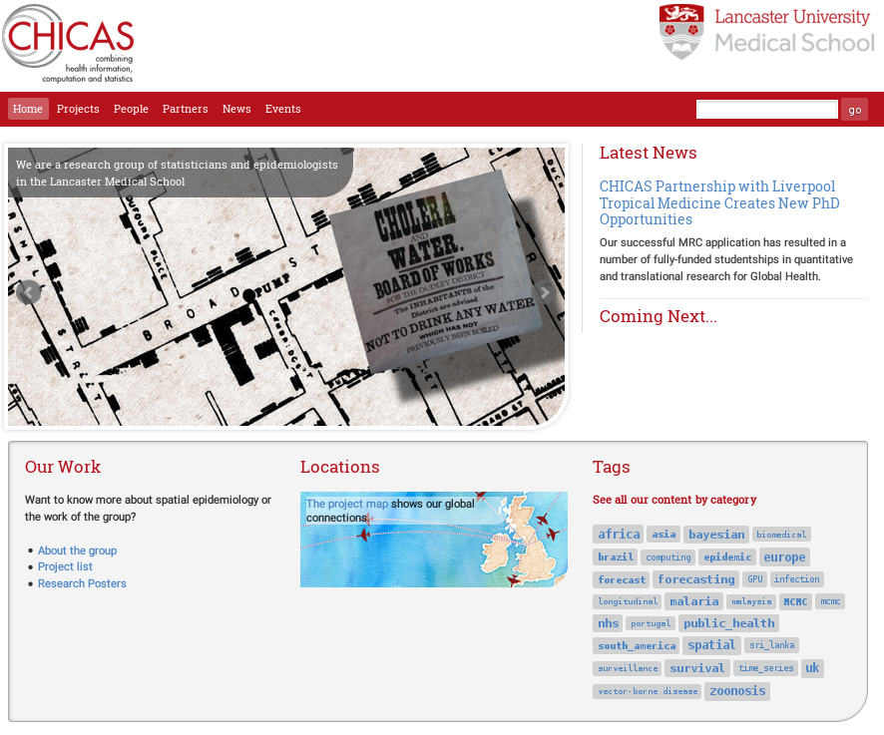
Web Site
http://chicas.lancaster-university.uk

Slide 28
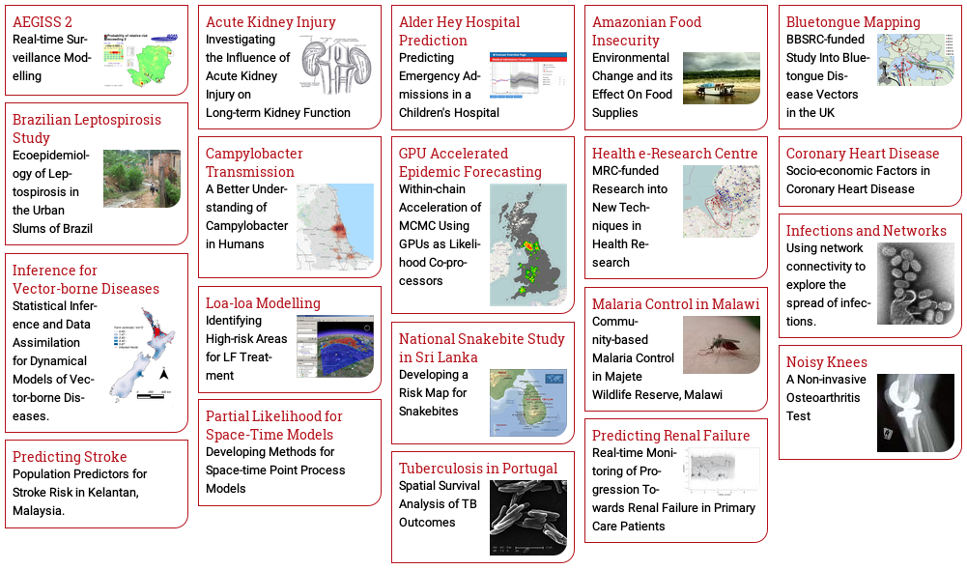

Projects

Slide 29
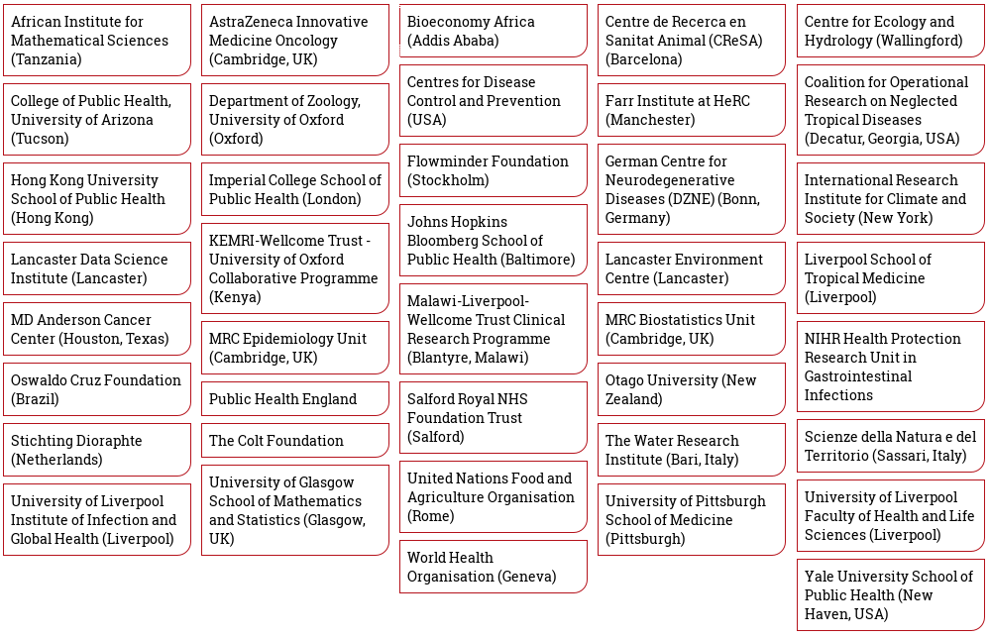
Connections

Slide 30

World Connections

Slide 31
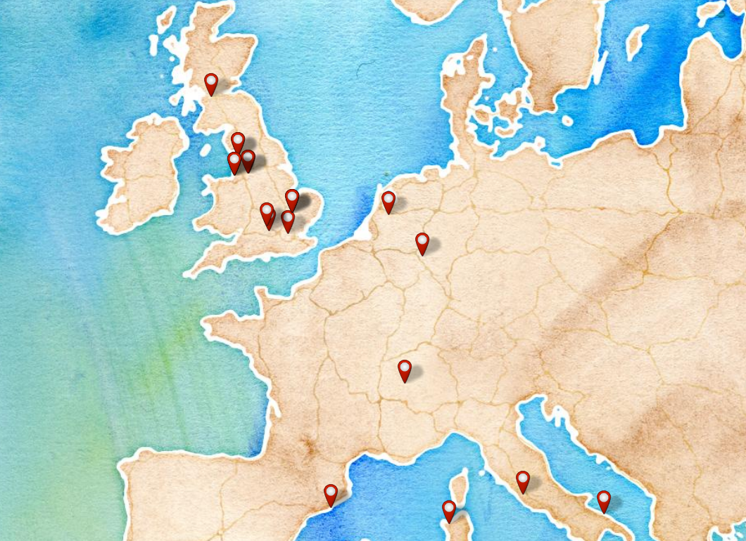
Euro Connections

Slide 32



http://chicas.lancaster-university.uk
CHICAS and BLS KE workshop
Fri, 29 January
12:00 – 16:30

