Slide 1
Resume JD Matching System
AI-powered Candidate Ranking, Skill Gap Analysis, and Recruiter Insights
Streamlit Demo · SBERT Embeddings · XGBoost · HR Tech

Slide 2
Project Summary
A modern HR Tech solution that automates resume screening by matching
candidate resumes to job descriptions.
Rank candidates by final match score
Analyze skill gaps vs job requirements
Provide explainable recruiter recommendations
Key Features
Skill Extraction
Semantic Matching
Candidate Ranking
Dashboard Deployment

Slide 3
Data & Model Approach
Data
• Hugging Face resume-job matching dataset
• Cleaned job descriptions + PDF resumes
• Skill extraction and resume parsing
Approach
• SBERT embeddings for semantic similarity
• XGBoost classifier with feature fusion
• Combined skill + semantic scoring

Slide 4
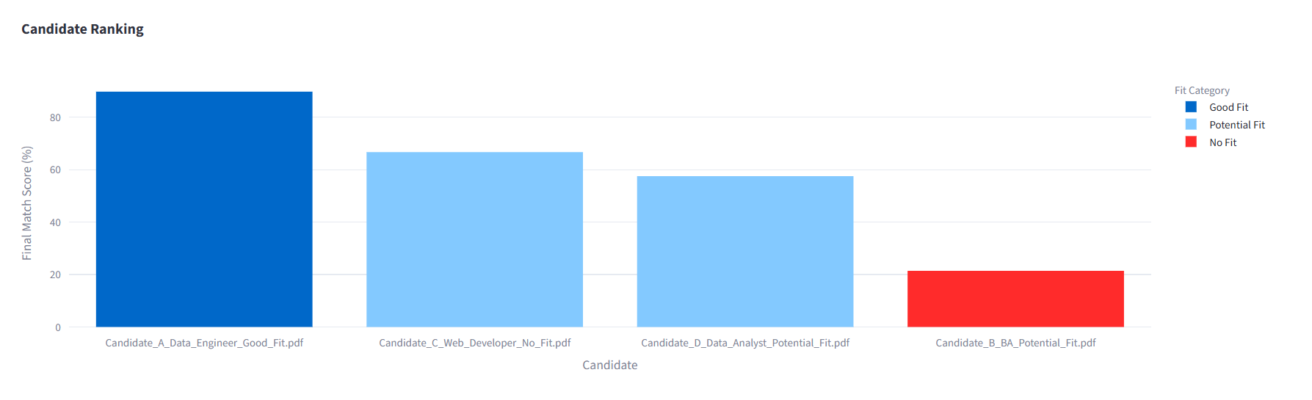
Candidate Ranking
The system ranks candidates by:
60% skill score
40% semantic score
Clear fit categories and recommendations

Slide 5
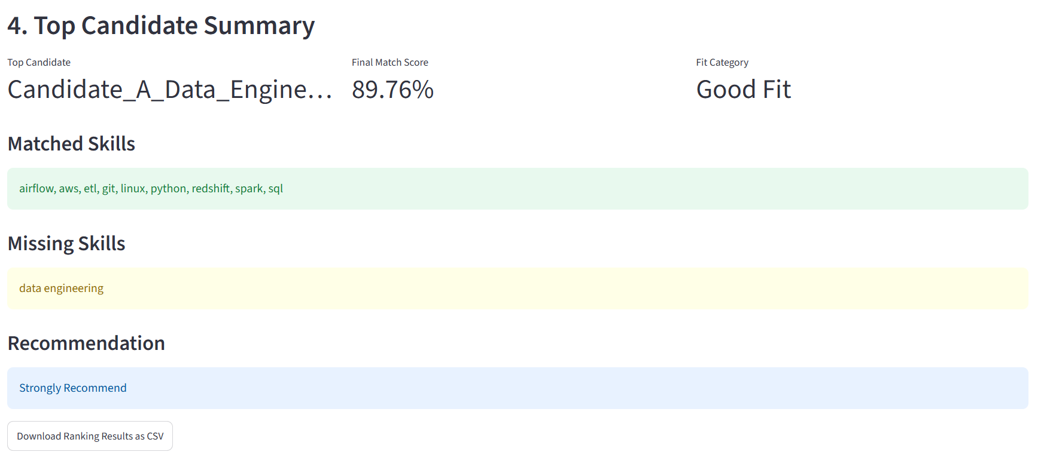
Top Candidate Insights
This slide explains why the top candidate stands out and highlights matched/missing skills.
• Best overall match score
• Strong recruiter recommendation
• Transparent skill gap reasoning

Slide 6
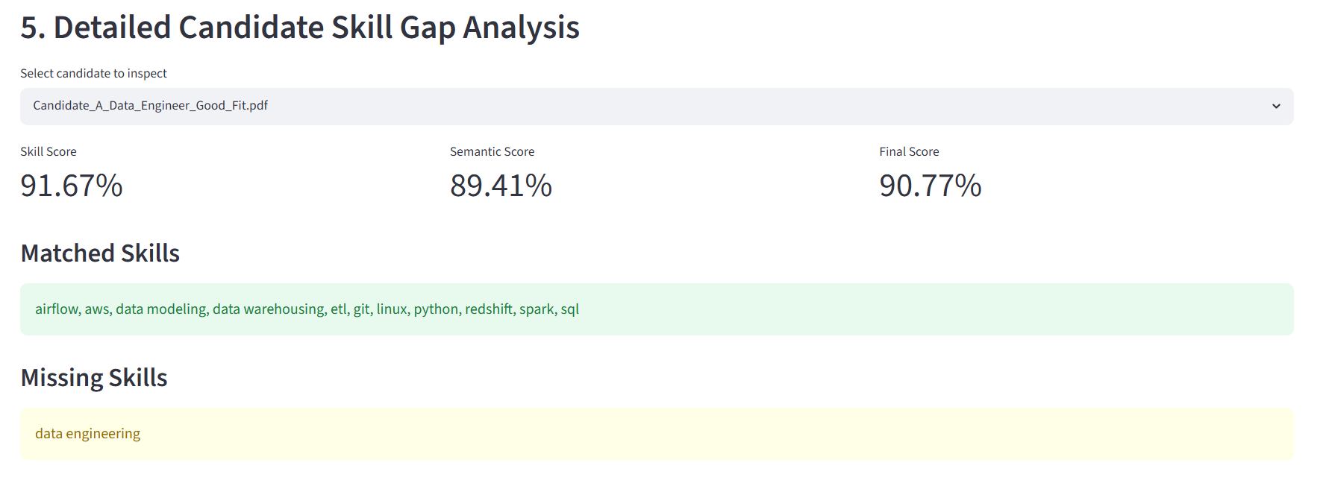
Skill Gap Analysis
The skill gap visual explains missing and matched skills for better hiring decisions.
• Compare JD skills vs resume skills
• Identify development opportunities
• Support explainable candidate evaluation

Slide 7
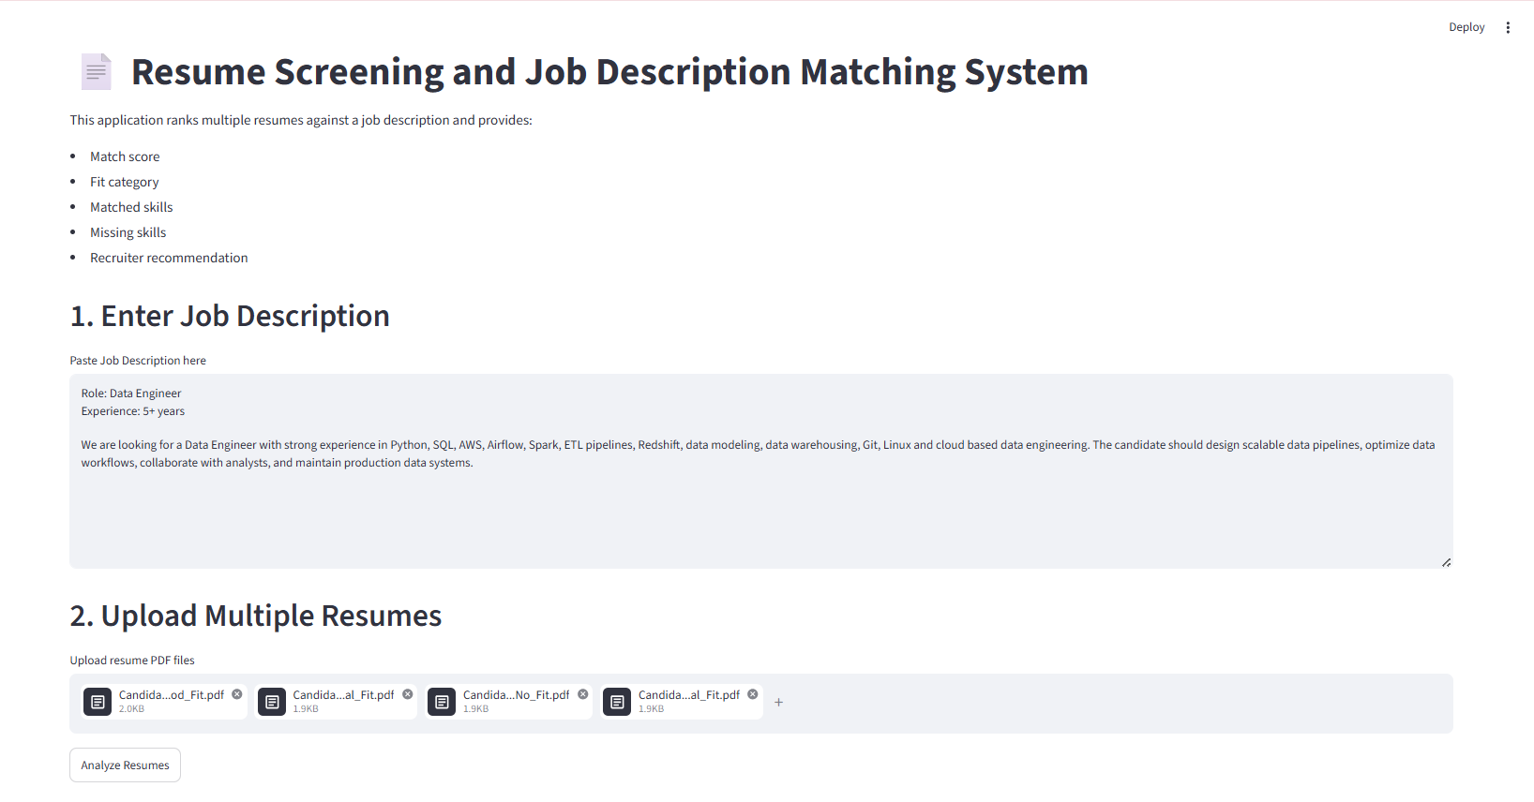
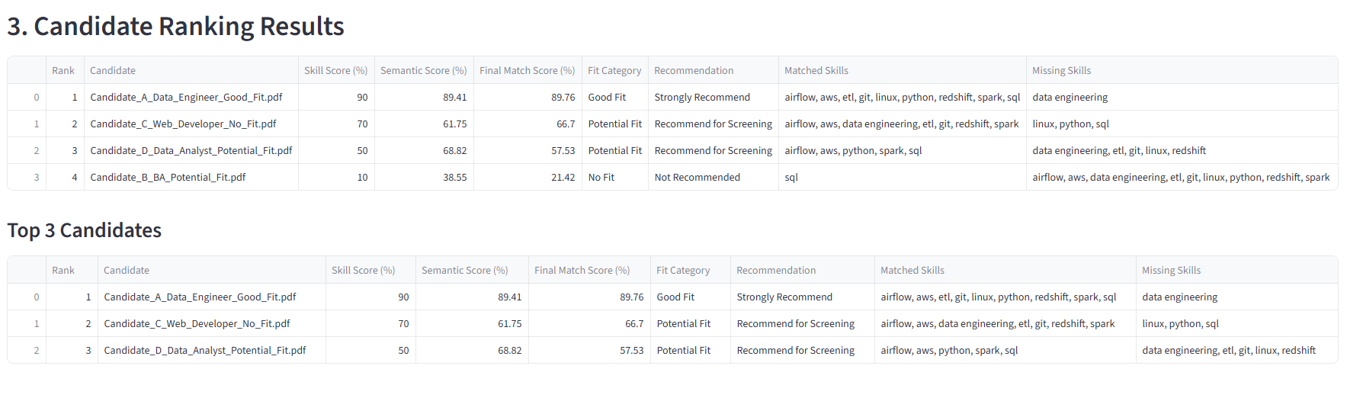
App Demo Screenshots

Slide 8
Impact & Next Steps
This solution helps recruiters screen resumes faster with transparent candidate recommendations.
• Faster hiring decisions
• Explainable candidate fit
• Future: richer resume parsing, improved UI, more skill coverage

