Slide 1


A high performance, open-source universal RPC framework

Slide 2
Why gRPC?
gRPC is a modern open-source high performance Remote Procedure Call (RPC) framework that can run in any environment.
It can efficiently connect services in and across data centers with pluggable support for load balancing, tracing, health checking and authentication.
It is also applicable in last mile of distributed computing to connect devices, mobile applications and browsers to backend services.
https://grpc.io

Slide 3
The story behind gRPC
gRPC was initially created by Google, which has used a single general-purpose RPC infrastructure called Stubby to connect the large number of microservices running within and across its data centers for over a decade. In March 2015, Google decided to build the next version of Stubby and make it open source. The result was gRPC, which is now used in many organizations outside of Google to power use cases from microservices to the “last mile” of computing (mobile, web, and Internet of Things).
https://grpc.io/about/#the-story-behind-grpc

Slide 4
The main usage scenarios
Lightweight microservices where efficiency is critical.
Polyglot systems where multiple languages are required for development.
Point-to-point real-time services that need to handle streaming requests or responses.
Generating efficient client libraries
https://grpc.io/about/#the-main-usage-scenarios

Slide 5
Core features that make it awesome
Idiomatic client libraries in 11 languages
Highly efficient on wire and with a simple service definition framework
Bi-directional streaming with http/2 based transport
Pluggable auth, tracing, load balancing and health checking
Contract-first API development, using Protocol Buffers by default, allowing for language agnostic implementations.
Tooling available for many languages to generate strongly-typed servers and clients.
Supports client, server, and bi-directional streaming calls.
Reduced network usage with Protobuf binary serialization.
https://grpc.io/about/#core-features-that-make-it-awesome

Slide 6

Used By

Slide 7
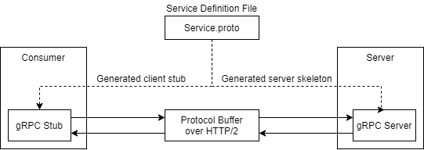
https://grpc.io/about/#core-features-that-make-it-awesome

Slide 8
Notes
ASP.NET Community Standup - gRPC Updates in .NET 7
JSON transcoding for REST services
https://www.youtube.com/watch?v=ds27V6rNick
Toolin
JSON Transcoding
https://docs.microsoft.com/en-us/aspnet/core/grpc/httpapi
ASP.NET Core gRPC server requirements
https://docs.microsoft.com/en-us/aspnet/core/grpc/supported-platforms?view=aspnetcore-6.0#aspnet-core-grpc-server-requirements
gRPC-Web
Performance
https://docs.microsoft.com/en-us/aspnet/core/grpc/performance?view=aspnetcore-6.0
YARP
https://microsoft.github.io/reverse-proxy/
gRPCurl
https://docs.microsoft.com/en-us/aspnet/core/grpc/test-tools?view=aspnetcore-6.0
Scalar types
https://docs.microsoft.com/en-us/dotnet/architecture/grpc-for-wcf-developers/protobuf-data-types
https://grpc.io/about/#core-features-that-make-it-awesome

