Slide 1


TVenzo Project
The "TVenzo" project is an online platform dedicated to showcasing popular television shows. It aims to provide users with an interactive and informative experience by offering comprehensive details on various shows while allowing them to express their preferences through features such as likes and comments. The site relies on an external API to fetch real-time information about the aired shows.

Slide 2
Team Presentation
Zouhair BARTA
Youssef Sabrallah

Slide 3
Current Link
1 Demo Link
A demo of the project is available via this link:
2 Repository Github
https://github.com/bartazouhair/alx-TVenzo
Demo Link

Slide 4
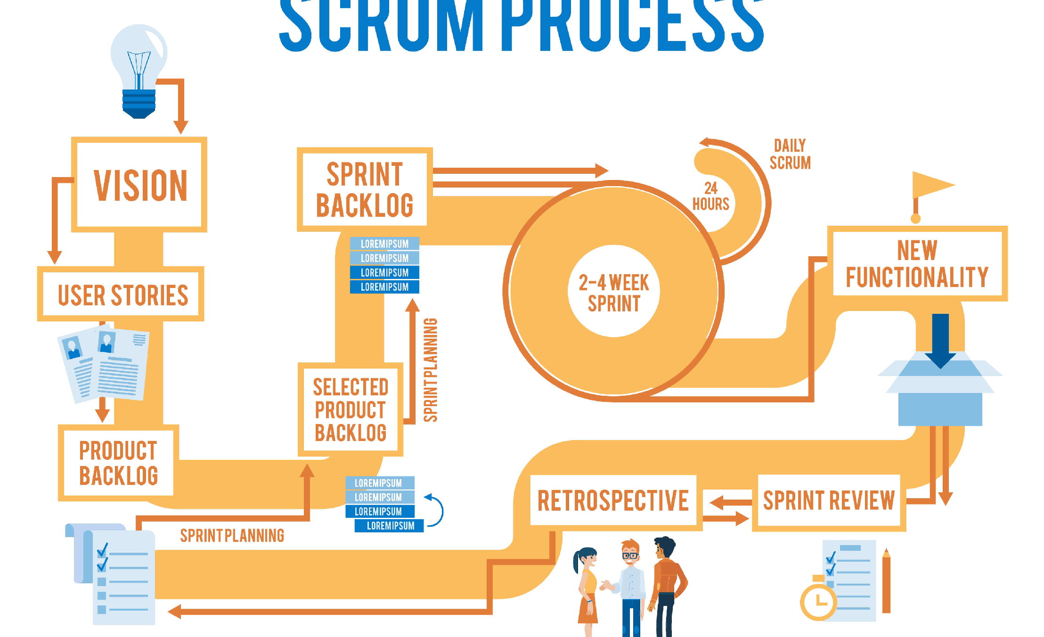

Scrum Method Used
1
Strengths
Identifying your strengths is the first step in leadership development. It's important to understand what you're naturally good at and where your skills lie. This can help you focus on areas where you can excel and contribute the most.
2
Goal Setting
Setting achievable goals is a crucial part of leadership development. Goals give you a clear direction and a target to aim for. They help you measure progress and keep you motivated. Remember to make your goals SMART - Specific, Measurable, Achievable, Relevant, and Time- bound.
3
Tools & Resources
Gathering the right tools and resources is essential for effective leadership development. This could include books, courses, mentors, and real-world experiences. The right resources can provide valuable insights and help you develop the skills you need to be an effective leader.

Slide 5
Architecture and Technologies Used
Technologies Used
HTML / CSS : For the structure and styling of the user interface.
JavaScript: For dynamic logic and user interaction.
Webpack : For bundling and managing project resources.
Architecture
The project is based on a Microverse architecture, favoring modularity and code maintainability. The different functionalities of the application are distributed across distinct modules, facilitating development, testing, and maintenance of the project.

Slide 6
Project Demo
1 Main Features
The project demo provides an interactive overview of the application, highlighting its main features such as navigation, show viewing, as well as the ability to like and comment.
2 User Interface
It also allows users to familiarize themselves with the user interface and its intuitive user experience.

Slide 7
Development Report
1
Successes
Robust Architecture: Establishment of a solid architecture, enabling efficient module management and project scalability.
2
Challenges
Dependency Management : Effectively managing external dependencies and ensuring application stability despite potential API updates.
Integration of External API : Successful integration of the external API for collecting data on television shows, ensuring relevance and timeliness of the presented information.
Advanced Development : Implementing advanced features such as comment management and responsive design while maintaining application performance across different devices and browsers.

Slide 8
Conclusion
1 Project Success
In conclusion, the TVenzo project represents a collaborative success in creating a web platform dedicated to television shows. Through a systematic approach, well-designed architecture, and effective collaboration, we were able to overcome challenges and successfully achieve project goals.
2 Lessons Learned
Agility and Adaptability: The importance of remaining agile and adaptable to project changes and challenges encountered during development.
Communication and Collaboration : The positive impact of clear communication and effective collaboration within the team to solve problems and progress in the project.

