Slide 1
OMUS meeting 02/06

Slide 2
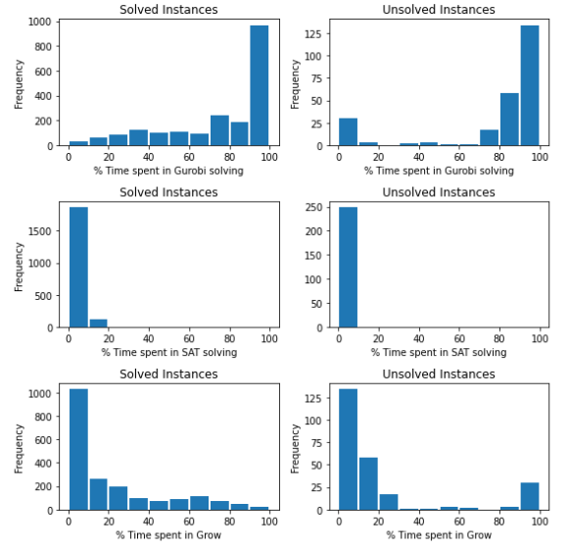
Progress
Hitting set computation is expensive
  postponing optimization
Extension : Parameterized, but no clear winner …
  Propagate unit litteral immediatly
  Weighing = Weight clause / (#unassigned lits)
  Best next literal = compare pure literal only
  Ignore sorting

Slide 3
Next
Pseudo code:
  OMUS Explanation
Implementation:
  Postponing optimization
Workshop Paper
CP doctoral consortium
ECAI doctoral consortium

Slide 4
Postponing optimization
Idea
Recognise situations non-opt solutions can be used instead of opt w/o impacting algortihm correctness
Augment model by many constraints
Every step:
  Try finding incremental hitting set (continue as much as possible)
  If not found: try finding greedy hitting set
  If found: back to incremental hitting set
  Else: Break; compute new optimal solution

Slide 5
Postponing optimization
FindIncrementalHittingSet(H, C, hs):
ToDo: Remove/Add clause in te newest grown Set to the current hitting set
FindGreedyHittingSet(H):
“standard” greedy algorithm for the MCHS problem:
“Approximation algorithms for combinatorial problems” (1973)

Slide 6
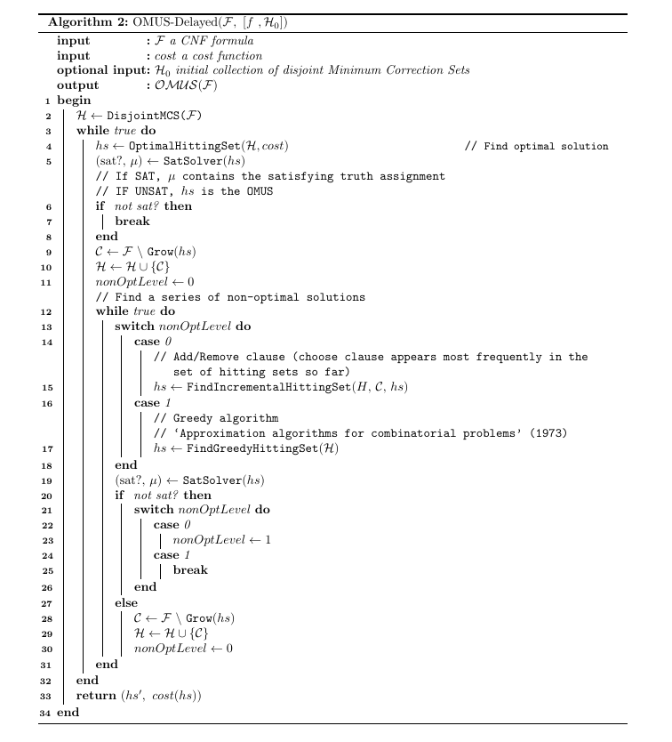

Slide 7
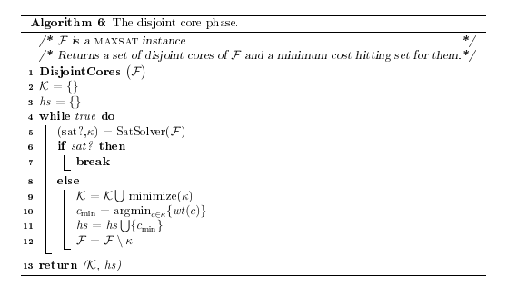

Slide 8
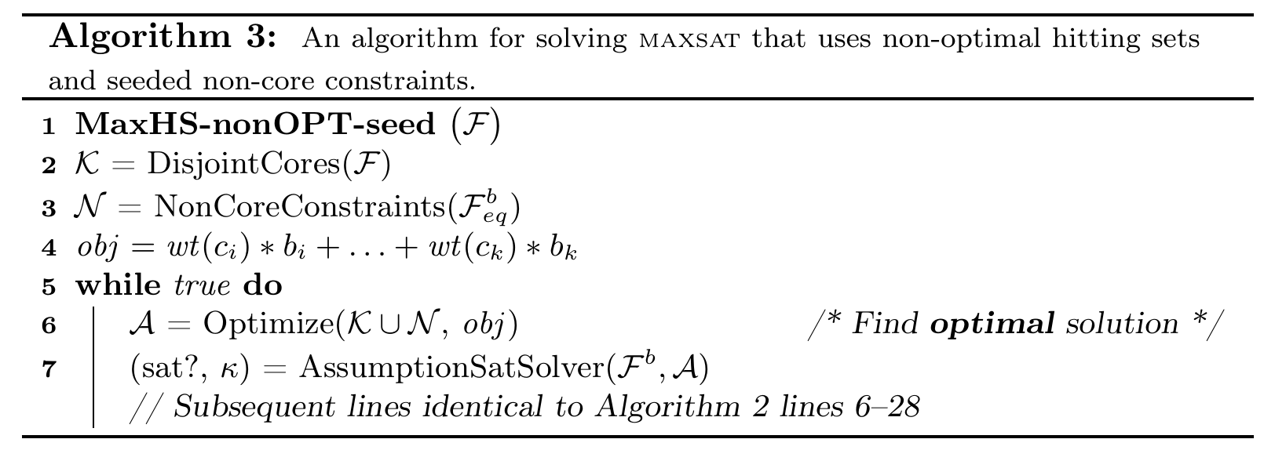
Postponing optimization
Improvements
Seed Gurobi with many non-core constraints as a preprocessing step (algo 3)
  Need to adapt to OMUS
Use lower/upper bound from findGreedyHittingSet(H)

Slide 9
OMUS explanation

