Slide 1
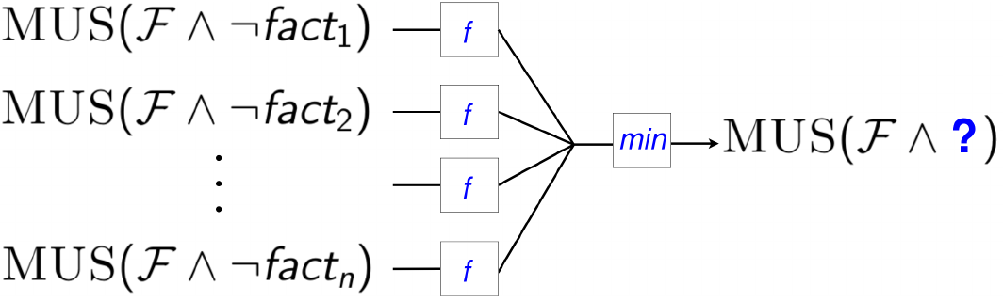
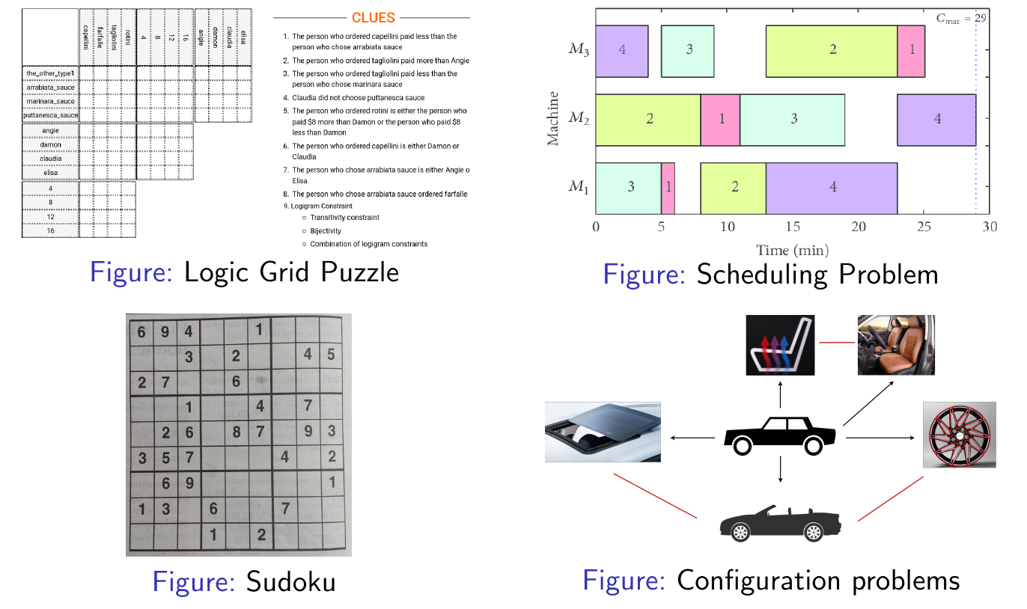





Efficiently Explaining Constraint Satisfaction Problems
with Unsat Core Optimisation
Emilio Gamba¹, Bart Bogaerts¹, Tias Guns¹
emilio.gamba@vub.be, bart.bogaerts@vub.be, tias.guns@kuleuven.be
Context
Explanation Generation
Context
Explanation Generation
Explain step-by-step how to solve
Constraint Satisfaction Problems
(Logic puzzles, Sudoku, Scheduling/configuration/Planning problems)
Strenghts
MUS guarantees non-redundancy
Limitations
Cost-function not-encoded in MUS-extraction
Cost function only in explanation finding heuristic
No guarantee explanation is cost-optimal
Explanation generation takes long!
→ Optimality
→ Efficiency+Incrementality
Motivation
!
Step-wise explanation problem
Generate an explanation sequence that explains
step-by-step how to derive the facts of the solution.
  F A formula (representation of the problem constraints)
  FactsToExplain Facts of the solution to explain
  f A cost function quantifying explanation difficulty
Bogaerts et al. [2020]
Bogaerts, Bart, et al. "Step-wise explanations of constraint satisfaction problems." 24th European Conference on Artificial Intelligence (ECAI). 2020.
Bart Bogaerts, Emilio Gamba and Tias Guns “A framework for step-wise explaining how to solve constraint satisfaction problems”
Saikko, Paul, Johannes Peter Wallner, and Matti Järvisalo. "Implicit Hitting Set Algorithms for Reasoning Beyond NP." KR. 2016.

