Slide 1
Code
Extension 1/2/3:
  Same parameters/structures
  Sat checking:
    Get better/best model (too many to check)
Need to run benchmark

Slide 2
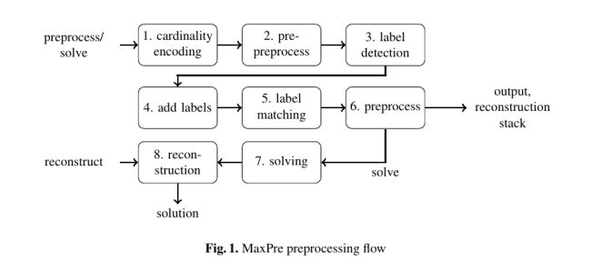
Optimization ideas
Pre-processor
  MaxPre: An Extended MaxSAT Preprocessor (2017)
    C++
    API for tight integration with MaxSat solver

Slide 3
Optimization Ideas
Branch and Bound (Grow)
  Use both the validated clauses and the falsified clauses
    Binary Search-like
  LB =
  UB =
Local Search
  Start from possible grown set and apply local search techniques from MaxSat

Slide 4
Optimization Ideas
Branch and Bound
Local Search
IP only:
  (2013) Solving (Weighted) Partial MaxSAT with ILP.
    Slow on industrial instances
    Fast on crafted instances

Slide 5
Optimization Ideas
Branch and Bound
Local Search
IP+ SAT:
  LMHS: a SAT-IP hybrid MaxSAT solver

