Slide 1
OMUS meeting 08/06

Slide 2
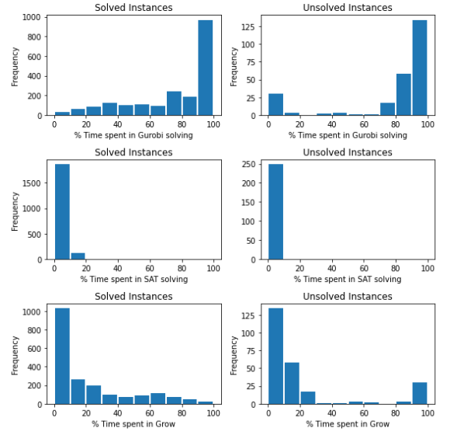
Progress
Hitting set computation is expensive
  postponing optimization
Extension : Parameterized, but no clear winner …
  Propagate unit litteral immediatly
  Weighing = Weight clause / (#unassigned lits)
  Best next literal = compare pure literal only
  Ignore sorting

Slide 3
Next
Pseudo code:
  OMUS Explanation
Implementation:
  Postponing optimization
Workshop Paper
CP doctoral consortium
ECAI doctoral consortium

Slide 4
Postponing optimization
Idea
Recognise situations non-opt solutions can be used instead of opt w/o impacting algortihm correctness
Augment model by many constraints
Every step:
  Try finding incremental hitting set (continue as much as possible)
  If not found: try finding greedy hitting set
  If found: back to incremental hitting set
  Else: Break; compute new optimal solution

Slide 5
Postponing optimization
FindIncrementalHittingSet(H, C, hs):
ToDo: Remove/Add clause in te newest grown Set to the current hitting set
FindGreedyHittingSet(H):
“standard” greedy algorithm for the MCHS problem:
“Approximation algorithms for combinatorial problems” (1973)

Slide 6
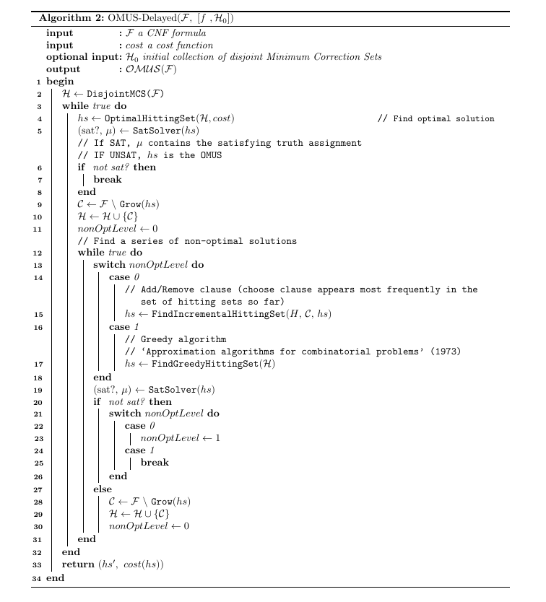
Todo:
– name cases
– Incrementalhittingset

Slide 7
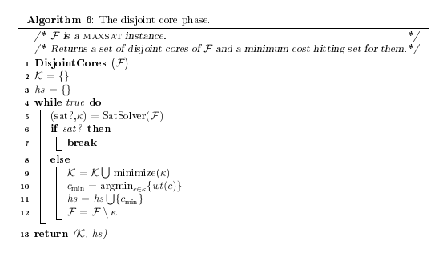

Slide 8
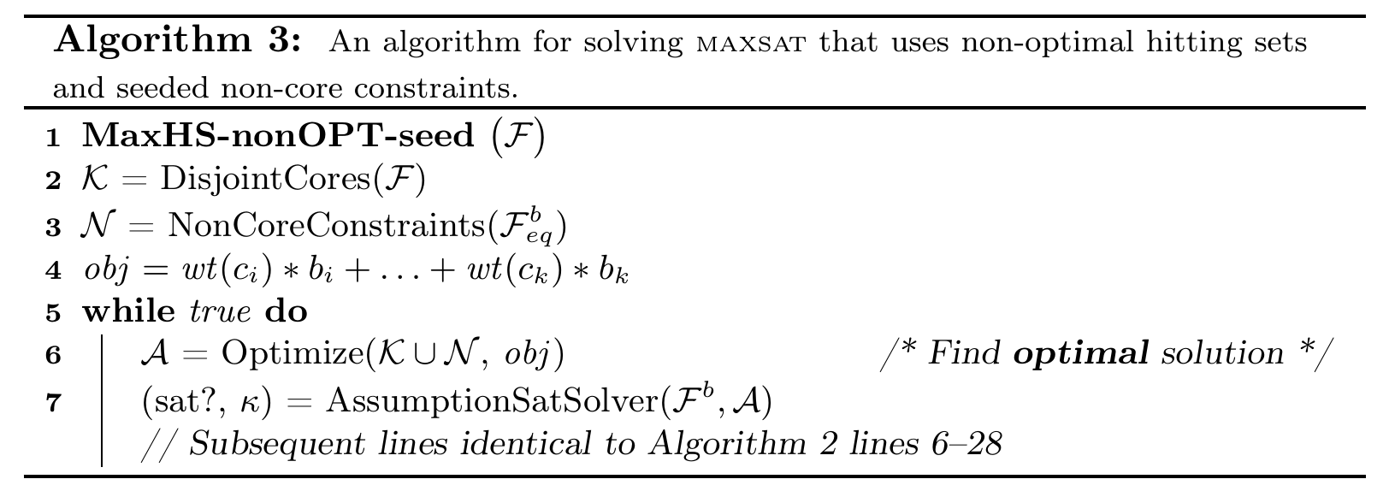
Postponing optimization
Improvements
Seed Gurobi with many non-core constraints as a preprocessing step (algo 3)
  Need to adapt to OMUS
Use lower/upper bound from findGreedyHittingSet(H)

Slide 9
OMUS explanation – Idee
Voor een bepaalde literal X:
– Explanation bestaat al = E de literal X impliceert, dan is omus dezelfde of beter, met X erbij
OMUS(variableY, cons + assigned_lits) >= OMUS(variableY, cons + assigned_lits +{litX})
– waar hittingsets hergebruiken ?
– Extensie explanations verbeteren : MSS => in vorm van een unit propagation
– omus incremental : reuse voor dezelfde literal (strictly growing constraint sets)
– omus incremental : verschillende literals (overlapping constraints sets)
– Lijn 8 : for i in not yet derived facts : OMUS(….)
– Lijn 16-18 : append < (E, S , N)> to seq
– Best kiezen
– Data structuur met “nuttige” informatie (subsets + facts)

