Slide 1
OMUS meeting 02/06

Slide 2
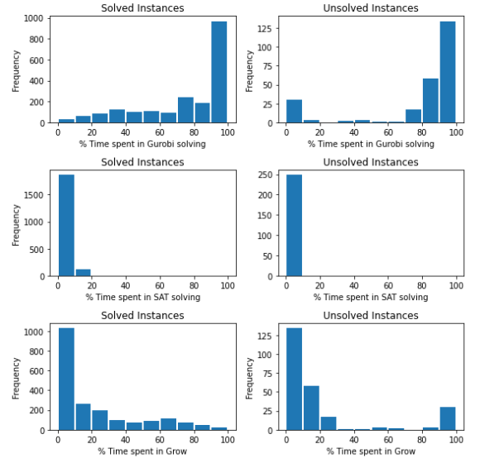
Progress
Hitting set computation is expensive
  postponing optimization
Extension : Parameterized, but no clear winner …
  Propagate unit litteral immediatly
  Weighing = Weight clause / (#unassigned lits)
  Best next literal = compare pure literal only
  Ignore sorting

Slide 3
Next
Pseudo code:
  OMUS Explanation
Implementation:
  Postponing optimization
Workshop Paper
CP doctoral consortium
ECAI doctoral consortium

Slide 4
Postponing optimization

Slide 5
OMUS explanation

