Slide 1
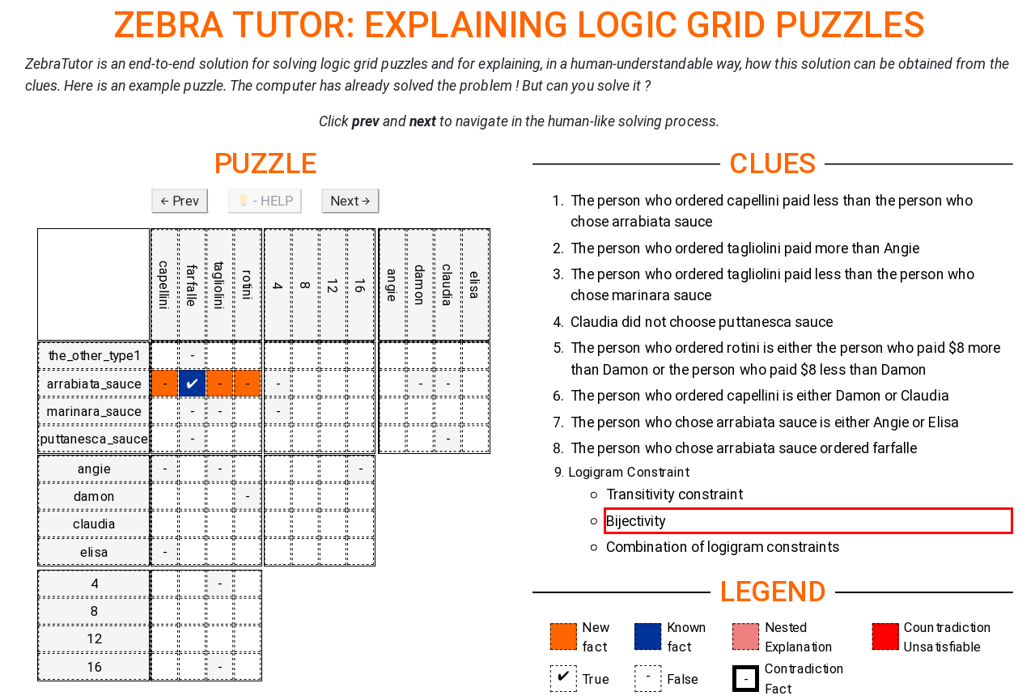
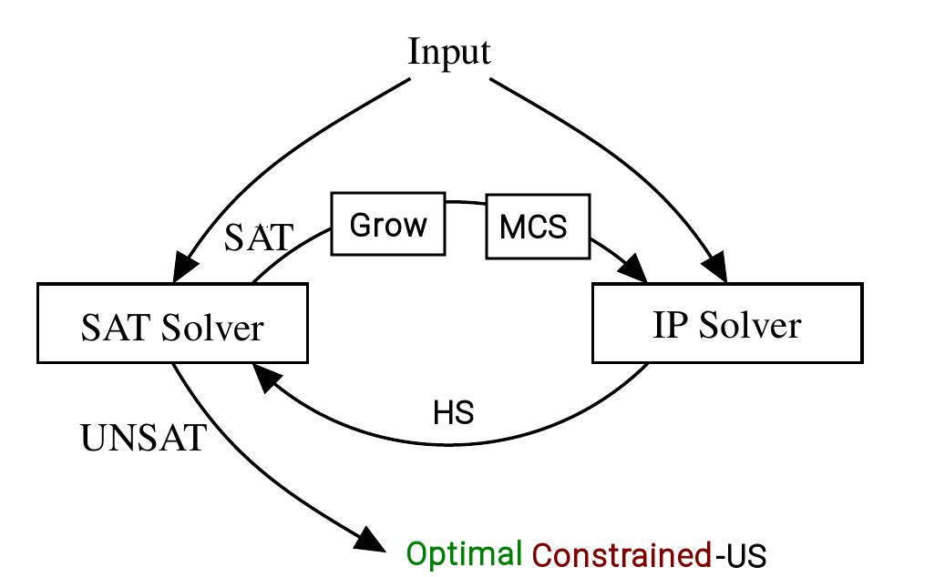
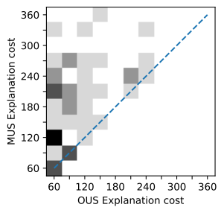
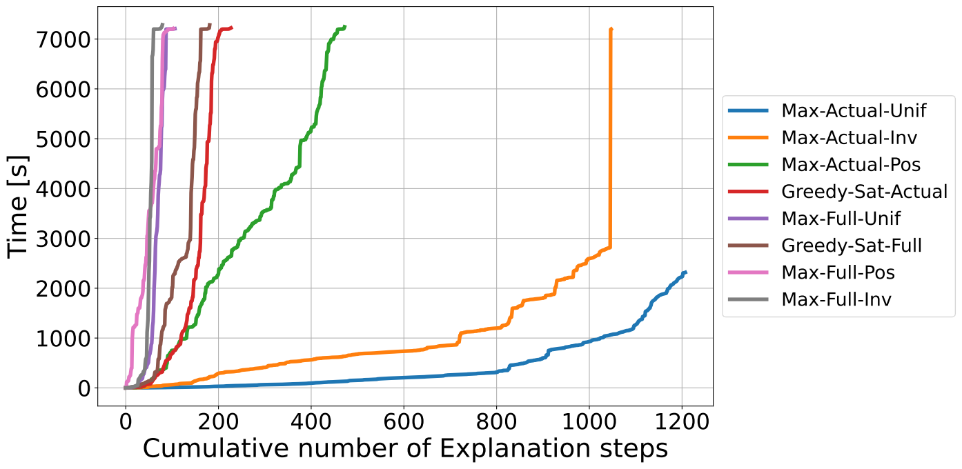
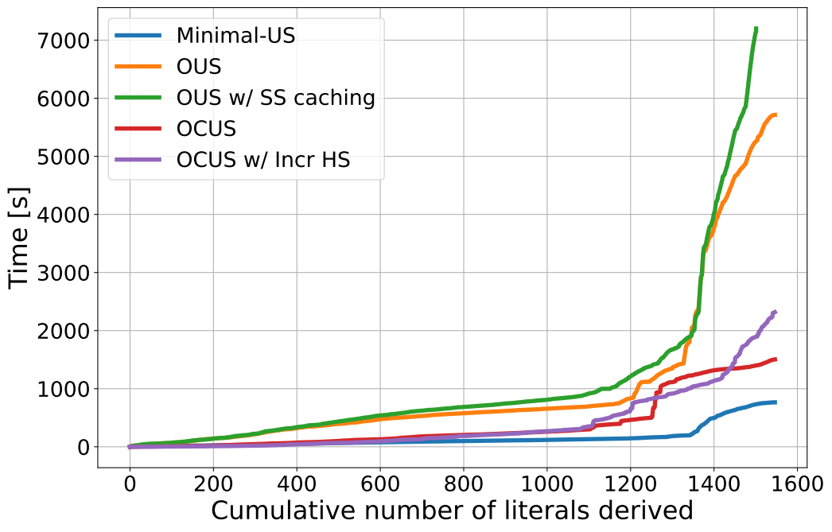





Efficiently explaining Constraint Satisfaction
Problems (CSP) with unsat core optimisation
Emilio Gamba¹, Bart Bogaerts¹, Tias Guns¹
Motivation
“From human-level problem specification, to human-level solving and explanations.”
Step-Wise Explanations for CSPs
I₁ = I₀ (initial information) + N₀ (new information in the grid)
C constraints (alldifferent, George did not take pasta, …)
How did we get there ?
1. Using one or a subset of the constraints (S ⊆ C)
2. Part of the already derived Facts (E ⊆ I)
EXPLANATION
Explanation is an implication of the form: E_{i} ∧ S_{i} ⇒ N_{i}
EXPLANTION SEQUENCE
I0
+N₀
I1
+N₁
I2
+N₂
...
+N_{n}
Iend
S₀
S₁
S₂
S_{n}
https://bartbog.github.io/zebra/
[ECAI2020]
Efficient generation
Figure inspired by [Saikko 2016]
1
What are good or bad explanations ?
Use cost function f for quantifying difficulty
How do we guarantee optimality?
2
How do I get to I_{end} efficiently?
Focus search on finding the next cost-optimal explanation
at any point in the explanation sequence.
CONSTRAINEDNESS We want to explain 1 fact at a time !
INCREMENTALITY What information can we re-use ?
Every subsequent call to finding an explanation is similar
to the previous one
3
Figure: Optimal constrained unsatisfiable subset computation
MUS
[ECAI2020]
OUS
OUS+I
OCUS
OCUS+I
+ optimality
+incrementality
+constrainedness
+incrementality
Experimental Results
[Accepted IJCAI 21]
1
2
3
¹Vrije Universiteit Brussel, firstname.lastname@vub.be
²KULeuven, firstname.lastname@kuleuven.be
[Accepted IJCAI 21] Emilio Gamba, Bart Bogaerts and Tias Guns “Efficiently Explaining CSPs with Unsatisfiable Subset Optimisation”
[ECAI2020] Bogaerts, Bart, et al. "Step-wise explanations of constraint satisfaction problems." 24th European Conference on Artificial Intelligence (ECAI). 2020.
[AIJournal] Bart Bogaerts, Emilio Gamba and Tias Guns “A framework for step-wise explaining how to solve constraint satisfaction problems”
[Saikko 2016] Saikko, Paul, Johannes Peter Wallner, and Matti Järvisalo. "Implicit Hitting Set Algorithms for Reasoning Beyond NP." KR. 2016.

