Slide 1
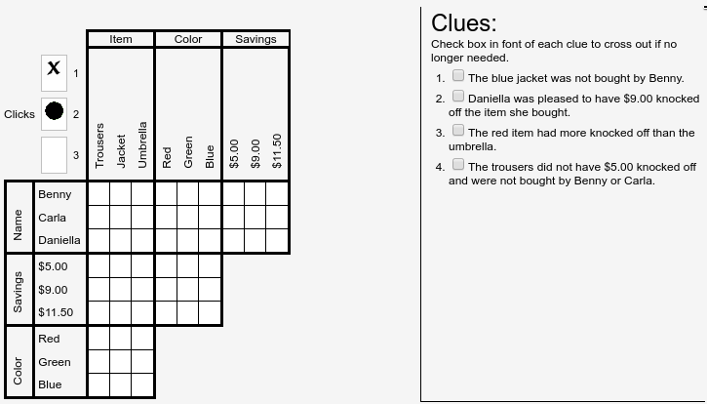

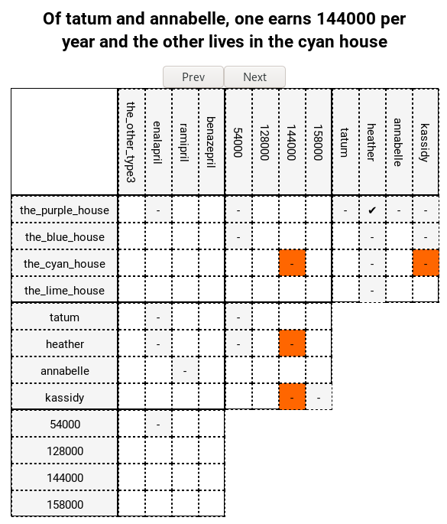
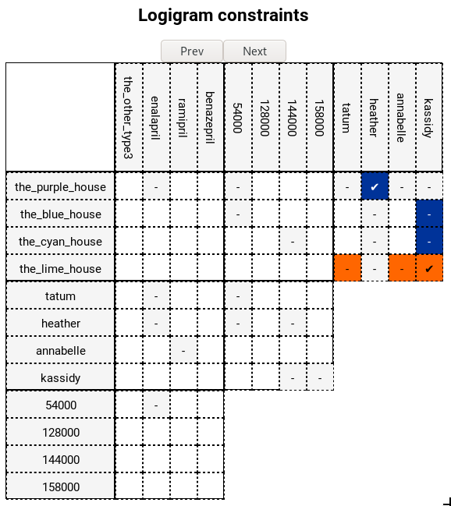
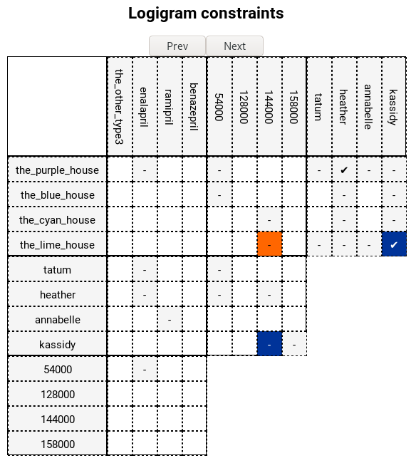



Human-Oriented Solving and Explaining
of Logic Grid Puzzles
Jens Claes¹, Bart Bogaerts², Rocsildes Canoy², Emilio Gamba², Tias Guns²
From human-level problem specification,
to human-level solving and explanation.
A.I. system that starts from natural language
Can reason over its perception of the language meaning
Can explain its reasoning steps, and aid users in problem solving
Applicable to other rich decision problems: scheduling, planning, regulation, fiscality, business processes, ...
applied on
Logic Grid Puzzles¹
REPLACE BY OWN DEMO
SCREENSHOT
HolyZebra approach:
Clues
Pos
Tagging
Chunking &
Lexicon building
First order
Logic
IDP
Language
Explanation
Generation
Visualisation
.json
.py
.py
.pl
.idp
.json
Pos
Tagging
In: Natural Language sentences
Out: Part-Of-Speech tagged words
Chunking &
Lexicon building
VBD
RB
In: POS tagged sentences
(the, DT), (patient, NN), (who, WP), (was, VBD), (prescribed, VBN), (enalapril, NN), (is, VBZ), (not, RB), (heather, NNPN)
Mid: Chunking
(the, det), (patient, noun), (who, relpro), ((was, prescribed), tvGap), (enalapril, pn), ((is, not), cop), (heather, pn)
Out: Lexicon for our B&B grammar
…
noun([patient], [patients]),
pn([heather]),
pn([enalapril]),
tvGap([was, prescribed], [for, their, heart, condition], [prescribe]),
…
Difficulty:
custom vocabulary per puzzle
word-play by authors
"The patient who was prescribed Enalapril is not Heather”¹
DT
NN
WP
VBN
NN
VBZ
NNPN
First order
Logic
In: Lexicon and Grammar
Out: Discourse Representation Theory
Blackburn and Bos [BB06] framework as a base:
Defined grammar based on 10 other puzzles, which includes :
  Template sentences specific to logic grid puzzles
  alldifferent rules : :“Of X,Y and Z, one is...”
  Numerical comparisons (“John scored 3 points higher than Mary”), …
We extended the Blackbrun & Bos framework to reason about types:
  Each entity (John, points) has a type
  Some relations (scored, has more, received) are synonyms: types allow detecting them
IDP
Language
In: Logical Representation (Discourse Representation Theory)
Out: IDP Puzzle specification
Compute interpretation of different types
  Type deduction from grid and type inference from sentences (synonyms)
Build Vocabulary
the patient who was prescribed enalapril is not heather → was_prescribed(enalapril, heather)
Construct IDP Theories
  IDP is a rich knowledge representation language [IDP2016]
?d [owner]: was_prescribed(d,enalapril) & ~ (heather = d).
Solving the Puzzle using the IDP solver
Explanation
Generation
Ordering of reasoning steps by mental effort required
get_reasoning_step(S: current partial assignment):
Until a solve leads to propagation (a more strict partial assignment):
Try: solve S + all implicit constraints
For n=0..|clues|, for all subsets of clues of size n:
Try: solve S + the constraints from the subset of clues
Break if it lead to propagation
For each literal that was assigned during propagation:
Compute minimal partial assignment S' needed to derive the literal
→ the S' is the UNSAT core when negating the literal
Store (S', clues used, literal)
return (S', clues, literal) with smallest S'
Visualisation
Newly derived fact(s)
Used facts that were derived earlier (fewer is generally easier)
Try it yourself!
https://bartbog.github.io/zebra/
¹jensclaes33@gmail.com
²Vrije Universiteit Brussel, firstname.lastname@vub.be
¹https://freuder.wordpress.com/pthg-19-the-third-workshop-on-progress-towards-the-holy-grail/
[BB06] P. Blackburn and J. Bos. Working with discourse representation theory. An Advanced Course in Computational Semantics, 2006.
[IDP2016] De Cat, B., Bogaerts et Al.: Predicate logic as a modelling language: The IDP system. (2016)

