Slide 1
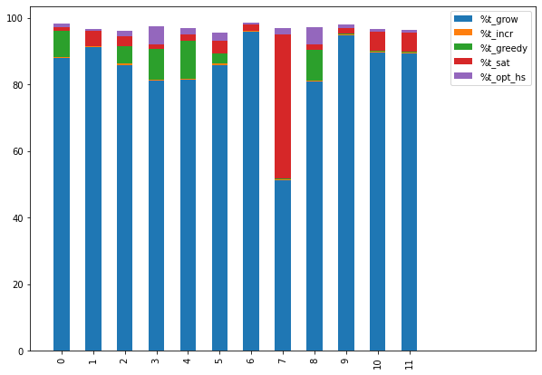

Slide 2
Workshop Paper
  Review ? (deadline ?)
AAAI
  Structure
  Experiments
    Encode logic problems in CPPY
    Apply Tseitin transform (transformation to CNF)
    CSP-explain
    CSP-explain-Incremental

Slide 3
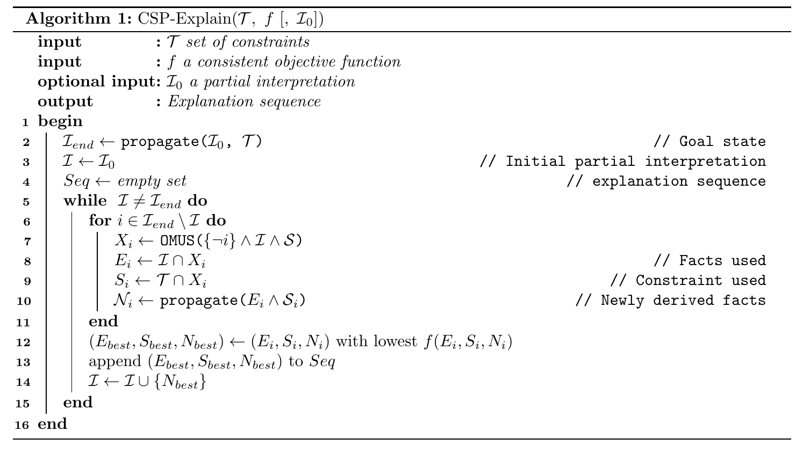

Slide 4
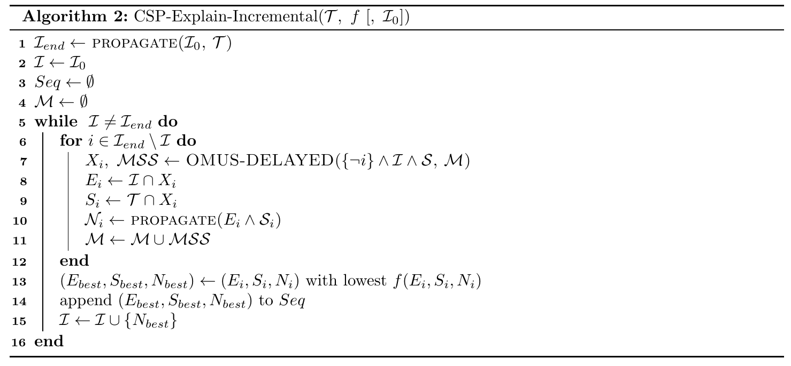

Slide 5
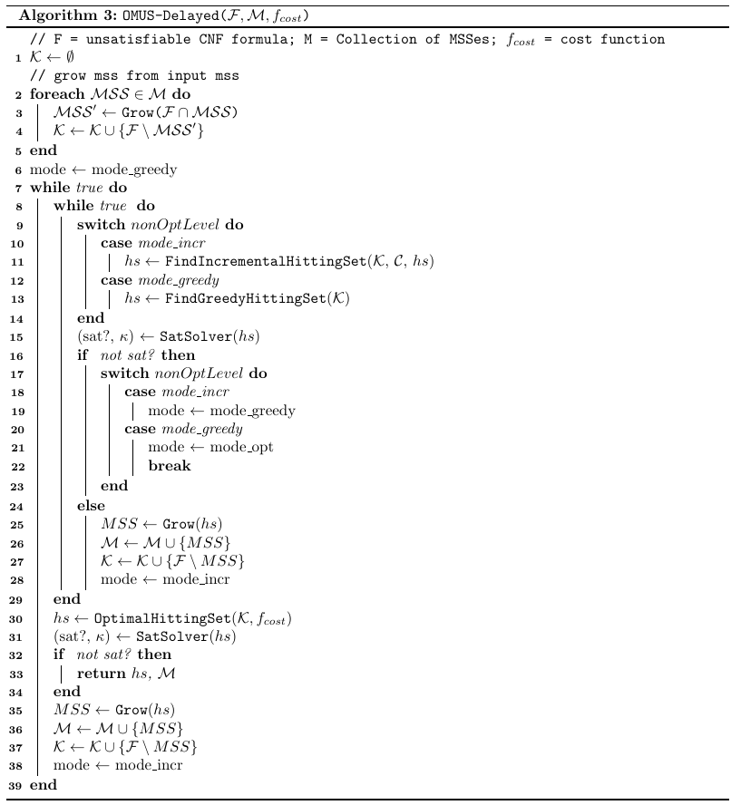

Slide 6
