Slide 1
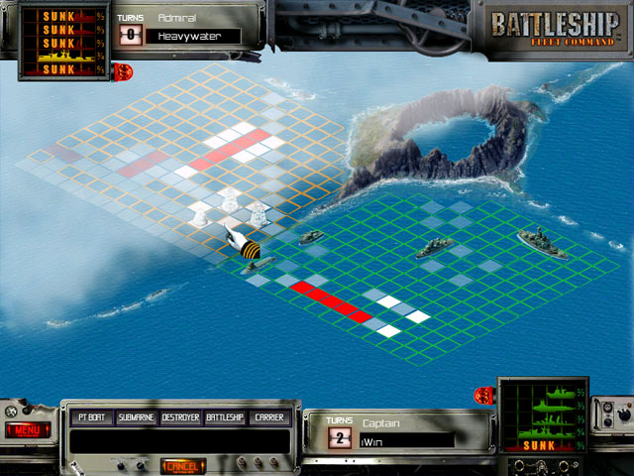





Bart, Beata Frutti di Mare team
Battleship project

Slide 2
Introduction to the project, flow chart and git repository creation, division of tasks (that would evolve a bit during the TM).
Lot of discussion on several “big” functions, first modifications is our initial plan. The first phase of the project is implemented.
Final tests and presentation!
Monday
March 30
Tuesday
March 31
Wednesday
April 1st
Thursday
April 2nd
Friday
April 3rd
Individual work, everyone writes its functions, so we can start to merge the work next day.
More changes in the initial list of functions, and the second phase is finally implemented:) Update of the list of tasks and presentation for Friday.

Slide 3
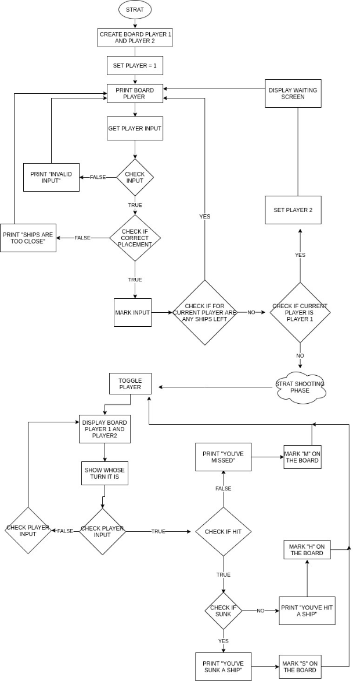
FLOW CHART

Slide 4
Objectives and difficulties of the project :
It was the first time we worked without existing template to create the game code, and it was a difficult exercice (identify each step and define related functions).
We particularly understood the importance of a complete and well organized flow chart, that facilitated our upcoming work.
One of the biggest difficulties was to write the “is_sunk” function (different sizes of ships).
Our cooperation during this week was challenged by discord technical issues;) and a bit uneven(:/) but instructive and successful!

