Slide 1
A Deterministic Grid-Based Game Engine in Rust
Yijun Chen - 1003045518
Bart Cui - 1011827908

Slide 2
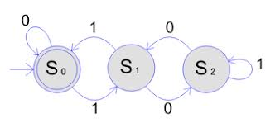
Motivation
Turn-based puzzle/chasing engine
Built with Rust + Bevy ECS
Focus on determinism, reproducibility, and debuggability
Designed as a reusable engine / crate
Notes:
For this project, we built a deterministic, grid-based game engine in Rust using Bevy ECS. Our main motivation was not just to make a playable game, but to design an engine that is predictable, reproducible, and easy to debug. Turn-based games often suffer from hidden state changes and non-deterministic behavior, so we focused on building a system where the same inputs always lead to the same outcomes, which is especially important for testing and future extensibility.

Slide 3
System Overview
Grid-based world representation
ECS-driven game objects
Deterministic turn execution
Data-driven level design (JSON)
Replay-based debugging
Grid
ECS
Turn Pipeline
Renderer
Notes:
At a high level, the engine is composed of a grid system, an ECS-based object model, and a deterministic turn scheduler that drives all gameplay logic. Levels are defined in external JSON files, and the engine handles validation, spawning, and execution. This modular structure allows us to cleanly separate data, logic, and presentation, making the engine usable both as a standalone game and as a reusable framework.

Slide 4
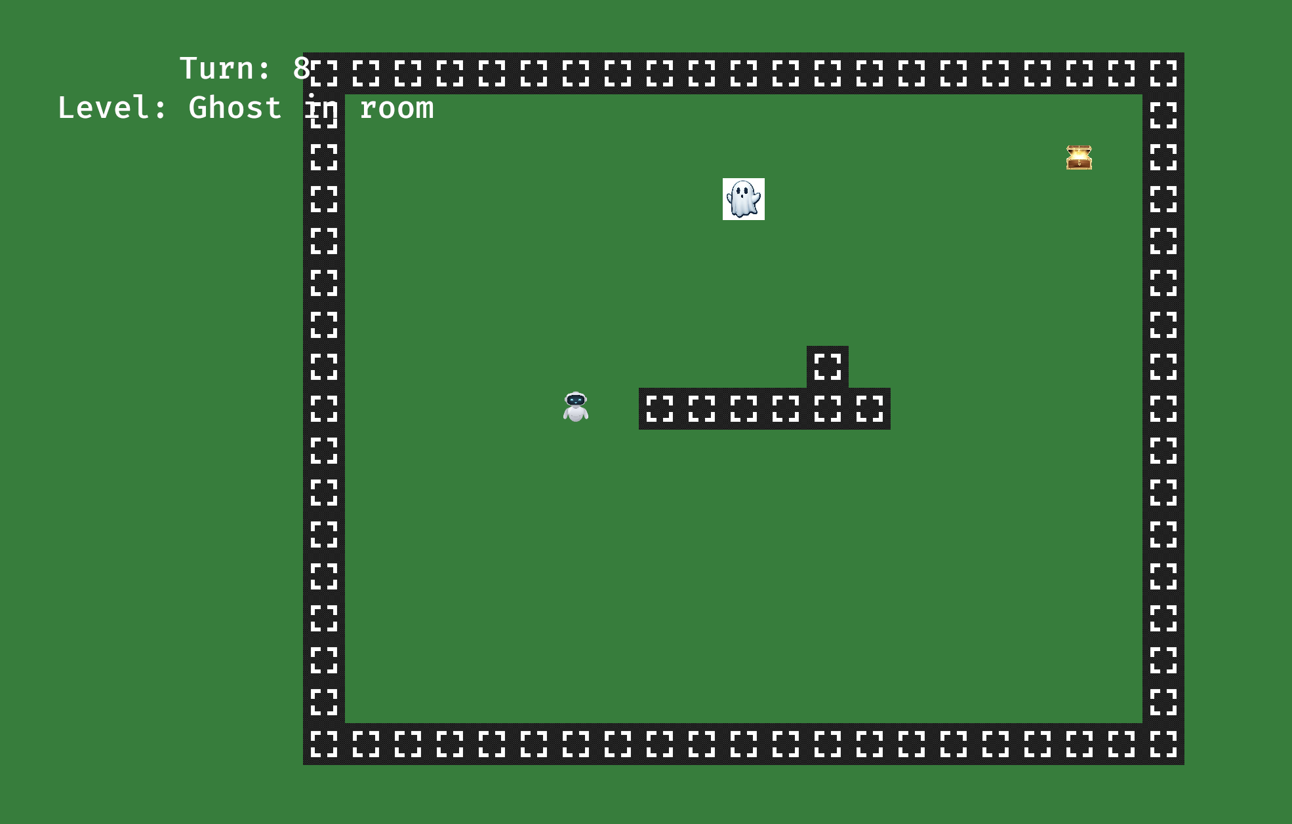
Grid System & Level Loading
Grid abstraction maps logical coordinates to screen space
Occupancy tracking enables collision and rule checks
Levels defined in JSON files
Automatic validation and entity spawning
Designers can add levels without touching Rust code
Notes:
The grid system acts as the foundation of the engine. All gameplay happens in grid coordinates, which are then mapped to screen positions for rendering. We track tile occupancy to support collision detection and rule evaluation. Levels are loaded from JSON files, allowing designers to create or modify levels without changing any Rust code. The engine validates these files at load time and automatically spawns the correct entities.

Slide 5
Deterministic Turn Scheduler
Fixed turn pipeline:
Explicit system ordering
Single-threaded commit phase
Seeded RNG for tie-breaking
Same inputs + same seed ⇒ same outcome
Input
AI Planning
Resolve
Commit
Clean Up
Notes:
The core contribution of this project is the deterministic turn scheduler. Each turn follows a fixed pipeline: Input, AI Planning, Resolve, Commit, and Cleanup. During planning and resolution, systems are only allowed to read state and generate intents. All actual state mutations happen in a single, ordered commit phase. We also use a seeded random number generator for tie-breaking, which ensures that the entire turn system behaves deterministically.

Slide 6
ECS for Game Objects
Objects composed from small components
Position, Actor, Blocking, Goal, AI
No rigid class hierarchies
Systems operate per turn stage
State mutations restricted to commit phase
Example:
Enemy = Position + Actor + AI + Blocking
Exit = Position + Goal
Notes:
All game objects are built using an Entity-Component-System approach. Instead of using inheritance, objects are composed from small, reusable components like Position, Actor, Blocking, Goal, and AI. This makes it easy to define new object types without modifying existing code. Systems operate on these components during specific turn phases, which helps keep logic isolated and predictable.

Slide 7
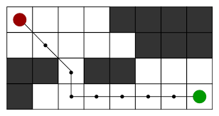
Pathfinding & AI
Grid-based A* pathfinding
Manhattan distance heuristic
Deterministic neighbor ordering
Pluggable passability policy
Integrates cleanly into turn pipeline
Notes:
For enemy movement, we implemented a deterministic A* pathfinding algorithm on the grid. It uses Manhattan distance as the heuristic and enforces fixed neighbor ordering to avoid non-deterministic behavior. Movement rules and passability are defined through a pluggable policy interface, which allows different entity behaviors without changing the core algorithm. This design integrates smoothly with the turn scheduler and ensures reproducible AI behavior.

Slide 8
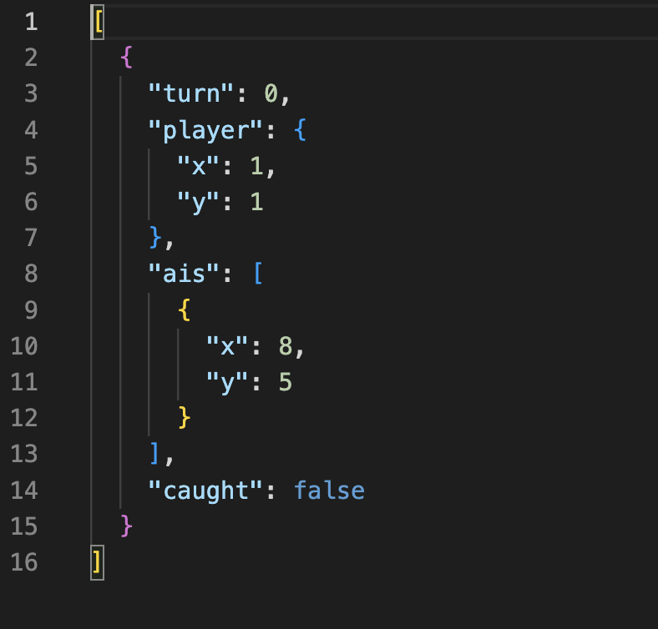
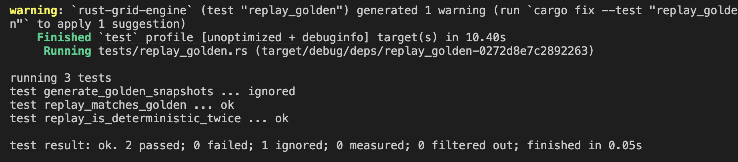
Reproducibility & Replay System
Inputs and RNG seed are logged
Replays reproduce exact game states
Supports “golden” tests
Enables step-by-step debugging
Verifies determinism end-to-end
note: An example of the golden snapshot which we used to test against the deterministic runs
Notes:
To support debugging and validation, we added a replay system that records the initial RNG seed and the sequence of player inputs. When replayed, the engine reconstructs the exact same sequence of states. This allowed us to create golden tests where the same seed and inputs always produce identical outcomes. It proved extremely useful for debugging subtle ordering and logic bugs in the turn pipeline.

Slide 9
Lessons Learned
Deterministic scheduling simplifies debugging
Clear phase separation prevents hidden bugs
Rust’s ownership model catches errors at compile time
Fewer runtime crashes and undefined states
ECS + Rust encourages clean system design
Notes:
One major lesson was how much easier debugging becomes when the game loop is fully deterministic. Clear phase boundaries and explicit ordering eliminated many classes of bugs. Another key takeaway was Rust’s ownership and borrowing system, which caught many errors at compile time that would normally appear at runtime. Together, determinism and Rust’s type system resulted in a much more robust and maintainable codebase.

Slide 10
Future Work
Implement additional game mechanics:
Traps (multi-turn stun)
Doors & keys
More interactive items
Expand save system
More complex AI behaviors
Additional automated replay tests
Notes:
While the core engine is complete, several gameplay mechanics such as traps, doors, keys, and more complex interactions are planned for future work. These features were intentionally deferred to demonstrate that the engine is extensible without requiring architectural changes. The deterministic pipeline and ECS design allow these mechanics to be layered on cleanly in future iterations.

