Slide 1
ADDING MACHINE INTELLIGENCE
TO YOUR BLAZOR APPS
Bart Czernicki
Principal Technical Architect – Machine Intelligence & Analytics
Wordwide Artificial Intelligence Community Lead
@bartczernicki
Statistics, Analytics & Machine Learning with Blazor Server & Blazor WebAssembly

Slide 2




Agenda
What we will cover
Blazor & Machine Intelligence Web Apps
Three main demos of Blazor apps and Machine Intelligence (Statistics, ML, Analytics)
Live deployed demos, play along (links on the last slide)
https://github.com/bartczernicki
Blazor Server/WASM with .NET Core 3.x and .NET 5
Core components to utilize Blazor to surface Machine Intelligence insights
Look at some C#/JS code, architecture diagrams & some things you may run into when crafting more advanced apps
Look at some patterns from Silverlight (yes, that Silverlight)

Slide 3
Decision Analysis Environment using historical baseball data
Baseball ML Workbench Scenario
http://aka.ms/BaseballMLWorkbench
Business Scenario
You are a sportswriter that focuses on the sport of baseball. You need a system that can assist you in understanding the performance of baseball position players.
Software Details
ASP.NET Core 3.x using Server-side Blazor
Available in Docker container for local or cloud execution
Can scale to thousands of real-time users with asynchronous communication using SignalR and prediction engine scaling
Fluid design across desktop and mobile browsers
Machine Learning Details
Multiple in-memory ML.NET models used for ML inference
ML.NET models built using historical baseball data from 1876 – current
Supervised learning binary classification – based on position player’s career statistics whether the player will be on the Hall of Fame Ballot or Inducted to the Hall of Fame

Slide 4
DEMO - Baseball ML Workbench Live Demo: https://aka.ms/BaseballMLWorkbench Business Scenario: Self-Service Decision Analysis environment using Machine Learning Technical Scenario: Blazor Server using .NET Core 3.x surfacing in-memory ML.NET models
Notes:
https://aka.ms/BaseballMLWorkbench

Slide 5










Sequence diagram and architecture
Baseball ML Workbench Scenario
Azure App Service
Azure App Insights
3
7
1
2
Machine Learning Workbench
Azure SignalR Communication
Azure Front Door
ASP.NET Core
4
Blazor
6
ML.NET
5
Decision
Analysis
Machine Learning Models

Slide 6
DEMO - Statistical Simulations & Visuals in Blazor WebAssembly Live Demo (.NET Core 3.x): https://StatisticsAndBlazorDotNetCore3.AzureEdge.Net Live Demo (.NET 5): https://StatisticsAndBlazorDotNet5.AzureEdge.Net Technical Scenario: Blazor WebAssembly (.NET Core 3x. & .NET 5) using D3.js data visualizations and a .NET statistical library (MathNet.Numerics) hosted on an Azure Static Website
Notes:
https://MLNetandBlazor.AzureEdge.Net

Slide 7
Blazor WASM – Performance Tests
.NET 6 Preview 1 faster than .NET 5 RTM faster than .NET 3.x Core
*Super unofficial benchmark using Statistical Simulations
Device (CPU) Tested | Browser | .NET Core 3.x (ms) | .NET 5 RTM (ms) | .NET 6 Preview 1 (ms) | % Difference Improvement (.NET Core 3 -> .NET 5) | % Difference Improvement (.NET 5 -> .NET 6 Preview 1)
iPod Touch (7th Gen, 2019) | Safari | 26,850 | 21,880 | 17,200 | 20.40% | 23.95%
iPhone X (Nov 2017) | Safari | 15,200 | 12,700 | 10,000 | 17.92% | 23.79%
iPad 11 Inch Pro (1st Gen, 2019) | Safari | 15,200 | 12,550 | 10,050 | 19.10% | 22.12%
iPhone 12 Pro (Oct 2020) | Safari | 10,420 | 8,750 | 7,070 | 17.42% | 21.24%
MacBook Pro (2.5GigHz-i7, mid-2015) | Firefox | 12,750 | 9,500 | 6,890 | 29.21% | 31.85%
Azure VM – F8s_v2 (Intel Xeon 2nd Gen) | Edge | 10,560 | 7,750 | 5,740 | 30.70% | 29.80%
AMD Ryzen 3900x | Chrome | 8,750 | 6,200 | 4,625 | 34.11% | 29.10%

Slide 8
Blazor WASM – The Browser Matters
Different browsers implement WebAssembly Differently
*Super unofficial benchmark using Statistical Simulations
Device (CPU) Tested | Browser | .NET Core 3.x (ms) | .NET 5 RTM (ms) | % Difference
Azure VM – F8s_v2 (Intel Xeon 2nd Gen) | Chrome | 10,350 | 7,700 | 29.36%
Azure VM – F8s_v2 (Intel Xeon 2nd Gen) | Firefox | 12,860 | 9,675 | 28.27%
Azure VM – F8s_v2 (Intel Xeon 2nd Gen) | Edge | 10,560 | 7,750 | 30.70%
Azure VM – F8s_v2 (Intel Xeon 2nd Gen) | Opera | 10,520 | 7,730 | 30.58%
Browser Difference Notes
WebAssembly Differences in browsers: https://webassembly.org/roadmap/
Browsers handle integrity security checks differently: https://docs.microsoft.com/en-us/aspnet/core/blazor/host-and-deploy/webassembly?view=aspnetcore-5.0#resolve-integrity-check-failures
Beware of call stack errors (.NET 5 especially in older devices, same browser version)

Slide 9
DEMO - ML.NET Baseball Predictions in Blazor WebAssembly Live Demo (Azure Static Website): https://MLNetandBlazor.AzureEdge.Net Live Demo (Azure App Service): https://Test-Blazor-MLNet.AzureWebSites.Net Technical Scenario: Blazor WebAssembly (.NET Core 3x. & .NET 5) using D3.js data visualizations with Machine Learning .NET surfacing the predictions
Notes:
https://MLNetandBlazor.AzureEdge.Net

Slide 10
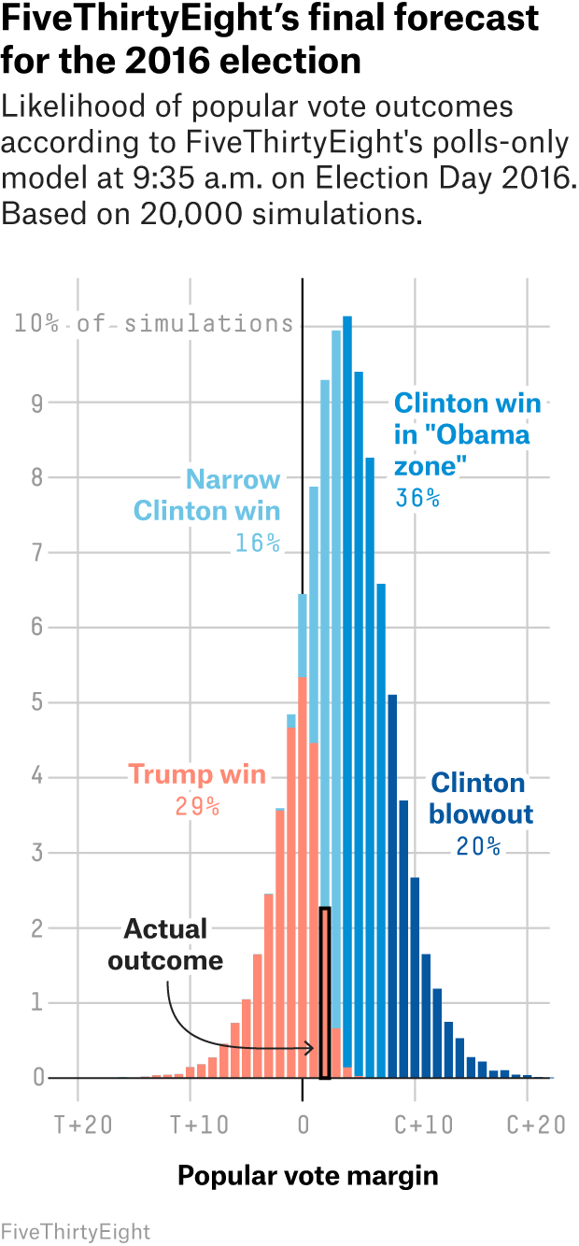
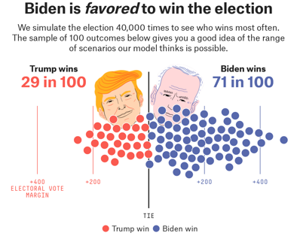
ML.NET & Blazor .NET 5
What can I do with this?
General Guidance
This is not just a Blazor & Machine Intelligence niche; other vendors are doing similar
Tensorflow JS: https://www.tensorflow.org/js
Anytime there is an Excel-like or Power BI-like subset of functionality that requires it to
be made into an “analytics app”, Blazor may be a great fit
Blazor WASM and Static Applications can be super effective for interactive blogs,
code examples (GitHub Pages), interactive information apps
(New York Times, FiveThirtyEight, Live Sports)

Slide 11
Sequence diagram and architecture
ML Predictions with Blazor WASM Scenario
Local Web Browser
WebAssembly Virtual Machine
2
7
1
ML Predictions (.NET 5) App
Network or local communication with Web Browser User Interface
ASP.NET Core
DOM
Blazor
D3.JS
3
5
6
ML.NET
SVG
Render of SVG Charts with JS
4
Prediction
Analysis
Machine Learning Models

Slide 12
Getting Started with ML.NET & Blazor .NET 5
How do I get started with ML.NET, .NET 5 and Blazor?
Checklist & Gotchas (as of .NET 5 RTM and ML.NET 1.5.2)
Blazor WebAssembly (local ML.NET execution)
.NET 5 RTM are the earliest bits that can be used for maximum compatibility with ML.NET algorithms
Requires the latest Visual Studio 2019 16.8 for .NET 5 tooling support
ML.NET NuGet packages need to be placed in a secondary assembly (i.e. [X].Shared) and referenced as a project inside the main Blazor WebAssembly client project
Currently ML.NET only inference supported in .NET 5 Blazor WASM
Training, AutoML etc. are not supported in .NET 5 as Blazor WASM currently runs in a single-thread
Smaller models recommended (< 4MB) when using ML.NET inference
If you need larger model support, use Azure Functions, APIs etc.
Static website or ASP.NET Static Web Apps deployment is supported
PWAs (offline caching) with ML.NET models and resources works
Blazor Server
Requires server deployment (compute on the server/Docker/App Service etc.)
Support for large Machine Learning .NET models (100MB+)
No static website deployment

Slide 13
Demos, Presentations & Source Code
Links
Live Demos
Baseball ML Workbench (.NET Core 3.x, Blazor Server): https://aka.ms/BaseballMLWorkbench
Statistical Simulations & Visuals (.NET Core 3.x, Blazor WASM): https://statisticsandblazordotnetcore3.azureedge.net/
Statistical Simulations & Visuals (.NET 5, Blazor WASM): https://statisticsandblazordotnet5.azureedge.net/
ML.NET Baseball Predictions (.NET 5, Blazor WASM, Azure Static Website): https://mlnetandblazor.azureedge.net/
ML.NET Baseball Predictions (.NET 5, Blazor WASM, Azure App Service): https://test-blazor-mlnet.azurewebsites.net/
Source Code
Baseball ML Workbench: https://github.com/bartczernicki/MachineLearning-BaseballPrediction-BlazorApp
Statistical Simulations & Visuals (.NET Core 3.x, Blazor WASM): https://github.com/bartczernicki/Test-Blazor-WebAssembly-StatisticsAndML
Statistical Simulations & Visuals (.NET 5, Blazor WASM): https://github.com/bartczernicki/Test-Blazor-WebAssembly-StatisticsAndML-DotNet5
ML.NET Baseball Predictions (.NET 5, Blazor WASM, Self-Host): https://github.com/bartczernicki/Test-Blazor-MLNet
Resources
Book - “Resampling: The New Statistics”: http://www.resample.com/intro-text-online/
Video – “Statistics for Hackers”: https://www.youtube.com/watch?v=Iq9DzN6mvYA

