Slide 1

Wikipedia Context (Grounding Information)
The New York Mets are an American professional baseball team based in the New York City borough of Queens. The Mets compete in Major League Baseball (MLB) as a member of the National League (NL) East Division. They are one of two major league clubs based in New York City, the other being the American League's (AL) New York Yankees. One of baseball's first expansion teams, the Mets were founded in 1962 to replace New York's departed NL teams, the Brooklyn Dodgers and the New York Giants. The team's colors evoke the blue of the Dodgers and the orange of the Giants. For the 1962 and 1963 seasons, the Mets played home games at the Polo Grounds in Manhattan before moving to Queens. From 1964 to 2008, the Mets played their home games at Shea Stadium, named after William Shea, the founder of the Continental League, a proposed third major league, the announcement of which prompted their admission as an NL expansion team…
Question
When where the Mets founded?
Prompt Instructions #1
Prompt Instructions #2
Answer the question with provided Wikipedia Context.
Before even answering the question, consider whether you have sufficient information in the Wikipedia article to answer the question fully. Your output should JUST be the Boolean true or false, if you have sufficient information in the Wikipedia article to answer the question. Respond with just one word, the Boolean true or false. You must output the word 'True', or the word 'False', nothing else.
OpenAI GPT Model (LLM)
OpenAI GPT Model (LLM)
Output to Prompt Instruction #1
Output to Prompt Instruction #2
The New York Mets Were founded in 1962.
True
LogProbs Data
Probability >99.9%
Combined answer & metadata surfaced to the human user or AI agent for further reasoning
Answer: The New York Mets Were founded in 1962.
Does Model Have Enough Information to Answer Question: True
Probability of Having Enough Information to Answer Question: > 99.9%

Slide 2
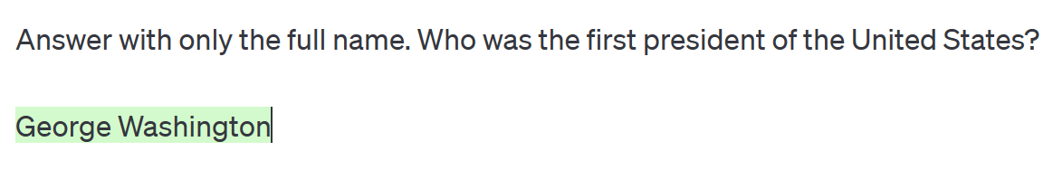
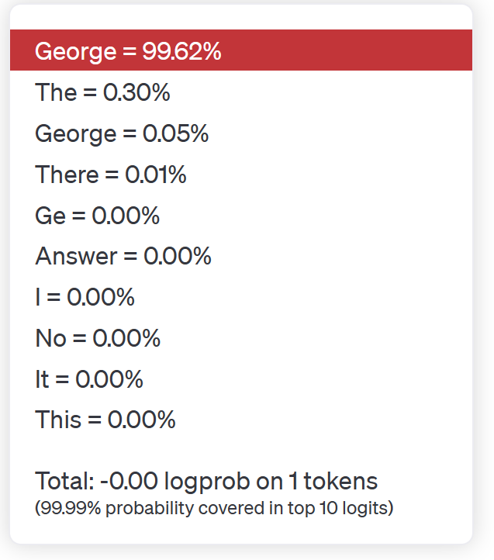
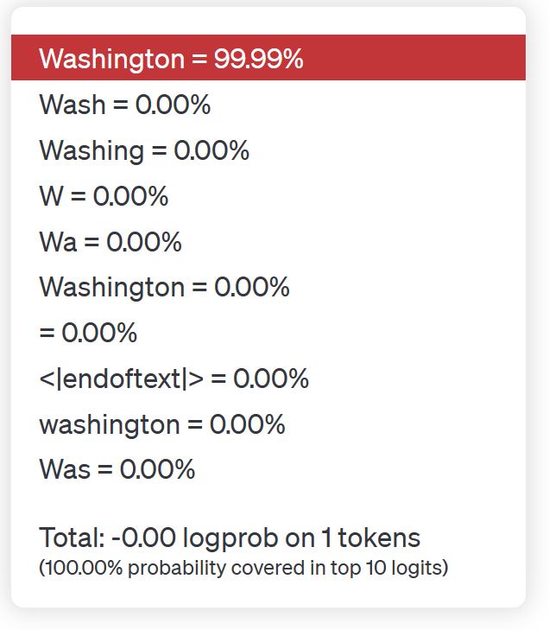

Slide 3

Enhance Generative AI
Performance with
Calculated Probabilities from
Azure OpenAI LogProbs

