Slide 1
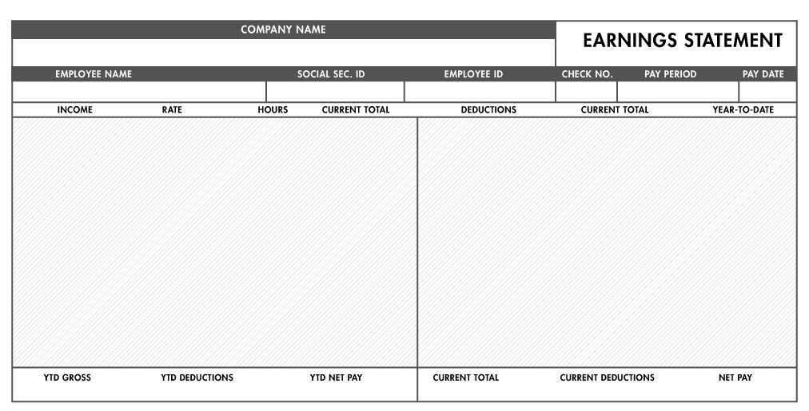

Slide 2
Macro Zoft
Joe Smith
122-45-6766
4500006
#23
05/01/2021- 5/18/2021
05/20/2021
GROSS WAGES 25 40 1000
FICA MED TAX 25 100
FICA SS TAX 50 200
FED TAX 200 800
4000
1100
2900
1000
275
725

Slide 3
Macro Zoft
Jannice Bobstein
166-45-6766
4500556
#4
05/01/2021- 5/18/2021
05/20/2021
GROSS WAGES 50 40 2000
FICA MED TAX 50 200
FICA SS TAX 100 400
FED TAX 400 1600
8000
2200
5800
2000
550
1450

Slide 4
Macro Zoft
Alex Theodery
132-56-7788
4500305
#3
02/01/2021- 2/14/2021
02/15/2021
GROSS WAGES 100 40 4000
FICA MED TAX 100 300
FICA SS TAX 200 600
FED TAX 800 2400
12000
3300
5800
4000
1100
2900

Slide 5
Macro Zoft Inc
Roberta Black
245-34-3900
4500205
#3
02/01/2021- 2/14/2021
02/15/2021
GROSS WAGES 100 30 3000
FICA MED TAX 75 250
FICA SS TAX 150 500
FED TAX 600 2000
9000
2750
6250
3000
825
2175

Slide 6
Macro Zoft Inc
Tom Stoney
244-34-3900
4500265
#3
02/01/2021- 2/14/2021
02/15/2021
GROSS WAGES 15 40 600
FICA MED TAX 50 150
FICA SS TAX 75 225
FED TAX 100 300
1800
675
1125
600
225
375

Slide 7
Macro Zoft Inc
Tom Stoney
244-34-3900
4500265
#2
01/15/2021- 1/31/2021
02/01/2021
GROSS WAGES 15 40 600
FICA MED TAX 50 100
FICA SS TAX 75 150
FED TAX 100 200
1200
450
750
600
225
375

Slide 8
Macro Zoft Inc
Tom Stoney
244-34-3900
4500265
#1
01/01/2021- 1/15/2021
01/16/2021
GROSS WAGES 15 40 600
FICA MED TAX 50 50
FICA SS TAX 75 75
FED TAX 100 100
600
225
375
600
225
375

Slide 9
Macro Zoft Inc
Tara Keyboards
XXX-XX-3900
2500555
#1
01/01/2021- 1/15/2021
01/16/2021
GROSS WAGES 60 40 2400
FICA MED TAX 150 150
FICA SS TAX 300 300
FED TAX 600 600
2400
1050
1250
2400
1050
1250

Slide 10
Macro Zoft Inc
Sophie Zombza
XXX-XX-3900
2500585
#4
02/15/2021- 2/28/2021
03/01/2021
GROSS WAGES 22.50 35 787.50
FICA MED TAX 75 300
FICA SS TAX 100 400
FED TAX 200 800
3150
1500
1650
787.50
375
412.50

