Slide 1
110-33-4509
1001-223-45445
65,000.00
25,000.00
65,000.00
5,000.40
Employer of The Year
123 SpringField Ave
Omaha, FL 02367
65,000.00
1,050.46
1,000.00
300.00
Roberta S. LastName
45 Suite Street
Philadelphia, PA 23490
X

Slide 2
311-50-4545
1001-223-45445
500,000.00
250,000.00
36,500.00
15,000.40
Contoso LLC
Bill Lane Suite 200 A
Fargo, ND 09033
36,000.00
5,050.46
10,000.00
800.00
Tyler Joseph Lambert
45 Fun Street
Spingfield, NH 08999
X

Slide 3
914-00-9090
700123-45400045
150,000.00
$50,000.00
6500.00
35,000.40
Contoso LLC
Bill Lane Suite 200 A
Fargo, ND 09033
6000.00
15,050.46
10000.00
0.00
Anna Kop
1 WhereAmI Apt 5
Timetown, PA 45094

Slide 4
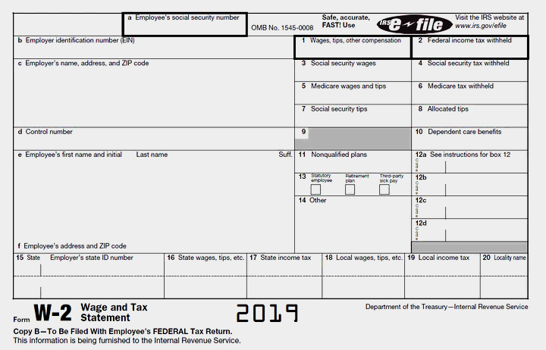
114-35-4000
1001-223-45445
150000
$50000
ACME CORPORATION
Bill Lane Suite 200 A
Fargo, ND 09033
6750
$3540
6300
15600
9000
0
Tyler Joseph Lambert
45 Fun Street
Spingfield, NH 08999
X

Slide 5
929-30-1234
909-222-569999
5000
500
MACRO & SOFT Partners
100 Fun Lane
Boise, ID 03044
400
2000
100
12000
400
0
Bob Zlopolowinski
1 Nowhere Lane
DELRAN, NJ 08054

Slide 6
114-35-4000
1001-223-45445
142,660.00
$60,000.00
6500.00
35,000.40
Contoso LLC
Bill Lane Suite 200 A
Fargo, ND 09033
6000.00
15,050.46
10000.00
0.00
Tyler Joseph Lambert
45 Fun Street
Spingfield, NH 08999
X

Slide 7
114-35-4000
1001-223-45445
$84,788.00
$50,000.00
6438
15,000.40
Paco’s Tacos
13 StreetCar Ave
Los Angeles, CA 45000
5498.75
8,050.46
10987.87
0
Jose Jino
5 Sweet Street
Los Angeles, CA 45000
X

Slide 8
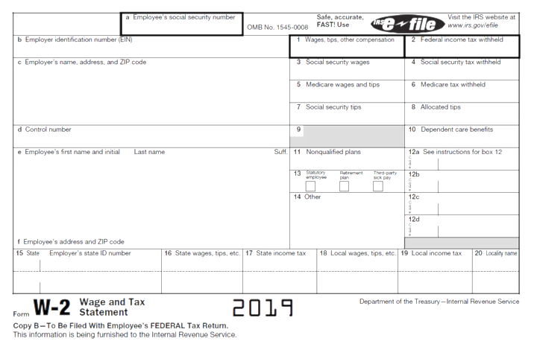
433 - 44- 8080
1881-293-45225
$288,008.50
$60,550.25
$4500
9,800.40
Bart’s Moms Pierogis
100 Poland Lane
Marlton, NJ 08033
5498.75
6,050.46
$3987.87
0
Robert Lewanski
123 Roberta Street
Lolifun, NV 08004

Slide 9
276-77-9090
125-50-9090
$350,000.50
$40,550.25
$2300
2,500.40
TOMS RIVER SPORTSWEAR
5000 MAIN LINE STREET
MOUNT FAIRLINE, PA 90909
5060.33
6,050.46
$2050.22
0
BOB TIMBER
45 SMALL STREET
GALVESTON, TX 09033

Slide 10
676-77-9090
155-99-888
450,000.55
40,850.25
1,500
4,500.40
BIKE SALES EMPORIUM
2 BIKE LANE
TRAPOS, TN 05299
1460.33
6,550.46
1250
0
Quberta Lowell
6 Popo Lane
Bobstown, MA 08022

Slide 11
276-77-9090
1881-293-45225
$288,008.50
$45,550.25
6600.99
5,800.45
Sir Waggington’s Super Dog Groomers
66 Puppy Way
Jonestown, NJ 0 8033
3400.99
6050.46
5,987.87
0
Tom Lovernall
545 Roberta Street
Timilas, SD 07055

Slide 12
120-53-4509
1001-223-45445
75,000.00
25,000.00
75,000.00
5,000.40
Main Employ Are
123 SpringField Ave
Omaha, FL 02367
75,000.00
1,050.46
1,000.00
300.00
Teller Moneys
986 Favorite Street Ap. 5
Philadelphia, PA 3409
X

Slide 13
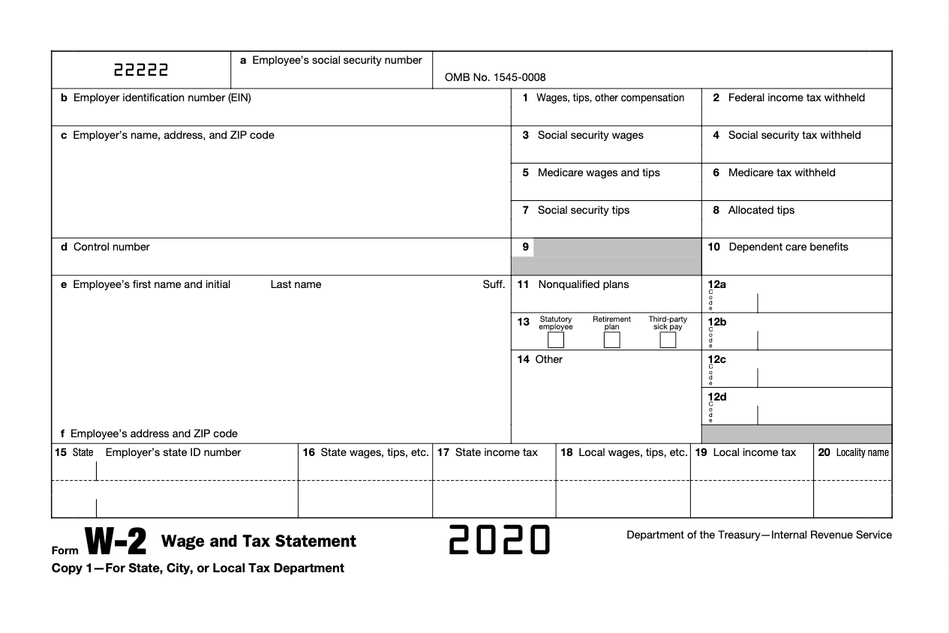
293-43-8227
1010-323-62537
80,000.00
14,000.00
80,000.00
4,000.50
Johnson’s Bakery
728 Palentine Street
Any Town, NJ 91325
80,000.00
1,200.52
1,000.00
410.00
Sarah K. Cortez
273 Funday Blvd.
San Diego, CA 92093
X

Slide 14
031-27-7890
928122-27910275
4300000
$928101
8292
$3281
Cat’s Corporation
26 Day Street
Keliso, CA 93262
21,933
72910
8,000
1
Harman Tacker
94 Paso Street
Filamore, PA 83292
X

Slide 15
626-89-1029
722-981-272919
240,000.00
$32,000.00
Ken & Kerry Partners
392 Tolly Blvd
Miami, FL 28190
6372.00
21,000.32
7000.00
54,929.30
20000.00
0.00
X
Brigit Smith
5 Wherever Apt 19
Tucson, AZ 21803

Slide 16
544-09-1829
909-777-283912
542900
$230000
3910
$21930
Jermy Corporation
Moz Lane Suite 828 J
Flagstaff, AR 92012
5391
92322
89200
0
X
Mat Leut
242 Platinum Court
Mesa, AL 82667

Slide 17
262-00-5441
729210-939201
2000
4000
400
2999
Contoso LLC
282 Pigeon Ave
Tempe, AZ 28910
21000
200
200
0
Melanie K. Last
95 Prescott Lane
Houston, TX 93202
X

Slide 18
031-27-7831
1010-323-62537
80,000.00
14,000.00
Johnson’s Bakery
728 Palentine Street
Any Town, NJ 91325
80,000.00
4,000.50
80,000.00
1,200.52
1,000.00
410.00
Sarah K. Cortez
273 Funday Blvd.
San Diego, CA 92093
X

Slide 19
115-92-3900
73829-83920
60,000.00
$4,000.00
ESTN Coporation
Quill Suite 929 L
Wells, ND 92819
60,000.00
$829.20
60,000.00
392011
1,000.00
21
James The Giant
92 Fairy Street.
Springfield, NH 82919
X

Slide 20
228-25-7321
1110-223-63327
43020
4302220
5000
4,000.50
Cat’s Corporation
26 Day Street
Keliso, CA 93262
600
1,200.52
53020
230.02
Harman Tacker
94 Paso Street
Filamore, PA 83292
X

Slide 21
544-09-1829
909-777-293912
542900
$230000
Jermy Corporation
Moz Lane Suite 828 J
Flagstaff, AR 92012
3290
$21930
5391
92322
89200
0
Mat Leut
242 Platinum Court
Mesa, AL 82667
X

Slide 22
932-12-8888
2111-888-888
23,000.00
4302.00
Johnson’s Bakery
728 Palentine Street
Any Town, NJ 91325
40,000.00
4,000.50
50,000.00
49020
20000
0
Mary Koshy
291 Kale Street.
Loas Angeles, CA 21891
X

Slide 23
