Slide 1
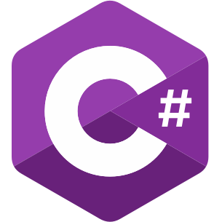
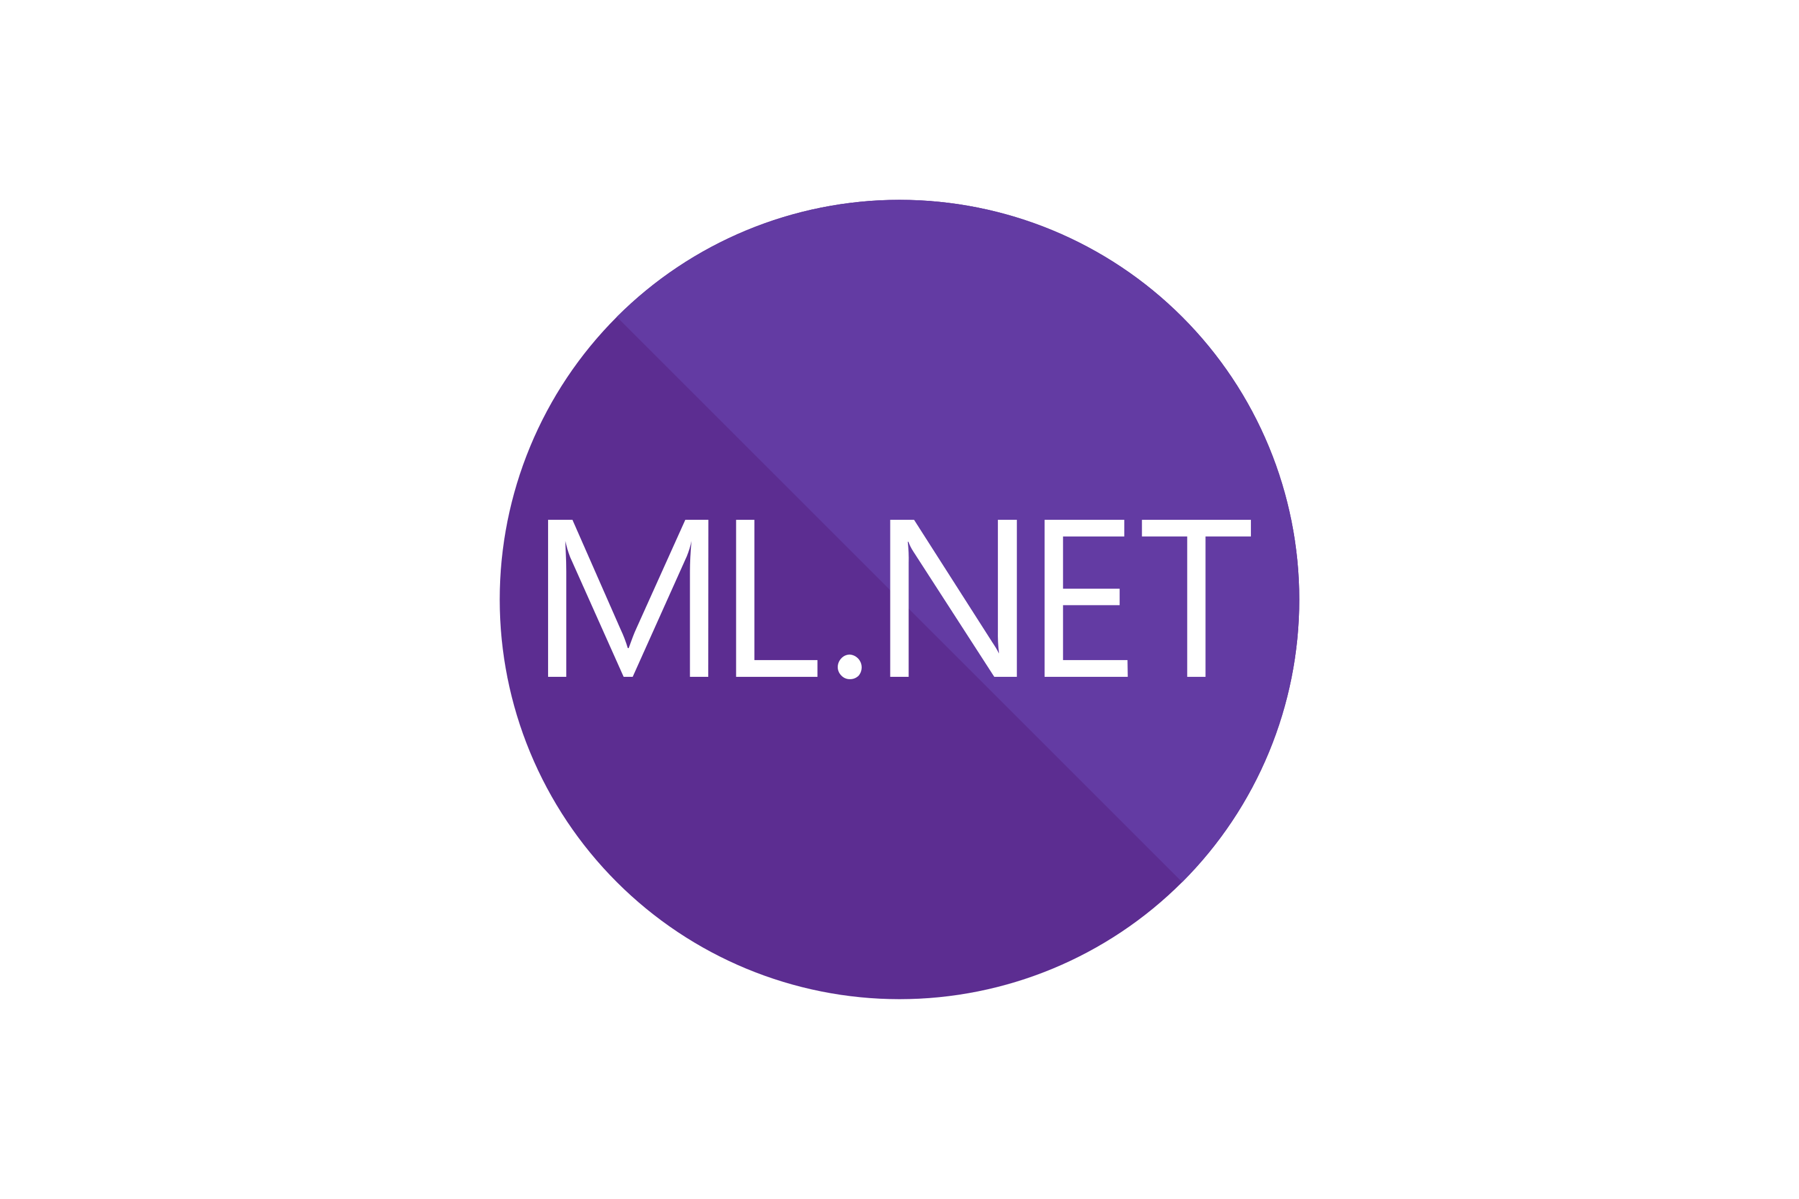


Document Enrichment Pipeline – Builds a Vector Database in SQL Server/Azure SQL from list of books
1
2
3
4
5
Download Books
Extract Tokens
Machine Learning
Enrichment
Retrieve Embeddings using OpenAI
Create Vector Database and Persist Enrichment
Downloads books from the the Project Gutenberg web sites and extracts the book text.
Extracts number of tokens in each book using the TokenSharp library and estimates proper embeddings encoding.
Perform Machine Learning enrichment of the book text using the ML.NET library – normalize text, remove stop words etc. Use Semantic Kernel to split text into paragraph chunks.
Get paragraph text embeddings from OpenAI API using text-embedding-ada-002 model to create semantic meaning in 1516 dimensions.
Create the vector database in SQL Server from the extracted embeddings. Persist the document enrichment into JSON file, which can be used inside a Data Lake or stored for further analysis.
Q&A over Vector Database Pipeline – Uses Vector Database search to isolate a phrase and answer questions
1
2
3
Convert Search String into Embeddings
Search Vector Index
Answer Questions
Convert asked question from search string (text) into OpenAI embeddings using Semantic Kernel (OpenAI API).
Search the vector index database using a hybrid of SQL Server (SQL) and cosine vector similarity math. Extract the top paragraphs that have similar semantic meaning.
Use Semantic Kernel to create a prompt (from a skill) to answer the question. Provide context to the prompt using top semantic meaning paragraphs.

