Slide 1
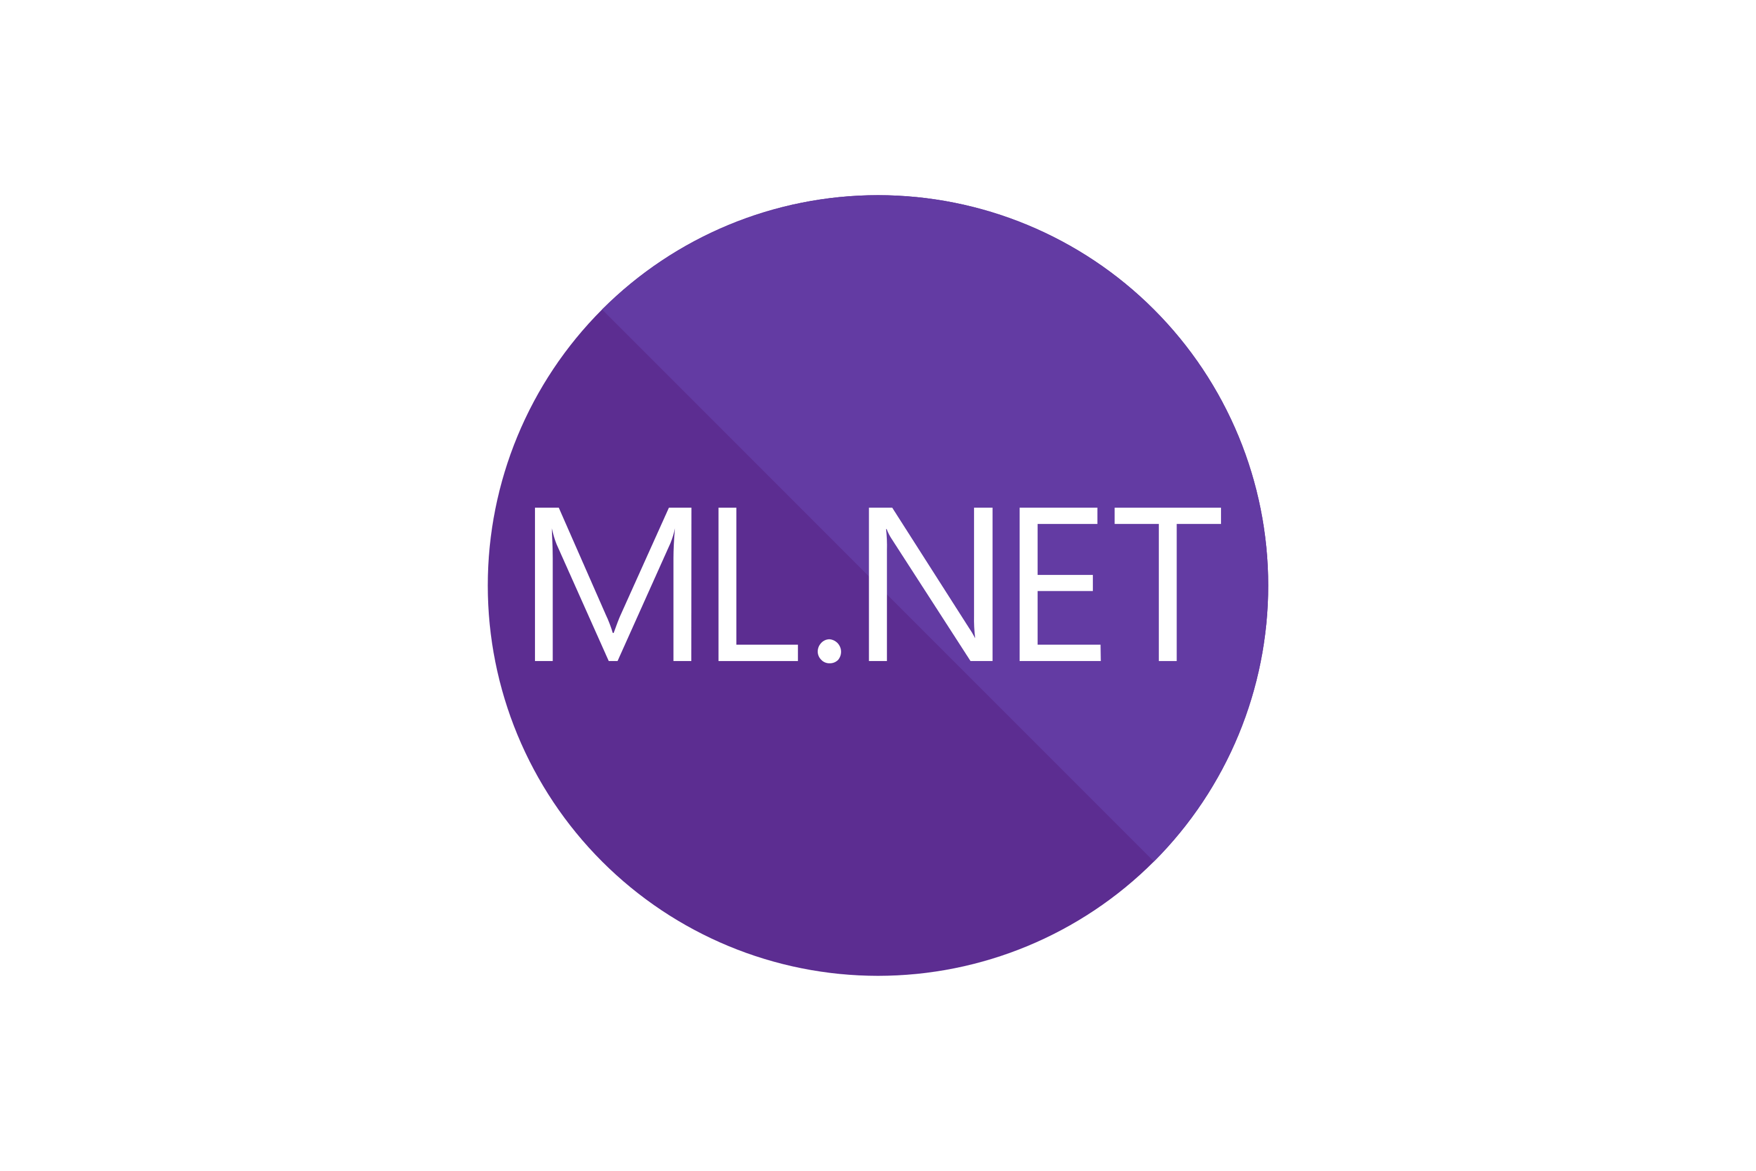


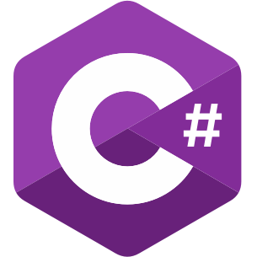
Document Enrichment Pipeline
Download Books
Extract Tokens
Machine Learning
Enrichment
Retrieve Embeddings using OpenAI
Create Vector Database and Persist Enrichment
Downloads books from the the Project Gutenberg sites and extracts the book text.
Extracts number of tokens in each book using the TokenSharp library and proper embeddings encoding.
Perform Machine Learning enrichment of the book text using the ML.NET library – normalize text, remove stop words etc. Use Semantic Kernel to split text into paragraphs.
Get paragraph text embeddings from OpenAI API.
Create the vector database in SQL Server from the extracted embeddings. Persist the document enrichment into JSON file.
Q&A Over Vector Database Pipeline
Convert Search String into Embeddings
Search Vector Index
Answer Question
Convert from search string (text) into OpenAI embeddings using OpenAI API.
Search the vector index database using SQL Server and vector similarity math. Extract the top paragraphs that match search.
Use Semantic Kernel and OpenAI to create a prompt to answer the question based on the extracted paragraph from vector search.

