Slide 1
Biometrics System Concepts (B-KUL-H02C7A) Assignment 2&3 additional questions
Bartosz Bogucki

Slide 2
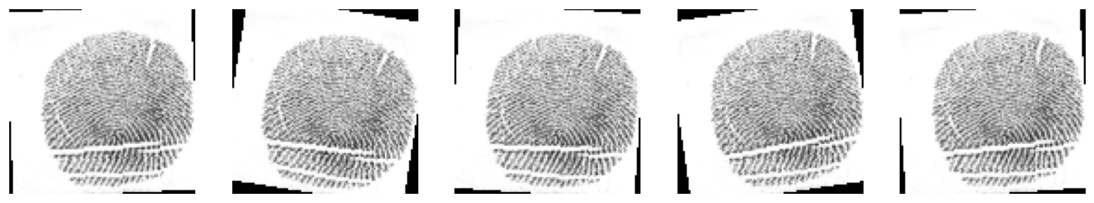
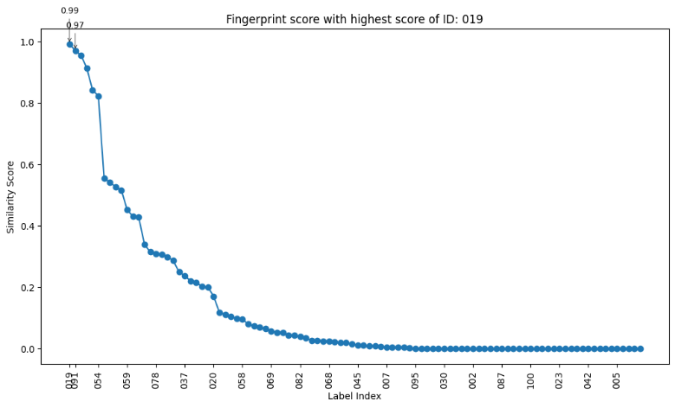
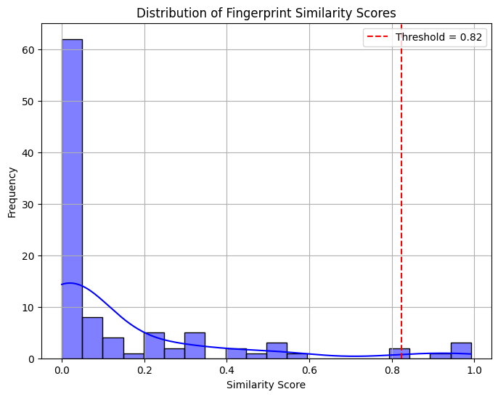
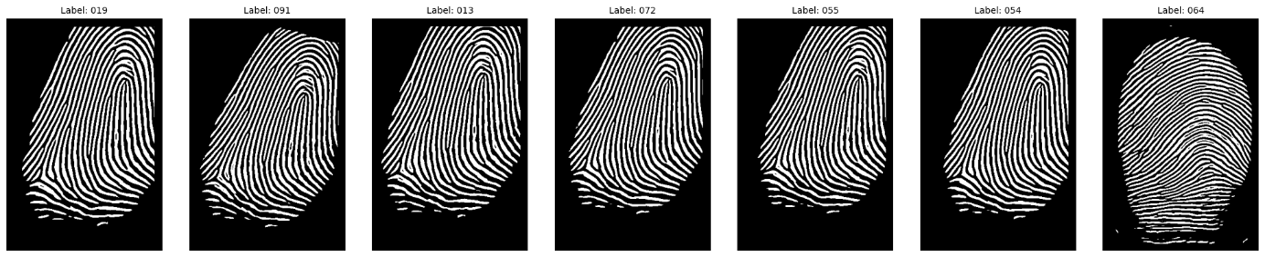
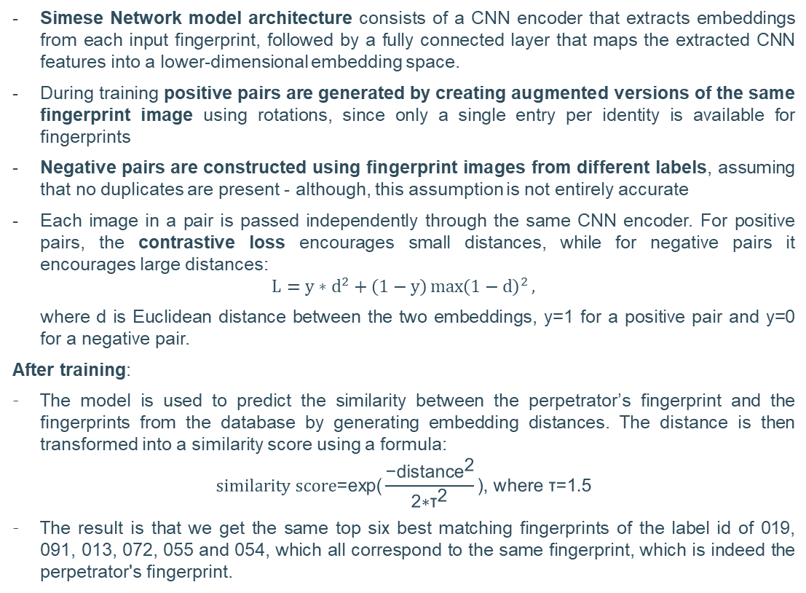
Assignment 2 – additional question 7: Siamese Network to obtain similarity scores directly from image data
Simese Network model architecture consists of a CNN encoder that extracts embeddings from each input fingerprint, followed by a fully connected layer that maps the extracted CNN features into a lower-dimensional embedding space.
During training positive pairs are generated by creating augmented versions of the same fingerprint image using rotations, since only a single entry per identity is available for fingerprints
Negative pairs are constructed using fingerprint images from different labels, assuming that no duplicates are present - although, this assumption is not entirely accurate
Each image in a pair is passed independently through the same CNN encoder. For positive pairs, the contrastive loss encourages small distances, while for negative pairs it encourages large distances:
$$L=y∗d^{2}+\left(1−y\right)\max{{\left(1−d\right)}^{2}},$$
where d is Euclidean distance between the two embeddings, y=1 for a positive pair and y=0 for a negative pair.
After training:
The model is used to predict the similarity between the perpetrator’s fingerprint and the fingerprints from the database by generating embedding distances. The distance is then transformed into a similarity score using a formula:
$$similarity score\text{=}\text{exp}\text{(}\frac{{\text{−}\text{distance}}^{\text{2}}}{\text{2∗}{\text{τ}}^{\text{2}}}\text{)}\text{, }\text{where} \text{τ}\text{=1.5}$$
The result is that we get the same top six best matching fingerprints of the label id of 019, 091, 013, 072, 055 and 054, which all correspond to the same fingerprint, which is indeed the perpetrator's fingerprint.

Slide 3
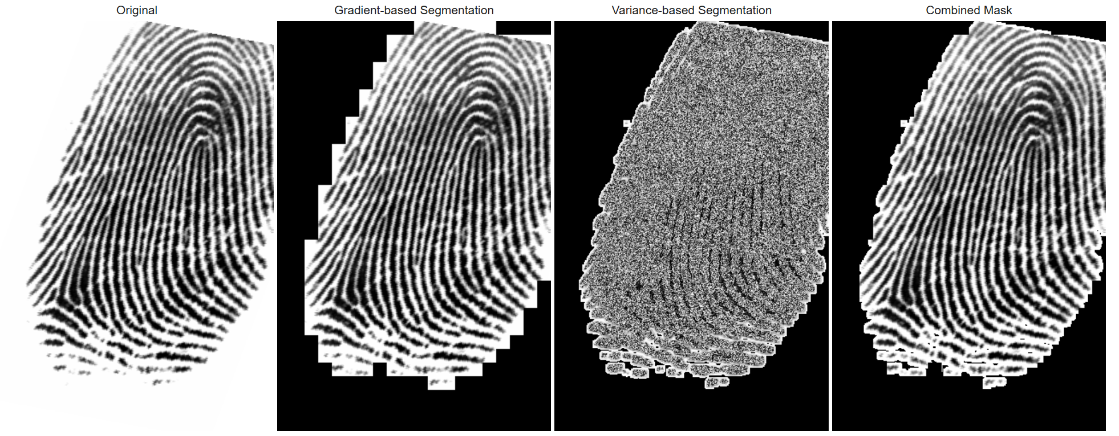
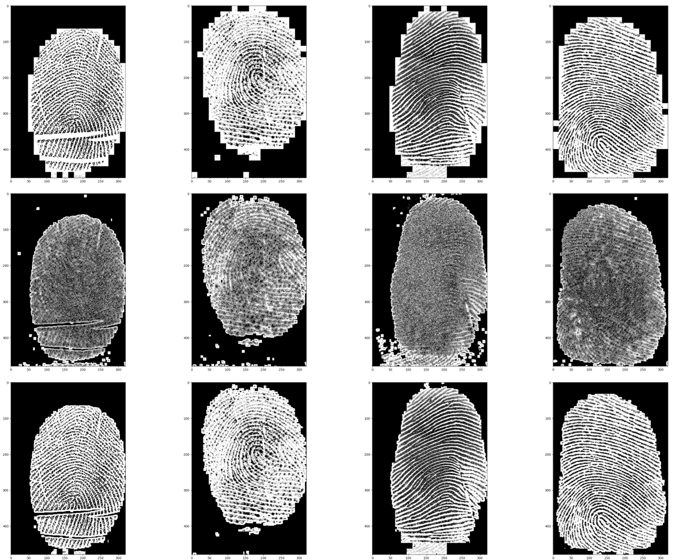
Assignment 2 – additional question 8: improved fingerprint segmentation
Fingerprint segmentation is the task of segmenting the part of the image that actually contains the fingerprint by discriminating foreground (striped, oriented pattern) from background (flat, isotropic).
The segmentation is improved here for fingerprint segmentation by combining the previous method based on the magnitude of the local gradient with the new method of local grey scale variance segmentation:
1. Local gradient magnitude segmentation:
Compute magnitude of local gradient at each pixel.
Pixels with gradient magnitude above a threshold are marked as “fingerprint region.”
Captures ridge edges but can include noisy, low-contrast areas.
2. Local grey-scale variance segmentation:
Divide the image into fixed 8 by 8 pixels window across the image.
Compute grey-scale variance within each window.
Windows with variance > 300 are considered part of the fingerprint region, as high variance is expected to correspond to ridge patterns.
A combined mask is generated by retaining only those areas confirmed as fingerprint regions by both the gradient-based and variance-based segmentation methods.
It can be observed that the introduction of the combined method reduces the considered fingerprint region, from 62.61% to 59.4% on average on training data. The addition of the grey scale variance based method to the previous local gradient magnitude method helps to remove noise, reducing false positives to some extent.
Method | Fingerprint region
Magnitude of the local gradient mask | 62.61%
Local grey scale variance mask | 62.9%
Combined mask | 59.4%

Slide 4
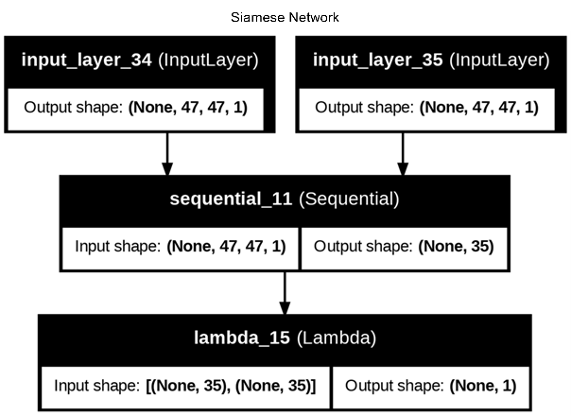
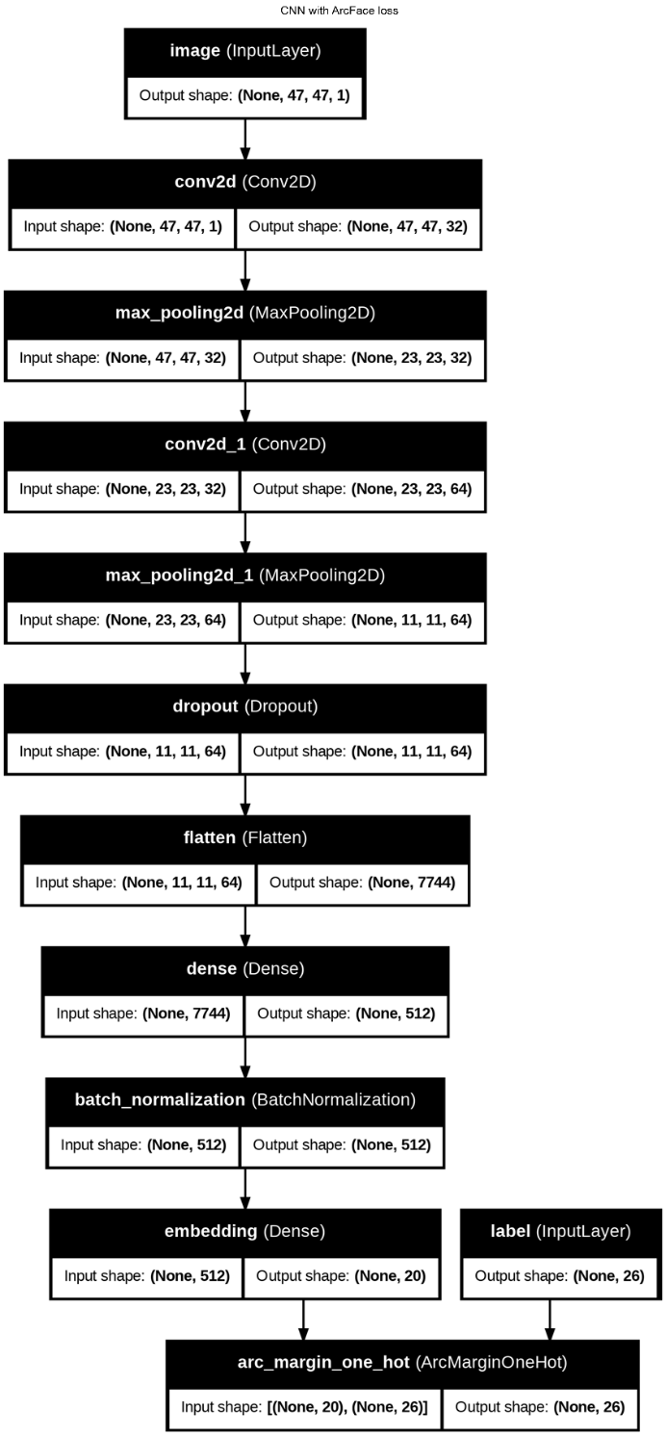

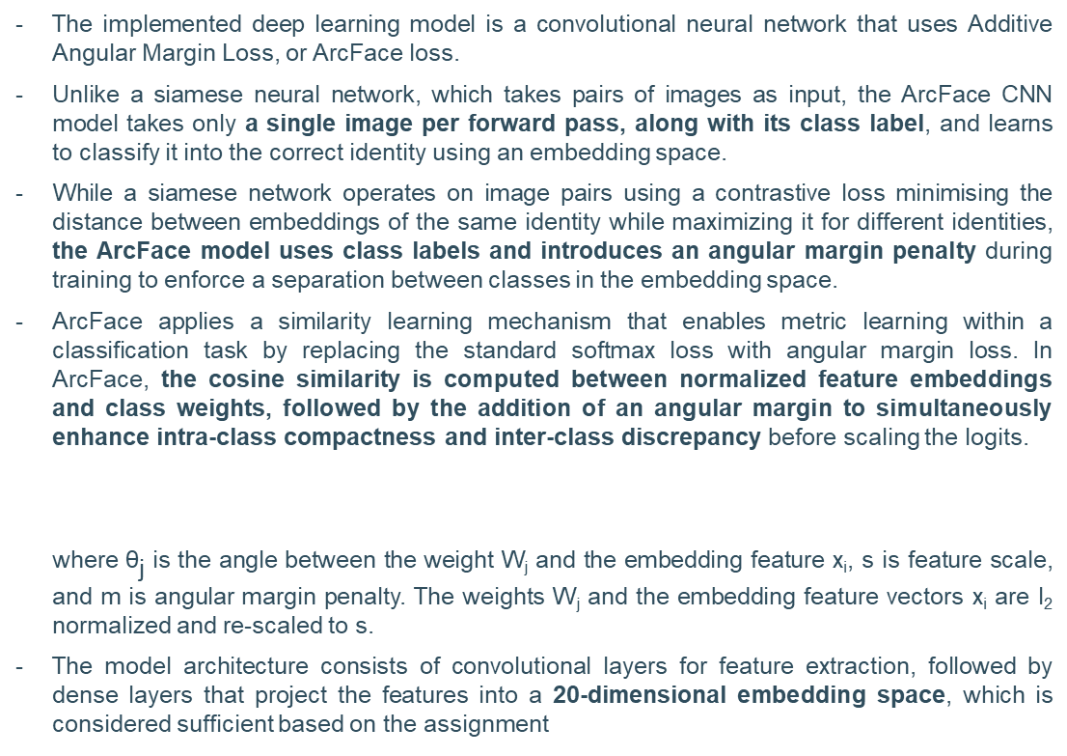
Assignment 3 – additional question 6: different DL model of CNN with ArcFace loss for face recognition (1/2)
The implemented deep learning model is a convolutional neural network that uses Additive Angular Margin Loss, or ArcFace loss.
Unlike a siamese neural network, which takes pairs of images as input, the ArcFace CNN model takes only a single image per forward pass, along with its class label, and learns to classify it into the correct identity using an embedding space.
While a siamese network operates on image pairs using a contrastive loss minimising the distance between embeddings of the same identity while maximizing it for different identities, the ArcFace model uses class labels and introduces an angular margin penalty during training to enforce a separation between classes in the embedding space.
ArcFace applies a similarity learning mechanism that enables metric learning within a classification task by replacing the standard softmax loss with angular margin loss. In ArcFace, the cosine similarity is computed between normalized feature embeddings and class weights, followed by the addition of an angular margin to simultaneously enhance intra-class compactness and inter-class discrepancy before scaling the logits.
where ${\text{θ}}_{\text{j}}$ is the angle between the weight W_{j} and the embedding feature x_{i}, s is feature scale, and m is angular margin penalty. The weights W_{j} and the embedding feature vectors x_{i} are l₂ normalized and re-scaled to s.
The model architecture consists of convolutional layers for feature extraction, followed by dense layers that project the features into a 20-dimensional embedding space, which is considered sufficient based on the assignment

Slide 5
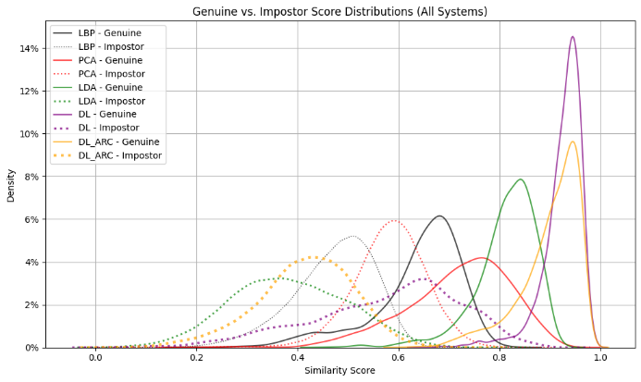
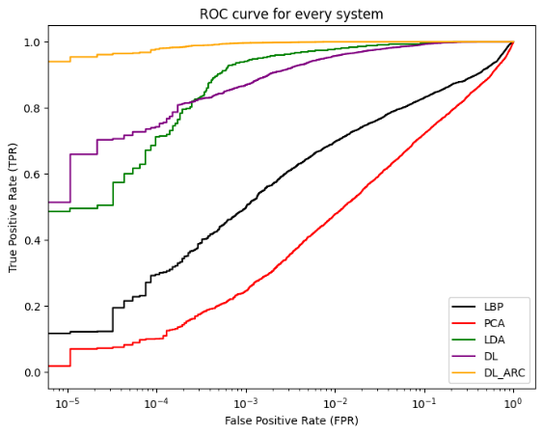
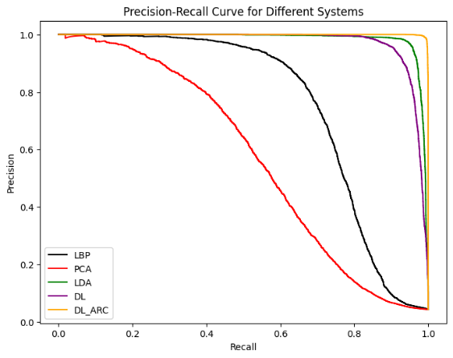
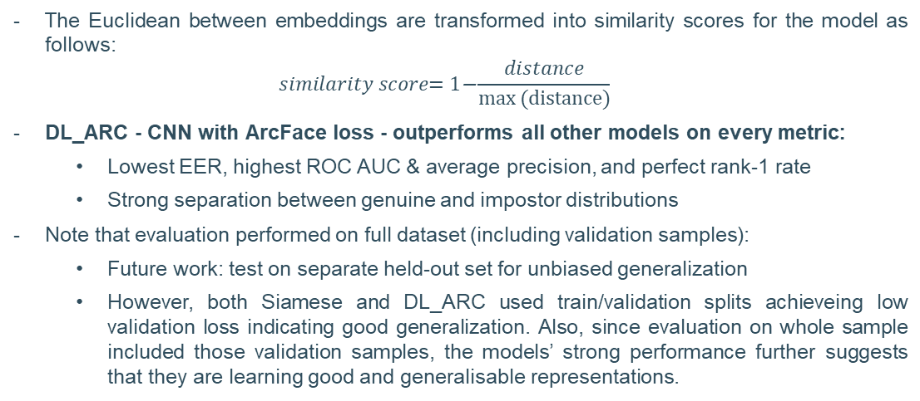
Assignment 3 – additional question 6: different DL model of CNN with ArcFace loss for face recognition (2/2)
The Euclidean between embeddings are transformed into similarity scores for the model as follows:
$$similarity score\text{= 1}\text{−}\frac{distance}{\text{max}{\text{(}\text{distance}\text{)}}}$$
DL_ARC - CNN with ArcFace loss - outperforms all other models on every metric:
Lowest EER, highest ROC AUC & average precision, and perfect rank-1 rate
Strong separation between genuine and impostor distributions
Note that evaluation performed on full dataset (including validation samples):
Future work: test on separate held-out set for unbiased generalization
However, both Siamese and DL_ARC used train/validation splits achieveing low validation loss indicating good generalization. Also, since evaluation on whole sample included those validation samples, the models’ strong performance further suggests that they are learning good and generalisable representations.
Model | EER Value | ROC AUC | Average Precision | Rank-1 Recognition Rate
LBP | 0.1490 | 91.1406% | 0.7600 | 0.9615
PCA | 0.2061 | 86.0737% | 0.5713 | 0.8846
LDA | 0.0162 | 99.8497% | 0.9853 | 1.0000
DL | 0.0260 | 99.7134% | 0.9724 | 1.0000
DL_ARC | 0.0022 | 99.9978% | 0.9996 | 1.0000

Slide 6
Thank you

