Slide 1
Football League
MySQL/Hibernate/JavaFX

Slide 2
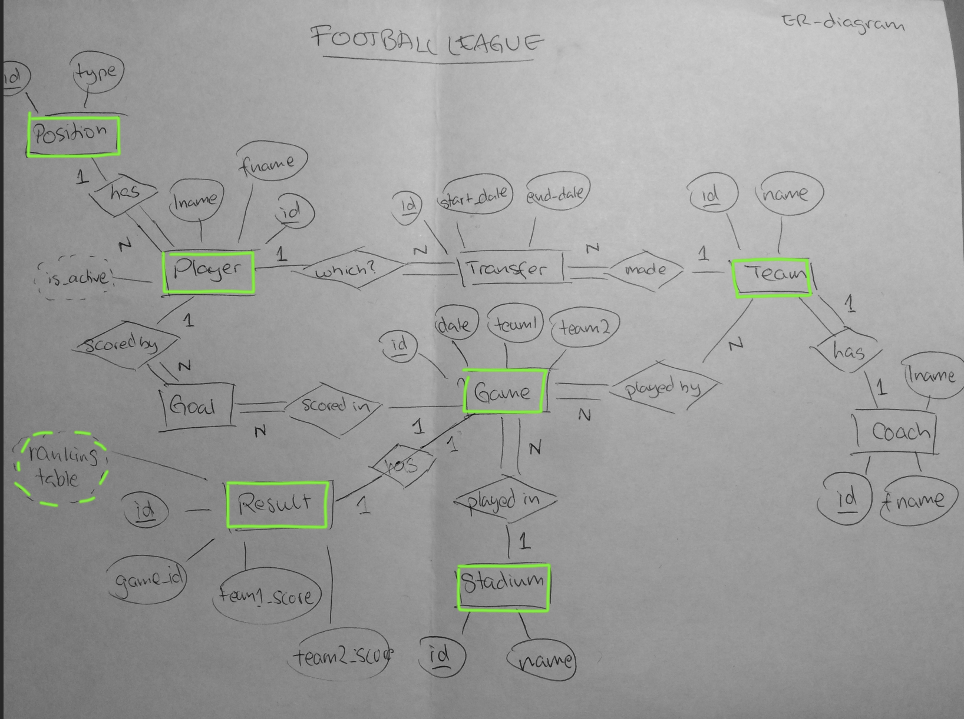
ER-diagram

Slide 3
Uppfyller
Genomtänkt struktur (ER-diagram)
Strukturerade klasser som motsvarar DB (ORM)
Strukturerade kod
Javadoc
Grafiskt gränssnit (JavaFX)

Slide 4
Data Flow
(pre user interaction)
Delete all results (ResultModel)
CRUD
Queue all games (GameModel)
Datalogisk klass
Create all results (ResultsModel)
CRUD

Slide 5
User options
Show Games
(ResultModel.getAllGames = Listners.addMenuLinkListener1)
)
CRUD
Show Results (ResultModel.getResultTeams()
= Listners.addMenuLinkListener2)
)
CRUD
Update results (ResultModel.updateScores()
=Listners.addUpdateButtonListeners()
)
)
CRUD
Ranking table (ResultModel.getResultsTeam()
= addMenuLinkListener3()
()
)
)
Search player (PlayerModel.findPlayerByName()
= addSearchButtonListeners()
()
)
)
Sökfunktion

Slide 6
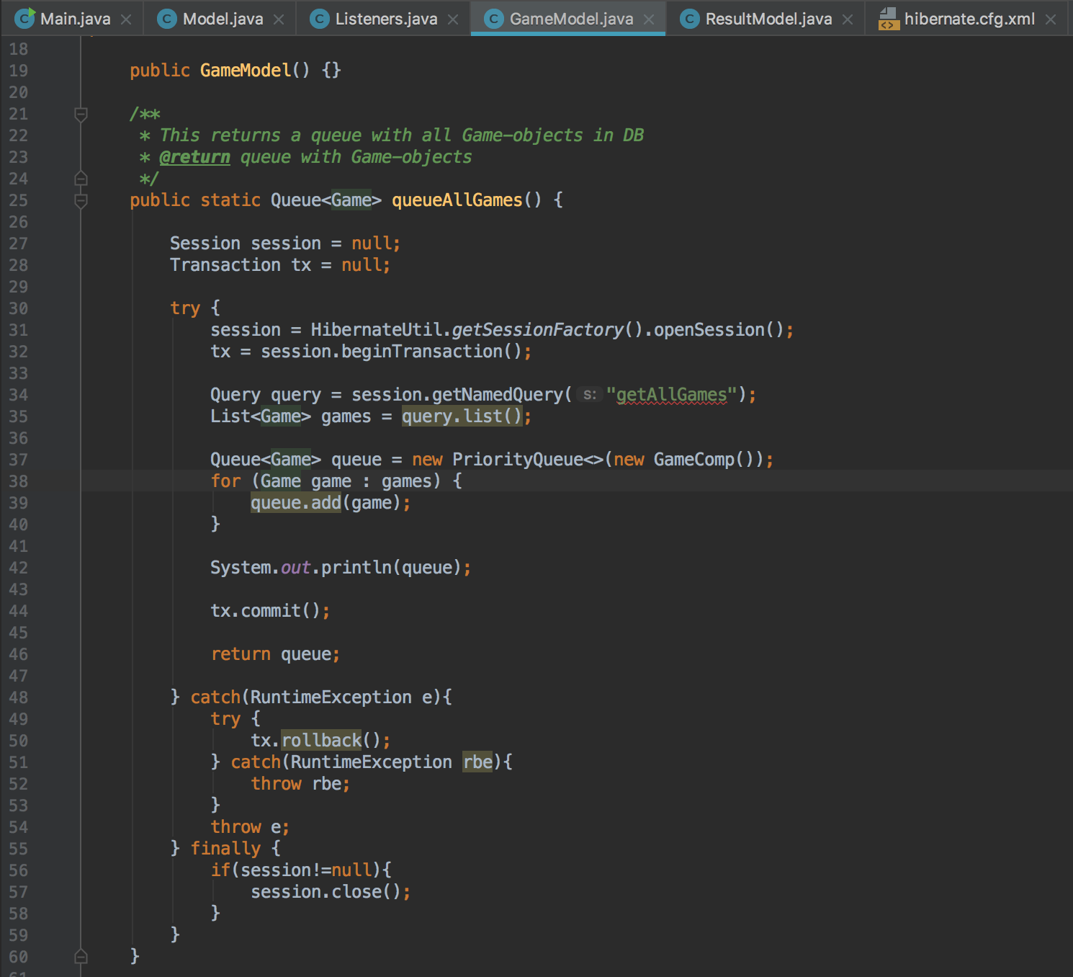
PriorityQueue
(datalogisk klass)
Queue<Game> queue = new PriorityQueue<>(new GameComp());
for (Game game : games) {
queue.add(game);
}

Slide 7
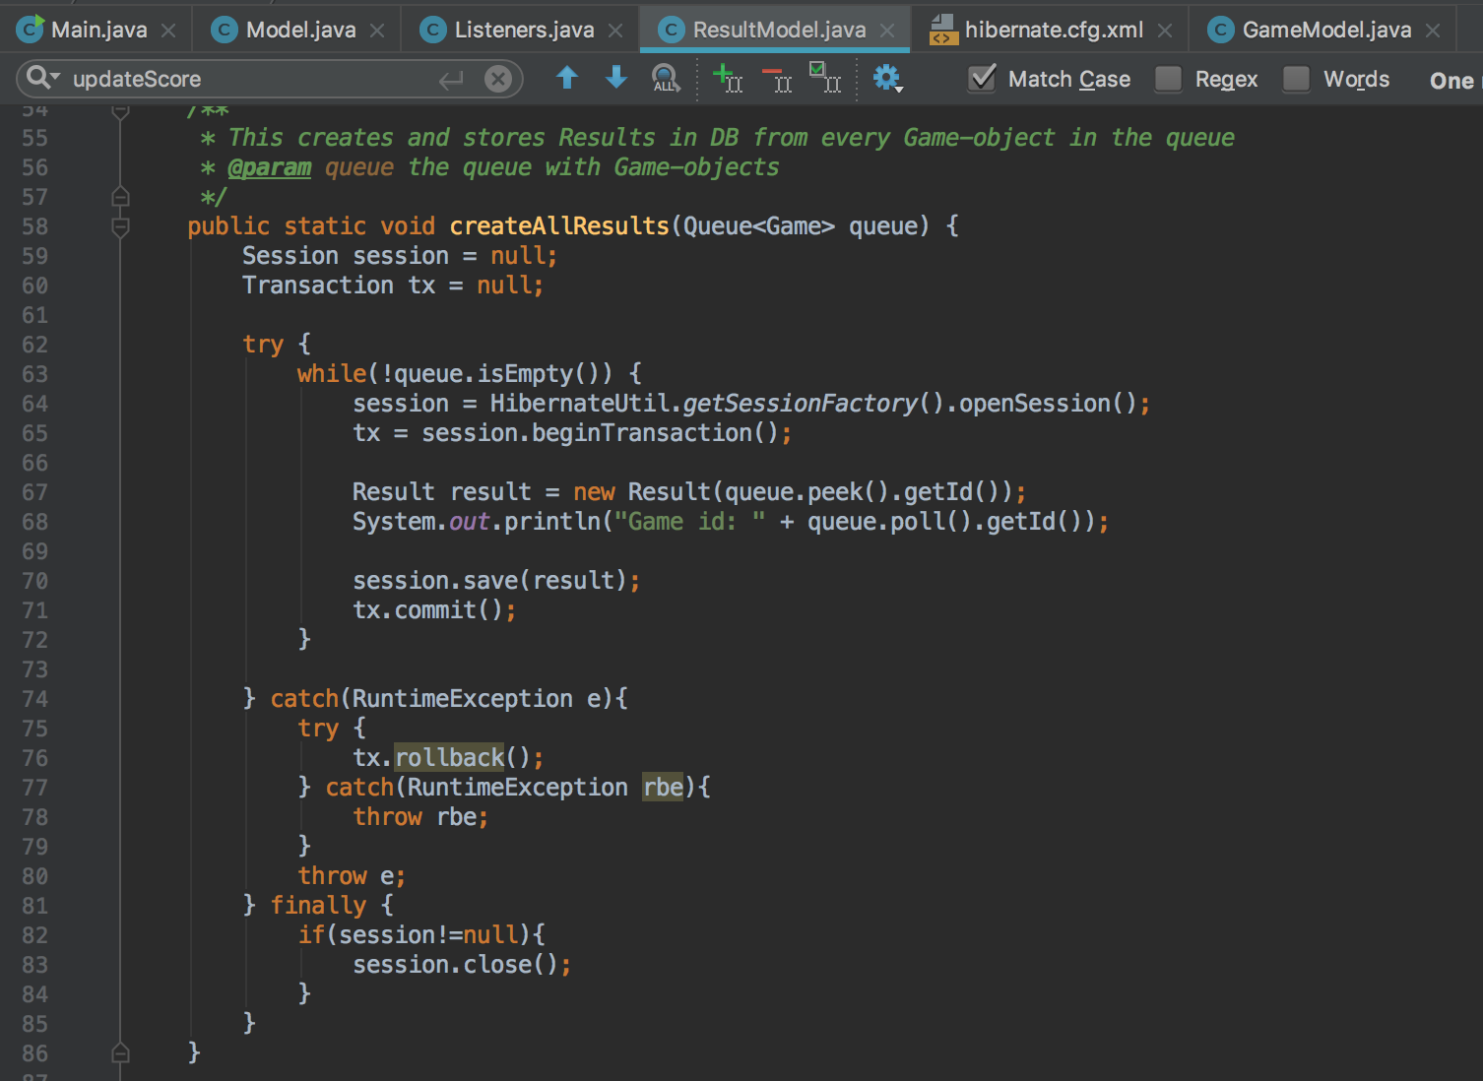
Användning av datalogis klass
Result result = new Result(queue.peek().getId());

Slide 8
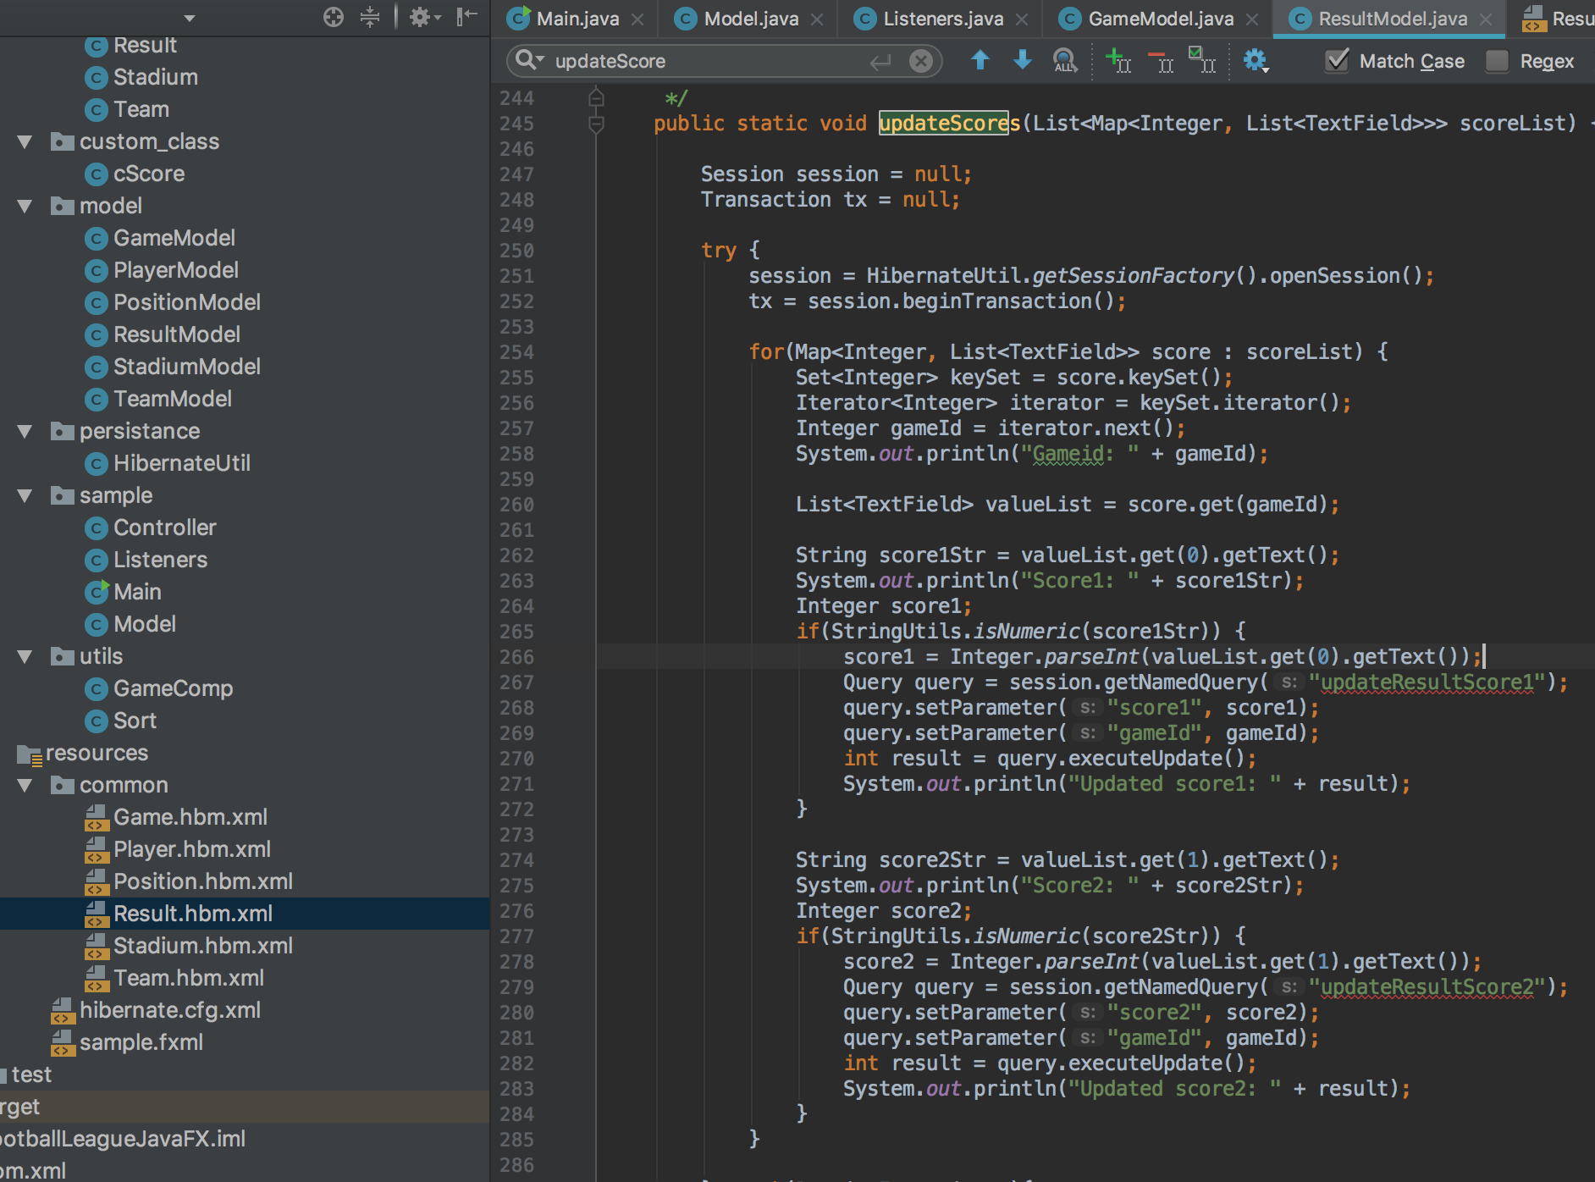
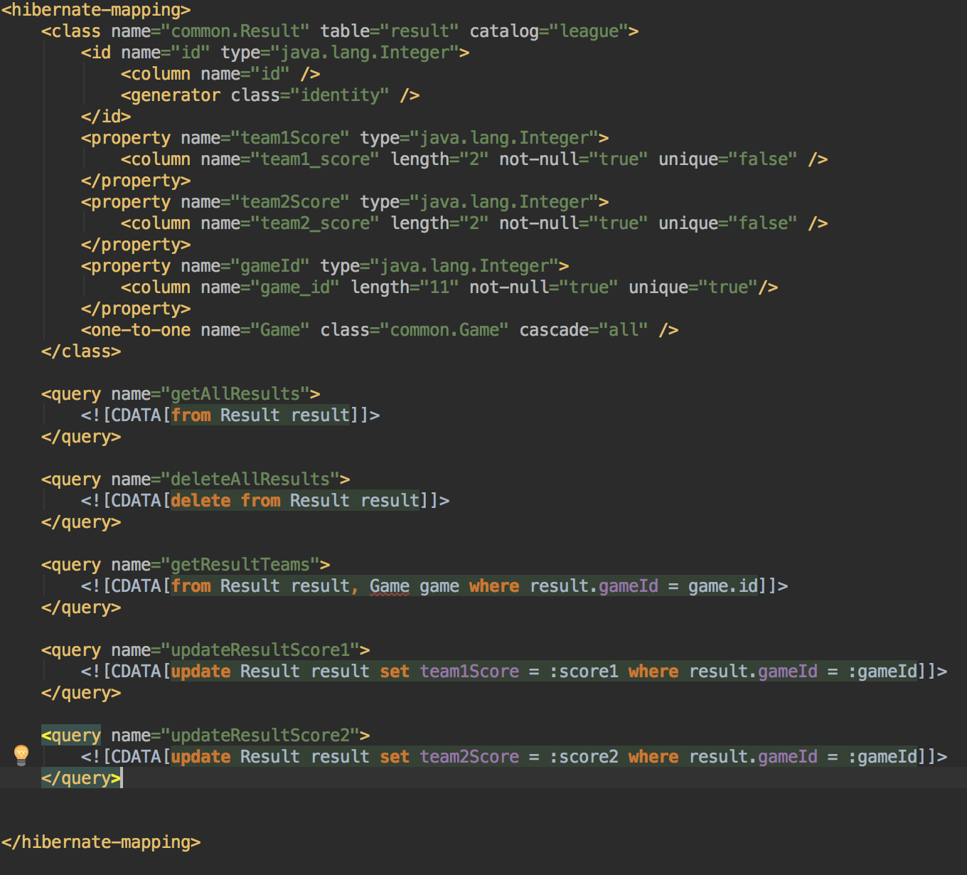
Named SQL Queries
Query query = session.getNamedQuery("updateResultScore1");
query.setParameter("score1", score1);
query.setParameter("gameId", gameId);
<query name="updateResultScore1">
<![CDATA[update Result result set team1Score = :score1 where result.gameId = :gameId]]>
</query>

Slide 9
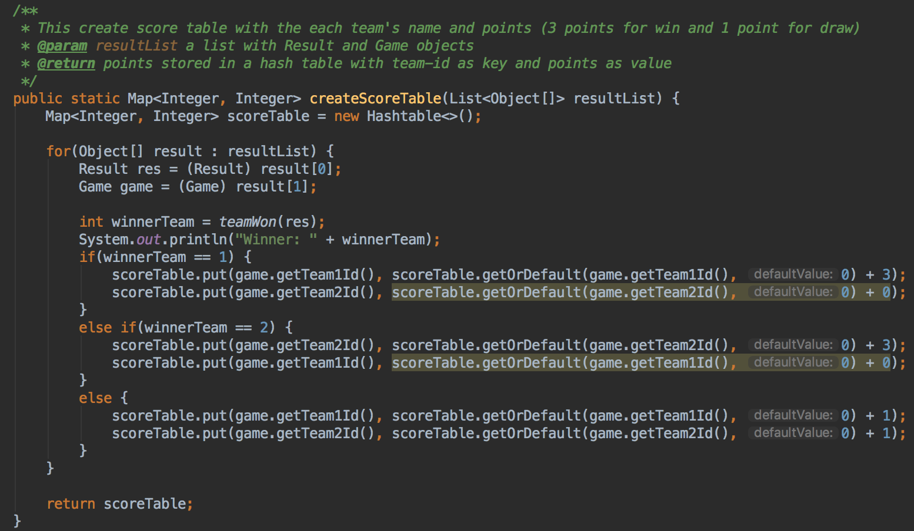
HQL join = mixat objekt
<query name="getResultTeams">
<![CDATA[from Result result, Game game where result.gameId = game.id]]>
</query>
List<Object[]> resultList

