Slide 1

Upgrade SSIS packages safely
Arne Bartels
Lead Datawarehouse Developer
Vestas Wind Systems

Slide 2






Data Saturday Gothenburg 2024
Sponsors
The after-party sponsor

Slide 3
Agenda
Whoami
Who is Vestas
Upgrade issues
Demos Concepts tools etc.

Slide 4
Whoami
Arne Bartels
Lead Datawarehouse Developer
arbar@vestas.com (work)
arne.bartels@posteo.net (private)
linkedin.com/in/arne-bartels-03b66b59 (and no further ”social” media contacts)
bartelsarne/DataSaturdayArneBartels (github.com) (brand new still empty)
I’m in the wind industry since 2001 and worked in many communication and database technologies spanning from modem connections to Cloud-technology.
Speaker on some SQL/DataSaturdays in Northern-Europe (third time in Gothenburg) on SQLBits and on PASS Summit in 2022 and 2023
Currently I'm working at Vestas Wind Systems in Aarhus, DK.

Slide 5
Who is Vestas?
and Motivation for this presentation
Vestas is the leading worlds wind turbine manufacturer and wind turbine service company. Currently 50000+ turbines worldwide are under contract and surveillance. For those we need complete and low latency data collection for reporting purposes and e.g. advanced error forecast for servicing purposes.
Right now, we have an advanced on-prem SQL2019 system using for all data extraction transform and loading. It requires 1200+ SSIS packages with 2500+ active data flows. The system is in existence for 20+ years.
Therefore, occasionally we need to upgrade from one SQL server version to the next and considering so many packages and dataflows an efficient upgrade possibility is needed.
Also, while presenting something else on script automatization this part was a tiny add-on as there was time left, but it actually got most questions and therefore is now its own presentation

Slide 6

Short demo
Upgrades of SQL versions
Upgrades happen often normally. Curiously the actual recompile happens when the package is opened in the editor. (Or when uploading?) And TargetFrameworkVersion often gets stuck.

Slide 7
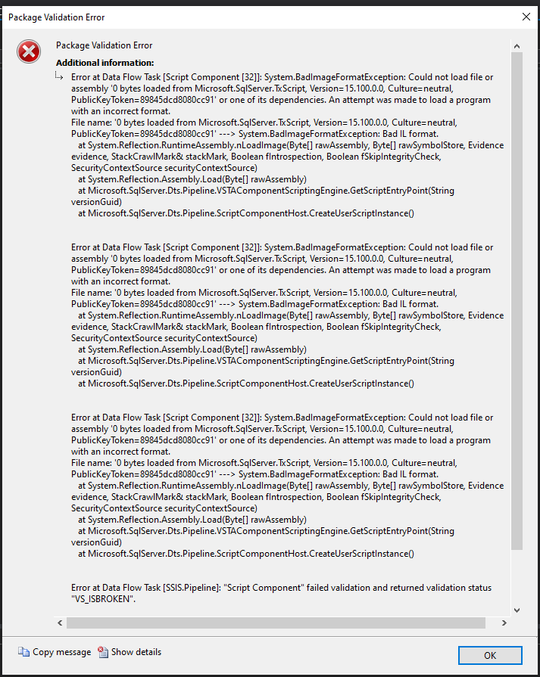
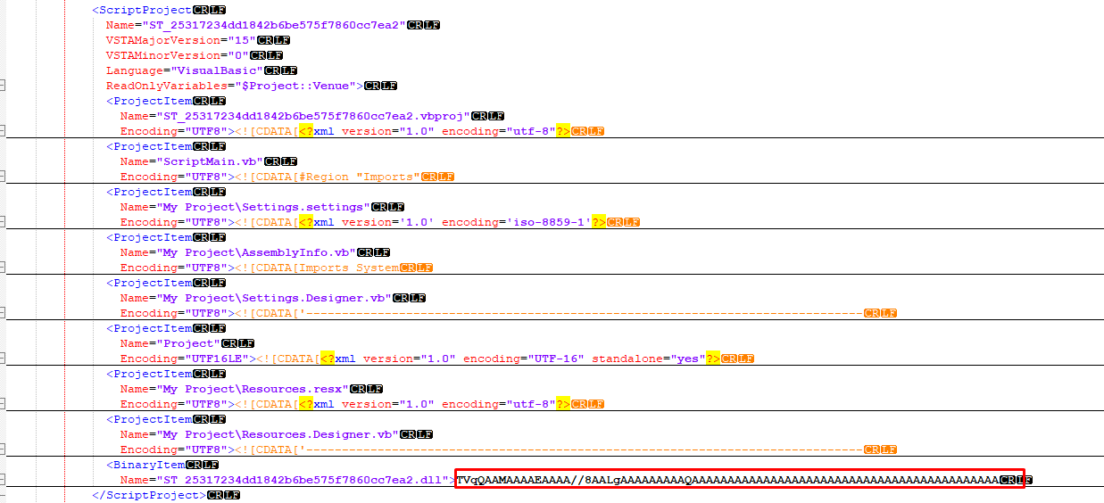
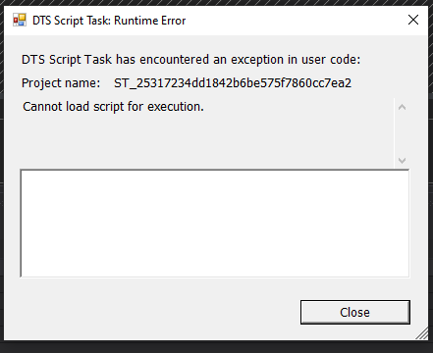
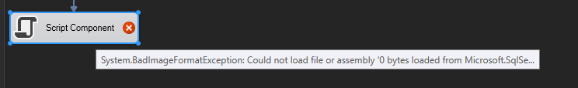
Issues
On big projects the upgrade might fail as VS fails due to lack of memory or similar.
TargetFrameworkVersion might be stuck to the original and leaves scripts impossible to edit (seems to be fixed by now).
The binary code might disappear, and the package will fail execution
Parts of the source code might disappear, and the component/task can’t be edited
The source code might disappear and be replaced with the standard template (no errors!)

Slide 8
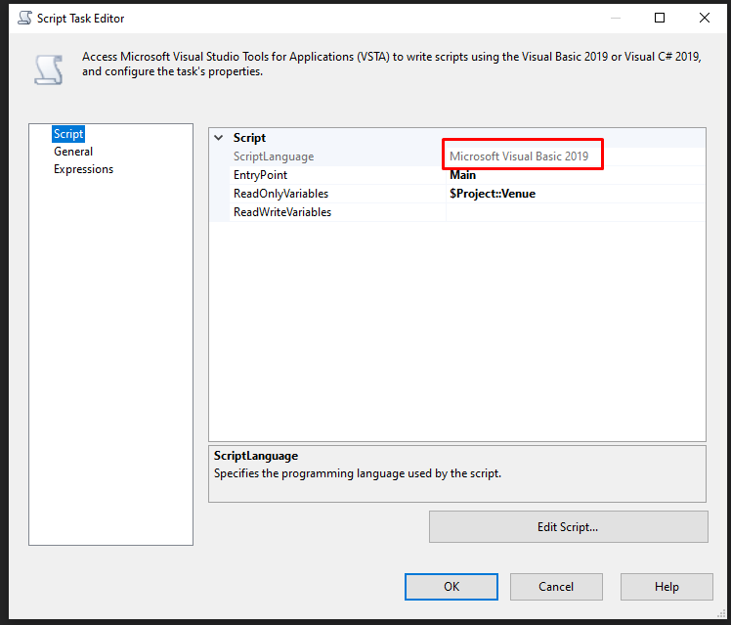
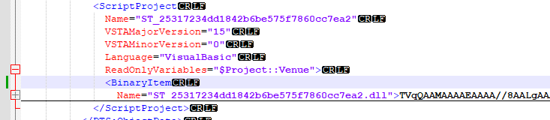
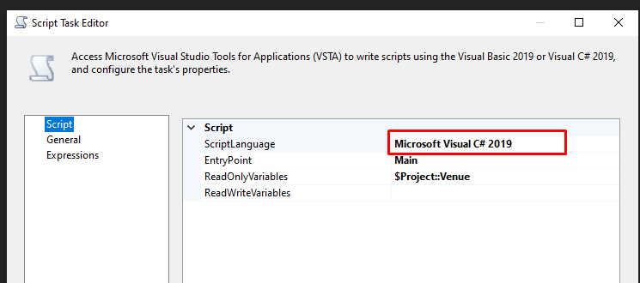
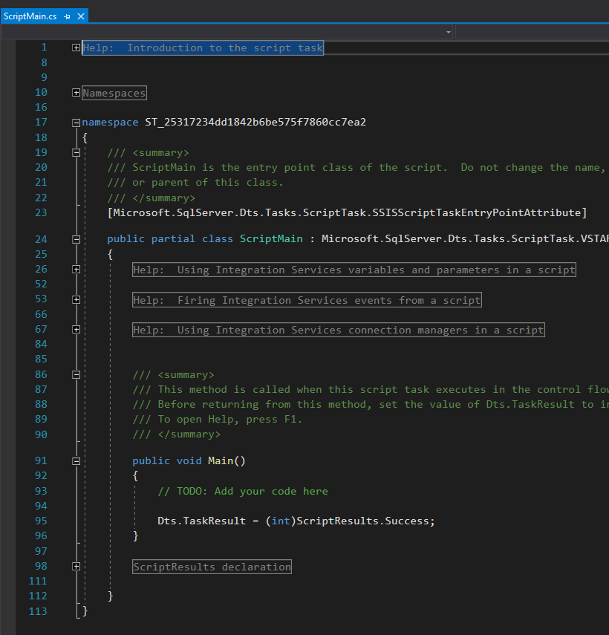

Slide 9
Concepts
Compiling script components in SSIS package through code - Microsoft Q&A
c# - Script Task on SQL Server works after rebuilt or migration - Stack Overflow
Describe recompiling of script content programmatically
SSIS script component failing after upgrading from 2016 to 2019 - Microsoft Q&A
suggests programmatically recompiling/BimlExpress/manual recompiling
Regular expression replace <TargetFrameworkVersion>.*</TargetFrameworkVersion> and &lt;TargetFrameworkVersion&gt;.*&lt:/TargetFrameworkVersion&gt; with nothing in all dtsx files.

Slide 10
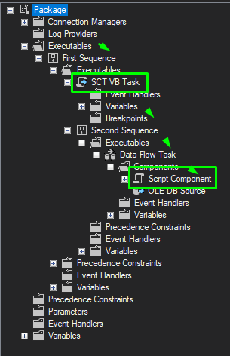
TOOLS
Idea: create modular commandline tools that can only one simple task but can be easily combined to taste and need. NOTE: all are to be considered as public domain, use at own taste (and risk)
Usage Recompile2Latest {project.ispac project.dtproj package.dtsx package_folder\\*.dtsx } [destinationpath]
This tool will traverse all packages of a project or a collection of packages and compile all scripts (Tasks and Components) it finds to the latest version.
Technically a .dtsx can be traversed recursively for each executable level. Much like a BIML file is structured (unsurprisingly as it is an intermediate language to do exactly this). Caveat: the current program version will always upgrade to SQL2019 irrespective of any other project setting!

Slide 11
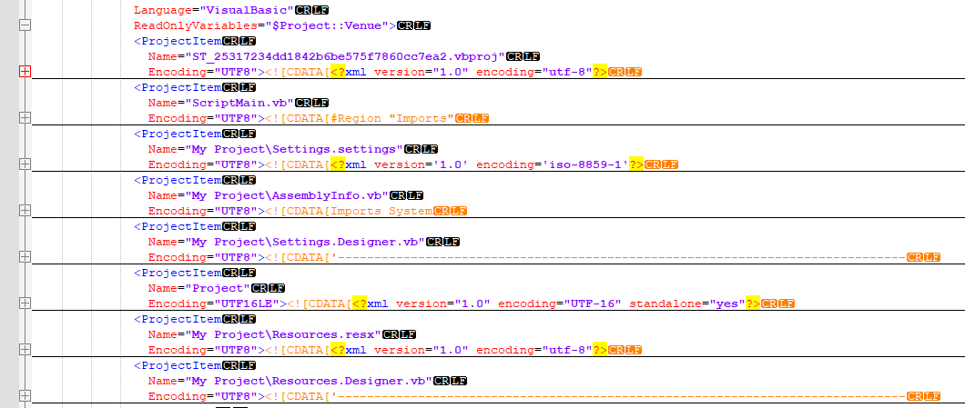
RestoreCodeFromBackup
Usage RestoreCodeFromBackup {input.ispac input.proj input.dtsx input_folder\\*.dtsx } {backup.ispac backup.proj backup.dtsx backup_folder\\*.dtsx } [destinationpath]
Uses the input to read as deploy project,project or package(s), uses a second (an older backup of older SQL version ?) to read from and restores all missing files or replaces changed relevant ones (not the project or standard files).
Caveat: any legitimate edit after taking the backup will be replaced without asking, so be careful with the backup source!

Slide 12
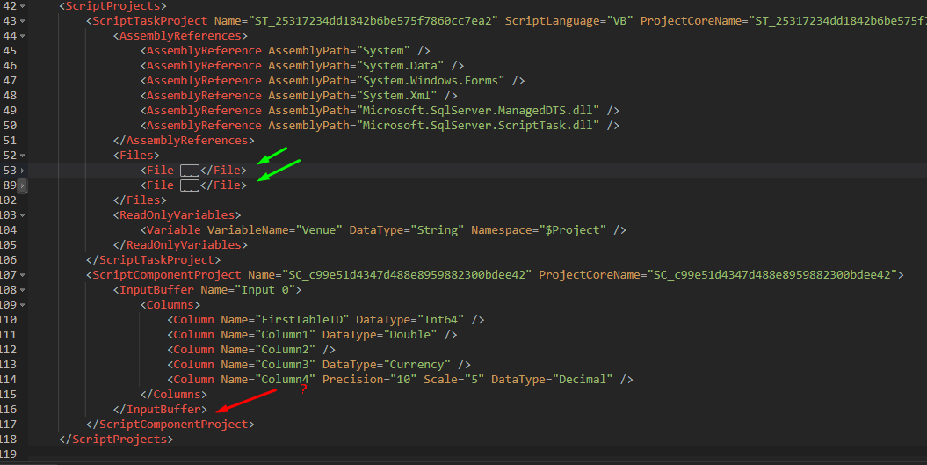
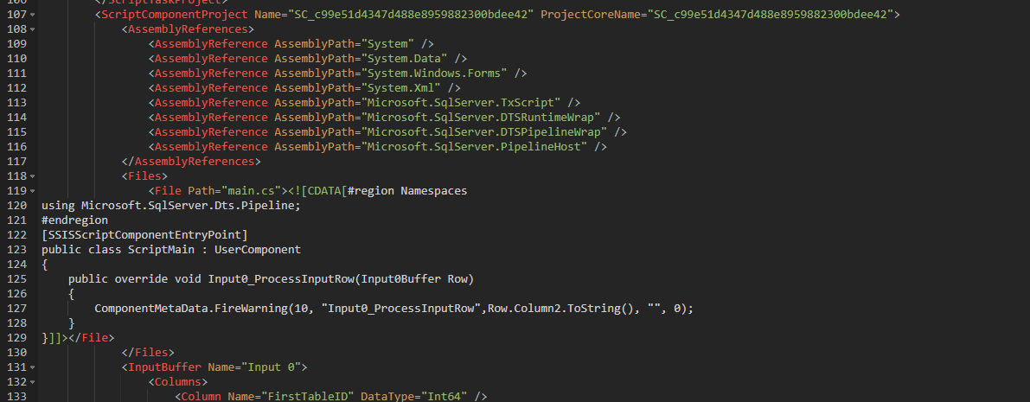
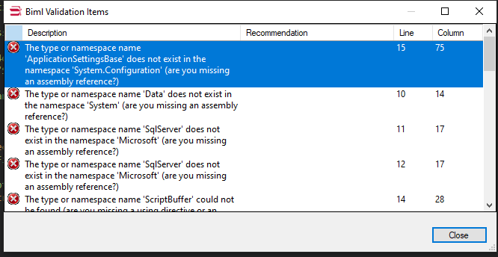
BIML tools: “just” create a copy in Biml and recreate if needed
CopyComponentScript2Biml
Bimlscript’s “Convert SSIS Packages to Biml” omits the code for creating script components, but it does supply the code of ScriptTasks.
Usage: CopyComponentScript2Biml input.biml {project.ispac project.dtproj package.dtsx package_folder\\*.dtsx } [result.biml]
This command line tool will read a reference SSIS project, project definition a single SSIS package or a file search string representing one or more SSIS packages. And then place the missing code in either a different biml file or updates the original one if no third argument is given. Note: BIMLExpress actually produces SQL2017 packages that are updated if opened.

Slide 13
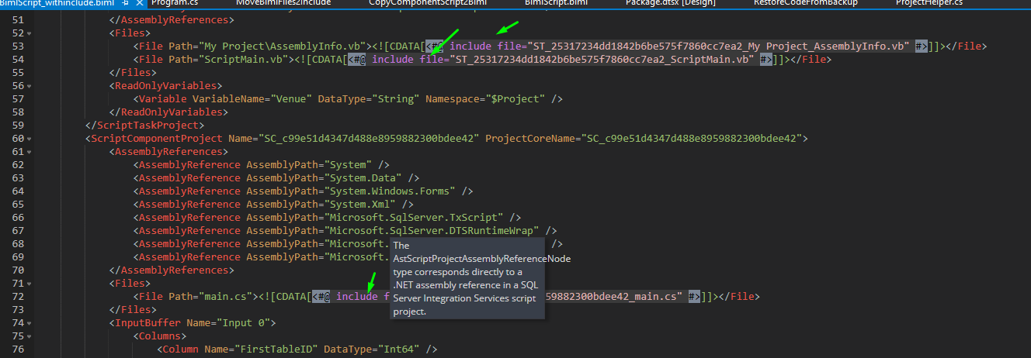
MoveBimlFiles2Include
Usage MoveBimlFiles2Include input.biml [result.biml]
To improve readability all files are moved to includes. And the included vb and cs files placed in the same folder as the written biml file.
With only one argument the input BIML file will be replaced otherwise written to a file using the second argument.
NOTE: already existing files or multiple identical files will be extracted only once. Can be used to detect (accidental reversal to) default templates.

Slide 14
BimlRemoveDedup
Usage BimlRemoveDedup input.biml [result.biml]
Biml sometimes renames (e.g. on re-exports) identifiers by attaching numbers. This little tool reverses that and deletes multiple connections.

Slide 15
Questions?

Slide 16
Thanks for your attention
Upgrade SSIS packages safely
Have a nice day!
arbar@vestas.com
arne.bartels@posteo.net
linkedin.com/in/arne-bartels-03b66b59
bartelsarne/DataSaturdayArneBartels (github.com) (brand new still empty)

Slide 17
Data Saturday 2025
September 6.

