Slide 1
DESIGN AND IMPLEMENTATION OF REAL-TIME ONLINE COMPETITIVE QUIZ SYSTEM
BY
OYEYEMI Aanuoluwapo Clement
CSC/2012/078
SUPERVISOR: DR. S. AINA

Slide 2
PRESENTATION OUTLINE
Introduction
Statement of Problem
Scope
Justification
Aim and Objectives
Literature Review
Methodology
Implementation
Conclusion
References

Slide 3
INTRODUCTION
A Quiz Competition is an activity that is organized to test the depth of the knowledge of participants in a topic or subject through the use of timed-questions.
Quiz competition can between individual participants or teams of participants. The platforms of quiz competition include television shows, school organized events, web and mobile applications.

Slide 4
STATEMENT OF PROBLEM
Quiz competition as a means of collaboration and competition is important in education. Although, it is organized in offline education despite its cost. It is presently not feasible in remote learning. As a result, students in remote locations do not get the benefits of competition and collaboration in education.
This project seeks to improve the quality of online education by solving this problem.

Slide 5
SCOPE
The competitive quiz system makes use of audio as a means of collaboration between the members of different teams in a competition.
The system assumes that the participants are on their best behavior.

Slide 6
JUSTIFICATION
This project provides the platform for students in the distance location to enjoy the benefits of collaborative and competitive learning through a real-time online competitive quiz system.
In addition, it allows more competitions to be held among schools as the physical presence of students is no longer be needed for participation and it reduces the cost of organizing quiz competitions.

Slide 7
AIM AND OBJECTIVES
This project is aimed at developing a real-time online system that allows participants in remote locations engage in competitive quiz competitions as part of collaborative teams.
The proposed objectives of this project are as shown below:
Design a suitable model for a real-time online competitive quiz system.
Implement the model in (i).
Evaluate the effectiveness of the system.

Slide 8
LITERATURE REVIEW
Peschel et. al, (2007). An online real-time quiz system for Readiness Assessment Testing
The system developed is an online real-time quiz used for formative purpose. This quiz system is in two parts, in the first part students answer time-based question individually. In the second part, the students are divided into groups and each group collaborate together to answer time-based questions using a single computer.
Remarks: Although this system encourage competition and collaboration, the system is hosted on a local network and the participants of this quiz system must be in the same physical location.

Slide 9
LITERATURE REVIEW CONT.
Sampaio et. al, (2012). Collaborative Quiz Game Developed With Epik.
EPIK stands for Edutainment by Playing and Interacting with Knowledge. It is a system that allows the development of collaborative quiz games. Quiz game developed is organized in different scenarios that is composed of an equal number of questions for each group member. Quiz created makes use of helps and scores to foster collaboration and competition among players.
Remarks: This system enforces competition and collaboration among the members of a team.

Slide 10
LITERATURE REVIEW CONT.
Chang et. al, (2003). Development and evaluation of multiple competitive activities in a synchronous quiz game system.
The authors developed a system called Joyce which is a computerized, competitive board game system that allows students to compete against each other or against a simple computer-simulated agent. The system is divided into several sections, one of the sections is quiz competition. The players make progress in the board based on the answers they give in the quiz.
Remarks: In a team quiz competition, the members of different teams collaborate through the use of hardware known as Educlick. The use of this device brings additional cost.

Slide 11
METHODOLOGY
The methodology of this project includes the following steps:
The design of the model of the system was done using Unified Modeling Language(UML) tools such as use-case, class diagram, state diagram, activity and sequence diagram.
The design of the system was implemented using the following technologies MySql database, Redis, Nodejs, Socket.io, Peer.js, Angular and Angularjs.
The system was evaluated using metrics such as response time of the system, ease of collaboration among team members and ease of use in general

Slide 12
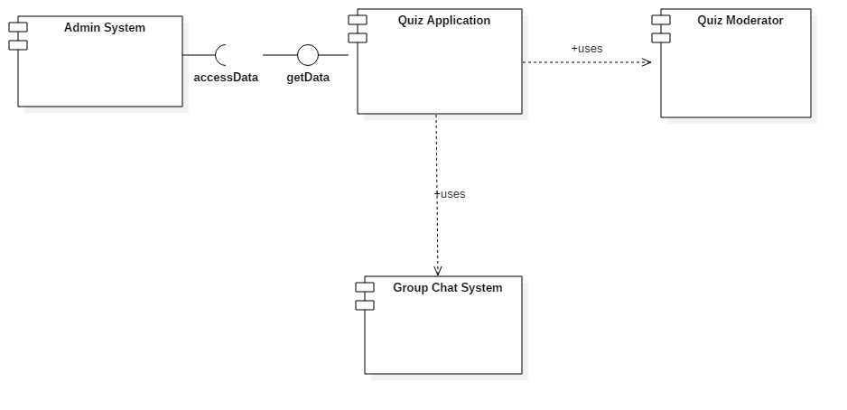
COMPONENTS OF APPLICATION

Slide 13
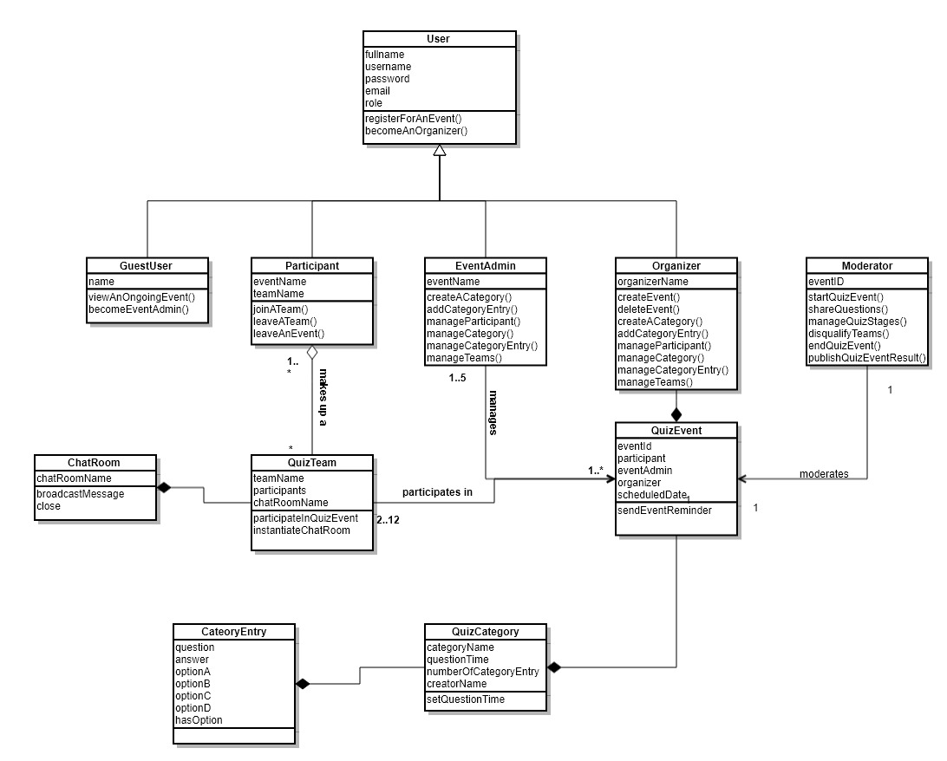
CLASS DIAGRAM

Slide 14
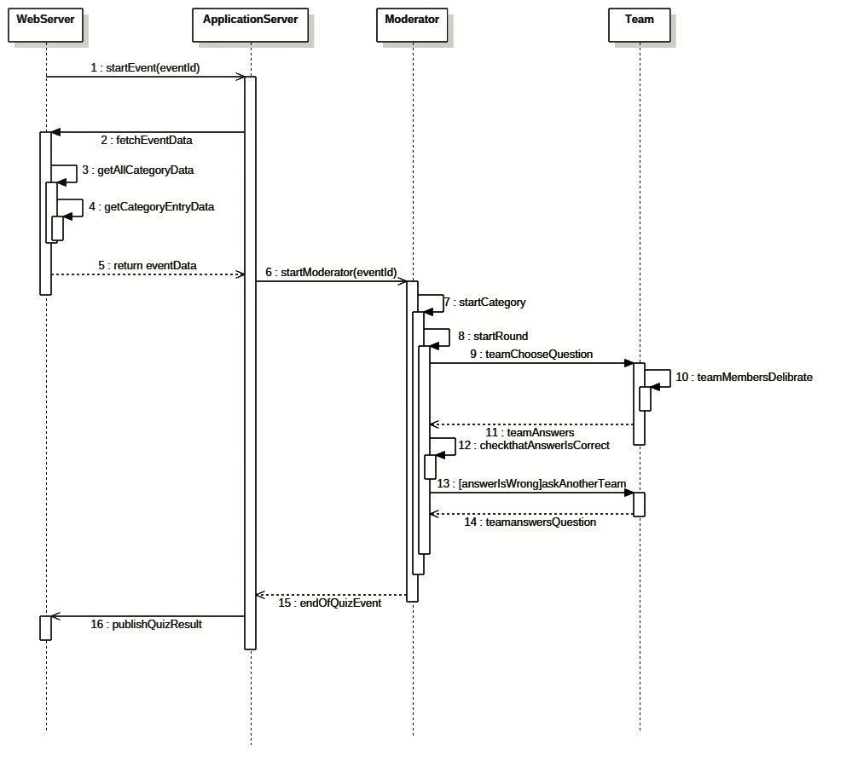
SEQUENCE DIAGRAM OF THE APPLICATION

Slide 15
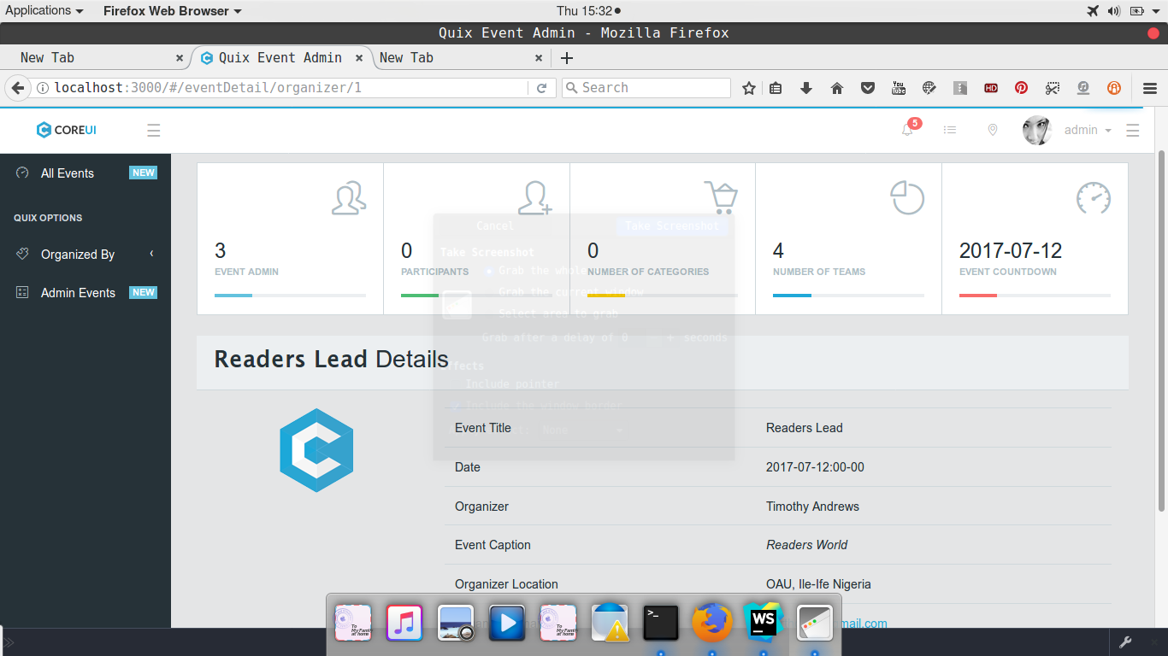
IMPLEMETATION

Slide 16
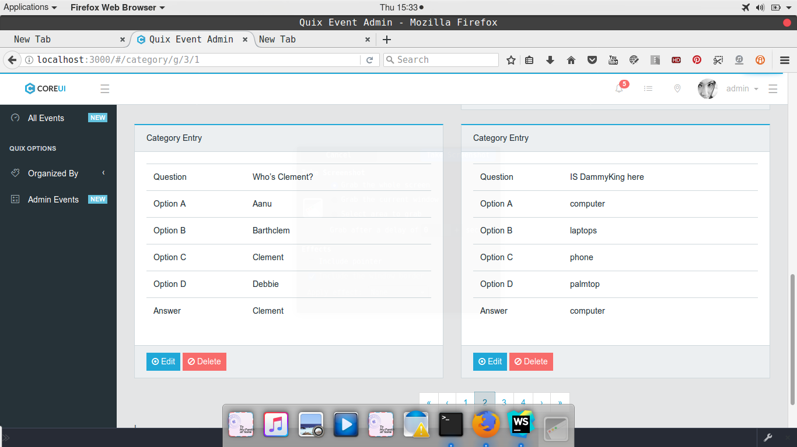
IMPLEMENTATION

Slide 17
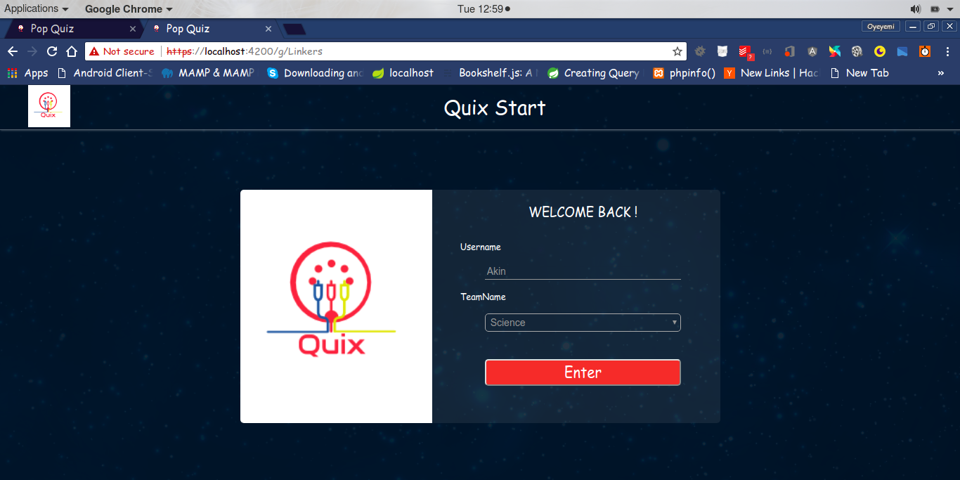
IMPLEMENTATION

Slide 18
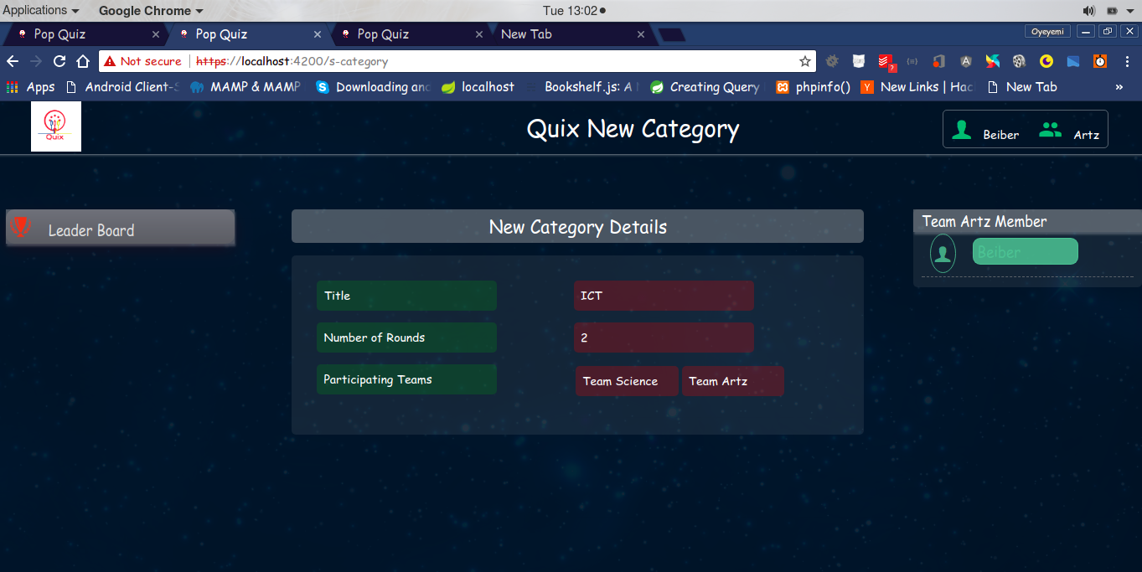
IMPLEMENTATION

Slide 19
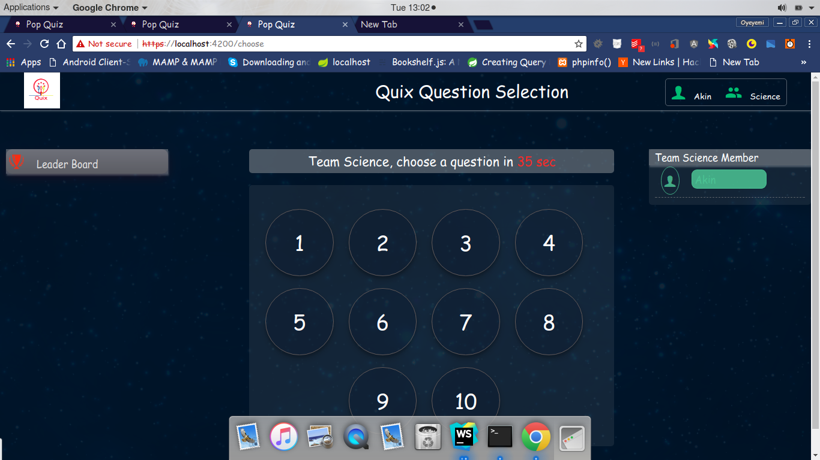
IMPEMENTATION

Slide 20
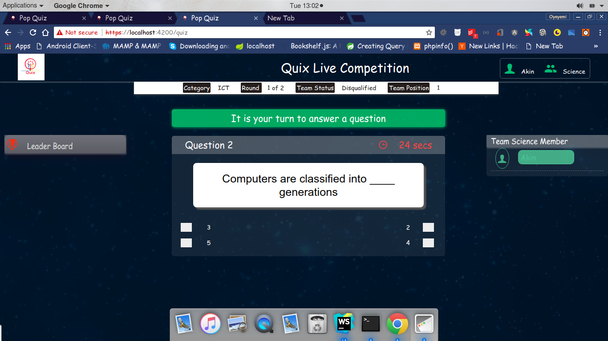
IMPLEMENTATION

Slide 21
IMPLEMENTATION

Slide 22
CONCLUSION
A quiz management system and quiz application were built during the course of this project to achieve the stated aim and objectives of this project by implementing the proposed methodology and design of the system.

Slide 23
THANK YOU

Slide 24
REFERENCES
Chang L., Yang J., and Yu F., (2003), Development and evaluation of multiple competitive activities in a synchronous quiz game system, Innovations in Education and Teaching International, 40:1, 16-26, DOI: 10.1080/1355800032000038840
Peschel J., Barrosso L., Cahill A., and Morgan J., (2007), An Online Real-Time Quiz
System For Readiness Assessment Testing, American Society for Engineering Education.
Sampaio B., Morgado C., and Barbosa F., (2012). Collaborative Quiz Game Developed With Epik: International Association for Development of the Information Society(IADIS), presented at International Conference on Cognition and Exploratory Learning in Digital Age, Madrid, Spain, 2012.

